Slide 1
Basic Business Statistics
12th Edition
Global Edition
Chapter 6
The Normal Distribution & Other Continuous Distributions
Chap 6-1

Slide 2
Learning Objectives
In this chapter, you learn:
To compute probabilities from the normal distribution
How to use the normal distribution to solve business problems
To use the normal probability plot to determine whether a set of data is approximately normally distributed
To compute probabilities from the uniform distribution
To compute probabilities from the exponential distribution
Chap 6-2

Slide 3
Continuous Probability Distributions
A continuous random variable is a variable that can assume any value on a continuum (can assume an uncountable number of values)
  thickness of an item
  time required to complete a task
  temperature of a solution
  height, in inches
These can potentially take on any value depending only on the ability to precisely and accurately measure
Chap 6-3

Slide 4
The Normal Distribution
‘Bell Shaped’
Symmetrical
Mean, Median and Mode
are Equal
Location is determined by the mean, μ
Spread is determined by the standard deviation, σ
The random variable has an infinite theoretical range:
+ ∞ to − ∞
f(X)
σ
X
μ
Mean
= Median
= Mode
Chap 6-4

Slide 5
The Normal Distribution
Density Function
The formula for the normal probability density function is
Where e = the mathematical constant approximated by 2.71828
π = the mathematical constant approximated by 3.14159
μ = the population mean
σ = the population standard deviation
X = any value of the continuous variable
Chap 6-5

Slide 6
Many Normal Distributions
By varying the parameters μ and σ, we obtain different normal distributions
Chap 6-6

Slide 7
The Normal Distribution Shape
f(X)
Changing μ shifts the distribution left or right.
Changing σ increases or decreases the spread.
σ
μ
X
Chap 6-7

Slide 8
The Standardized Normal
Any normal distribution (with any mean and standard deviation combination) can be transformed into the standardized normal distribution (Z)
Need to transform X units into Z units
The standardized normal distribution (Z) has a mean of 0 and a standard deviation of 1
Chap 6-8

Slide 9
Translation to the Standardized Normal Distribution
Translate from X to the standardized normal (the “Z” distribution) by subtracting the mean of X and dividing by its standard deviation:
The Z distribution always has mean = 0 and standard deviation = 1
Chap 6-9

Slide 10
The Standardized
Normal Distribution
Also known as the “Z” distribution
Mean is 0
Standard Deviation is 1
f(Z)
1
Z
0
Values above the mean have positive Z-values, values below the mean have negative Z-values
Chap 6-10

Slide 11
Example
If X is distributed normally with mean of $100 and standard deviation of $50, the Z value for X = $200 is
This says that X = $200 is two standard deviations (2 increments of $50 units) above the mean of $100.
Chap 6-11

Slide 12
Comparing X and Z units
$100
$200
$X
(μ = $100, σ = $50)
0
2.0
Z
(μ = 0, σ = 1)
Note that the shape of the distribution is the same, only the scale has changed. We can express the problem in the original units (X in dollars) or in standardized units (Z)
Chap 6-12

Slide 13
Finding Normal Probabilities
Probability is measured by the area under the curve
f(X)
P
(
a
≤
X
≤
b
)
=
P
(
a
<
X
<
b
)
(Note that the probability of any individual value is zero)
a
b
X
Chap 6-13

Slide 14
Probability as
Area Under the Curve
The total area under the curve is 1.0, and the curve is symmetric, so half is above the mean, half is below
f(X)
0.5
0.5
μ
X
Chap 6-14

Slide 15
The Standardized Normal Table
The Cumulative Standardized Normal table in the textbook (Appendix table E.2) gives the probability less than a desired value of Z (i.e., from negative infinity to Z)
0.9772
Example:
P(Z < 2.00) = 0.9772
0
2.00
Z
Chap 6-15

Slide 16
The Standardized Normal Table
(continued)
The column gives the value of Z to the second decimal point
Z 0.00 0.01 0.02 …
0.0
0.1
The row shows the value of Z to the first decimal point
.
.
.
The value within the table gives the probability from Z = − ∞ up to the desired Z- value
2.0
.9772
P(Z < 2.00) = 0.9772
2.0
Chap 6-16

Slide 17
General Procedure for Finding Normal Probabilities
To find P(a < X < b) when X is distributed normally:
Draw the normal curve for the problem in
terms of X
Translate X-values to Z-values
Use the Standardized Normal Table
Chap 6-17

Slide 18
Finding Normal Probabilities
Let X represent the time it takes (in seconds) to download an image file from the internet.
Suppose X is normal with a mean of 18.0 seconds and a standard deviation of 5.0 seconds. Find P(X < 18.6)
X
18.0
18.6
Chap 6-18

Slide 19
Finding Normal Probabilities
(continued)
Let X represent the time it takes, in seconds to download an image file from the internet.
Suppose X is normal with a mean of 18.0 seconds and a standard deviation of 5.0 seconds. Find P(X < 18.6)
μ = 18
σ = 5
μ = 0
σ = 1
18
18.6
X
0
0.12
Z
P(X < 18.6)
P(Z < 0.12)
Chap 6-19

Slide 20
Solution: Finding P(Z < 0.12)
Standardized Normal Probability
Table (Portion)
P(X < 18.6)
= P(Z < 0.12)
Z
.00
.01
.02
0.5478
0.0
.5000
.5040
.5080
0.1
.5398
.5438
.5478
0.2
.5793
.5832
.5871
Z
0.3
.6179
.6217
.6255
0.00
0.12
Chap 6-20

Slide 21
Finding Normal
Upper Tail Probabilities
Suppose X is normal with mean 18.0 and standard deviation 5.0.
Now Find P(X > 18.6)
X
18.0
18.6
Chap 6-21

Slide 22
Finding Normal
Upper Tail Probabilities
(continued)
Now Find P(X > 18.6)…
P(X > 18.6) = P(Z > 0.12) = 1.0 - P(Z ≤ 0.12)
= 1.0 - 0.5478 = 0.4522
0.5478
1.000
1.0 - 0.5478 = 0.4522
Z
Z
0
0
0.12
0.12
Chap 6-22

Slide 23
Finding a Normal Probability Between Two Values
Suppose X is normal with mean 18.0 and standard deviation 5.0. Find P(18 < X < 18.6)
Calculate Z-values:
18
18.6
X
0
0.12
Z
P(18 < X < 18.6)
= P(0 < Z < 0.12)
Chap 6-23

Slide 24
Solution: Finding P(0 < Z < 0.12)
P(18 < X < 18.6)
Standardized Normal Probability
Table (Portion)
= P(0 < Z < 0.12)
= P(Z < 0.12) – P(Z ≤ 0)
Z
.00
.01
.02
= 0.5478 - 0.5000 = 0.0478
0.0
.5000
.5040
.5080
0.0478
0.5000
0.1
.5398
.5438
.5478
0.2
.5793
.5832
.5871
0.3
.6179
.6217
.6255
Z
0.00
0.12
Chap 6-24

Slide 25
Probabilities in the Lower Tail
Suppose X is normal with mean 18.0 and standard deviation 5.0.
Now Find P(17.4 < X < 18)
X
18.0
17.4
Chap 6-25

Slide 26
Probabilities in the Lower Tail
(continued)
Now Find P(17.4 < X < 18)…
P(17.4 < X < 18)
= P(-0.12 < Z < 0)
= P(Z < 0) – P(Z ≤ -0.12)
= 0.5000 - 0.4522 = 0.0478
0.0478
0.4522
The Normal distribution is symmetric, so this probability is the same as P(0 < Z < 0.12)
17.4
18.0
X
-0.12
0
Z
Chap 6-26

Slide 27
Given a Normal Probability
Find the X Value
Steps to find the X value for a known probability:
1. Find the Z-value for the known probability
2. Convert to X units using the formula:
Chap 6-27

Slide 28
Finding the X value for a Known Probability
(continued)
Example:
Let X represent the time it takes (in seconds) to download an image file from the internet.
Suppose X is normal with mean 18.0 and standard deviation 5.0
Find X such that 20% of download times are less than X.
0.2000
?
18.0
X
?
0
Z
Chap 6-28

Slide 29
Find the Z-value for
20% in the Lower Tail
1. Find the Z-value for the known probability
Standardized Normal Probability
Table (Portion)
20% area in the lower tail is consistent with a Z-value of -0.84
Z
…
.03
.04
.05
-0.9
…
.1762
.1736
.1711
0.2000
-0.8
…
.2033
.2005
.1977
-0.7
…
.2327
.2296
.2266
?
18.0
X
-0.84
0
Z
Chap 6-29

Slide 30
Finding the X value
2. Convert to X units using the formula:
So 20% of the values from a distribution with mean 18.0 and standard deviation 5.0 are less than 13.80
Chap 6-30

Slide 31
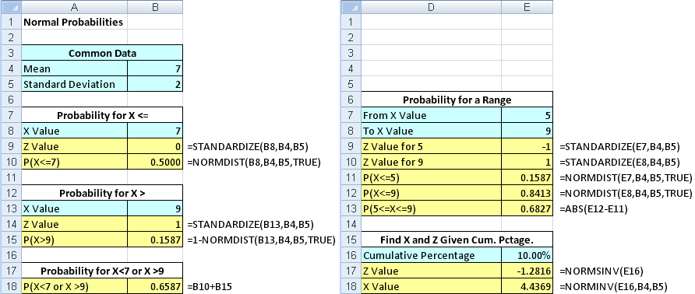
Using Excel With The Normal Distribution
Finding Normal Probabilities
Finding X Given A Probability
Chap 6-31

Slide 32
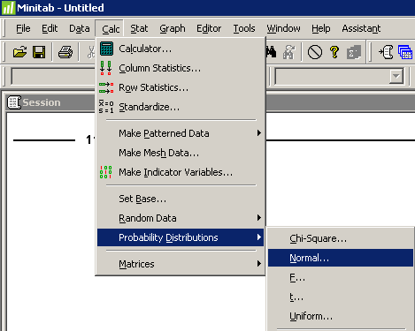
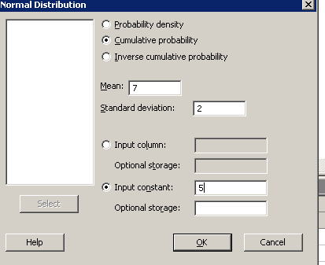
Using Minitab With The Normal Distribution
Finding P(X<5) when X is normal
with a mean of 7 and a standard deviation of 2
1
4
2
3
Cumulative Distribution Function
Normal with mean = 7 and standard deviation = 2
x P( X <= x )
5 0.158655
Chap 6-32

Slide 33
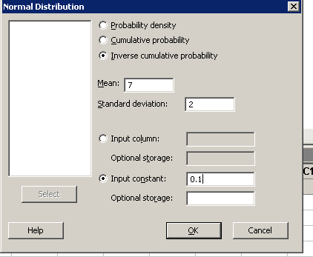
Using Minitab With The Normal Distribution
(continued)
Finding x so that P(X<x) = 0.1 when X is normal
with a mean of 7 and a standard deviation of 2
1
4
2
3
Inverse Cumulative Distribution Function
Normal with mean = 7 and standard deviation = 2
P( X<= x ) x
0.1 4.43690
Chap 6-33

Slide 34
Evaluating Normality
Not all continuous distributions are normal
It is important to evaluate how well the data set is approximated by a normal distribution.
Normally distributed data should approximate the theoretical normal distribution:
  The normal distribution is bell shaped (symmetrical) where the mean is equal to the median.
  The empirical rule applies to the normal distribution.
  The interquartile range of a normal distribution is 1.33 standard deviations.
Chap 6-34

Slide 35
Evaluating Normality
(continued)
Comparing data characteristics to theoretical properties
Construct charts or graphs
  For small- or moderate-sized data sets, construct a stem-and-leaf display or a boxplot to check for symmetry
  For large data sets, does the histogram or polygon appear bell-shaped?
Compute descriptive summary measures
  Do the mean, median and mode have similar values?
  Is the interquartile range approximately 1.33 σ?
  Is the range approximately 6 σ?
Chap 6-35

Slide 36
Evaluating Normality
(continued)
Comparing data characteristics to theoretical properties
Observe the distribution of the data set
  Do approximately 2/3 of the observations lie within mean ±1 standard deviation?
  Do approximately 80% of the observations lie within mean ±1.28 standard deviations?
  Do approximately 95% of the observations lie within mean ±2 standard deviations?
Evaluate normal probability plot
  Is the normal probability plot approximately linear (i.e. a straight line) with positive slope?
Chap 6-36

Slide 37
Constructing A Quantile-Quantile Normal Probability Plot
Normal probability plot
  Arrange data into ordered array
  Find corresponding standardized normal quantile values (Z)
  Plot the pairs of points with observed data values (X) on the vertical axis and the standardized normal quantile values (Z) on the horizontal axis
  Evaluate the plot for evidence of linearity
Chap 6-37

Slide 38
The Quantile-Quantile Normal Probability Plot Interpretation
A quantile-quantile normal probability plot for data from a normal distribution will be approximately linear:
X
90
60
30
-2
-1
0
1
2
Z
Chap 6-38

Slide 39
Quantile-Quantile Normal Probability Plot Interpretation
(continued)
Left-Skewed
Right-Skewed
X
90
X
90
60
60
30
30
-2
-1
0
1
2
Z
-2
-1
0
1
2
Z
Rectangular
Nonlinear plots indicate a deviation from normality
X
90
60
30
-2
-1
0
1
2
Z
Chap 6-39

Slide 40
Normal Probability Plots In Excel & Minitab
In Excel normal probability plots are quantile-quantile normal probability plots and the interpretation is as discussed
The Minitab normal probability plot is different and the interpretation differs slightly
As with the Excel normal probability plot a linear pattern in the Minitab normal probability plot indicates a normal distribution
Chap 6-40

Slide 41
Normal Probability Plots In Minitab
In Minitab the variable on the x-axis is the variable under study.
The variable on the y-axis is the cumulative probability from a normal distribution.
For a variable with a distribution that is skewed to the right the plotted points will rise quickly at the beginning and then level off.
For a variable with a distribution that is skewed to the left the plotted points will rise more slowly at first and rise more rapidly at the end
Chap 6-41

Slide 42
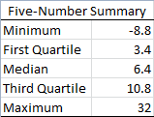
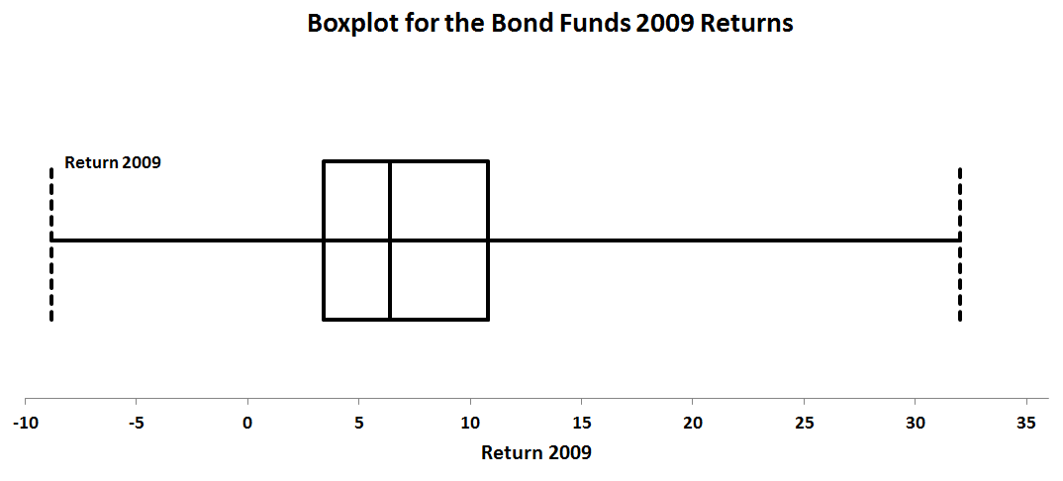
Evaluating Normality
An Example: Bond Funds Returns
The boxplot is skewed to the right. (The normal distribution is symmetric.)
Chap 6-42

Slide 43
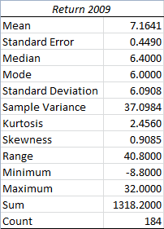
Evaluating Normality
An Example: Bond Funds Returns
(continued)
Descriptive Statistics
The mean (7.1641) is greater than the median (6.4). (In a normal distribution the mean and median are equal.)
The interquartile range of 7.4 is approximately 1.21 standard deviations. (In a normal distribution the interquartile range is 1.33 standard deviations.)
The range of 40.8 is equal to 6.70 standard deviations. (In a normal distribution the range is 6 standard deviations.)
73.91% of the observations are within 1 standard deviation of the mean. (In a normal distribution this percentage is 68.26%.
85.33% of the observations are within 1.28 standard deviations of the mean. (In a normal distribution this percentage is 80%.)
Chap 6-43

Slide 44
Evaluating Normality
An Example: Bond Funds Returns
(continued)
Descriptive Statistics
96.20% of the returns are within 2 standard deviations of the mean. (In a normal distribution, 95.44% of the values lie within 2 standard deviations of the mean.)
The skewness statistic is 0.9085 and the kurtosis statistic is 2.456. (In a normal distribution each of these statistics equals zero.)
Chap 6-44

Slide 45
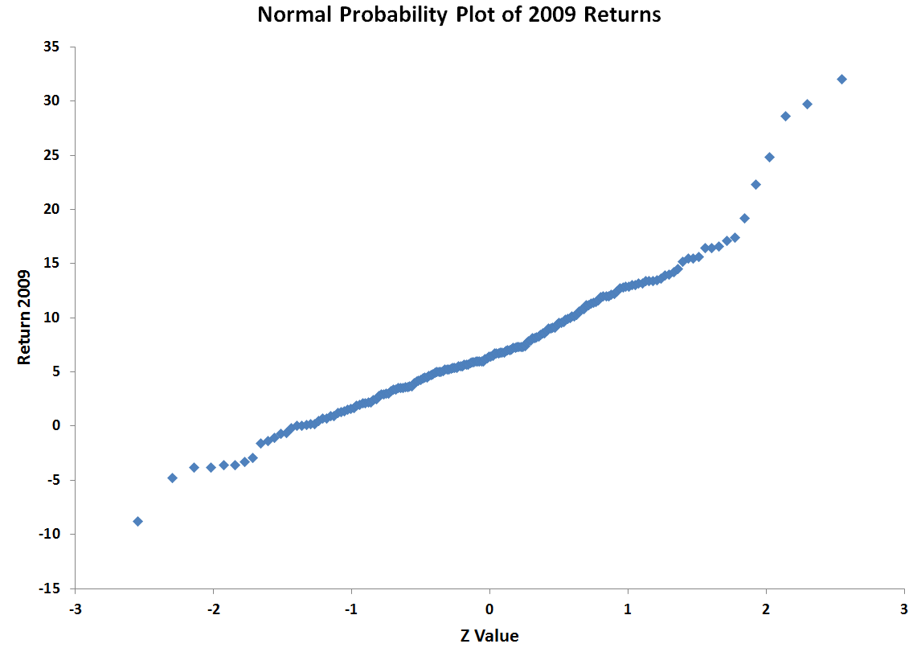
Evaluating Normality
An Example: Bond Funds Returns
(continued)
Quantile-Quantile Normal Probability Plot From Excel
Plot is not a straight line and shows the distribution is skewed to the right. (The normal distribution appears as a straight line.)
Chap 6-45

Slide 46
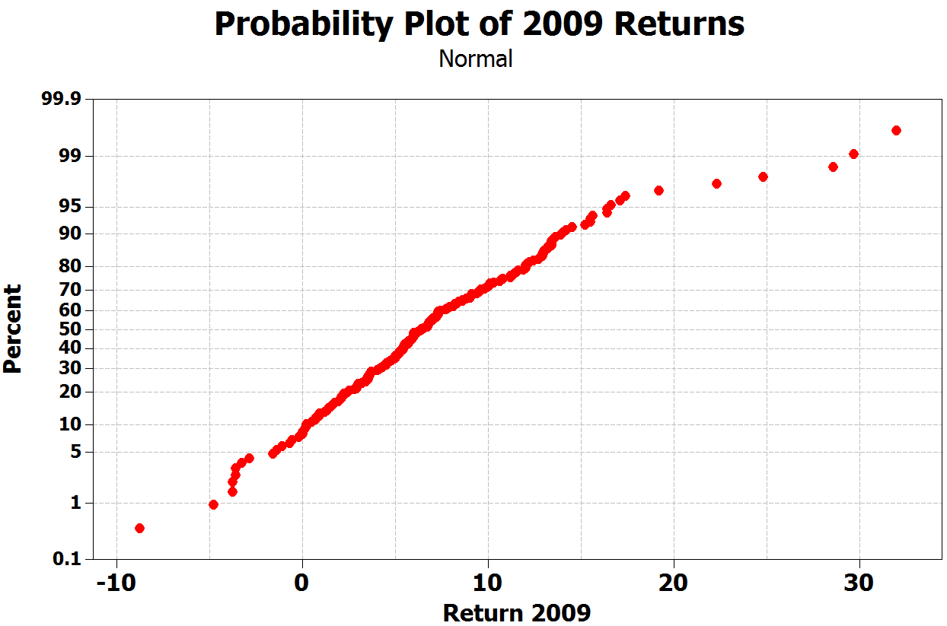
Evaluating Normality
An Example: Bond Funds Returns
(continued)
Normal Probability Plot From Minitab
Plot is not a straight line, rises quickly in the beginning, rises slowly at the end and shows the distribution is skewed to the right.
Chap 6-46

Slide 47
Evaluating Normality
An Example: Mutual Funds Returns
(continued)
Conclusions
  The returns are right-skewed
  The returns have more values within 1 standard deviation of the mean than expected
  The range is larger than expected (mostly due to the outlier at 32)
  Normal probability plot is not a straight line
  Overall, this data set greatly differs from the theoretical properties of the normal distribution
Chap 6-47

Slide 48
The Uniform Distribution
The uniform distribution is a probability distribution that has equal probabilities for all possible outcomes of the random variable
Also called a rectangular distribution
Chap 6-48

Slide 49
The Uniform Distribution
The Continuous Uniform Distribution:
f(X) =
where
f(X) = value of the density function at any X value
a = minimum value of X
b = maximum value of X
Chap 6-49

Slide 50
Properties of the
Uniform Distribution
The mean of a uniform distribution is
The standard deviation is
Chap 6-50

Slide 51
Uniform Distribution Example
Example: Uniform probability distribution
over the range 2 ≤ X ≤ 6:
1
f(X) = = 0.25 for 2 ≤ X ≤ 6
6 - 2
f(X)
0.25
2
6
X
Chap 6-51

Slide 52
Uniform Distribution Example
(continued)
Example: Using the uniform probability distribution to find P(3 ≤ X ≤ 5):
P(3 ≤ X ≤ 5) = (Base)(Height) = (2)(0.25) = 0.5
f(X)
0.25
2
3
4
5
6
X
Chap 6-52

Slide 53
The Exponential Distribution
Often used to model the length of time between two occurrences of an event (the time between arrivals)
  Examples:
    Time between trucks arriving at an unloading dock
    Time between transactions at an ATM Machine
    Time between phone calls to the main operator
Chap 6-53

Slide 54
The Exponential Distribution
Defined by a single parameter, its mean λ (lambda)
The probability that an arrival time is less than some specified time X is
where e = mathematical constant approximated by 2.71828
λ = the population mean number of arrivals per unit
X = any value of the continuous variable where 0 < X <
Chap 6-54

Slide 55
Exponential Distribution
Example
Example: Customers arrive at the service counter at the rate of 15 per hour. What is the probability that the arrival time between consecutive customers is less than three minutes?
The mean number of arrivals per hour is 15, so λ = 15
Three minutes is 0.05 hours
P(arrival time < .05) = 1 – e^{-λX} = 1 – e^{-(15)(0.05)} = 0.5276
So there is a 52.76% chance that the arrival time between successive customers is less than three minutes
Chap 6-55

Slide 56
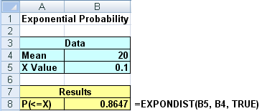
The Exponential Distribution
In Excel
Calculating the probability that an exponential distribution with a mean of 20 is less than 0.1
Chap 6-56

Slide 57
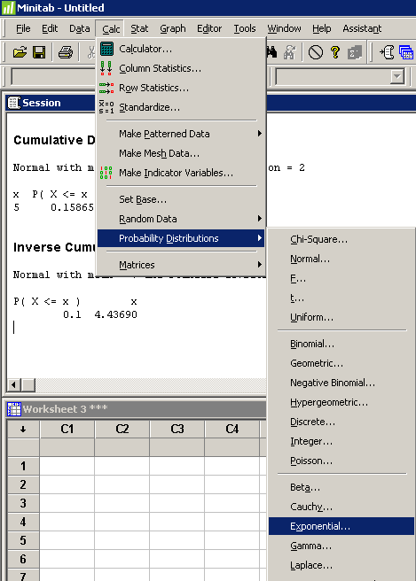
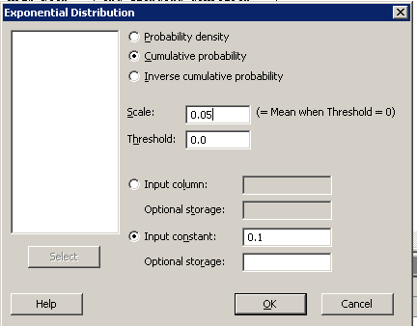
The Exponential Distribution In Minitab
Calculating the probability that an exponential distribution with a mean of 1/20 is less than 0.1
Cumulative Distribution Function
Exponential with mean = 0.05
x P( X <= x )
0.1 0.864665
Chap 6-57

Slide 58
Chapter Summary
Presented key continuous distributions
  normal, uniform, exponential
Found probabilities using formulas and tables
Recognized when to apply different distributions
Applied distributions to decision problems
Chap 6-58

Slide 59
Basic Business Statistics
12th Edition
On Line Topic
The Normal Approximation To The Binomial

Slide 60
Learning Objectives
In this topic, you learn:
Why using a continuity adjustment yields a more accurate approximation
To approximate binomial probabilities using the normal distribution

Slide 61
Using A Normal Distribution To Approximate A Binomial Probability
A binomial distribution is a discrete distribution which can only take on the values of 0, 1, 2, . . , n.
When n gets large the calculations associated with the binomial distribution become tedious.
In these situations can use a normal distribution with the same mean and standard deviation as the binomial to approximate the binomial probability

Slide 62
The Need For A Continuity Adjustment
For a binomial random variable X, P(X = c) is nonzero for c = 0, 1, 2, . . . n.
For a normal random variable W, P(W = c) for any value c is zero.
So to approximate a binomial probability using the normal distribution have to use a continuity adjustment.
If X is binomial and W is normal we approximate P(X=c) by P(c – 0.5 < W < c + 0.5) where W has the same mean and standard deviation as X.
Adding and subtracting the 0.5 is the continuity adjustment

Slide 63
When Can The Normal Approximation Be Used
The normal approximation can be used as long as:
  nπ ≥ 5 and
  n(1 – π) ≥ 5
Recall
  Mean of a binomial is μ = nπ
  Standard deviation of a binomial is σ=SQRT(nπ(1 – π))

Slide 64
An Example
You select a random sample of n = 1600 tires from a production process with a defect rate of 8%. You want to calculate the probability that 150 or fewer tires will be defective.
Here μ = 1600*0.08 = 128 and σ = SQRT(1600*0.08*0.92) = 10.85.
Let X be a normal random variable with this mean and standard deviation then the desired probability is P(X < 150.5)

Slide 65
Example (Con’t)
This is P(Z <(150.5 – 128)/10.85) = 0.9808
So we approximate the probability of finding 150 or fewer defects as 0.9808.

Slide 66
Topic Summary
In this topic, you learned:
Why using a continuity adjustment yields a more accurate approximation
To approximate binomial probabilities using the normal distribution

