Slide 1
Handwritten Devanagari Character Recognition using Machine Learning
A Comparative Study of Random Forest and SVM Models

Slide 2
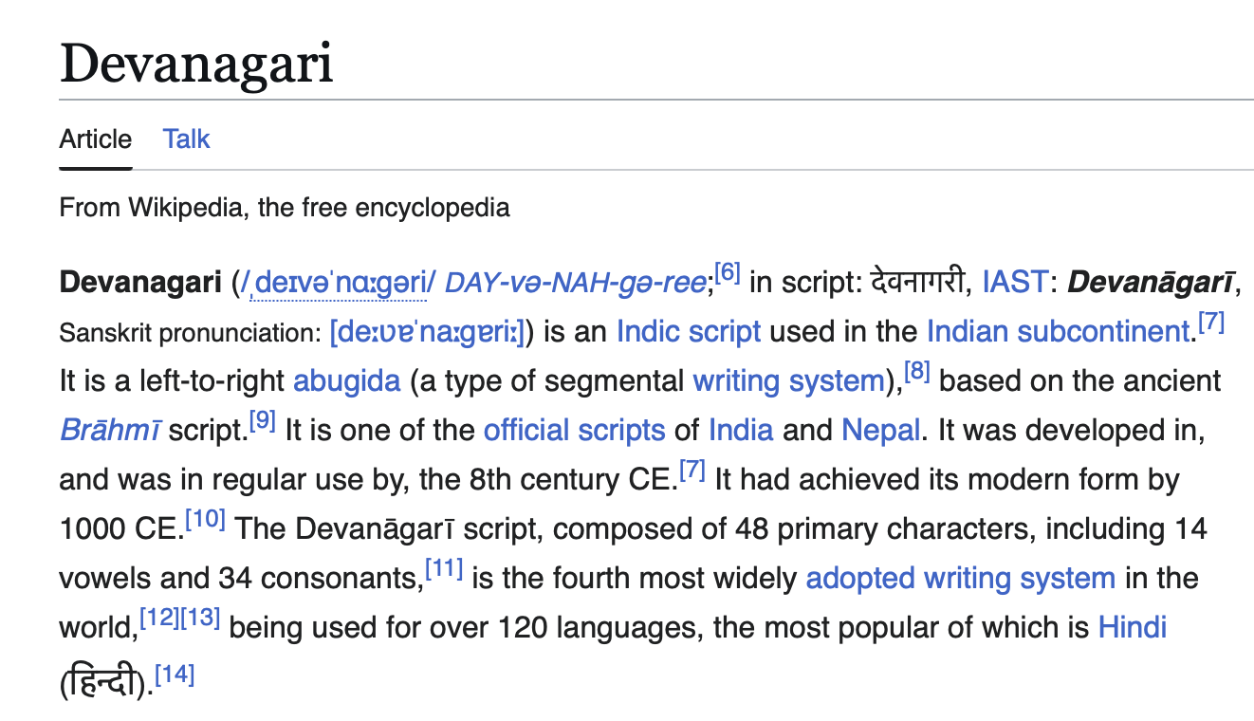
Introduction

Slide 3
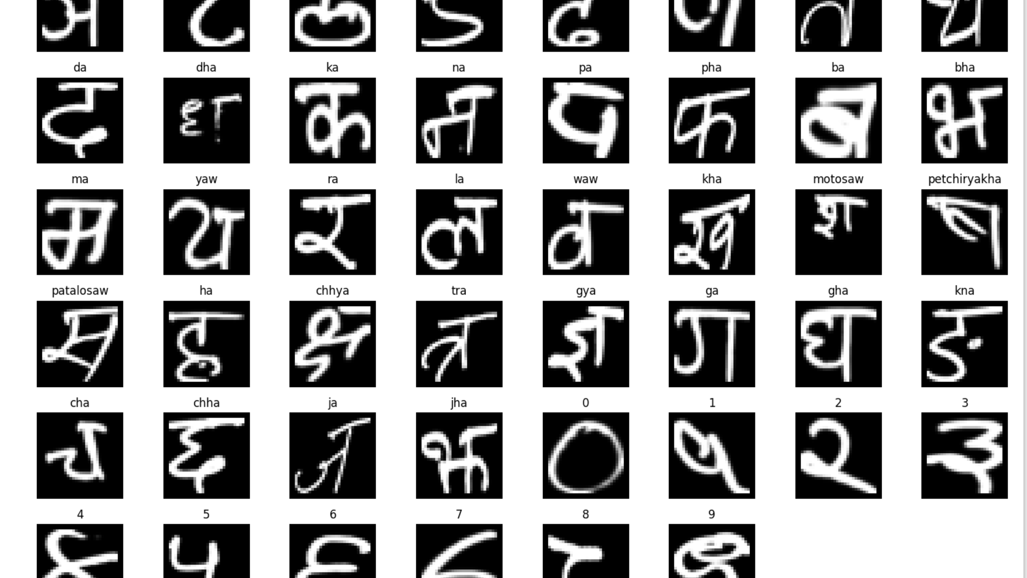
Dataset Overview
Devanagari Handwritten Character Dataset
Classes: 46 total (36 characters + 10 digits)
Format: 32×32 grayscale images
Data split: ~78,200 training, ~13,800 testing
Storage structure: /train and /test folders, each containing character-specific subfolders

Slide 4
Data Preprocessing
Convert images to grayscale arrays (32×32 → 1024 features)
Apply normalization / scaling
Map labels (character_10_yna → yna)

Slide 5
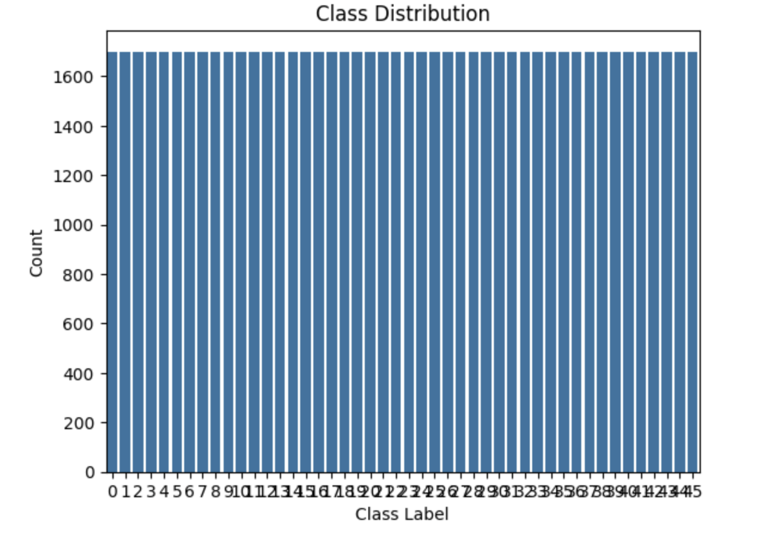
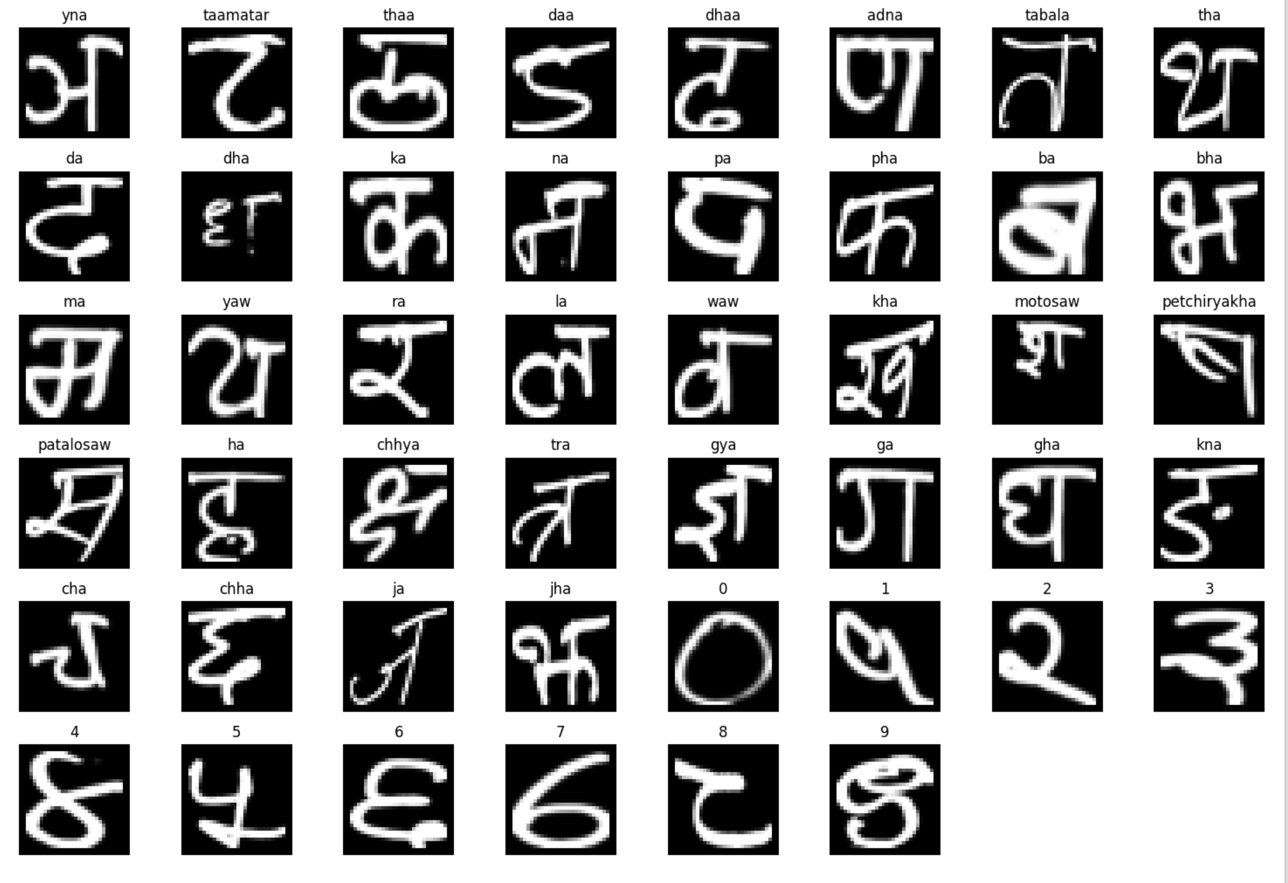
Exploratory Data Analysis
Distribution of classes (plot 1)
Visualization of character samples (plot 2)
The train and test set sample are banlanced

Slide 6
Models Implemented
Model | Description | Goal
Random Forest | Ensemble of decision trees | Handle nonlinear relationships
SVM (raw) | Linear decision boundary | Baseline for performance
SVM + PCA | Dimensionality reduction | Improve generalization

Slide 7
Model Evaluation Metrics
Model | Train Acc | Test Acc | F1 | MSE
Random Forest | 1.00 | 0.92 | 0.92 | 18.9
SVM (raw) | 0.70 | 0.60 | 0.60 | 104.9
SVM + PCA | 0.67 | 0.66 | 0.66 | 89.3
Insights:
PCA improved SVM’s generalization.
Random Forest best captured nonlinear handwriting patterns.
Linear models struggled with similar characters.

Slide 8
Conclusion
Random Forest outperformed all other models.
SVM + PCA achieved better balance between accuracy and efficiency.
Feature reduction (PCA) helped reduce noise and improve performance

Slide 9
Future Work

