Slide 1
Hybrid Movie Recommendation System
Combining Collaborative and Content-Based Approaches
Wenhao chen

Slide 2
Introduction
Recommender systems
Collaborative Filtering (based on user behavior)
Content-Based Filtering (based on item features)

Slide 3
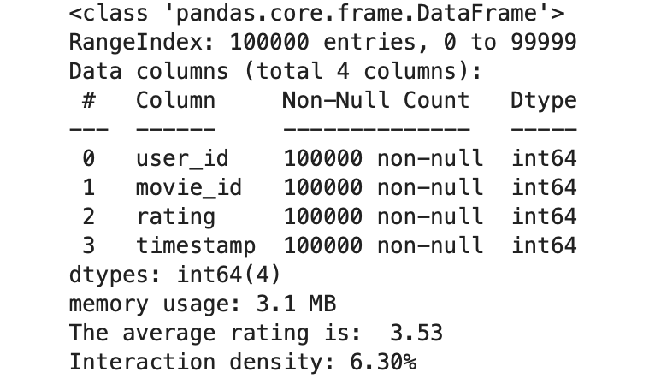
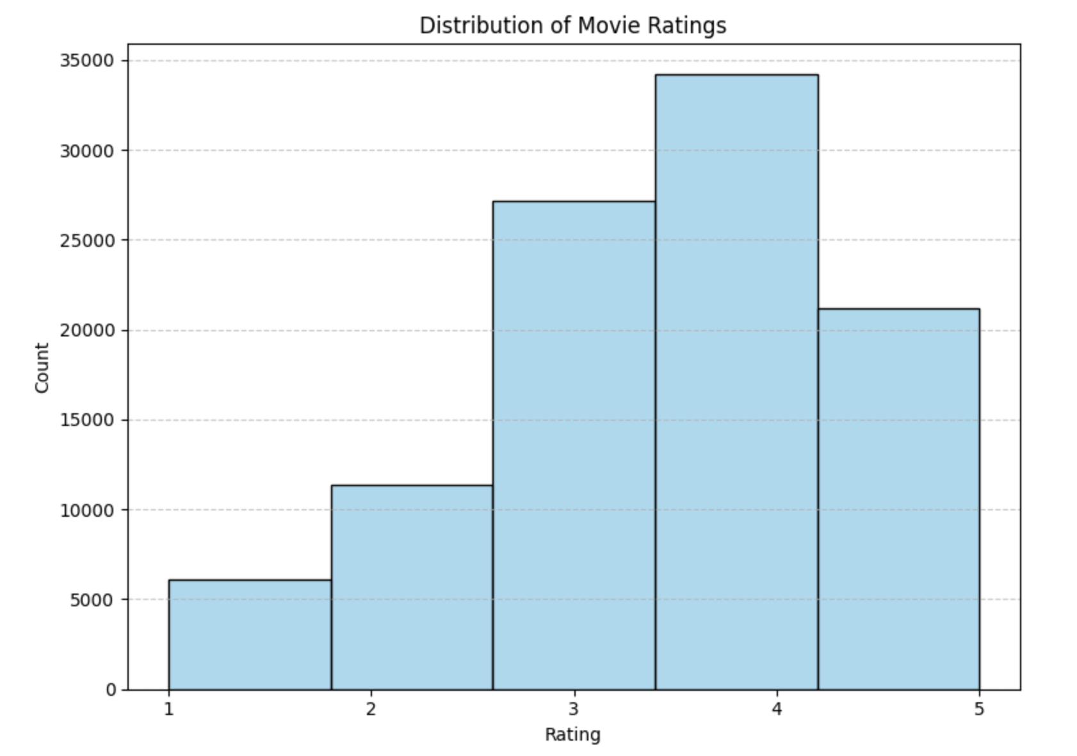
Dataset Overview
Dataset: MovieLens 100k
Users: 943
Movies: 1,682
Ratings: 100,000
Rating scale: 1–5
Features used: user_id, movie_id, rating, genres

Slide 4
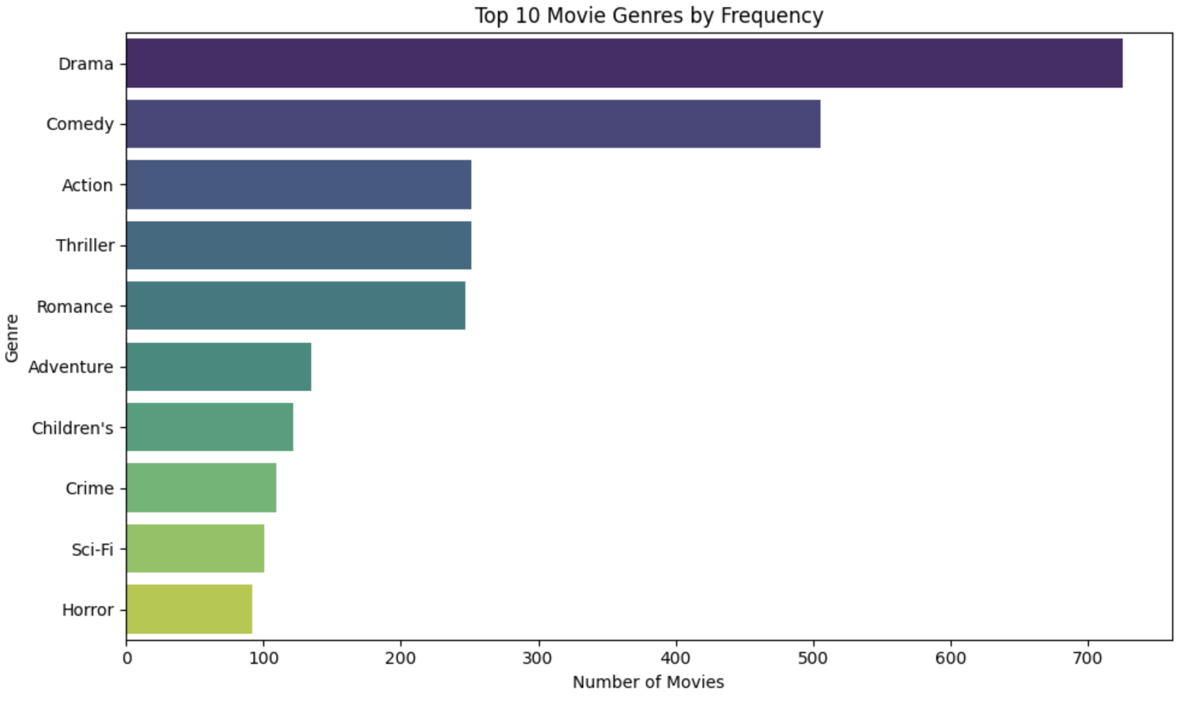
Exploratory Data Analysis (EDA)
Users tend to rate between 3 and 5 → positive bias
Popular genres: Drama, Comedy, Action
Many movies have multiple genres

Slide 5
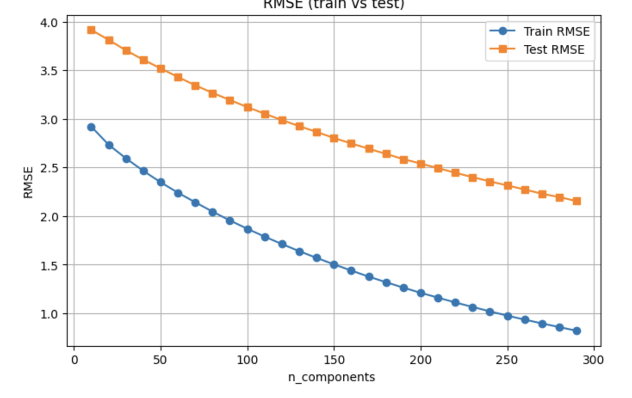
Baseline Model: Matrix Factorization
Implemented with Truncated SVD
Goal: learn latent features for users and movies
Parameters tested: n_components = [10, 20, 30, 40, 50 … , 300]
RMSE results table

Slide 6
Content-Based Filtering
Used movie genres as features
Created genre similarity matrix using:
CountVectorizer → bag-of-genres encoding
cosine_similarity → measure movie similarity
Each movie scored based on how similar it is to movies the user liked

Slide 7
Hybrid Recommendation System
Combined predictions:
Added user-preferred genre weighting for personalization
Tuned α between 0.4 and 0.6
Pipeline:
User Ratings → SVD → Collaborative Score
Movie Genres → Similarity → Content Score → Weighted Fusion → Final Recommendations

Slide 8
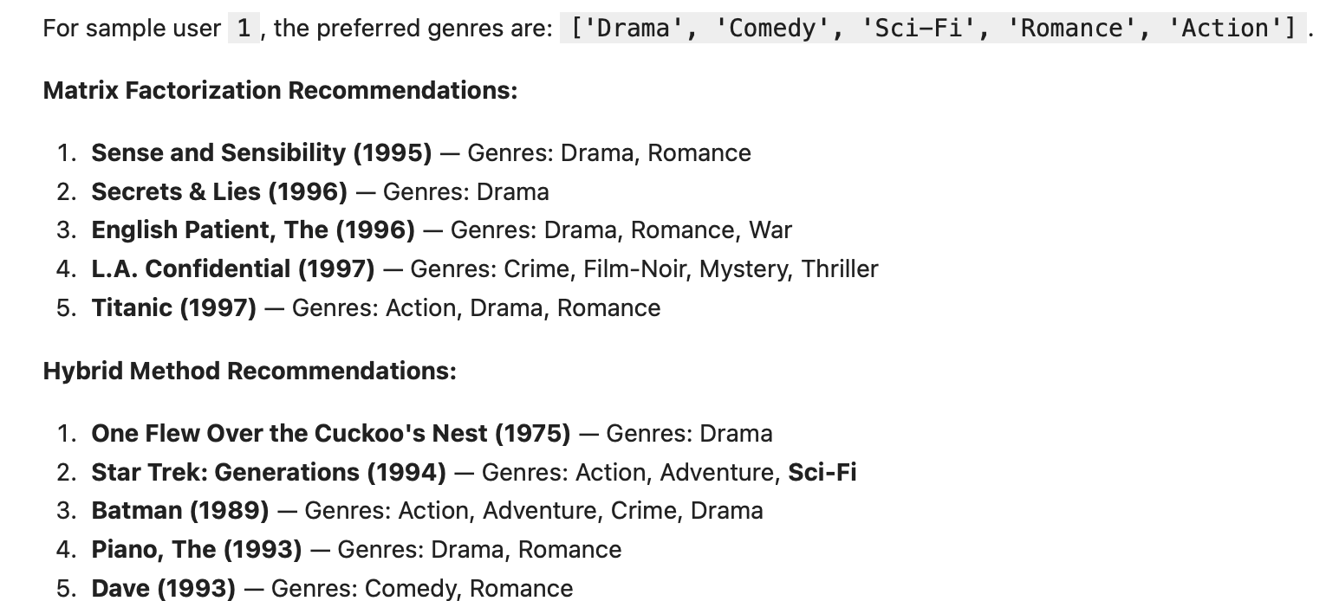
Result Comparison
Example user (User 1) preferred genres: Drama, Comedy, Sci-Fi, Romance, Action
Compare top 5 movies from both models
Quantitative Evaluation
Baseline MF: 0.813
Hybrid Model: 0.858

Slide 9
Discussion
Matrix Factorization captures hidden patterns
Content-based adds interpretability & handles cold start
Hybrid = balance of accuracy + diversity
Limitations & Future Work
Only uses explicit ratings
Genre features are basic; could add TF-IDF or embeddings
Can integrate user demographics (age, gender, occupation)
Try deep learning (e.g., Autoencoder or Neural CF)

Slide 10
Conclusion
Hybrid system outperforms baseline in both accuracy and personalization
Genre alignment confirms better match with user taste
Demonstrates power of combining collaborative and content knowledge

