Slide 1
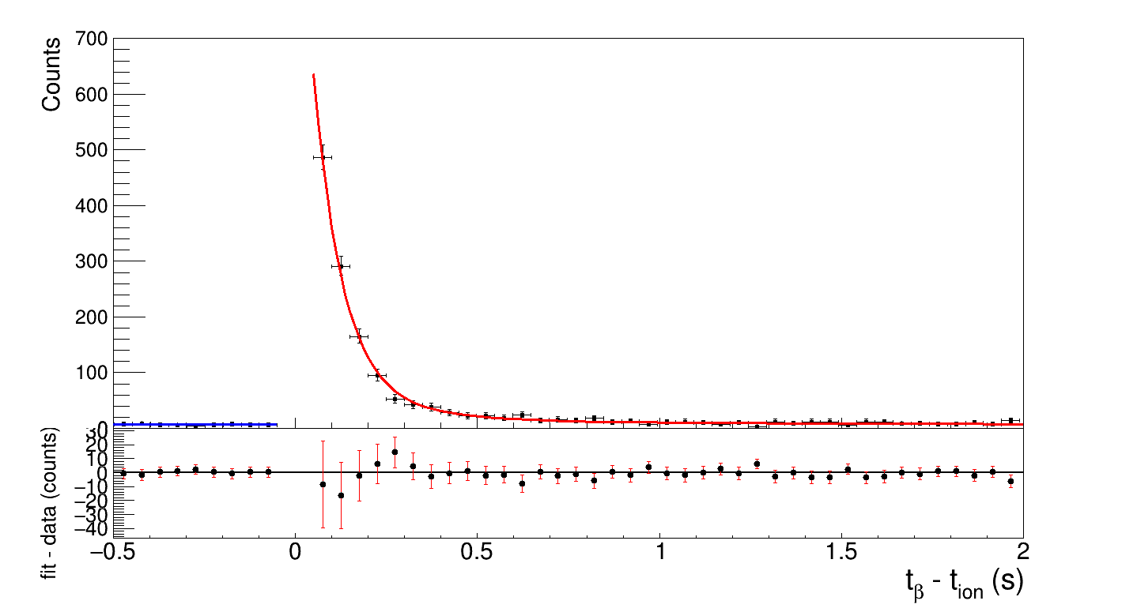
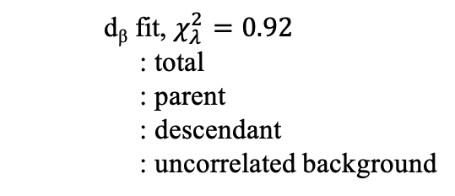
d_{β1n} fit
: total
: uncorrelated background
(backward time)
d_{β2n} fit
: total
: uncorrelated background
(backward time)

