Slide 1
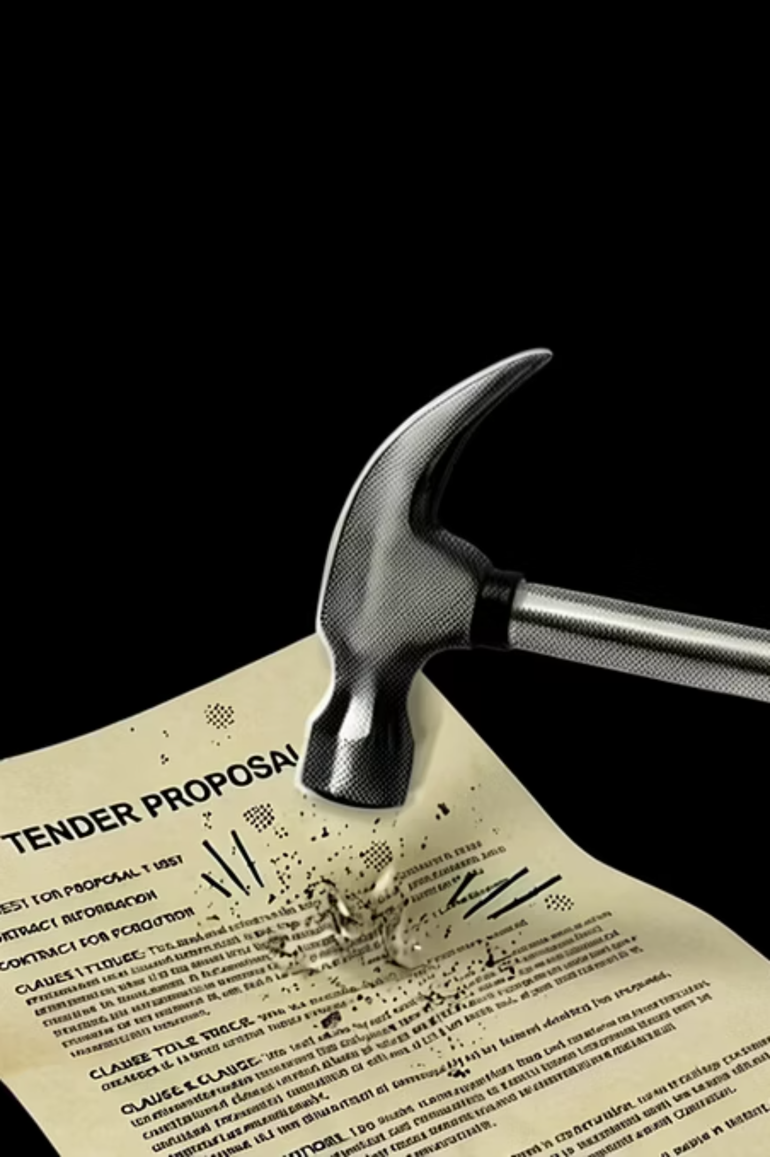
The Tenderizer
Pounding tough tenders into easily digestible drafts.

Slide 2
Problem Statement
Who they are, what they struggle with.
The Profile
Reality Today
Team Overload
50–250 employees
€5M–€50M revenue firms
Infra / Env / Gov / Consulting
~40% -60% of time lost in drafting
Endless rewriting & formatting
Lack data-driven bid qualifications
Missed requirements under deadline pressure
Burnout from constant bid stress
Limited insight into bid success likelihood

Slide 3
Agentic Architecture
Generation Pipeline
Upload
Analyze
Retrieve
Generate
Process
View & Edit
Supporting Systems
Knowledge Base
AI Engine
Interactive Layer
Central repository of past bids, templates, and reference content that grounds every response in trusted project knowledge.
Core orchestration and generation layer that interprets inputs, drafts content, and refines outputs for bid workflows.
User-facing workspace for reviewing, editing, and approving generated content before delivery.

Slide 4





Business Impact
From Document Work → Strategic Bidding
Reduced Operational Overhead
Speedy Submission
Increased Bid Volume
Higher Win Rate
"We turn bid managers into decision-makers, not document editors."

Slide 5
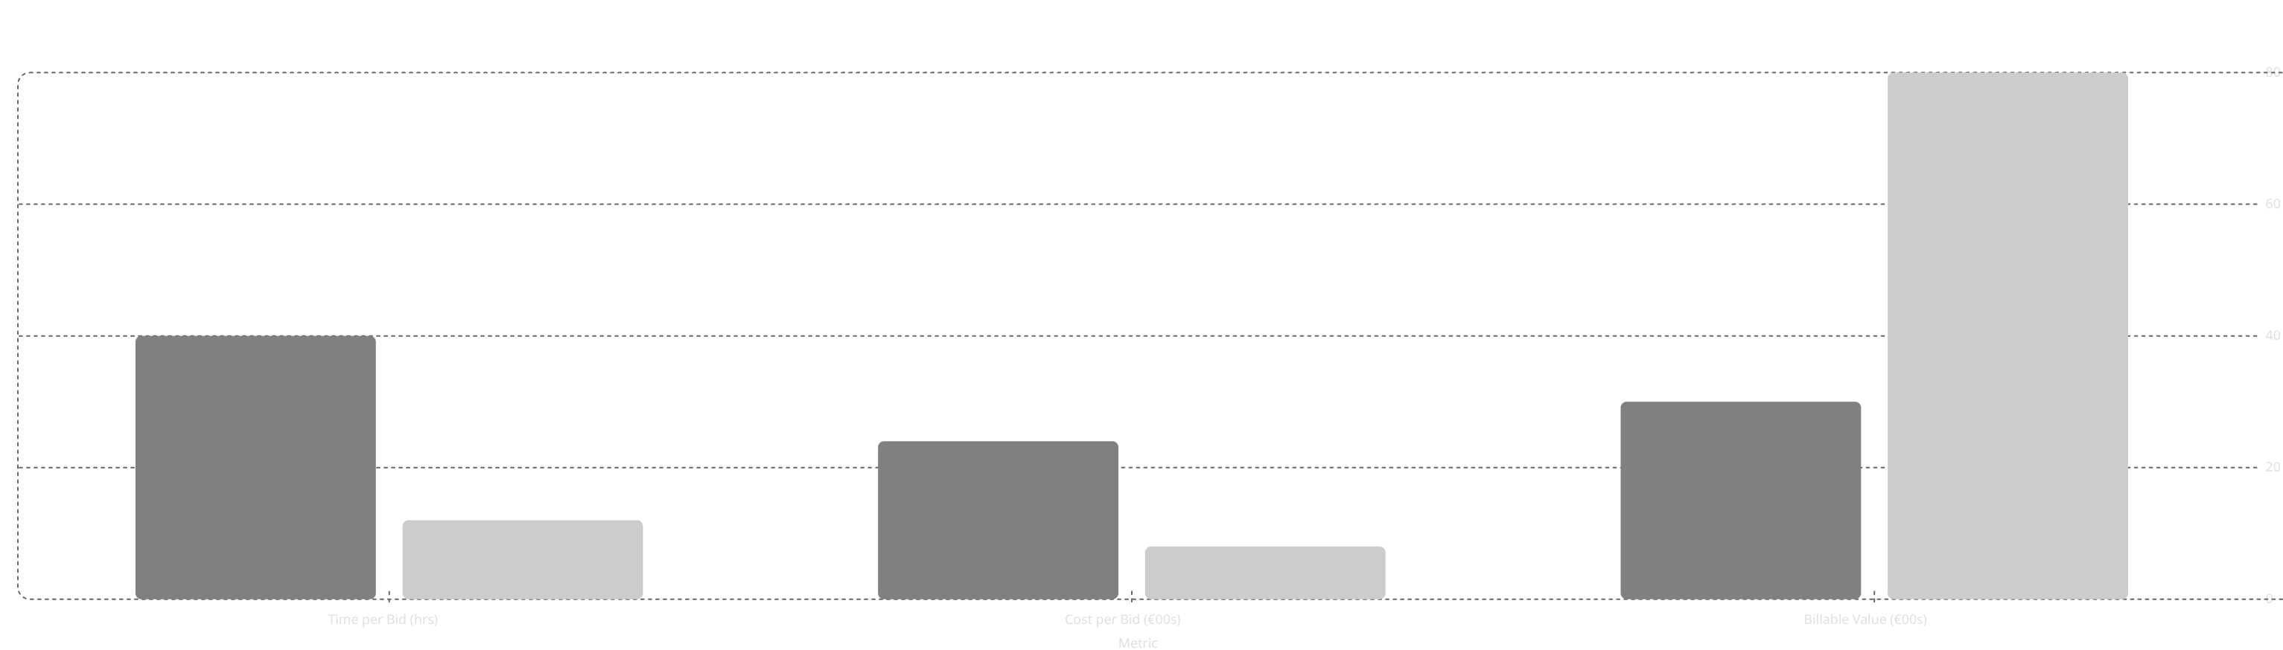



Financial Model: Time → Revenue Unlock
Manual
AI-Assisted
80
40
30
24
12
8
28h
€5.6K
€168K
Time Saved
Value Unlocked
Annual Impact
"This isn't cost-saving. This is revenue creation."

Slide 6
Limitations
Addressing the challenges and considerations for AI-driven bid management.
Cold Start Problem
Quality Ceiling
New customers need to populate their knowledge base first. The first 2–3 tenders won't feel magical until the wiki has enough content.
Tenderizer produces a strong first draft, not a submission-ready document. Human judgment remains essential — and that's by design.
Hallucination Risk
Thin Early Moat
We ground generation in retrieved content and flag gaps explicitly. But zero risk doesn't exist — human review is non-negotiable.
he RAG pipeline is reproducible. Defensibility grows with each customer's knowledge base and domain-specific formatting logic.

Slide 7
Future Scope
The roadmap that turns a drafting tool into a full strategic bid intelligence platform.
CRM Ecosystem Integration
Predictive Win Engine
Pull live data from Salesforce and HubSpot to auto-populate requirements and track win rates natively.
Train our AI on your historical bids to automatically score new tenders based on proven win characteristics.
Cross-Border Language Support
Automated Pricing Models
Instantly translate and localize bids for international markets while preserving legal and technical accuracy.
AI-generated competitive pricing suggestions from scope extraction, reducing financial risk on fixed-price bids.

Slide 8
Thank You.
Ready to turn your bid managers into strategic decision-makers?
Let's unlock revenue — together.

