Slide 1

Introduction to Hadoop (programming)
LC Hsieh
NTU, 2011
Some slides are inspired by the slides of Philip Zeyliger at http://www.slideshare.net/cloudera/apache-hadoop-talk-at-qcon

Slide 2
Data is everywhere.
Data is important.
Data is exploding.

Slide 3

The Trend of Data Growth
In 2009, the digital data grew 62% over 2008 to 800 billion GB (0.8 ZB)
The digital data created in 2010 (1.2 ZB) equals
  Every man, woman and child on Earth "Tweeting" continuously for 100 years
  75 billion fully-loaded 16 GB Apple iPads, which could fill the Taipei 101 Tower 23 times
The number of files, images, records and other digital information containers will grow by a factor of 67
  Despite this growth, the number of IT professionals globally will grow only by a factor of 1.4

Slide 4
“I keep saying that the sexy job in the next 10 years will be statisticians, and I’m not kidding.”
Hal Varian
Google chief economist

Slide 5
What Is (Apache) Hadoop?

Slide 6

The Apache™ Hadoop™ project develops open-source software for reliable, scalable, distributed computing.
-- http://hadoop.apache.org/

Slide 7



Two Main Components of
HDFS
MapReduce
High-bandwidth clustered storage
Fault-tolerant distributed computing

Slide 8
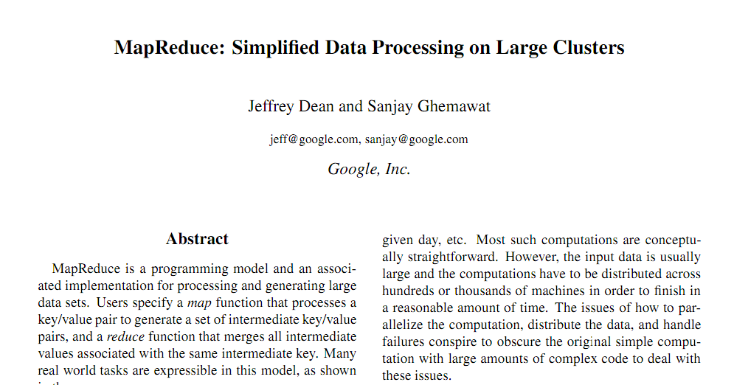
A simple programming model that applies to many large-scale computing problems [Dean, PACT’06 Keynote]
MapReduce is a patented software framework introduced by Google to support distributed computing on large data sets on clusters of computer [Wikipedia]
MapReduce = Distributed computation + distributed storage + scheduling / fault tolerance [Spiros Papadimitriou, KDD Tutorials’2010]

Slide 9
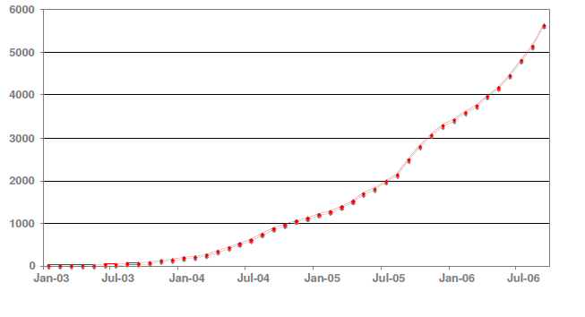
Growth of MapReduce Programs in Google
[Dean, PACT’06 Keynote]
Growth of MapReduce programs in Google source tree (2003~2006)
  Distributed grep, distributed sort, web access log stats, web link-graph reversal, inverted index construction, statistical machine translation, machine learning, document clustering, etc.

Slide 10
The M/R Programming Model
Defining your map() and reduce() functions.
The framework takes care other tasks (fault-tolerance, parallelization, etc.) for you.

Slide 11

map function: the worker processes smaller problem
map: K1, V1 -> list(K2, V2)
(shuffle) supported by MapReduce framework
map output is assigned to reducer
map output is sorted by key
reduce function: the worker that aggregately processes the intermediate output from mappers
reduce: K2, list(V2) -> list(K3, V3)

Slide 12
Word Counting by MapReduce
void map(String name, String document):
// name: document name
// document: document contents
for each word w in document:
EmitIntermediate(w, "1");
void reduce(String word, Iterator partialCounts):
// word: a word
// partialCounts: a list of aggregated partial counts
int result = 0;
for each pc in partialCounts:
result += ParseInt(pc);
Emit(AsString(result));

Slide 13
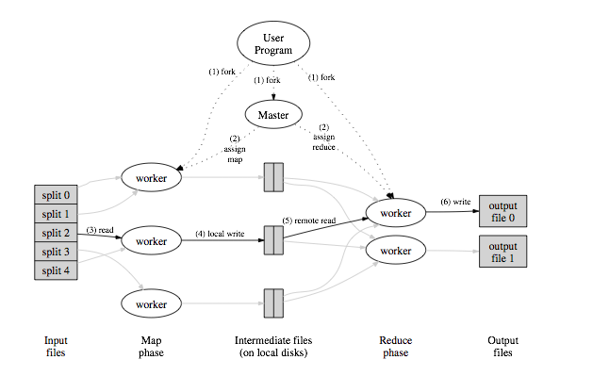
Logical
map
shuffle
reduce
dog
cow
cow
...
<dog, 1>
<cow, 1>
<cow, 1>
...
<dog, (1) >
<cow, (1, 1)>
...
<dog, 1>
<cow, 2>
...
Physical

Slide 14
Hadoop Virtual Image
You can experiment with Hadoop platform right now without setting a Hadoop cluster by using pre-configured virtual machine images
  Google Hadoop virtual image [http://code.google.com/edu/parallel/tools/hadoopvm/index.html]
  Yahoo! Hadoop virtual machine [http://developer.yahoo.com/hadoop/tutorial/module3.html]
Virtualization software
  VMware Player as mentioned in previous web pages
  VirtualBox works with Google Hadoop virtual image

Slide 15
Hadoop Java API
Map class
public class Map extends Mapper<LongWritable, Text, Text, IntWritable> {
public void map(LongWritable key, Text value, Context context) throws IOException, InterruptedException {
}
}
Reduce class
public class Reduce extends Reducer<Text, IntWritable, Text, IntWritable> {
public void reduce(Text key, Iterable<IntWritable> values, Context context) throws IOException, InterruptedException {
}
}

Slide 16
Inverted List Construction
MapReduce “killer app” [Lin & Dryer, Tutorial at NAACL/HLT 2009]
From document-term model to term-document model
  map function tokenizes text document and emits (term, doc id) as key/value pair
  reduce function aggregates doc ids for every term and outputs (term, <doc id>*) as inverted list

Slide 17
Inverted List Construction: map
public class Map extends Mapper<LongWritable, Text, Text, Text> {
private Text word = new Text();
private Text doc_id = new Text();
public void map(LongWritable key, Text value, Context context) throws IOException, InterruptedException {
String line = value.toString();
StringTokenizer tokenizer = new StringTokenizer(line);
if (tokenizer.hasMoreTokens())
doc_id.set(tokenizer.nextToken());
while (tokenizer.hasMoreTokens()) {
word.set(tokenizer.nextToken());
context.write(word, doc_id);
}
}
}

Slide 18
Inverted List Construction: reduce
public class Reduce extends Reducer<Text, Text, Text, Text> {
public void reduce(Text key, Iterable<Text> values, Context context) throws IOException, InterruptedException {
StringBuffer strbuf = new StringBuffer();
for (Text val : values) {
strbuf.append(val.toString() + " ");
}
context.write(key, new Text(strbuf.toString()));
}
}

Slide 19
OK. I have written a Hadoop program in Java.
How do I run it?

Slide 20
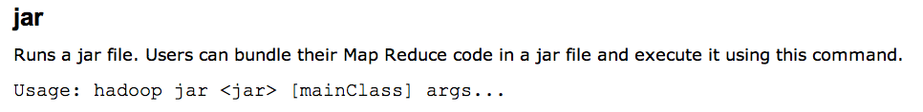
Using command ‘jar’:
For example:
$ bin/hadoop jar /usr/joe/wordcount.jar org.myorg.WordCount /usr/joe/wordcount/input /usr/joe/wordcount/output

Slide 21
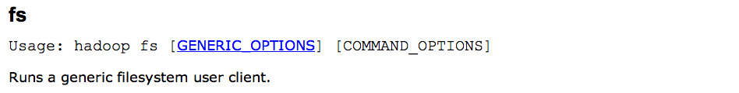
Put your data on HDFS:
For example:
$ bin/hadoop fs -ls /usr/joe/wordcount/output
Most of the commands have similar behaviors like corresponding Unix commands.

Slide 22
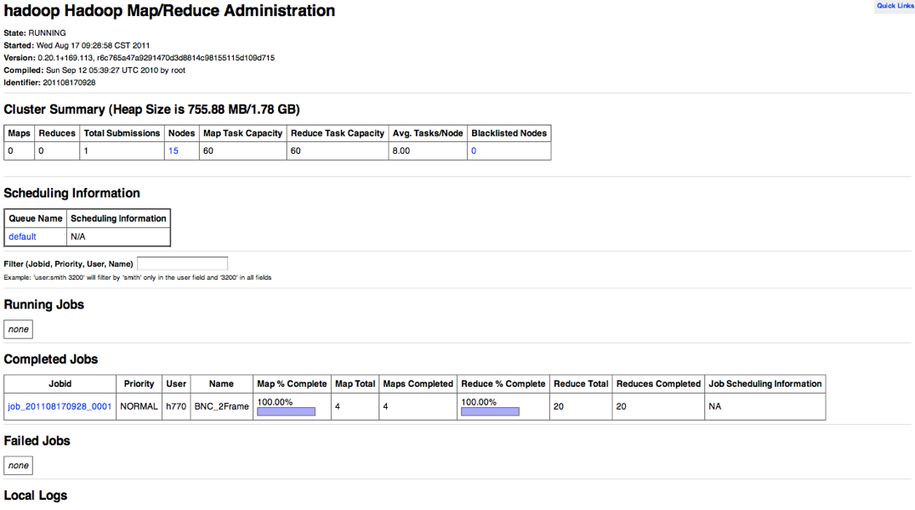
Examine the status of your submitted jobs

Slide 23
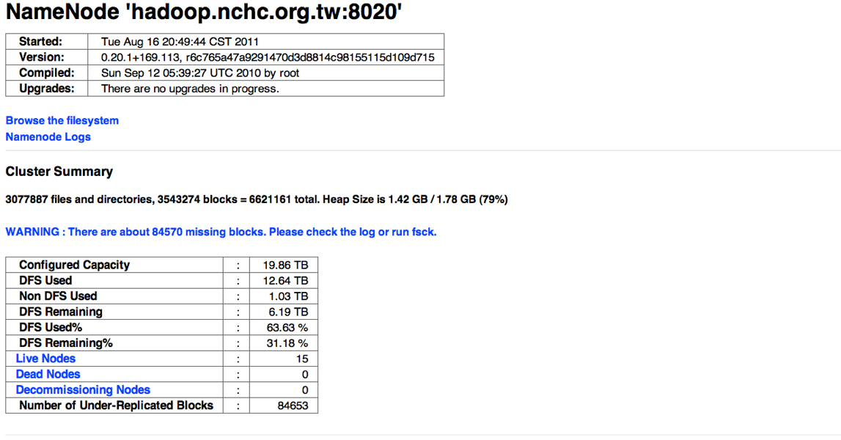
Examine the status of HDFS

Slide 24
What if you cannot or do not want to write Hadoop programs in Java?

Slide 25
There is more than the Java API
Streaming
  Perl/Python/Ruby/Shell Script.....
Pipes (C/C++)
Higher level interface
  Pig, Hive
On the research clusters of Yahoo!, most research jobs are not Java based [Owen O’Malley, ApacheCon US 2008]42% Streaming28% Pig28% Java2% C++

Slide 26
Hadoop Streaming
Hadoop streaming is a utility that comes with the Hadoop distribution.
The utility allows you to create and run MapReduce jobs with any executable or script as the mapper and/or the reducer.

Slide 27
Word Counting with Streaming
$HADOOP_HOME/bin/hadoop jar $HADOOP_HOME/hadoop-streaming.jar \
-input myInputDirs \
-output myOutputDir \
-mapper /bin/cat \
-reducer /bin/wc
Using your program as mapper/reducer
Package files in your job with -file option
-mapper myScript \
-reducer /bin/wc
-file myScript

Slide 28
Feature Extraction Using Hadoop Streaming
Many images stored on Hadoop HDFS that wait for feature extraction
Existing binary programs for feature extraction that take image filename as command parameter
The steps to integrate the existing program with Hadoop streaming
  Write a text file listing those image filenames
  Write a wrapper script to process the text file using Hadoop Streaming
  In the script
    Move image from HDFS to local disk
    Call external program to extract features for each image
    Move extracted feature back to HDFS

Slide 29
A Ruby Script for Extract Feature
#!/usr/bin/env ruby
STDIN.each_line do |line|
# obtain filename from file list
filename = line.chop!
if /\A.*\/(.*?)\z/i.match(filename)
localfilename = $1
else
exit
end
# copy file from HDFS to local disk
system("hadoop dfs -get /user/username/" + filename + " " + localfilename)
#begin to process local file
system("chmod a+x ./extract_features_64bit.ln") # the parallelized existing program
system("./extract_features_64bit.ln -hesaff -sift -i ./" + localfilename + " -o1 ./" + localfilename + ".hes")
system("hadoop dfs -put " + localfilename + ".hes" + " " + "/user/username/output/features/.")
puts "0\t#{localfilename}"
system("rm " + localfilename)
system("rm " + localfilename + ".hes")
end
The image list file on HDFS
.....
input/images/1316255637_t.pgm
input/images/1918648013_t.pgm
input/images/2134555347_t.pgm
.....

Slide 30
Hadoop Streaming Usage
Using the script as mapper/reducer
$HADOOP_HOME/bin/hadoop jar $HADOOP_HOME/hadoop-streaming.jar \
-input input/images_list \
-output output/features \
-mapper extract_local_feature.rb \
-file extract_local_feature.rb \
-file extract_features_64bit.ln \
-jobconf mapred.map.tasks=10
-jobconf mapred.reduce.tasks=0

Slide 31
Problem: Large Number of (Small) Files
Large number of small files stored on HDFS is inefficient due to the design of HDFS
  A file is small when it is less than the HDFS block size (128MB by default)
  Files and blocks are name objects in HDFS and occupy namespace
  Namespace is limited by physical memory size in HDFS NameNode
Try more complicated pre-processing
  Archive many files together and process the archives in script
  Archive processed results before moving them back to HDFS

Slide 32
Modified Script
The image list file on HDFS
.....
input/images/images_1.tar
input/images/images_2.tar
input/images/images_3.tar
.....
#!/usr/bin/env ruby
STDIN.each_line do |line|
....
system("mkdir images")
system("mv " + localfilename + " images/.")
system("tar xfv images/" + localfilename + " -C images")
system("chmod a+x ./extract_features_64bit.ln")
files = Dir.glob("images/*")
files.each do |image_file|
#begin to process local file
system("/usr/bin/convert " + image_file + " " + image_file + ".pgm")
system("./extract_features_64bit.ln -hesaff -sift -i " + image_file + ".pgm -o1 " + image_file + ".hes")
end
system("mkdir features")
system("mv images/*.hes features/.")
system("tar cf " + localfilename + " -C features .")
system("/opt/hadoop/bin/hadoop dfs -put " + localfilename + " " + "/user/username/output/features/.")
....
end

Slide 33
Simple Experiment
Extracting SIFT features for 917 images
  5 tar files: 269, 355, 144, 80 and 69 images, respectively
Feature extraction in 4.5 minutes using 5 mapper
  203.7778 image/per minute in average

Slide 34
Question?

