Slide 1
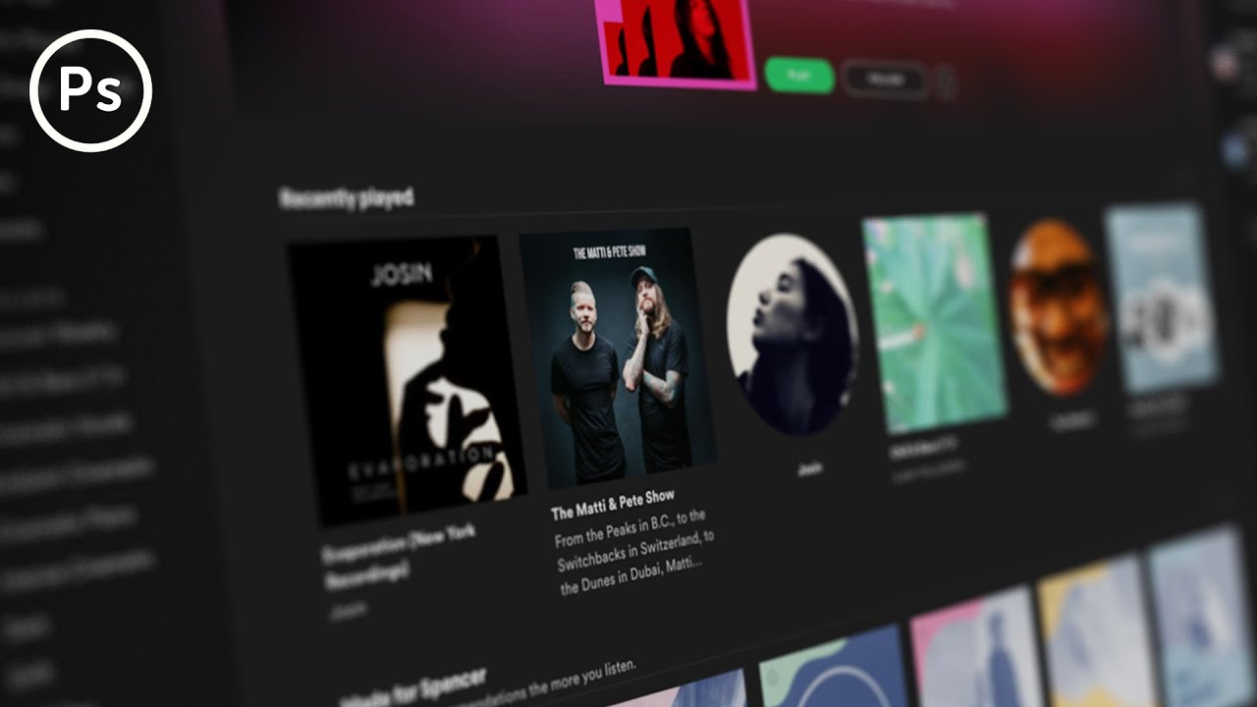
Name:Vishal C Halkodu
ID:AF0377844
Topic:Spotify Dashboard
Guide:Mr Sivakumar

Slide 2
Abstract
This study aims to analyze and present an overview of the most streamed songs on Spotify, one of the world's leading music streaming platforms.
By examining streaming data, we aim to identify trends, patterns, and key factors contributing to a song's popularity.
The dataset encompasses various genres, artists, and time periods, offering a comprehensive look at user preferences and listening habits.
Through statistical analysis and data visualization, we highlight the top-performing tracks and investigate the role of factors such as release date, genre, artist popularity, and regional variations.
The findings provide insights into the dynamics of digital music consumption and the impact of streaming services on the music industry.
This abstract serves as a precursor to a detailed exploration of the determinants of musical success in the digital age, offering valuable information for artists, producers, and marketers aiming to optimize their reach and engagement on streaming platforms.

Slide 3
Why Spotify analysis?
1. Market Insights:
- Gain a deep understanding of current music trends, popular genres, and emerging artists, helping stakeholders stay ahead in a competitive industry.
2. Artist and Label Strategy:
- Provide critical data for artists and labels to strategize releases, marketing campaigns, and promotional efforts, maximizing their reach and engagement.
3. Consumer Behavior:
- Reveal detailed insights into user listening habits and preferences, allowing for the creation of personalized recommendations and enhancing overall user experience.
4. Economic Impact:
- Assess the financial implications of streaming, including revenue generation and monetization strategies, crucial for sustaining the music industry in the digital age.
5. Regional Differences:
- Identify and understand regional variations in music popularity, enabling tailored content and marketing strategies to cater to diverse geographical markets effectively.

Slide 4
Problem Statement
Analyze the most streamed songs on Spotify using Power BI to gain insights into song popularity, artist influence, genre trends, and listening patterns over time. Create interactive visualizations to showcase total streams, artist rankings, genre distribution, and demographic preferences, enabling data-driven decision-making for stakeholders.

Slide 5
Aim
To utilize Power BI for analyzing and visualizing Spotify's top 100 most streamed songs, providing insights into song popularity, artist influence, genre trends, and listener demographics, thereby facilitating informed decision-making for music industry stakeholders.

Slide 6
Methodology
- NumPy: Provides support for efficient numerical computations and array operations.
- Pandas: Offers data manipulation and analysis tools through dataframes.
- Matplotlib: Enables creating static, interactive, and animated visualizations.
- Seaborn:*Builds on Matplotlib to provide a high-level interface for drawing attractive statistical graphics.

Slide 7
Hardware and Software Requirements
Processor: Intel Core i5 or equivalent (minimum), Intel Core i7 or higher (recommended)
RAM: 8 GB (minimum), 16 GB or more (recommended)
Storage: 256 GB SSD (minimum), 512 GB SSD or more (recommended)
Graphics: Integrated graphics for basic visualization, dedicated GPU for more intensive visualizations
Display: Full HD monitor (1920x1080 resolution) or higher
Internet Connection: Stable internet connection for downloading datasets and libraries

Slide 8
SOFTWARE REQUIREMENTS:
Operating System:
Windows 10 or higher
macOS 10.14 (Mojave) or higher
Linux (any modern distribution)
Programming Languages:
Python 3.6 or higher
Python Libraries:
pandas: For data manipulation and analysis.

Slide 9
IDE/Text Editor: Jupyter Notebook/JupyterLab (recommended for EDA) Visual Studio Code PyCharm

Slide 10
Summary
This project aims to analyze the most streamed songs on Spotify using Power BI, focusing on understanding song popularity, artist influence, genre trends, and listener demographics. By importing and transforming streaming data, we will create interactive visualizations to display total streams, artist rankings, genre distribution, and demographic insights. The resulting Power BI dashboard will provide stakeholders with actionable insights, helping them make data-driven decisions regarding marketing strategies, playlist curation, and music production.

