Slide 1

Problem
Followed traditional monolithic architecture
It became hard to scale, maintain, and upgrade their applications on physical servers

Slide 2
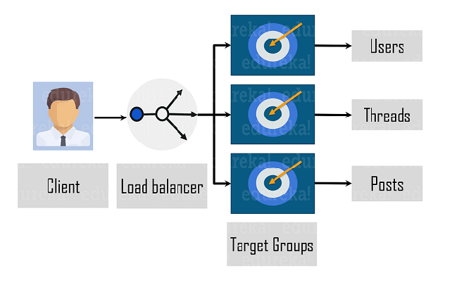
Solution:
Amazon moved from physical servers to cloud-based Amazon Web Services (AWS)
Follows a microservice architecture as shown in the figure below

Slide 3
Some of the main tools used at Amazon which implements DevOps:
Developers apply frequent but small changes over their code via version control tools like Git and GitHub.
AWS CodeDeploy is one such service that keeps track of deployments and simplifies the software release process
Amazon also uses Apollo, a simple one-click internal deployment tool. Apollo’s job is to deploy a specified set of software across a group of hosts. It also provides versioned artifacts and test rollbacks.
Configuration management and infrastructure-as-code help to monitor and make changes in the software. It keeps track of the system’s performance and resources used by developers. This way, the testing team can identify problems before in hand and fix them immediately.
These DevOps practices and implementations helped Amazon save millions of dollars!

Slide 4

Problem:
Only two software releases per year,
manual testing after of writing code
labor-intensive and tiresome work for the developers
The team needed a new approach to remove the bottleneck

Slide 5
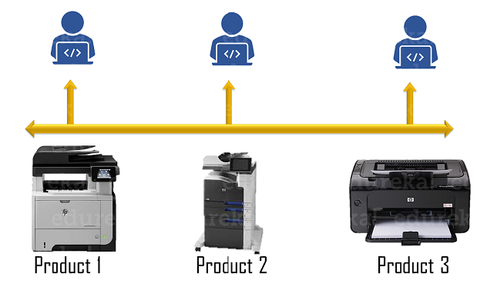
Solution:
HP team adopted Continuous Integration/Continuous Deployment (CI/CD) pipeline and test automation.
Trunk-based development or continuous integration which eliminated toil caused by the integration of different code branches.
Automated unit tests to improve product quality and inducing faster feedback.
These DevOps practices-led around 100 to 150 code commits and 75,000 to 1,00,000 lines of code changes in a single day!

