Slide 1

TakeAStand.org
Team Name : Dange Karvaoge Kya

Slide 2
Rebels with a cause
Reach out to the Right People for the Right Cause

Slide 3
WHAT WE Offer
Our mission is to empower every person and every organization on the planet to stand for what is right.
We help people help the world.
By offering a technological solution to one of the basic rights of society.
The right to protest. !

Slide 4
HOW IT WORKS
Login/Signup
Launch a Movement
Share and Collaborate
With just a few clicks, you can sign up on our platform with ease.
Once in, you’ve the support of thousand others, where your voice will be heard.
Organize a blood donation camp , or a tree plantation drive, or clean up of the cities’ beaches.
Totally up to you.
Fill up a simple form and we’re good to go.
Your call for supporters will be live. With a single link, reach out to people and share the word.
Utilise the discussion forum for a healthy conversation.
And on the D-day, make an impact!

Slide 5
Why Is This Relevant?
We live far far far away from a Utopian world.
Not just signing petitions, there is a need for driving real change
To spread unbiased awareness about local as well as global issues
Exclusivity - a dedicated, unbiased and not for profit platform

Slide 6
4.50 billion
800 Million
100%
Have access to the internet*. Even a fraction of them can change the world in a single day.
Are critically vulnerable to climate change**
The percentage of news channels that are biased***.
* https://www.conservation.org/
** https://www.statista.com/
*** my dad

Slide 7
Even the strongest blizzards start with a single snowflake.

Slide 8
Features :
Open Discussion Forum for each Event with foul language filter and polarity segregation.
Integrated Map for location details
Live update on number of registrations
Like and Dislike feature
Image gallery for each event
Markdown supported input

Slide 9
FUTURE SCOPE :
Collaboration with NGOs and Govt. organisations
Integrate a transparent crowdfunding system to support the events
Creative space for artists and individuals to showcase their skills
Follow up on a particular movement by allowing a thread of posts.
.
Add features to report inappropriate posts
Consider the legal implications of such a platform

Slide 10
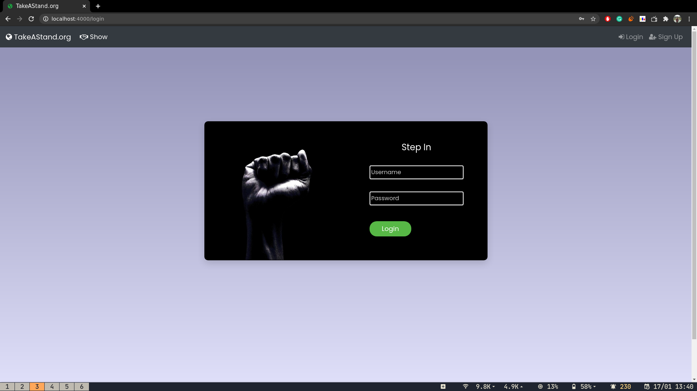
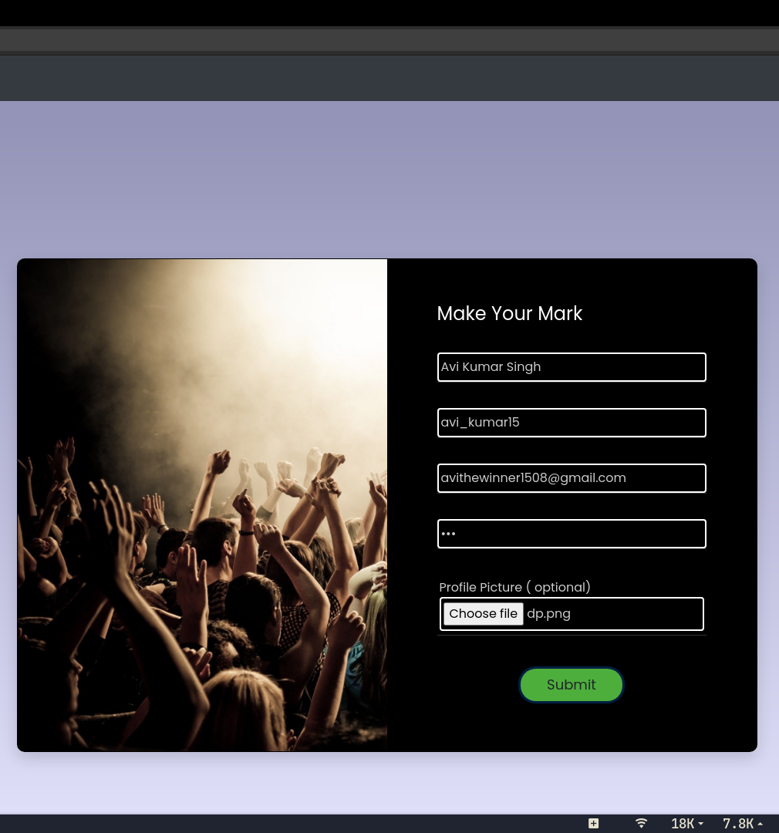
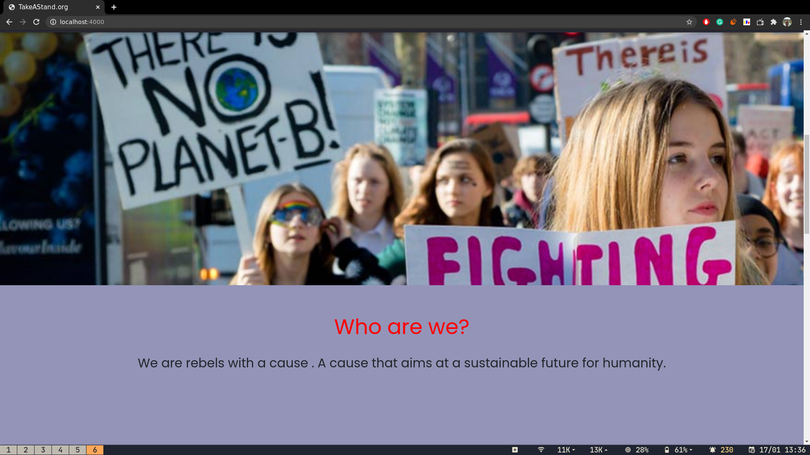
SCREENSHOTS

Slide 11
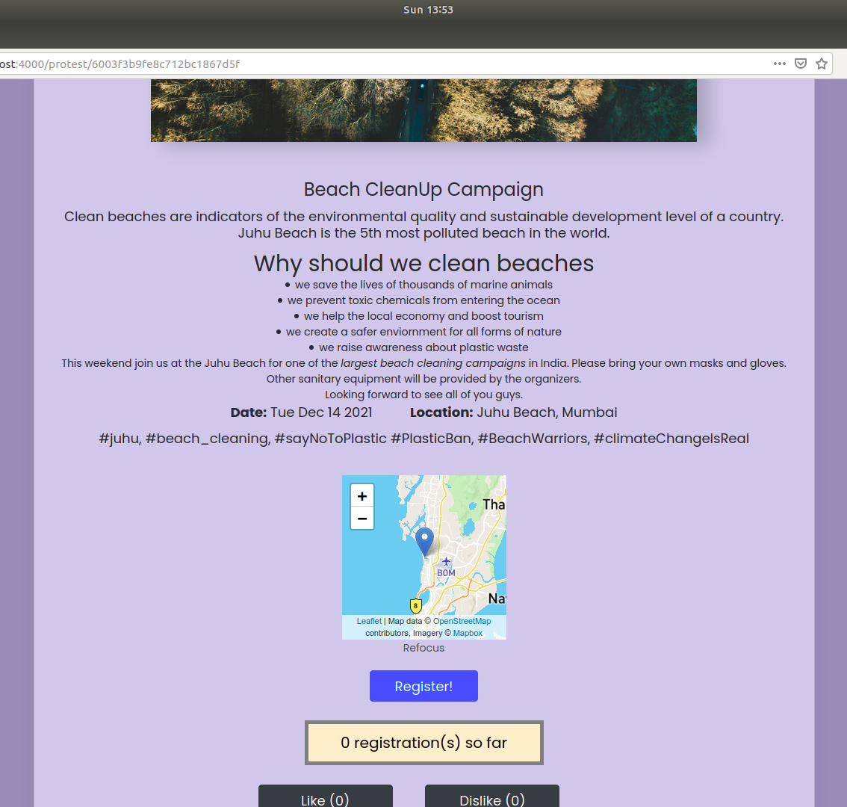
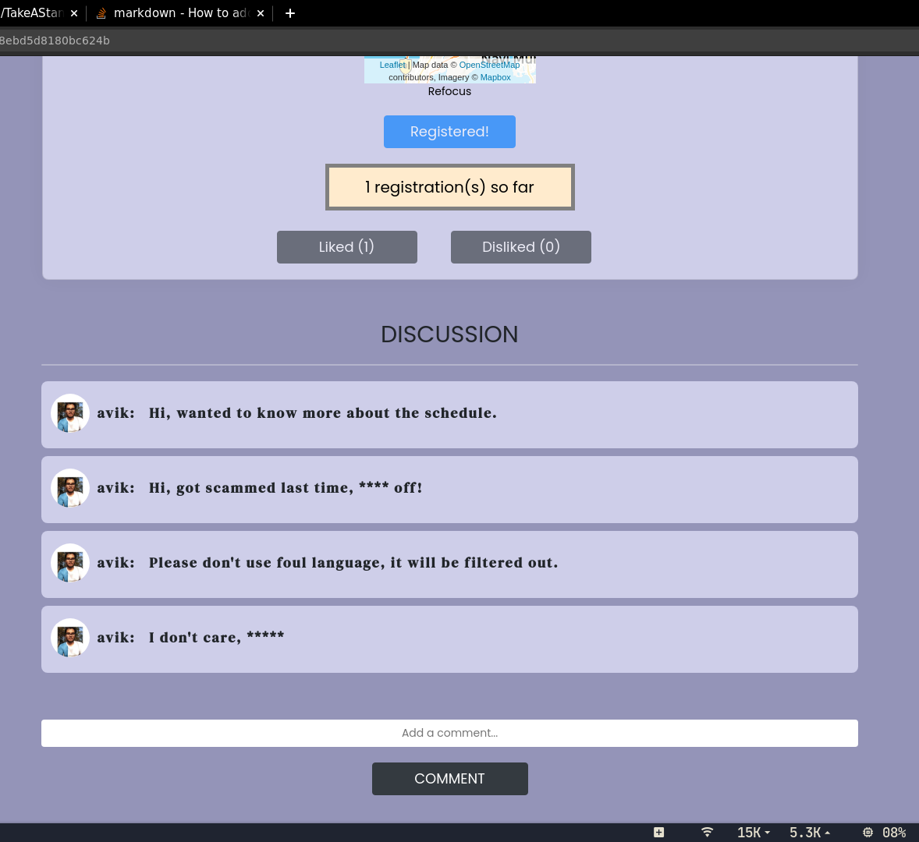

Slide 12
Nobody is Perfect! Neither are we!
Open to Questions!

