Slide 1


CARDIOCARE
AI POWERED GUARDIAN OF HEART WITH EMOTION INTELLIGENCE
Dr. Y. Nancy Jane (Mentor)
Assistant Professor
Department of Computer
Technology, MIT
Mr. M. Vijai Suria
vijaisuria04@gmail.com
6381544020
Mr. C. B. Siva Jegadeesh
chithambarampillai7@gmail.com
9524177935

Slide 2

OBJECTIVE
Develop a user-friendly chatbot and virtual assistant named "Cardiocare Bot" integrated into a mobile app.
Utilize cutting-edge emotion intelligence technology, including eye lens emotion detection and sentiment analysis of social media posts.
Provide personalized emotional well-being support to users.
Improve users' overall quality of life by safeguarding heart health and offering guidance for maintaining a healthy heart and emotional balance.
Swiftly alert and notify relatives and parents in critical situations to ensure timely interventions and support, enhancing user safety and cardiac health.

Slide 3
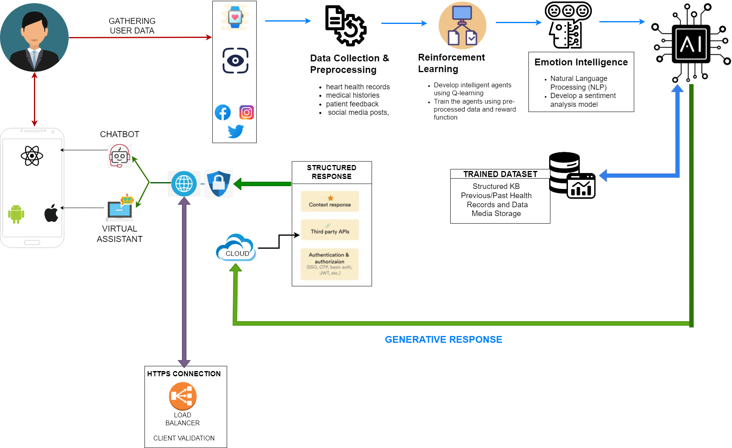
WORKPLAN

Slide 4
EXPECTED DELIVERABLES AND
SOCIETAL RELEVANCE
Accurate Heart Disease Detection
Personalized Recommendations
Emotional Well-being Assessment
Cost-Effective Healthcare Management
Improved User Engagement and Adherence
Timely Emergency Notifications
Enhanced Heart Health Awareness
User-Friendly Mobile Application

Slide 5

HEAD | AMOUNT (Rs.) | REASON
Material / Fabrication / Component | 12000 | Sensors, cameras, hardware
Travel | 3000 | Meetings, conferences, research
Contingency | 3000 | Unforeseen expenses
Consumables | 1000 | batteries, testing materials, calibration tools,
Others | 6000 | IEEE Paper Publishing Fee
PROPOSED BUDGET

Slide 6
CARDIOCARE BOT: AI POWERED GUARDIAN OF HEART
WITH EMOTION INTELLIGENCE
THANK YOU!
Student's Innovative Project

Slide 7
REFERENCES
[1] G. Joo, Y. Song, H. Im and J. Park, "Clinical Implication of Machine Learning in
Predicting the Occurrence of Cardiovascular Disease Using Big Data (Nationwide Cohort
Data in Korea)," in IEEE Access, vol. 8, pp. 157643-157653, 2020, doi:
10.1109/ACCESS.2020.3015757.
[2] J. Wang et al., "A Stacking-Based Model for Non-Invasive Detection of Coronary
Heart Disease," in IEEE Access, vol. 8, pp. 37124-37133, 2020, doi:
10.1109/ACCESS.2020.2975377.
[3] S. J. Pasha and E. S. Mohamed, "Novel Feature Reduction (NFR) Model With
Machine Learning and Data Mining Algorithms for Effective Disease Risk Prediction,"
in IEEE Access, vol. 8, pp. 184087-184108, 2020, doi: 10.1109/ACCESS.2020.3028714.

Slide 8
REFERENCES
[4] A. Abdellatif, H. Abdellatef, J. Kanesan, C. -O. Chow, J. H. Chuah and H. M. Gheni,
"An Effective Heart Disease Detection and Severity Level Classification Model Using
Machine Learning and Hyperparameter Optimization Methods," in IEEE Access, vol. 10,
pp. 79974-79985, 2022, doi: 10.1109/ACCESS.2022.3191669
[5] M. Z. M. Shamim, S. Alotaibi, H. S. Hussein, M. Farrag and M. Shiblee, "Diagnostic
Accuracy of Smartphone-Connected Electrophysiological Biosensors for Prediction of
Blood Glucose Level in a Type-2 Diabetic Patient Using Machine Learning: A Pilot
Study," in IEEE Embedded Systems Letters, vol. 14, no. 1, pp. 27-30, March 2022,
doi: 10.1109/LES.2021.3096717.
[6] R. Kapila, T. Ragunathan, S. Saleti, T. J. Lakshmi and M. W. Ahmad, "Heart Disease Prediction
Using Novel Quine McCluskey Binary Classifier (QMBC)," in IEEE Access, vol. 11, pp. 64324-64347, 2023,
doi: 10.1109/ACCESS.2023.3289584

Slide 9
REFERENCES
[7] C. Chakraborty and A. Kishor, "Real-Time Cloud-Based Patient-Centric Monitoring Using Computational Health Systems," in IEEE Transactions on Computational Social Systems, vol. 9, no. 6, pp. 1613-1623, Dec. 2022, doi: 10.1109/TCSS.2022.3170375.
[8] P. Yevtushenko et al., "Deep Learning Based Centerline-Aggregated Aortic Hemodynamics: An Efficient Alternative to Numerical Modeling of Hemodynamics,” in IEEE Journal of Biomedical and Health Informatics, vol. 26, no. 4, pp. 1815-1825, April 2022, doi: 10.1109/JBHI.2021.3116764.
[9] B. Y. Al-Mualemi and L. Lu, "A Deep Learning-Based Sepsis Estimation Scheme,” in IEEE Access, vol. 9, pp. 5442-5452, 2021, doi: 10.1109/ACCESS.2020.3043732.
[10] L. D. Sharma and A. Bhattacharyya, "A Computerized Approach for Automatic Human Emotion Recognition Using Sliding Mode Singular Spectrum Analysis," in IEEE Sensors Journal, vol. 21, no. 23, pp. 26931-26940, 1 Dec.1, 2021, doi: 10.1109/JSEN.2021.3120787

