Slide 1

is a process of decomposing ‘unsatisfactory’ relations to smaller relations.
Normalization helps eliminate redundancy.
organizes data efficiently and reduces potential anomalies during data operations (insertion, updating and deletion operations)
Normalization provides rules which we can use to analyse and evaluate the design of a relational database.
Once the ER diagram is mapped to a Relational Schema, it is necessary to normalize the relations using the Normalization process.
A formal process for deciding which attributes should be grouped together in a relation.
Primarily a tool to validate and improve a logical design so that it satisfies certain constraints that avoid unnecessary duplication of data.
The process of decomposing relations with anomalies to produce smaller, well-structured relations.
In the relational model, methods exist for quantifying how efficient a database is. These classifications are called normal forms (or NF), and there are algorithms for converting a given database between them.
Normalization generally involves splitting existing tables into multiple ones, which must be re-joined or linked each time a query is issued.

Slide 2
Constraints……………???
Relational Model Constraints
The various types of constraint that can be specified on a relational database schema includes:
Domain constraints
Key constraints
Entity integrity constraints
Referential integrity constraints

Slide 3
Domain constraint
Domain constraints specify that the value of each attribute must be atomic.
Key constraint
No two tuples can have the same combination of values for all their attributes.

Slide 4
Entity Integrity Constraint
This constraint states that no primary key value can be null. This is because the primary key value is used to identify individual tuples in a relation.

Slide 5
Referential Integrity Constraints
A tuple in one relation that refers to another relation must refer to an existing tuple in that relation.
For example:
The attribute Dnum of employee gives the department for which each employee work. Therefore, its value in every employee tuple must match Dno value in some tuple in the department relation.

Slide 6
Department
Employee
FK
Dno | Dname
1 | Admin
2 | Accounts
3 | Marketing
Eno | Ename | Dnum
100 | Perera | 2
200 | Silva | 1
300 | Yapa | 4
Violating the referential
integrity constraint

Slide 7
ANOMALIES
Well-Structured Relations
A relation that contains minimal data redundancy and allows users to insert, delete, and update rows without causing data inconsistencies.
Goal is to avoid anomalies
Insertion Anomaly–adding new rows forces user to create duplicate data
Deletion Anomaly–deleting rows may cause a loss of data that would be needed for other future rows
Modification Anomaly–changing data in a row forces changes to other rows because of duplication
General rule of thumb: A table should not pertain to more than one entity type

Slide 8
Example
Supplier
S# | Status | City | P# | Qty
S1 | 20 | Colombo | P1 | 200
S1 | 20 | Colombo | P2 | 100
S1 | 20 | Colombo | P3 | 500
S2 | 10 | Kandy | P2 | 300
S3 | 10 | Kandy | P1 | 100
S3 | 10 | Kandy | P2 | 500
S4 | 20 | Colombo | P3 | 400
S5 | 30 | Galle | P2 | 200
Decompose the table ‘Supplier’ into 1NF relations.

Slide 9
Supplier1
Supplier2
S# | Status | City
S1 | 20 | Colombo
S2 | 10 | Kandy
S3 | 10 | Kandy
S4 | 20 | Colombo
S5 | 30 | Galle
S# | P# | Qty
S1 | P1 | 200
S1 | P2 | 100
S1 | P3 | 500
S2 | P2 | 300
S3 | P1 | 100
S3 | P2 | 500
S4 | P3 | 400
S5 | P2 | 200

Slide 10
Data operations anomalies in the above tables:
Insert –
We cannot insert the fact that a particular city has a particular status until we have a supplier located in that city.
Eg: If we need to insert that Kurunagala has the status 40, we need a supplier from Kurunagala.

Slide 11
Delete –
We cannot delete supplier details without deleting details about a status of a city.
Eg: If we need to delete the supplier S5, then we lose the information that Galle has a status 30.

Slide 12
Update –
Status of a city is repeated several times in the table Supplier 1. Therefore, if we need to change the status of a particular city, we need to change it in several places.

Slide 13
Objectives of normalization
Provide a better design
Make it easy to maintain data
Simplify the enforcement of referential integrity constraint
Minimize data redundancy, avoiding anomalies and conserving storage space
1
2
3
4

Slide 14
Benefits of Normalization
Less storage space
Quicker updates
Less data inconsistency
Clearer data relationships
Easier to add data
Flexible Structure

Slide 15
Determinant
Definitions
Determinant: The attribute on the left-hand side of the arrow in a functional dependency.
A primary key is always a determinant,
while a determinant may or may not be
a primary key.

Slide 16
Functional dependency
Functional dependency is a particular relationship between two attributes or two sets of attributes: The value of one attribute (the determinant) determines the value of other attributes.
In a given table, an attribute Y is said to have a functional dependency on a set of attributes X (written X → Y) if and only if each X value (the determinant) is associated with precisely one Y value(determines the value of Y)/ If the value of ‘X’ at all times determines the value for ‘Y’.
For any relation R, the attribute Y is functionally dependent on Z if for every instance of Z, that value of Z uniquely determines the value of Y.
For example, in an "Employee" table that includes the attributes "Employee ID" and "Employee Date of Birth", the functional dependency {Employee ID} → {Employee Date of Birth} would hold. It follows from the previous two sentences that each {Employee ID} is associated with precisely one {Employee Date of Birth}.
Normalization is based on the analysis of functional dependency.

Slide 17
Full functional dependency
An attribute is fully functionally dependent on a set of attributes X if it’s: functionally dependent on X, and not functionally dependent on any proper subset of X. {Employee Address} has a functional dependency on {Employee ID, Skill}, but not a full functional dependency, because it is also dependent on {Employee ID}.
‘Y’ is fully functionally dependent on ‘Z’, if it is functionally dependent on ‘Z’ and not functionally dependent on any part of ‘Z’.
Example:
If {Sno, Pno} -> Qty
part of A part of A
A
2 NF is based on the concept of full functional dependency.
A relational schema ‘R’ is in 2 NF if every non-key attribute A in ‘R’ is fully functionally dependent on the primary key of ‘R’.
Example: Non key attributes (A)
Student (Sno, sname, marks)
Key attribute
R

Slide 18
Trivial functional dependency
A trivial functional dependency is a functional dependency of an attribute on a superset of itself. {Employee ID, Employee Address} → {Employee Address} is trivial, as is {Employee Address} → {Employee Address}.
Transitive dependency
A transitive dependency is an indirect functional dependency, one in which X→Z only by virtue of X→Y and Y→Z.
Multivalued dependency
A multivalued dependency is a constraint according to which the presence of certain rows in a table implies the presence of certain other rows.
Join dependency
A table T is subject to a join dependency if T can always be recreated by joining multiple tables each having a subset of the attributes of T.

Slide 19
Normalization works through a series of stages called normal forms:
First normal form (1NF)
Second normal form (2NF)
Third normal form (3NF)
Boyce Codd Normal Form(BCNF)
The highest level of normalization is not always desirable.

Slide 20
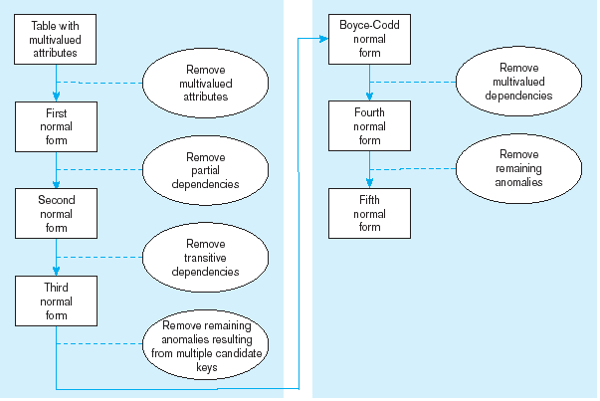
Steps in Normalization

Slide 21
Table -1(books)
Example -1
(Repetition of Author)
Title | Author1 | Author2 | ISBN | Subject | Pages | Publisher
Database System Concepts | Abraham Silberschatz | Henry F. Korth | 0072958863 | MySQL , Computers | 1168 | McGraw-Hill
Operating System Concepts | Abraham Silberschatz | Henry F. Korth | 0471694665 | Computers | 944 | McGraw-Hill
(Multiple Values for a single CELL)

Slide 22
Table 1 problems
1.This table is not very efficient with storage.
2.This design does not protect data integrity.
3.Third, this table does not scale well.

Slide 23
1.First Normal Form
In our Table 1(books), we have two violations of First Normal Form:
First- we have more than one author field.
Second- our subject field contains more than one piece of information. With more than one value in a single field, it would be very difficult to search for all books on a given subject.

Slide 24
Characteristics of 1st Normal Form
Relational Schema
Must first fulfill the requirements to be in First Normal Form
No multi Valued attributes(Disallows composite attributes that are them selves multivalued- nested relations).
No Repeating groups.
Every attribute Value is Atomic(simple & Indivisible).
Can’t include several values for a single cell.
No repetition of the same column name.
Primary key has been defined.
All the key attributes are defined.
All attributes are dependent on the primary key.
Deals with redundancy of data across a horizontal row.
1st Normal Form

Slide 25
First Normal Form –Table-1(books)
After Considering the characteristics of 1st NF for the table 1,
Title | Author | ISBN | Subject | Pages | Publisher
Database System Concepts | Abraham Silberschatz | 0072958863 | MySQL | 1168 | McGraw-Hill
Database System Concepts | Henry F. Korth | 0072958863 | Computers | 1168 | McGraw-Hill
Operating System Concepts | Henry F. Korth | 0471694665 | Computers | 944 | McGraw-Hill
Operating System Concepts | Abraham Silberschatz | 0471694665 | Computers | 944 | McGraw-Hill
(No Repetition of Author)
(No Multiple values in a single CELL)

Slide 26
Here we have a one-to-many relationship between the book table and the publisher. A book has only one publisher, and a publisher will publish many books. When we have a one-to-many relationship, we place a foreign key in the Book Table, pointing to the primary key of the Publisher Table.

Slide 27
Dependency Diagram- Example 1-Table -1

Slide 28
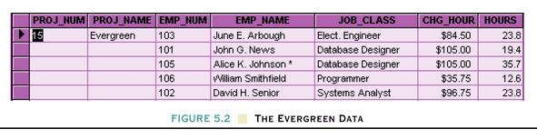
Table - 2
Example -2

Slide 29
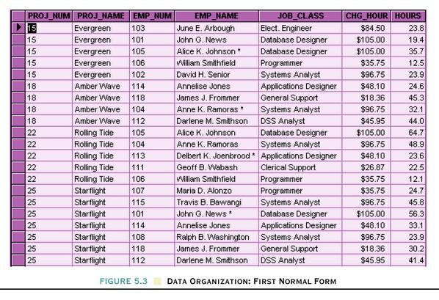
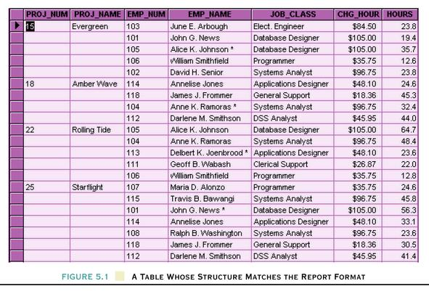
After Considering the characteristics of 1st NF for the table - 2, First Normal Form –Table-2
After
Before

Slide 30
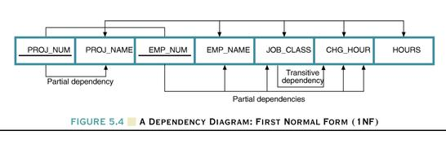
Dependency Diagram- Example 2-Table -2
The primary key components are bold, underlined, and shaded in a different color.
The arrows above entities indicate all desirable dependencies, i.e., dependencies that are based on PK.
The arrows below the dependency diagram indicate less desirable dependencies -- partial dependencies and transitive dependencies.

Slide 31
Example -3
Table - 3
Supplier { Eno, Ename, { Pno, hours} }
This relation Supplier is an example of a nested relation. Such relations are said to be un-normalized. In order to represent the information in a relational model, normalization must be carried out. This is done by removing the repeating groups.

Slide 32
Emp_proj
Eno | Ename | Project
 |  | Pno | Hours
100 | Nimal | 4 | 100
100 | Nimal | 7 | 40
100 | Nimal | 2 | 150
200 | Sunil | 2 | 100
200 | Sunil | 1 | 55
Repeating groups of data
Emp_proj1
Emp_proj2
Eno
Ename
Eno
Pno
Hours

Slide 33
Example 4
Table - 4
Department
Dno | Dname | managerEno | Dloc
1 | HQ | 100 | Colombo
2 | Marketing | 200 | Colombo Kandy
3 | Reserach | 300 | Galle Gampaha N’eliya

Slide 34
As this relation contains multi valued attributes, it is not in 1 NF. Therefore, break the table into two tables.
Dept_1
Dno
Dname
ManagerEno
Dept_2
Dno
Dloc

Slide 35
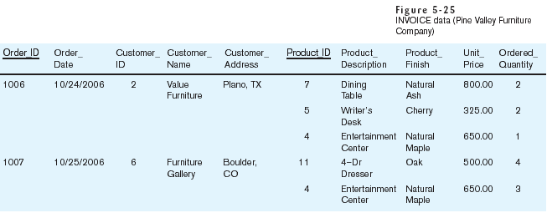
Example 5
Table - 5
Table with multivalued attributes, not in 1st normal form
Note: this is NOT a relation

Slide 36
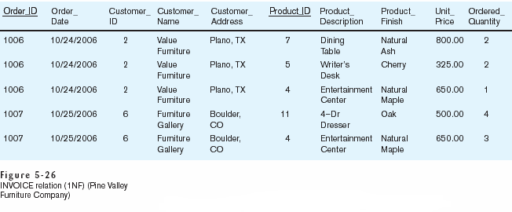
Table with no multivalued attributes and unique rows, in 1st normal form
Note: this is relation, but not a well-structured one

Slide 37
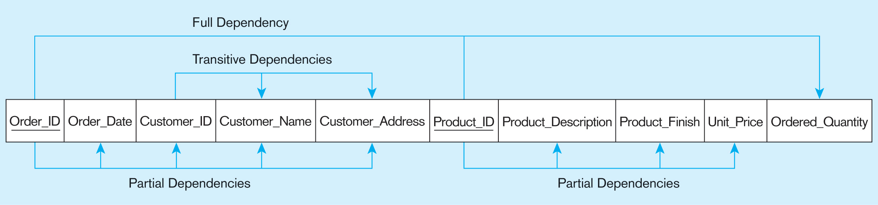
Functional dependency for invoice

Slide 38
Characteristics of 2nd Normal Form
Based on full Functional Dependency.
Therefore Includes No Partial Dependencies.( no attribute is dependent on only a portion of the primary key./-a non key attribute is functionally dependent on part of the primary key)
Deals with redundancy of data in vertical columns.
Cannot have any data in a table with a composite key that does not relate to all portions of the composite key.
It is still possible for a table in 2NF to exhibit transitive dependency; that is, one or more attributes may be functionally dependent on non key attributes.
1NF PLUS every non-key attribute is fully functionally dependent on the ENTIRE primary key
Every non-key attribute must be defined by the entire key, not by only part of the key
1st Normal Form
2nd Normal Form

Slide 39
Convert to 2NF
Create a new relation for each primary key attribute that is a determinant in a partial dependency. That attribute is the primary key in the new relation.
Move the non key attributes that are dependent on this primary key from the old relation to the new relation.

Slide 40
Continue with example - 1 table - 1
After converting table -1 to 1st Normal Form………
We now have two rows for a single book. Additionally, we would be violating the Second Normal Form…
A better solution to our problem would be to separate the data into separate tables- an Author table and a Subject table to store our information, removing that information from the Book table:

Slide 41
Subject Table
Subject_ID | Subject
1 | MySQL
2 | Computers
Author Table
Author_ID | Last Name | First Name
1 | Silberschatz | Abraham
2 | Korth | Henry
Book Table
ISBN | Title | Pages | Publisher
0072958863 | Database System Concepts | 1168 | McGraw-Hill
0471694665 | Operating System Concepts | 944 | McGraw-Hill

Slide 42
Each table has a primary key, used for joining tables together when querying the data. A primary key value must be unique with in the table (no two books can have the same ISBN number), and a primary key is also an index, which speeds up data retrieval based on the primary key.
Now to define relationships between the tables.

Slide 43
Relationships
Book_Author Table
Book_Subject Table
ISBN | Author_ID
0072958863 | 1
0072958863 | 2
0471694665 | 1
0471694665 | 2
ISBN | Subject_ID
0072958863 | 1
0072958863 | 2
0471694665 | 2

Slide 44
After Considering the characteristics of 2nd ^{t} NF for the table 1- already in1st NF, Second Normal Form –Table-1
Publisher Table
Publisher_ID | Publisher Name
1 | McGraw-Hill
Book Table
ISBN | Title | Pages | Publisher_ID
0072958863 | Database System Concepts | 1168 | 1
0471694665 | Operating System Concepts | 944 | 1

Slide 45
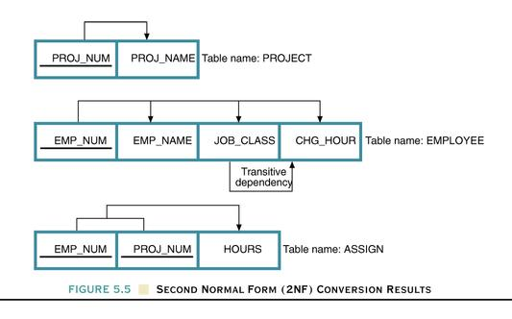
Dependency Diagram- Example 2-Table -2

Slide 46
Example 1
Items (Invno, Ino, Iname, Invdate, Qty)
Suppose the PK is {Invo, Ino} and:
If Invno can be used to find Invdate
If Ino can be used to find Iname
If Invo and Ino can be used to find Qty.

Slide 47
Items
Invno | Ino | Iname | Invdate | Qty
Since non-key attributes Iname and Invdate are not fully functionally dependent on the PK, this relation is not in 2 NF.

Slide 48
Break the relation Items into three relations:
Item1 (Invno, Invdate)
Item2 (Ino, Iname)
Item3 (Invno, Ino, Qty)

Slide 49
Example 2
Emp_proj
Eno | Pno | Hours | Ename | Pname | Ploc
Is this relation in 2NF? If not what is the reason?

Slide 50
Example 3
Consider the relation Supplier = {Sno, Pno, Sname, City, Status, Pname, Qty} and the functional dependencies:
{Sno, Pno} -> {Qty}
{Sno} -> {Sname, City}
{Pno} -> {Pname}
{City} ->{Status}
Assume that the primary key of Supplier is {Sno, Pno}. Decompose R in to 2NF relations.

Slide 51
Supplier1
Sno | Sname | City | Status
Supplier2
Sno | Pno | Qty
Supplier3
Pno | Pname

Slide 52
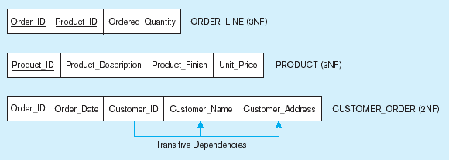
Figure 5-28 Removing partial dependencies
Getting it into Second Normal Form
Partial dependencies are removed, but there are still transitive dependencies

