Slide 1


Ev Prediction/Charging Demand Prediction
Name: Vijay Vengatesan
AICTE STUDENT ID: STU68320c847ea121748110468

Slide 2

Learning Objectives
Understand real-world EV adoption patterns using county-level data.
Apply feature engineering on time-series data (lags, rolling mean, growth).
Build and deploy forecasting models using regression techniques.
Develop an interactive dashboard using Streamlit.
Visualize and compare historical vs. forecasted EV trends.
Analyze and communicate 3-year EV adoption growth across counties.
Deliver a complete end-to-end data science solution for real-world impact.
GOAL
Source :
www.freepik.com/

Slide 3
Tools and Technology used
Python – Core programming language for data processing and modeling
Pandas & NumPy – Data manipulation and numerical operations
Matplotlib – Data visualization for historical and forecasted trends
Scikit-learn – Machine learning model development and evaluation
Joblib – Model serialization and loading
Streamlit – Building the interactive web-based dashboard
Jupyter Notebook – Data exploration, preprocessing, and model training
CSV Files – Storage of historical EV adoption data

Slide 4
Methodology
Data Collection:
Gathered county-level EV adoption data.
Preprocessing:
Cleaned data, formatted dates, handled missing values.
Feature Engineering:
Created lags, rolling means, % changes, and growth slopes.
Model Building:
Trained regression model using scikit-learn.
Forecasting:
Predicted EV adoption for the next 3.5 years (42 months).
Visualization:
Plotted trends using matplotlib in a Streamlit dashboard.
Deployment:
Built an interactive web app for real-time county-level forecasting.

Slide 5
Problem Statement:
Despite the growing importance of electric vehicles (EVs) in addressing environmental and energy challenges, many local governments and stakeholders lack tools to accurately forecast EV adoption at the county level. This hinders strategic planning for infrastructure, policy, and investment.
Objective: To develop a machine learning–based forecasting tool that predicts EV adoption trends for the next 3.5 years across counties in Washington State, enabling data-driven planning through an interactive Streamlit dashboard.

Slide 6
Solution:
Developed an interactive forecasting tool that uses historical EV adoption data and machine learning to:
Predict EV growth for the next 3.5 years at the county level
Leverage regression models with engineered time-series features
Provide an easy-to-use Streamlit dashboard for visualization and comparison
Support data-driven planning for policymakers, urban planners, and stakeholders
This solution enables accurate forecasting, intuitive exploration, and informed decision-making for EV infrastructure and policy development.
Github Link:github.com/vijay-1253/Ev_Vehicle_Adaption_AICTEInternship/tree/main/Edunet_Shell

Slide 7
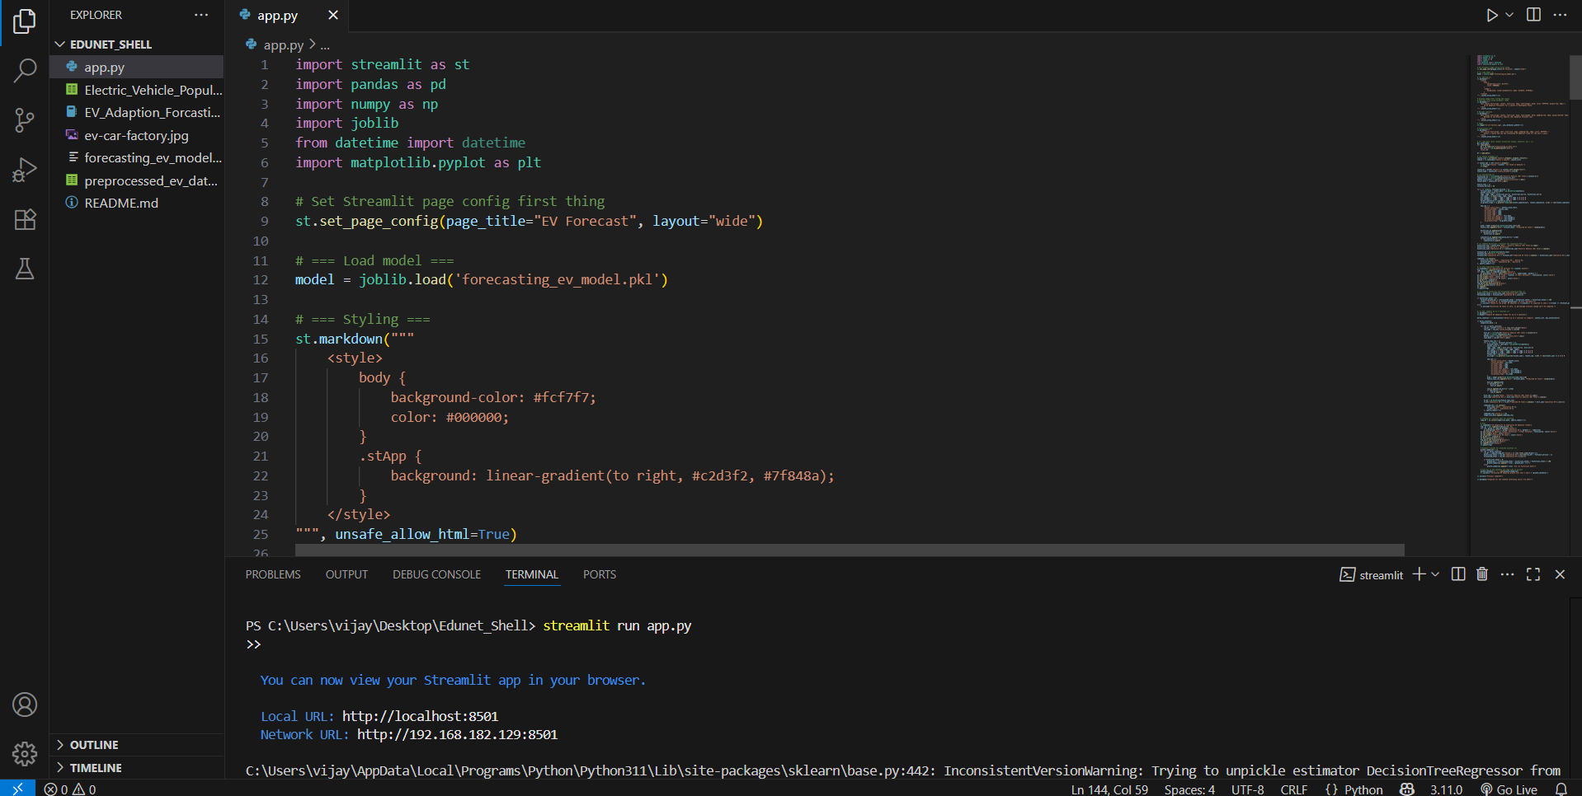
Screenshot of Output:

Slide 8
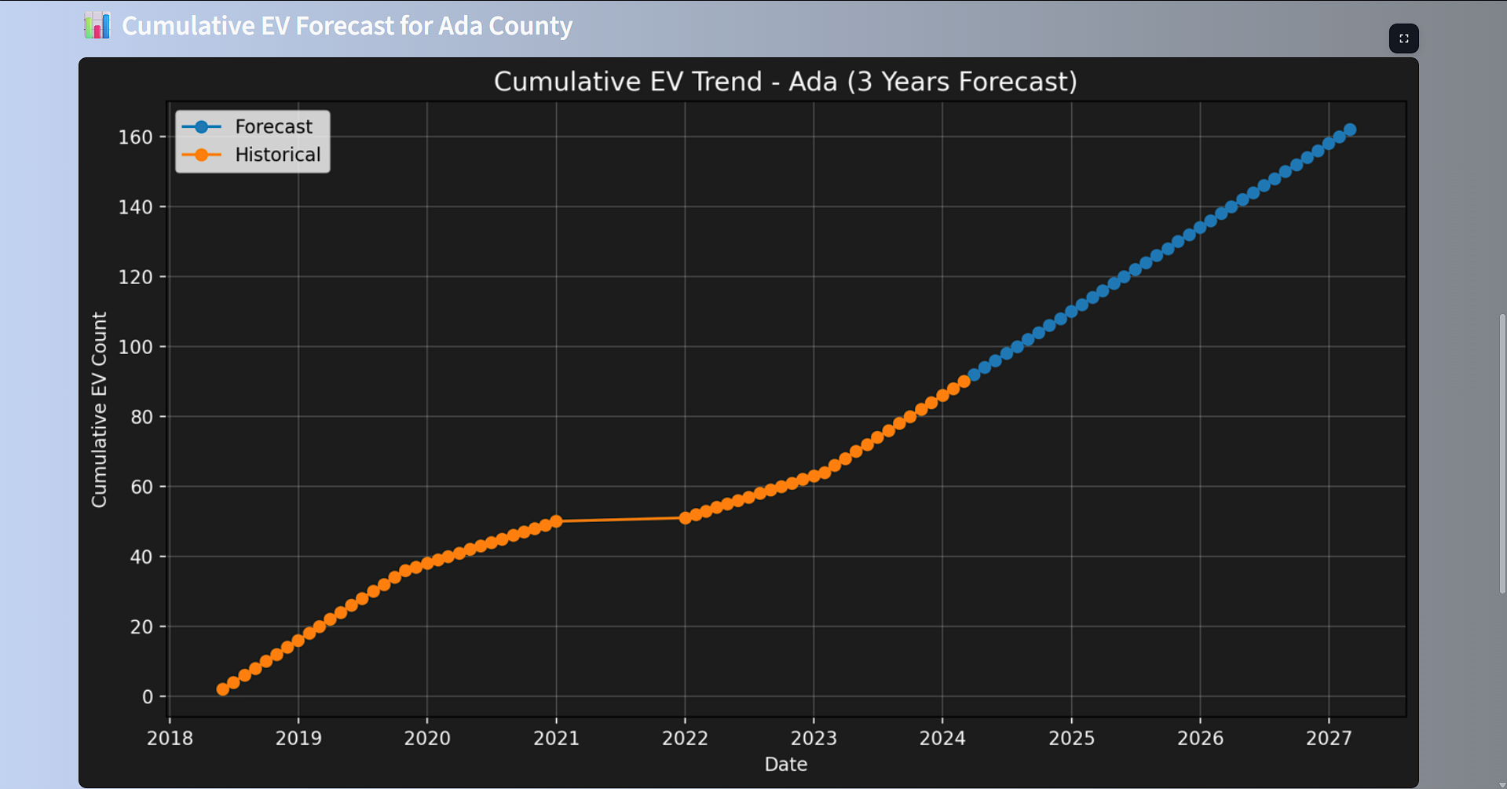
Screenshot of Output:

Slide 9
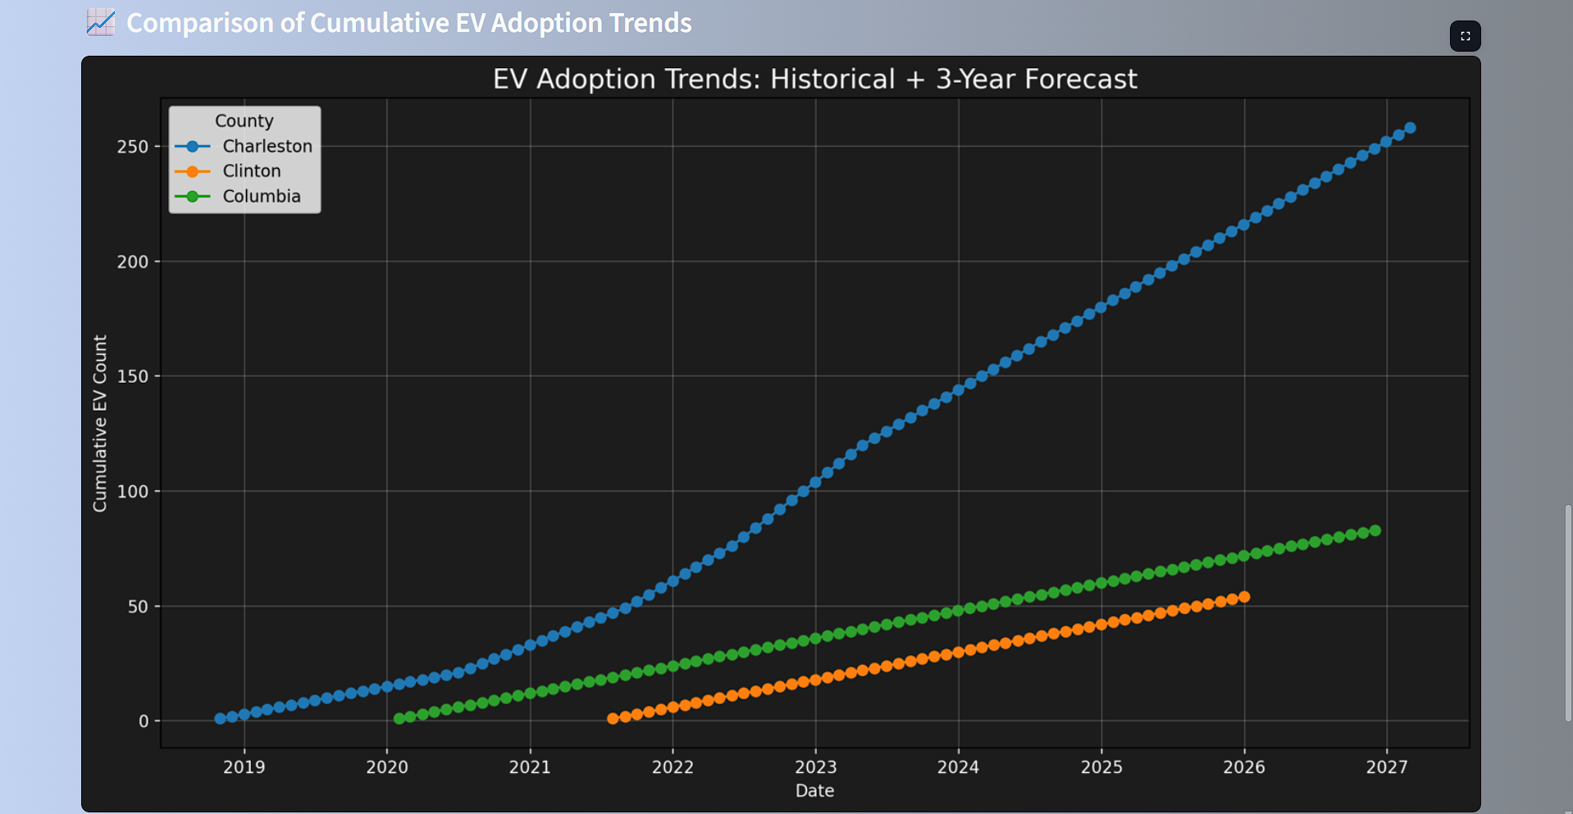
Screenshot of Output:

Slide 10
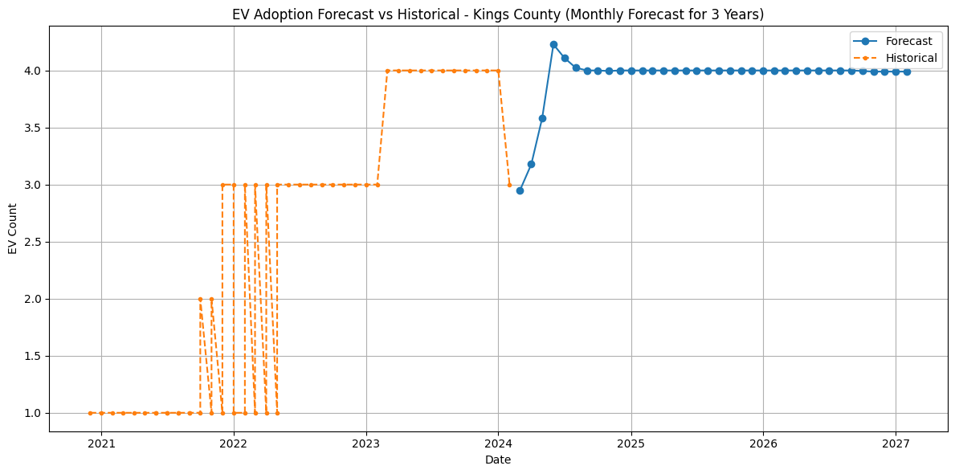
Screenshot of Output:

Slide 11
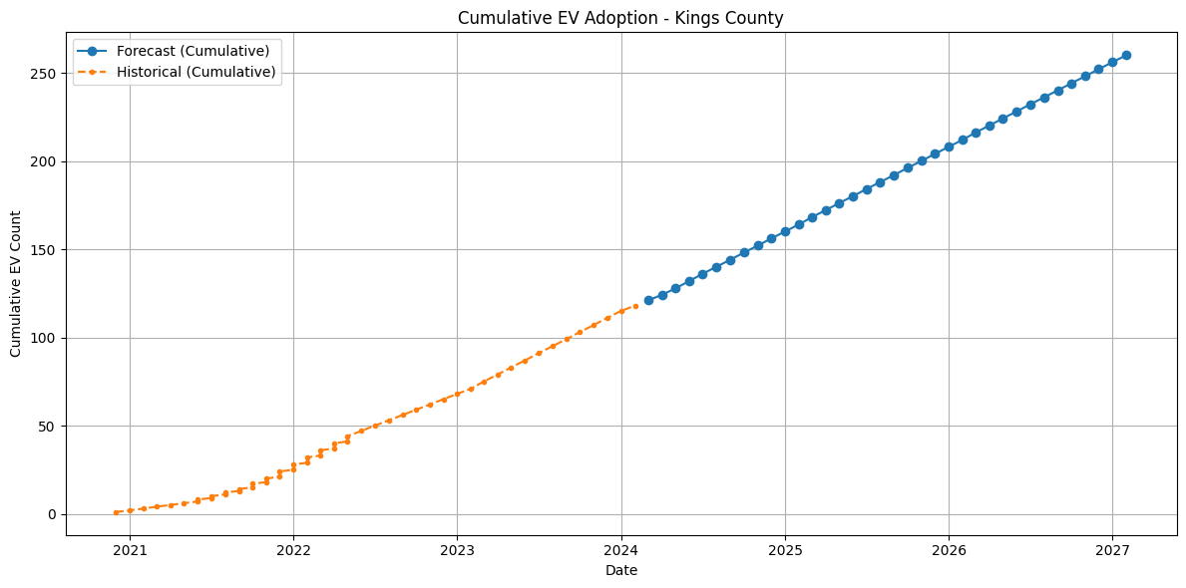
Screenshot of Output:

Slide 12
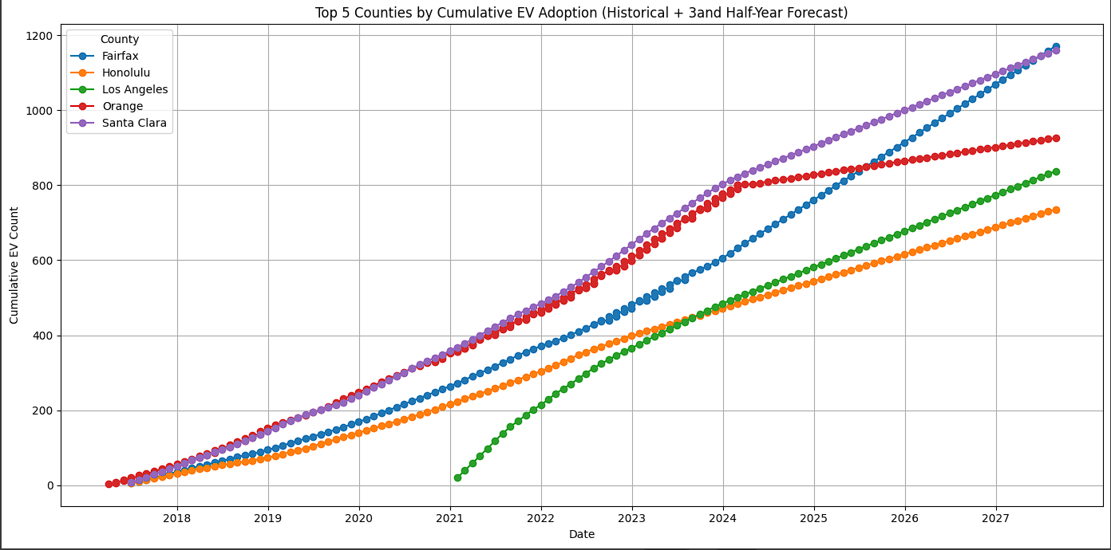
Screenshot of Output:

Slide 13
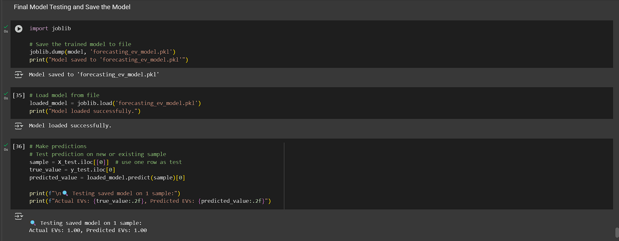
Screenshot of Output:
This is the Predicted output of the model

Slide 14
Conclusion:
The project successfully delivers a machine learning–based forecasting tool for predicting EV adoption at the county level over the next 3.5 years.
By combining data preprocessing, feature engineering, and interactive visualization, the tool enables clear insights into future EV trends.
The Streamlit dashboard empowers users to explore and compare adoption patterns across counties, supporting informed decision-making.
This solution contributes toward sustainable transportation planning and promotes the scalable adoption of electric vehicles.

