Slide 1

Project Title – Seasonal Agriculture Performance Analysis
Student Name- Kayala Hima Naga Mani Vijay
College Name- Chebrolu Engineering College , Guntur , Andhra Pradesh.
AICTE STU ID : (STU68b535f90713a1756706297)

Slide 2

PROBLEM STATEMENT
Agricultural activities are influenced by seasonal variations in environmental conditions, farming practices, resource availability and market conditions. As a result, agricultural performance may differ from one season to another. However, raw agricultural data does not clearly explain how agricultural performance changes across seasons or what patterns can be observed in different seasonal conditions. The problem is to analyze the given agricultural dataset and investigate seasonal differences in agricultural performance by identifying meaningful patterns, trends, relationships and variations within the available data.

Slide 3
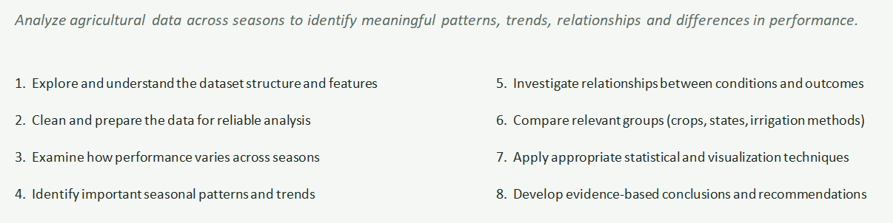
Project Description

Slide 4

WHO ARE THE END USERS?
1)Farmers
Use seasonal performance insights to plan sowing.
Select suitable irrigation and farming practices.
Manage resources according to seasonal conditions.
Reduce crop losses and improve profitability.
2)Policy Planners / Government Agencies
Use data-driven insights for agricultural planning.
Identify high-risk seasons and regions.
Develop season-specific agricultural support programs.
3)Irrigation & Water Management Bodies
Identify inefficient irrigation practices.
Promote drip irrigation and improve water-use efficiency.
Allocate water resources according to seasonal requirements.
4)Agri-Businesses & Lenders
Assess seasonal agricultural risks.
Support decisions related to credit, insurance and farming contracts.
Evaluate profitability a

Slide 5

Technology Used
Python – Main programming language for data analysis.
Pandas – Data cleaning, manipulation, grouping, and analysis.
NumPy – Numerical computations and data processing.
Jupyter Notebook – Developing and documenting the complete analytical workflow.
Matplotlib – Creating data visualizations and charts.
Seaborn – Visualizing seasonal patterns and relationships.
Statistical Analysis – Correlation, grouping, and comparison techniques.

Slide 6
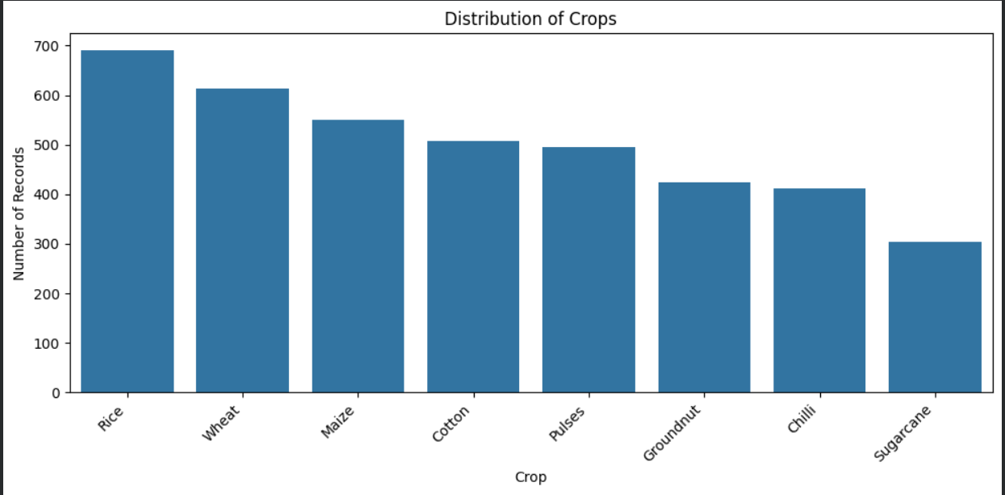
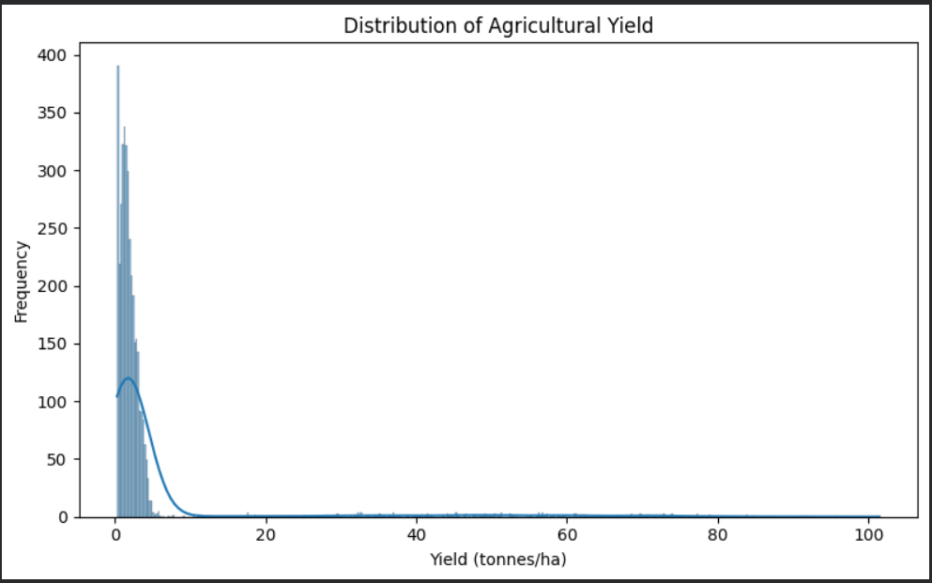
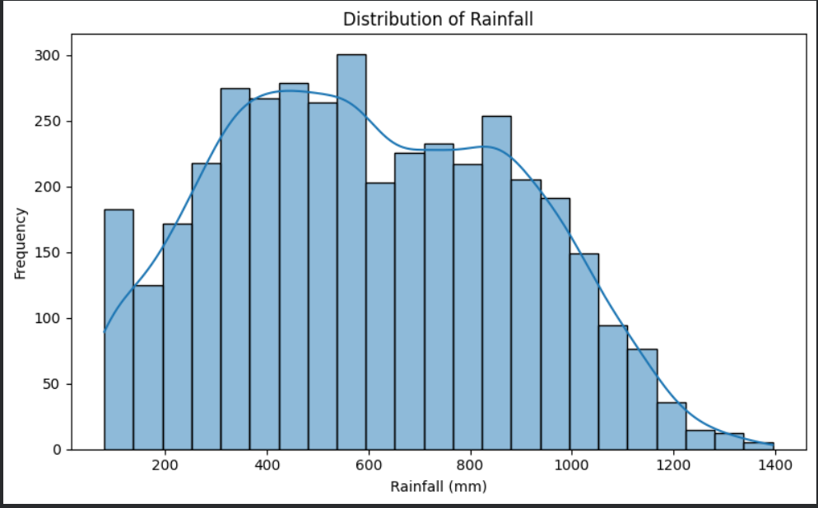
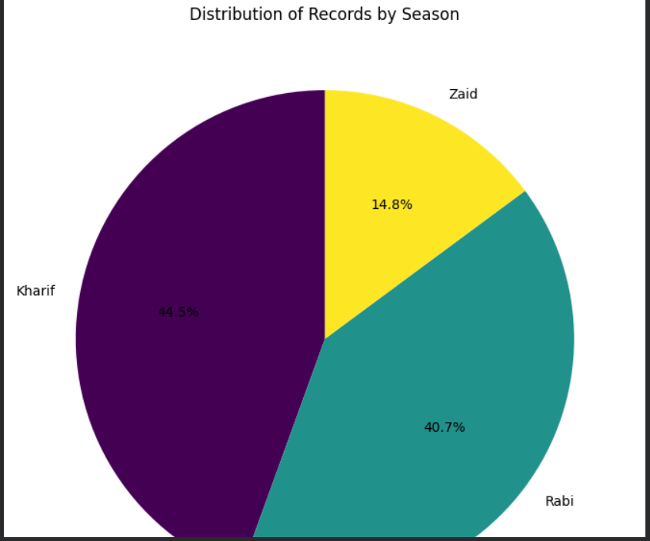
RESULTS
[Add screen shots of your code ]

Slide 7
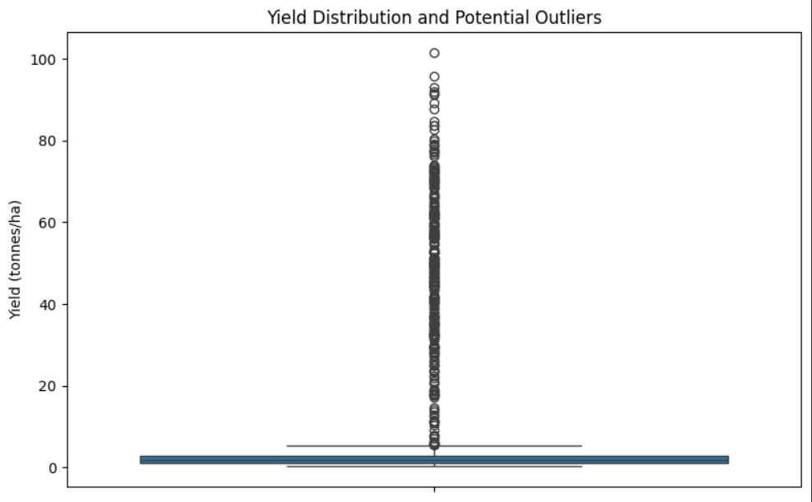
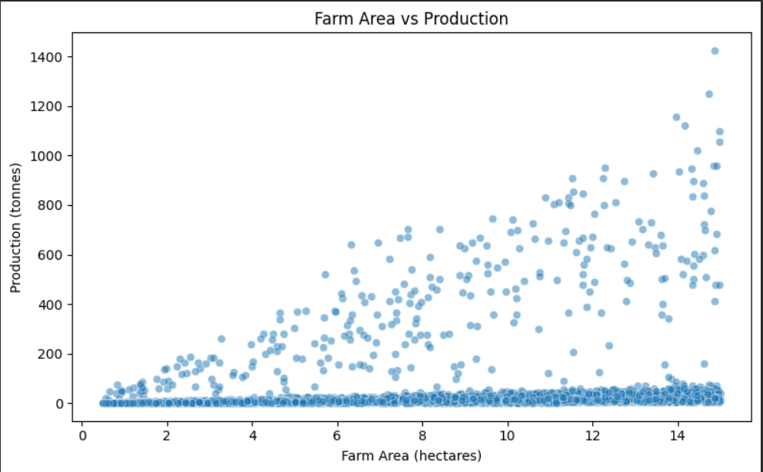
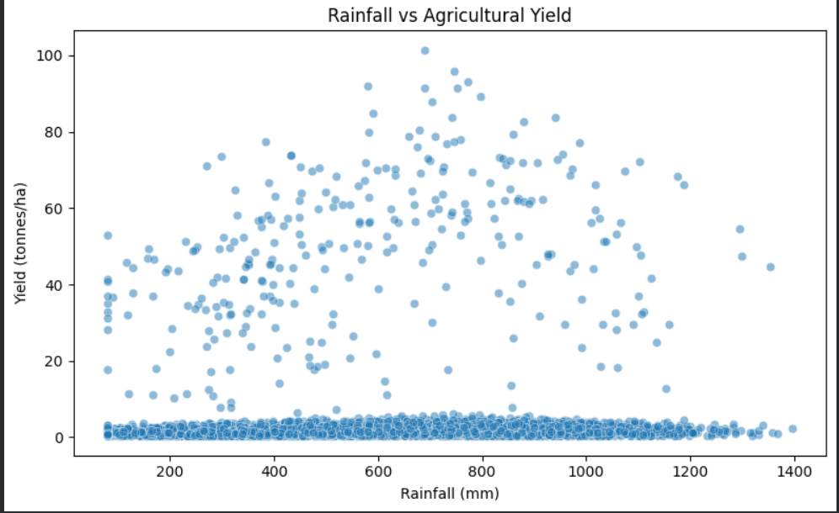
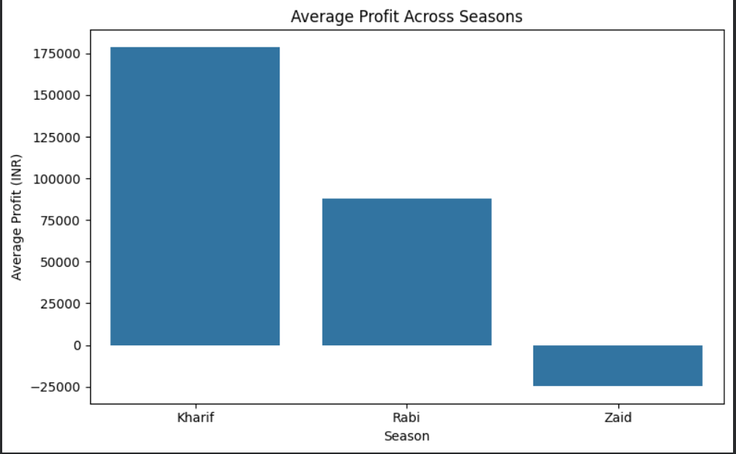
RESULTS
[Add screen shots of your code ]

Slide 8
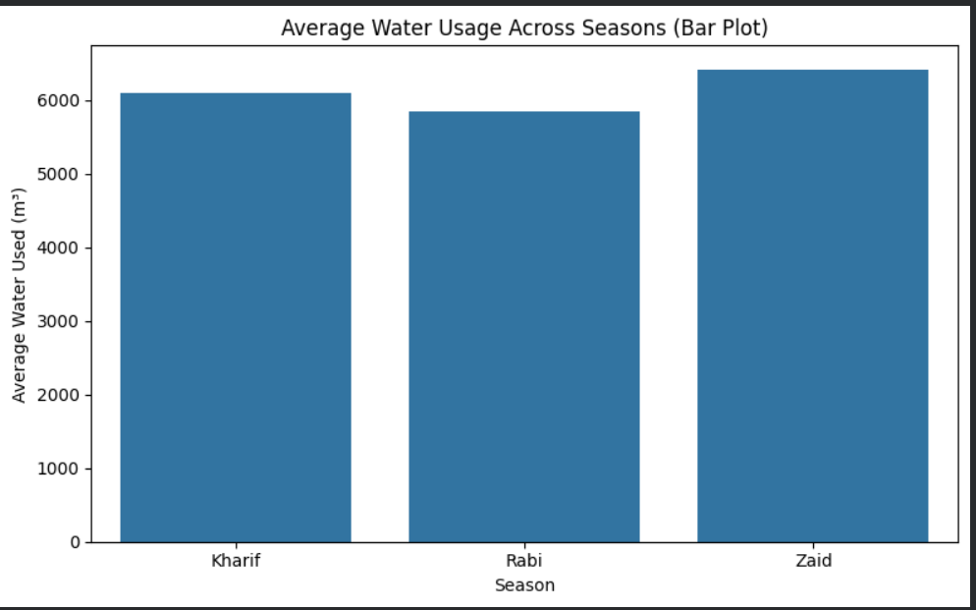
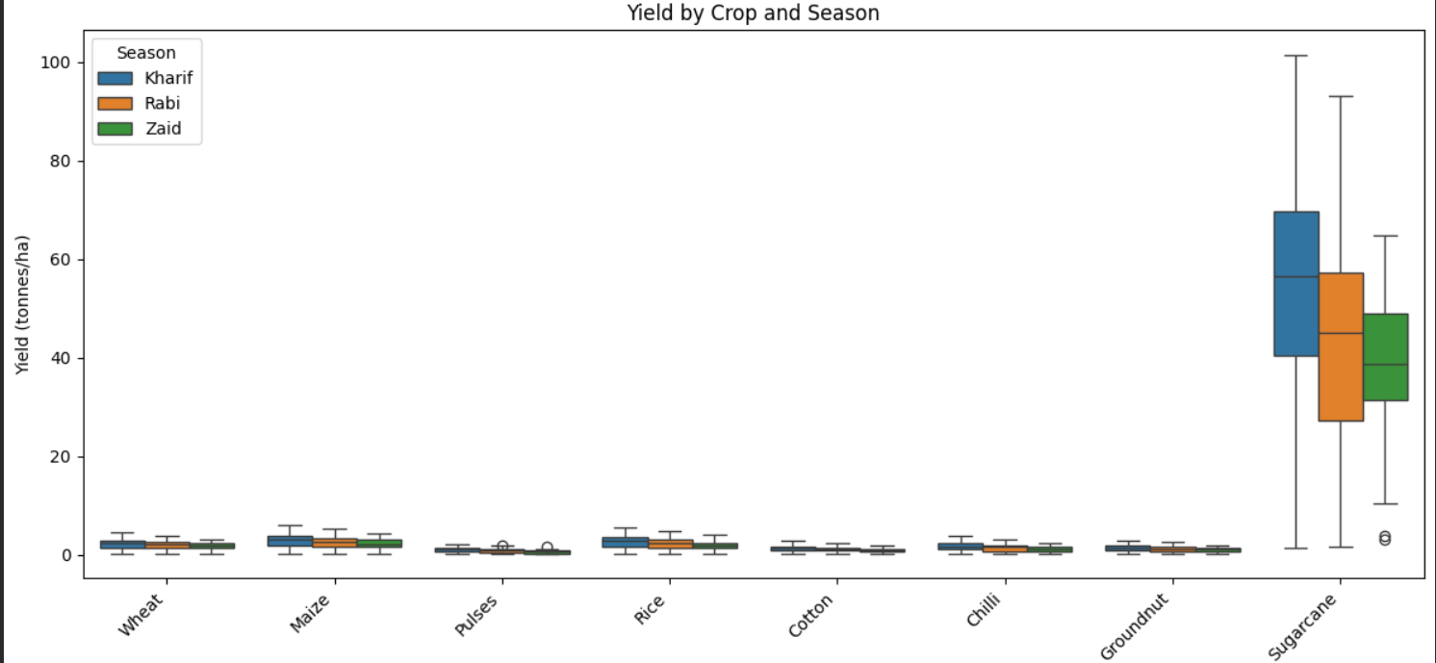
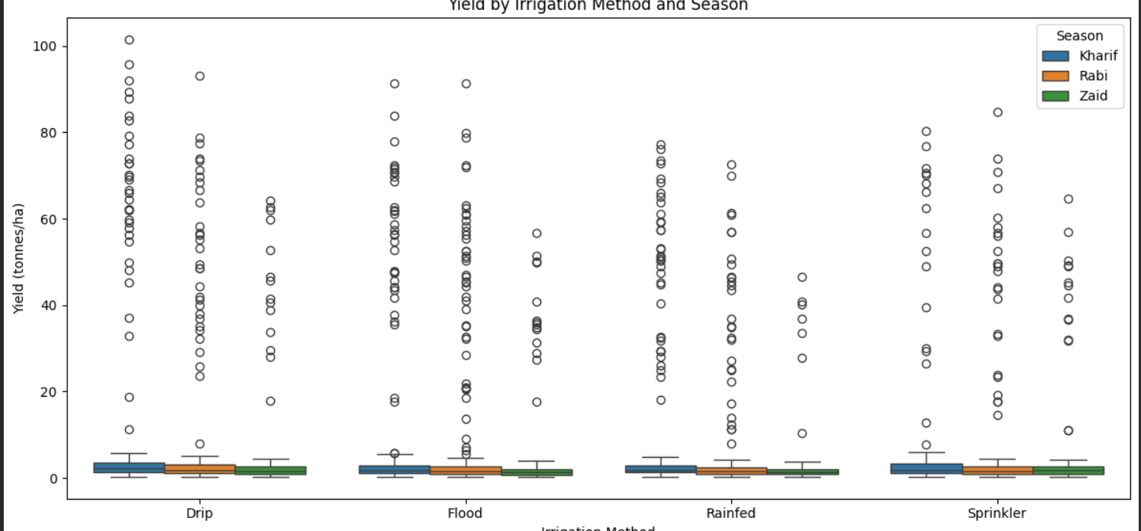
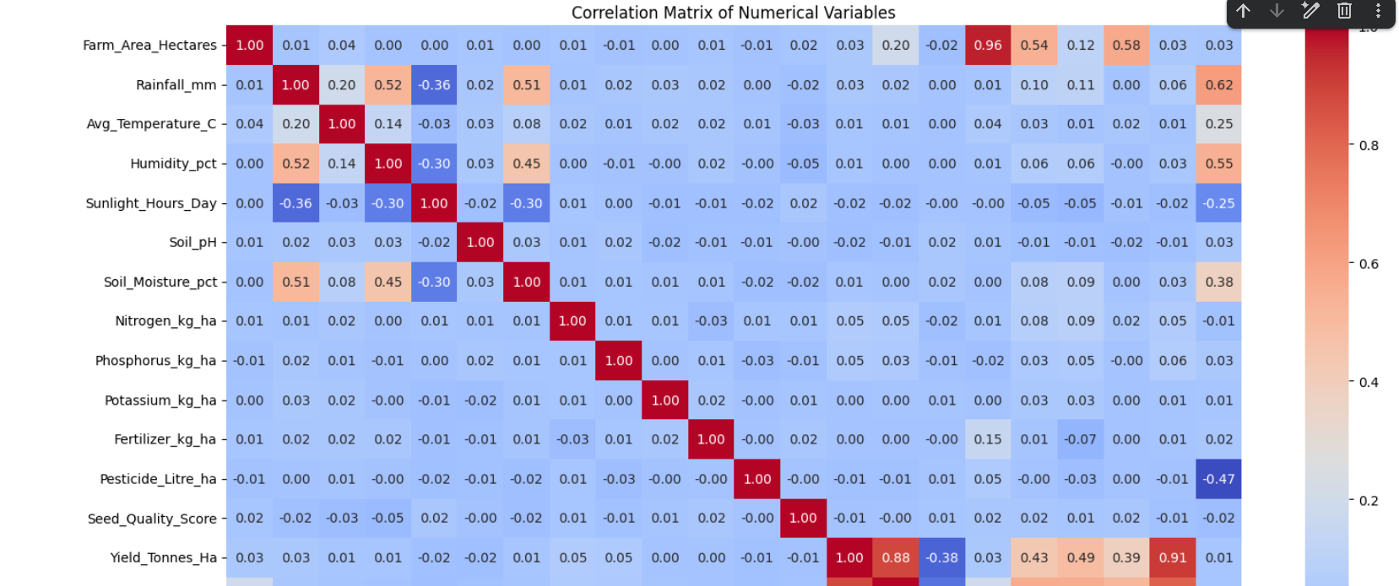
RESULTS
[Add screen shots of your code ]

Slide 9
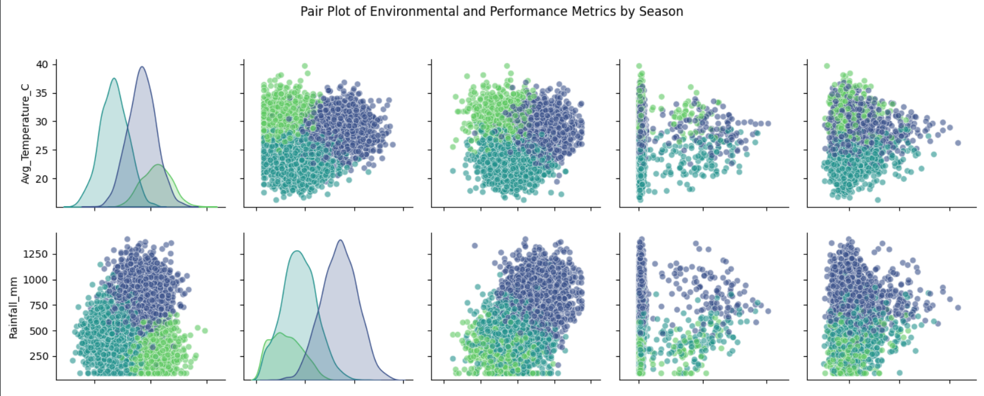
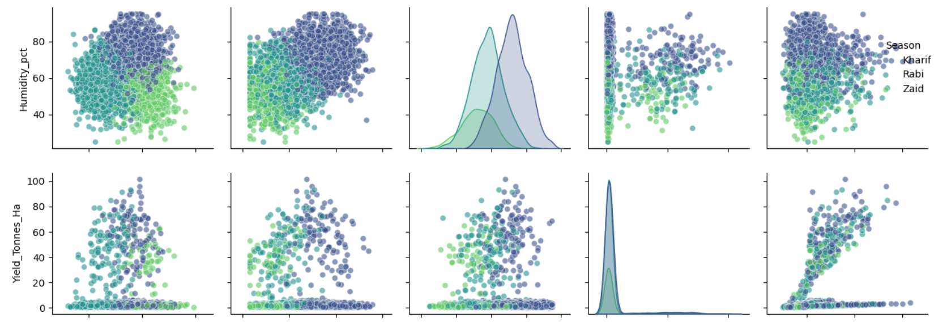
RESULTS
[Add screen shots of your code ]

Slide 10
Future scope 1) Real-Time Data Integration Integrate live weather, soil, crop and market-price data for continuous monitoring. 2) Predictive Analytics Develop machine-learning models to predict crop yield, profit and seasonal risks. 3) Crop Recommendation System Recommend suitable crops based on season, soil, weather and available resources. 4) Disease & Pest Prediction Build an early-warning system using weather and historical data to predict disease/pest outbreaks. 5) Smart Irrigation Integrate IoT sensors to provide real-time irrigation recommendations and improve water efficiency. 6) Interactive Dashboard Develop a web/mobile dashboard where farmers and decision-makers can explore seasonal performance and recommendations.

Slide 11
GitHub Link
https://github.com/vijay-2004-kayala/Vijay04-Seasonal-Agriculture-performance-Analysis.git

Slide 12
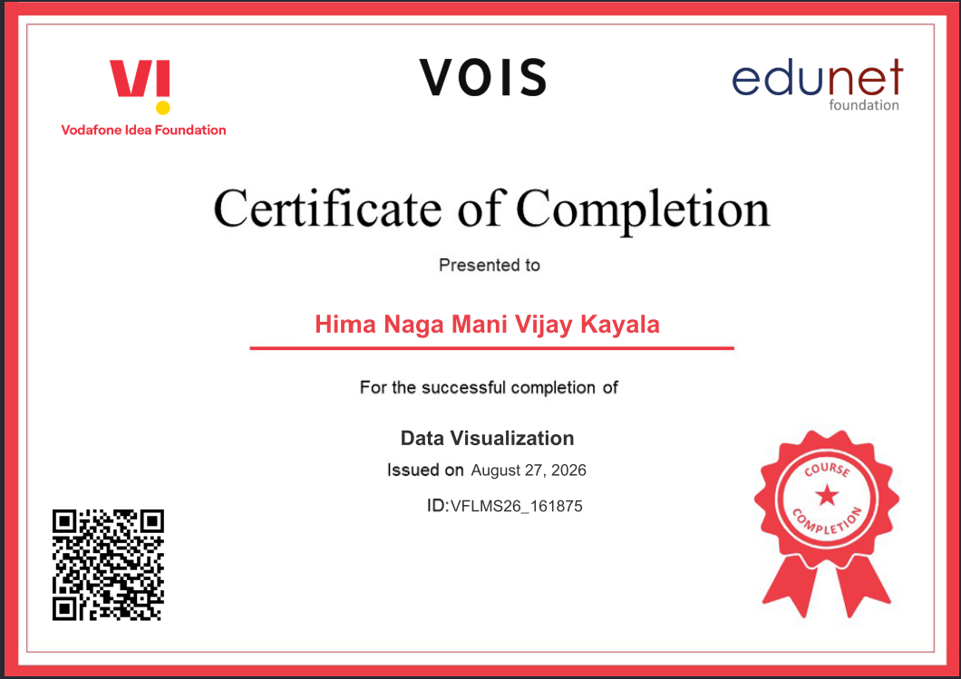
VOIS Course completion certificate - Course name- Data Visualization

Slide 13
Thank you
.
.

