Slide 1
AI5112022 MACHINE LEARNING DECISION TREES & RANDOM FOREST CLASSIFIER

Slide 2
DECISION TREES
A binary tree that splits the dataset until we are left with just 1 leaf node.
2 kinds of nodes – Decision/internal nodes and the leaf nodes.
We might not have 100% pure leaf nodes.
In that case we perform majority voting and assign the majority class to the test point.
At each level, impurity of states decreases.
Greedy Algorithm
Current best split that maximizes information gain.
Does not backtrack and change the previous split.
Subsequent splits depend on present split.
Does not guarantee most optimal set of splits.

Slide 3
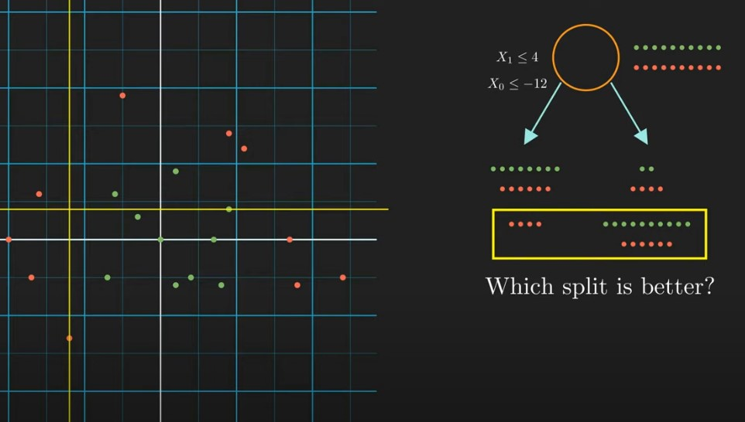
TRAINING A DECISION TREE
At the root, we have the entire dataset.
How to choose the better split?
Model will chose the split that will maximize the information gain.

Slide 4
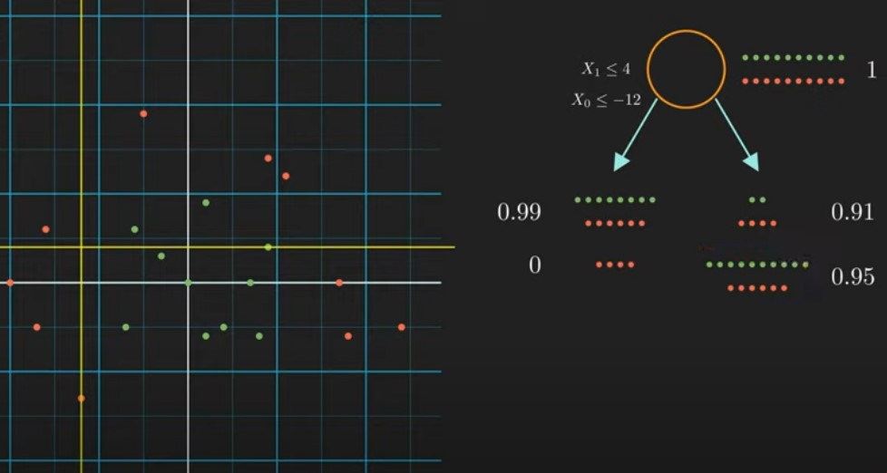
INFORMATION IN A STATE
Entropy = -Σpi log(pi)
Entropy is directly proportional to uncertainty about the class to which the point belongs.

Slide 5
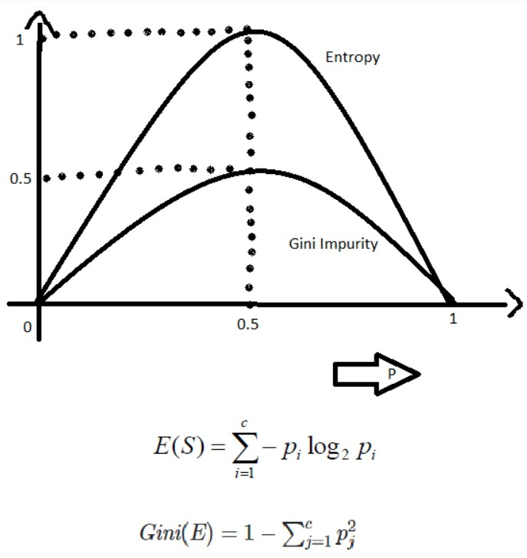
GINI-INDEX vs ENTROPY
Gini Impurity is more efficient than entropy in terms of computing power.
Log is an expensive operation in mathematics.
Deals with real numbers in a shorter range => [0, 0.5]

Slide 6
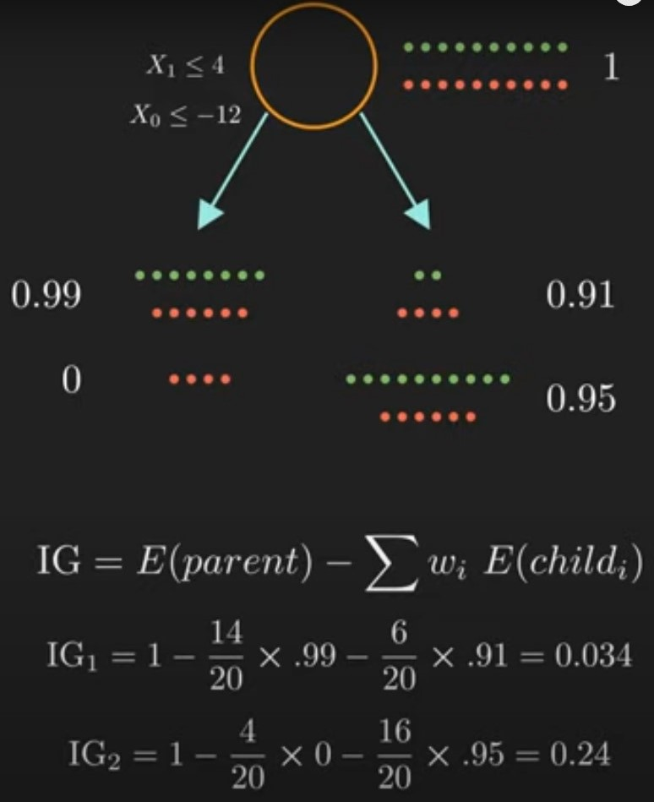
INFORMATION GAIN
Model considers every possible split and takes the one with the maximum information gain.
Traverses through every possible feature and feature value to search for the best feature and the corresponding threshold value.

Slide 7
RANDOM FOREST
Collection of many decision trees.
Random Sampling with replacement => Bootstrapped Dataset
This enables our model to be less sensitive to our training data.
NOT all features used for training decision trees.
Pick a subset of features for all trees and use them for training.
Called random because we have used 2 random processes – Bootstrapping and random feature selection.

Slide 8
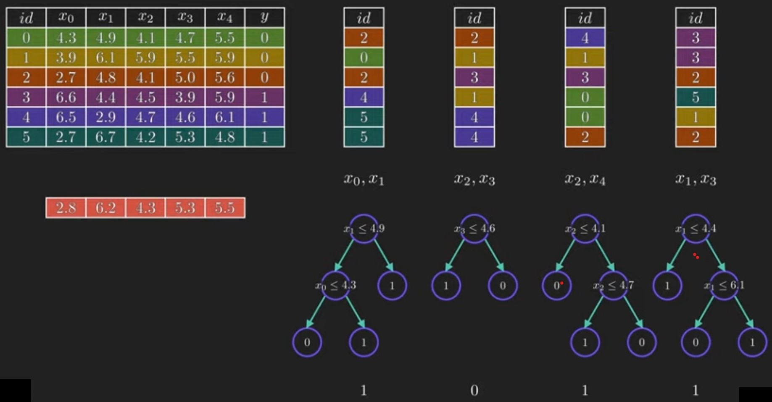
BAGGING = BOOTSTRAPPING + AGGREGATION

Slide 9
ADVANTAGES OF RANDOM FEATURE SELECTION
Reduces correlation between the DTs.
If all use the same set of features, then all DTs might behave similarly.
Results balanced out
Trees trained on less important features will give bad predictions
Some will give bad predictions in the opposite direction.
Number of random features per tree
Sqrt(total features)
log2(Total features)

