Slide 1
Genetic algorithms ft. Prisoners’ dilemma
MAS Mandate 3

Slide 2
Intent of this mandate
To showcase something we found interesting and to correlate those concepts through simulations covering concepts discussed in class.

Slide 3
Prisoners’ dilemma

Slide 4
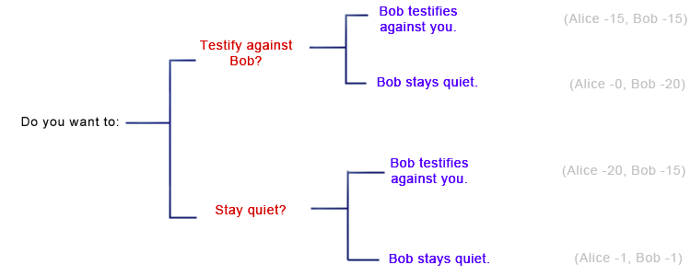

Slide 5
Prisoners’ dilemma
# Score matrix represented as (agent, antagonist)
SCORE_MATRIX = {
('C', 'C'): (5, 5),
('C', 'D'): (0, 10),
('D', 'C'): (10, 0),
('D', 'D'): (3, 3)
}

Slide 6
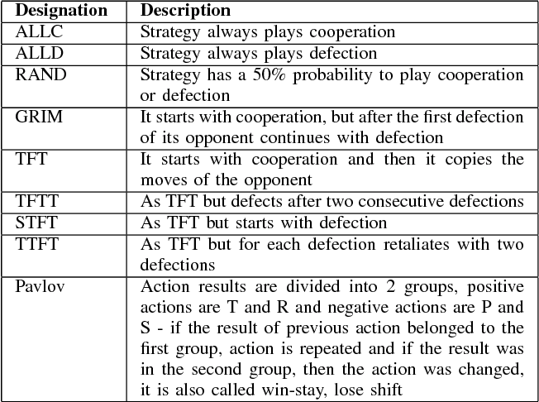

Slide 7
Genetic algorithms

Slide 8
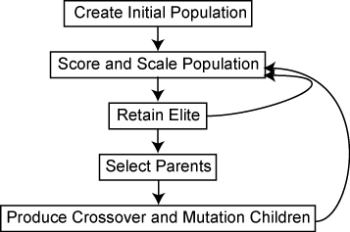
The genetic algorithm is a method for solving both constrained and unconstrained optimization problems that is based on natural selection, the process that drives biological evolution. The genetic algorithm repeatedly modifies a population of individual solutions.

Slide 9
Key elements of a genetic algorithm
Genetic representation of a solution
A function to generate new solutions
Fitness function
Selection function
Crossover function
Mutation function

Slide 10
Game theory and genetic algorithms
Hassan, et al.
We found that Game Theory is tightly related to Evolutionary Algorithms, especially Genetic Algorithm. Genetic Algorithm was mainly utilized for
finding an absolute optimal strategy by virtually applying a game against a known strategy.

Slide 11
Code review + Results

Slide 12
Hyperparameters
N_EPISODES = 20_000
POPULATION_SIZE = 250
GENE_SIZE = 100
K = 25
P_MUTATION = 0.25
P_CROSSOVER = 0.75

Slide 13
References
Introduction to PD: https://www.lesswrong.com/posts/QdXrkWoK2Pp6XhNuQ/introduction-to-prisoners-dilemma
IPD strategies: https://www.semanticscholar.org/paper/A-review-of-iterated-prisoner%27s-dilemma-strategies-Jurisic-Kermek/e4334e8b798416bb58e335226d9f55779aeb33a3
MAS slides: https://drive.google.com/file/d/1Xx8W2iKCDkJddiQnIOEze_1YxXd7e4Tq/view
Introduction to genetic algorithms: https://in.mathworks.com/help/gads/what-is-the-genetic-algorithm.html
Hassan, et al. https://ieeexplore.ieee.org/stamp/stamp.jsp?arnumber=5561648
Genetic algorithms in Python: https://machinelearningmastery.com/simple-genetic-algorithm-from-scratch-in-python/
Kai codes YT: https://www.youtube.com/watch?v=XP8R0yzAbdo

Slide 14
Thank you!
~ IMT2019525 VIJAY JAISANKAR

