Slide 1
Literature Survey
IMT2019525 Vijay Jaisankar (under the guidance of Prof. Jaya Sreevalsan Nair)

Slide 2
This work is part of the 20-credit project submission.

Slide 3
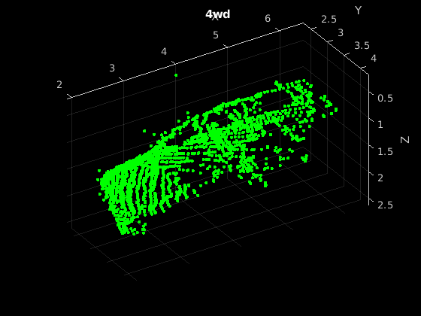
Point Clouds
Useful for representing 3D Data
No discretisation of points
Main source: LIDAR

Slide 4
MVCNN
Generate different renderings for 3D shape
CNN-1: Feature maps for each rendering
CNN-2: Global descriptor acting on ViewPooled outputs
Simple baseline

Slide 5
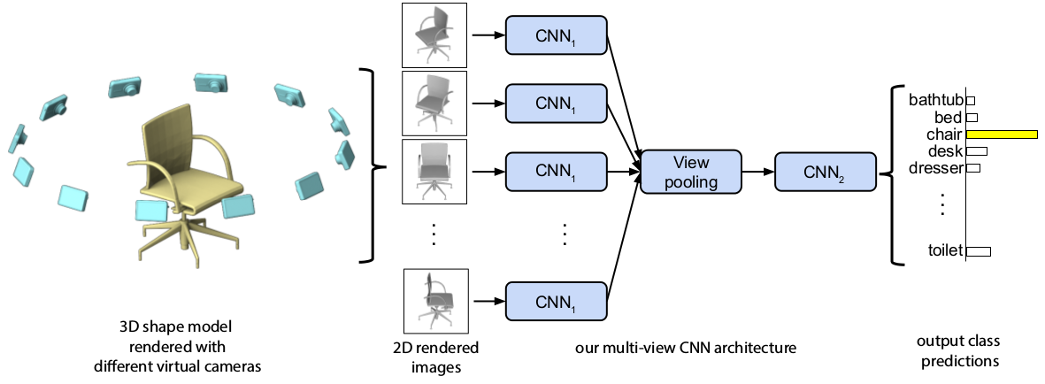
Architecture

Slide 6
PointNet
Permutation and Transformation invariance
Shared MLP and T-Nets: Feature vectors for points
Max pooling: Global descriptor acting on MLP outputs
Simple baseline

Slide 7
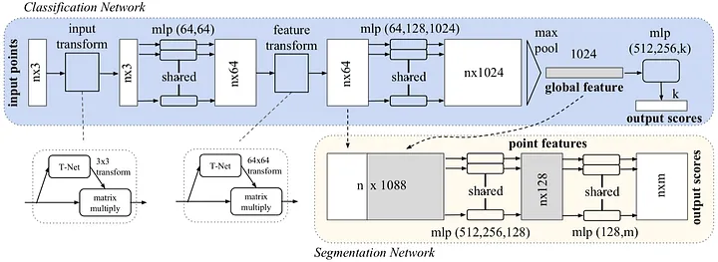
Architecture

Slide 8
PointMLP
Multiple Affine+MLP blocks - each increasing the receptive field
Features computed before and after aggregation
Stronger point features over deeper architectures

Slide 9
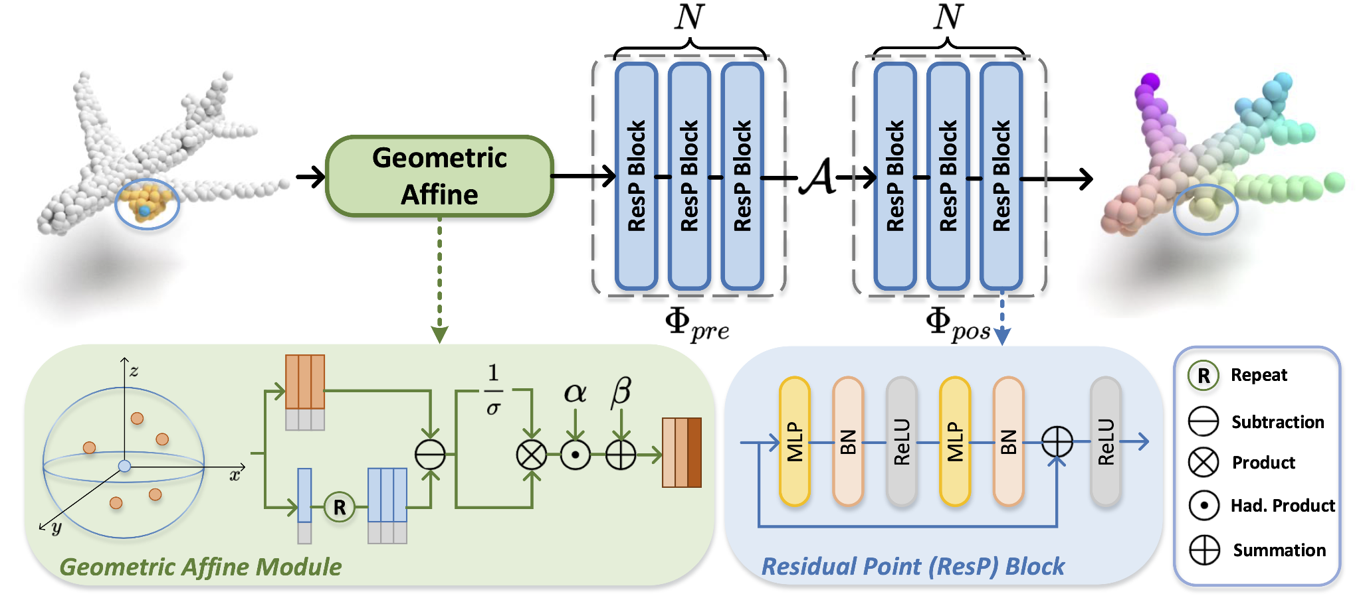
Architecture

Slide 10
Point Transformer
Self-attention implemented as a set function - permutation invariance
Downsampling and Upsampling (semseg) through FPS - self-attention in local neighbourhood of points
Better than convolution, as no strong local structure that self-attention copes with better

Slide 11
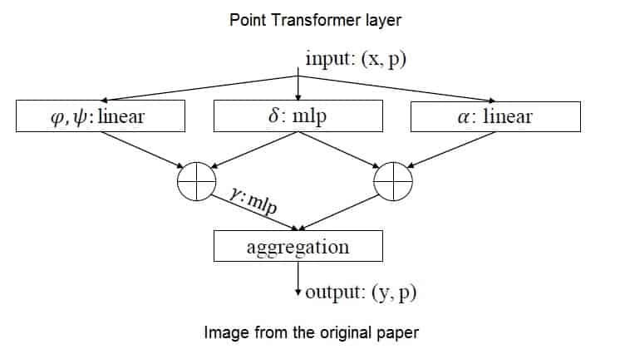
Architecture

Slide 12
RandLANet
3D Encoder-decoder architecture with skip connections
Spatial encoding (KNN+MLP), Attentive Pooling (Aggregation) and Dilated Residual Block (with Skip Connections)
Fast and scales well to arbitrary sized point clouds

Slide 13
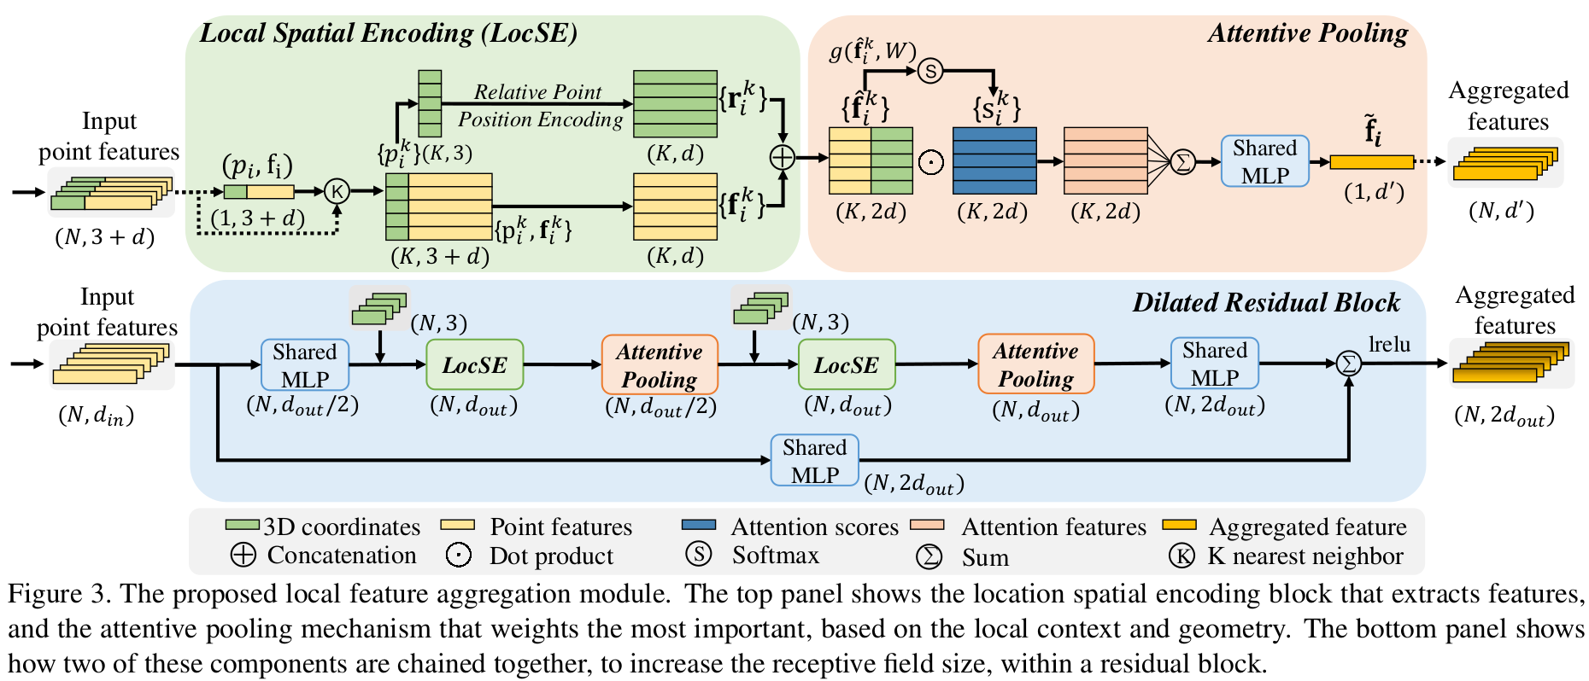
Architecture

Slide 14
DGCNN
Extracting useful features through graph encodings and EdgeConv
Reading graphs in semantically meaningful order - SortPool
Interesting application of GNNs

Slide 15
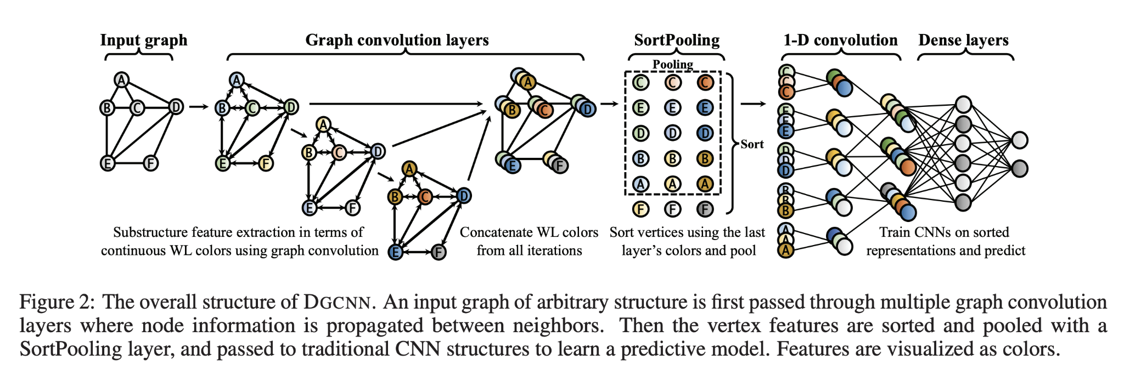
Architecture

Slide 16
ULIP
Multi-modal contrastive learning - unified representations for image, text, and point clouds
Frozen CLIP for point cloud alignment with images and texts
Cross-domain tasks
Similarity search

Slide 17
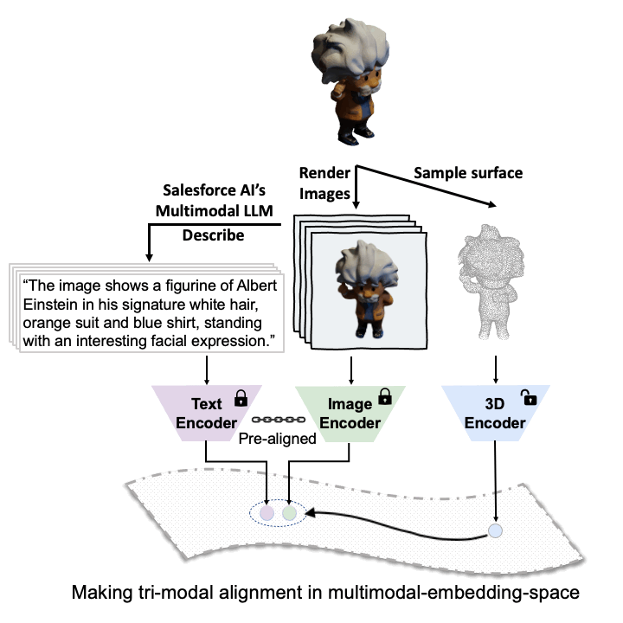
Architecture

Slide 18
SAM3D
Projecting SAM outputs into 3D space
Depth projection
Group-wise merging

Slide 19
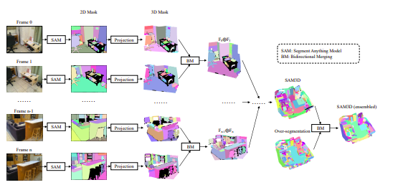
Architecture

Slide 20
PointE
Image/Text to point cloud
Fine-tuned GLIDE to generate synthetic view
Two-hop diffusion strategy to generate point clouds
Fast inference time, large-scale pretraining

Slide 21
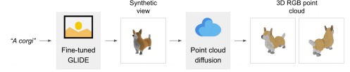
Architecture

Slide 22
On Isometry Robustness of Deep 3D Point Cloud Models under Adversarial Attacks
Restricted Isometry attack
Preserves local geometry properties
RL paradigm to find patches to attack on

Slide 23
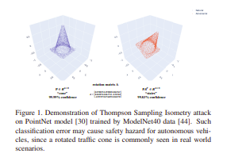
Example

Slide 24
Generating 3D Adversarial Point Clouds
Point additions and point perturbations
Distance norms as validation criteria

Slide 25
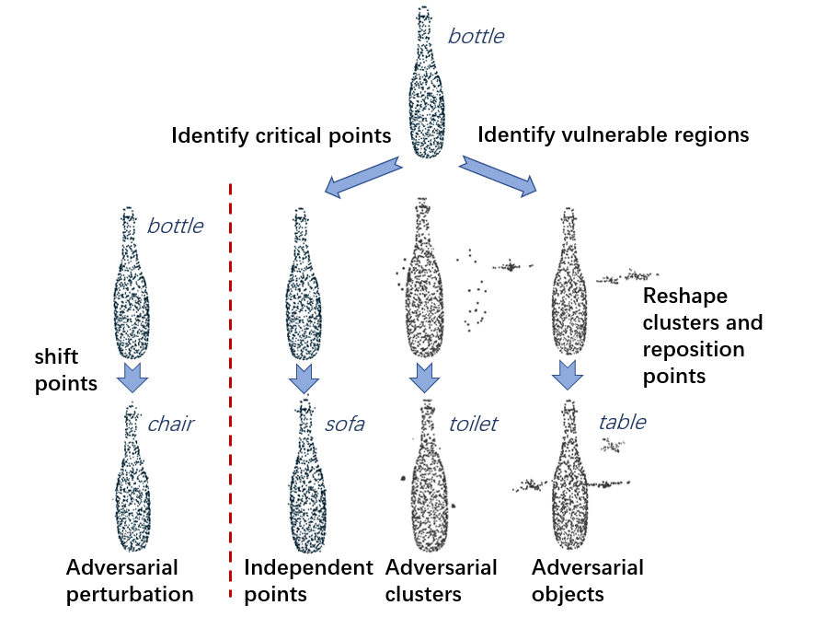
Example

Slide 26
SampleNet
Effective point cloud sampling through soft projections
Differentiable relaxation to nearest neighbour selection
Saves inference time and memory requirements

Slide 27
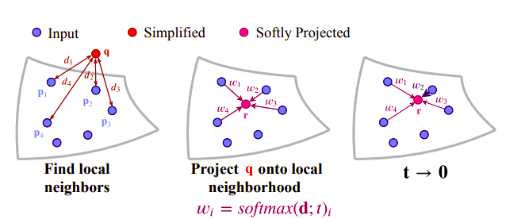
Architecture

Slide 28
References (1 of 2)
References
[1912.12033] Deep Learning for 3D Point Clouds: A Survey
Holger Caesar, Varun Bankiti, Alex H. Lang, Sourabh Vora, Venice Erin Liong, Qiang Xu, Anush Krishnan, Yu Pan, Giancarlo Baldan, Oscar Beijbom; Proceedings of the IEEE/CVF Conference on Computer Vision and Pattern Recognition (CVPR), 2020, pp. 11621-11631
SemanticKITTI
Toronto-3D: A Large-Scale Mobile LiDAR Dataset for Semantic Segmentation of Urban Roadways
PointNet: Deep Learning on Point Sets for 3D Classification and Segmentation
[2202.07123] Rethinking Network Design and Local Geometry in Point Cloud: A Simple Residual MLP Framework
Point Transformer
RandLA-Net: Efficient Semantic Segmentation of Large-Scale Point Clouds

Slide 29
References (2 of 2)
DCGNN: a single-stage 3D object detection network based on density clustering and graph neural network | Complex & Intelligent Systems
ULIP: Learning a Unified Representation of Language, Images, and Point Clouds for 3D Understanding
[2306.03908] SAM3D: Segment Anything in 3D Scenes
[2212.08751] Point-E: A System for Generating 3D Point Clouds from Complex Prompts
On Isometry Robustness of Deep 3D Point Cloud Models Under Adversarial Attacks
Generating 3D Adversarial Point Clouds
SampleNet: Differentiable Point Cloud Sampling

Slide 30
Thank you!

