Slide 1
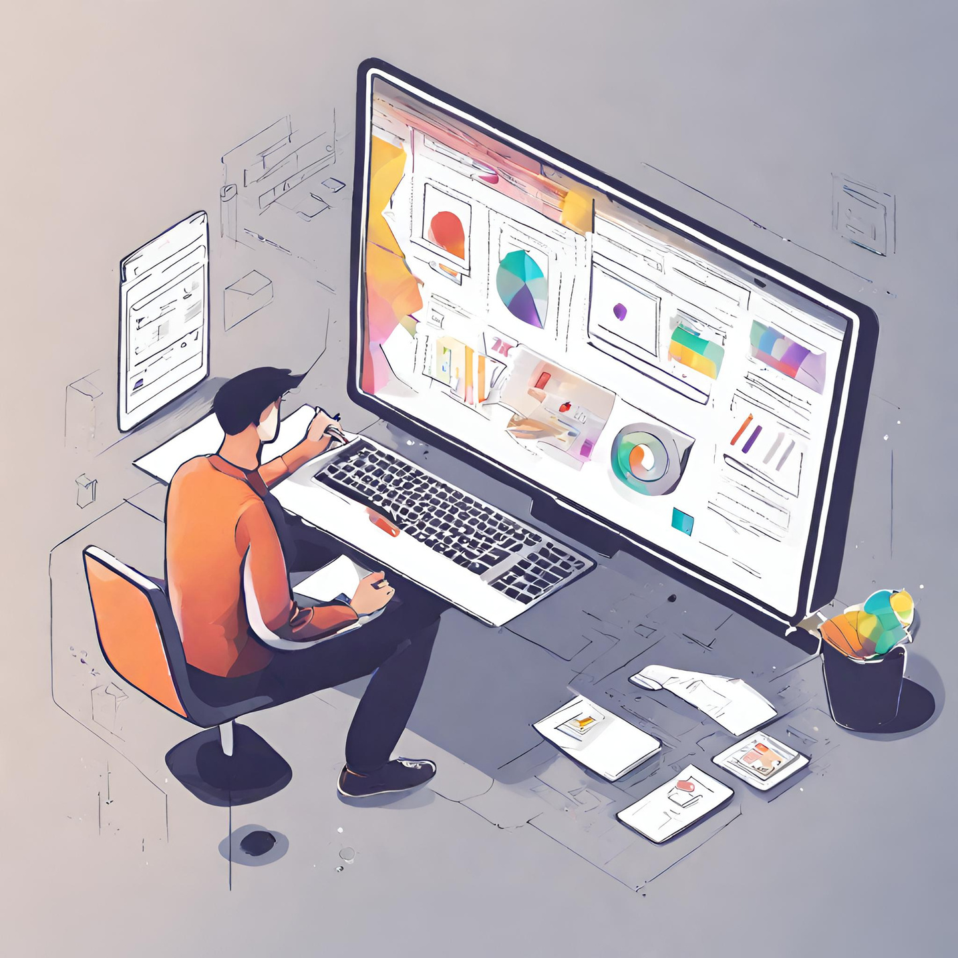
Enhancing the Accessibility and User-Friendliness of the DARPG Portal/Tool

Slide 2
Problem Statement
Enhance the functionality and user interfaces of DARPG portal /tool using tree dashboards .
The DARPG portal/tool is a comprehensive platform developed by the Department of Administrative Reforms and Public Grievances (DARPG) to enhance the adoption and usability of various services and tools. It serves as a centralized hub for accessing information, submitting grievances, and tracking their status.
Purpose
The primary purpose of the DARPG portal/tool is to streamline administrative processes, improve public service delivery, and promote transparency and accountability in governance. It aims to empower citizens by providing them with a user-friendly interface to interact with government departments and agencies.

Slide 3

Existing System
Challenges in Existing System
User Feedback
Users have reported difficulties in navigating the portal/tool and finding the information they need.
Some users have expressed frustration with the lack of user-friendly interfaces and unintuitive design.
Technical Issues
Users have encountered technical issues such as slow loading times and system crashes.

Slide 4

Proposed System
Improved Search Functionality
Our enhanced search functionality provides users with quick and accurate results. Users can now easily find the information they are looking for, saving time and improving efficiency.

Slide 5
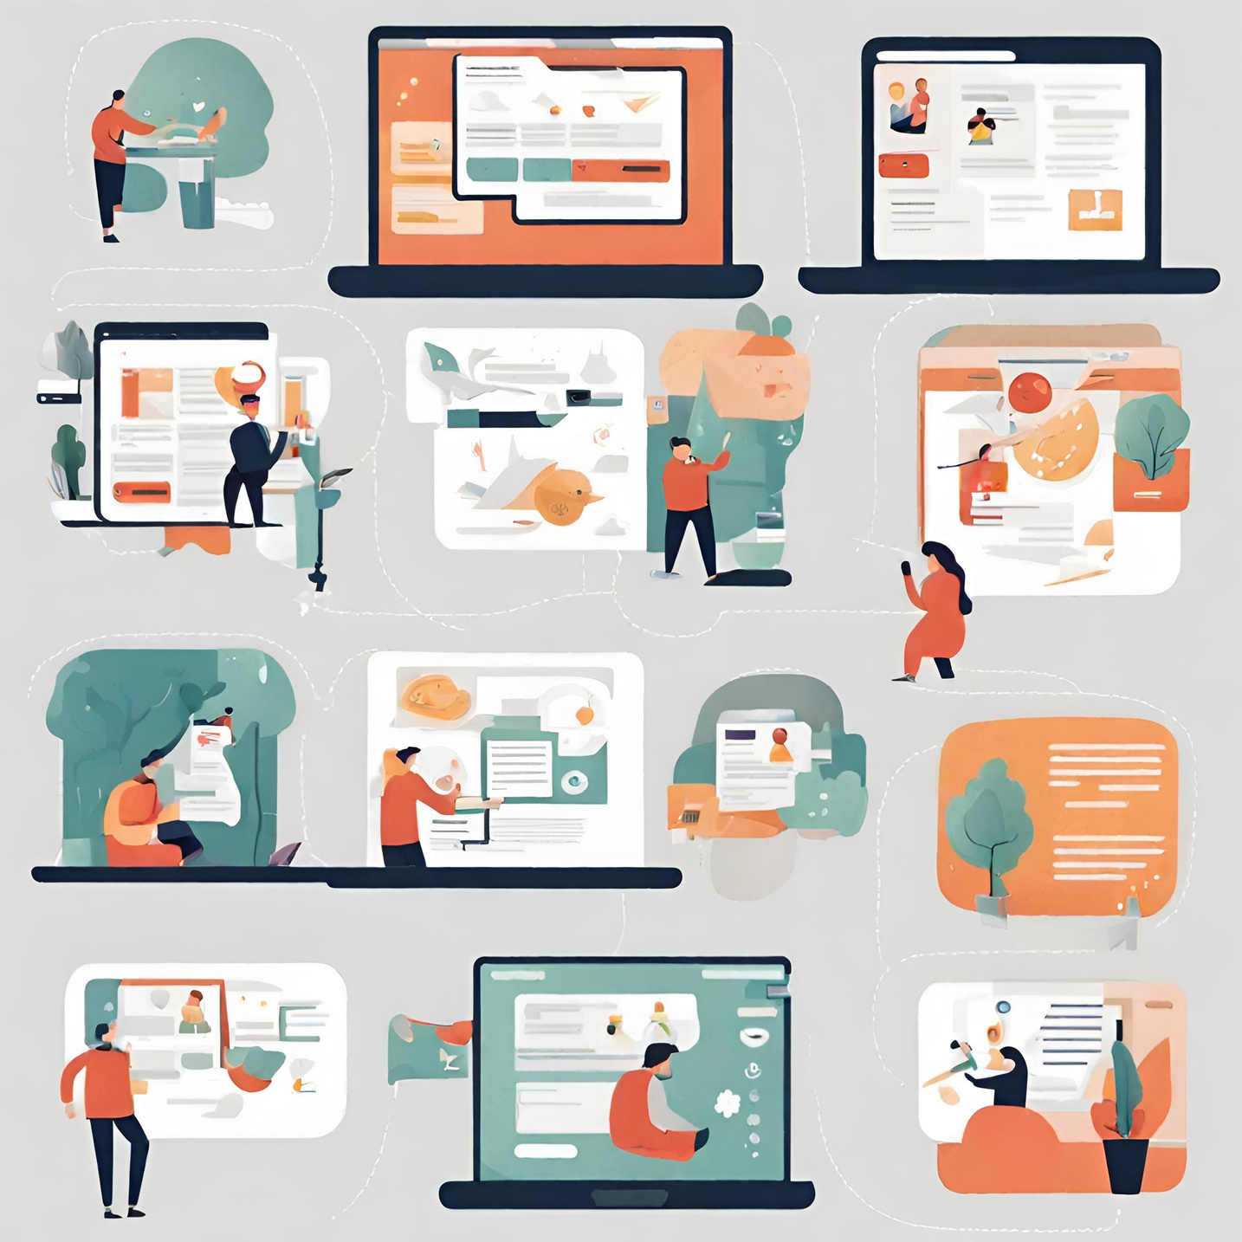
Enhanced Navigation
We have implemented a user-friendly navigation system that allows users to easily access different sections of the DARPG portal/tool. This ensures a seamless browsing experience and improves overall usability.

Slide 6
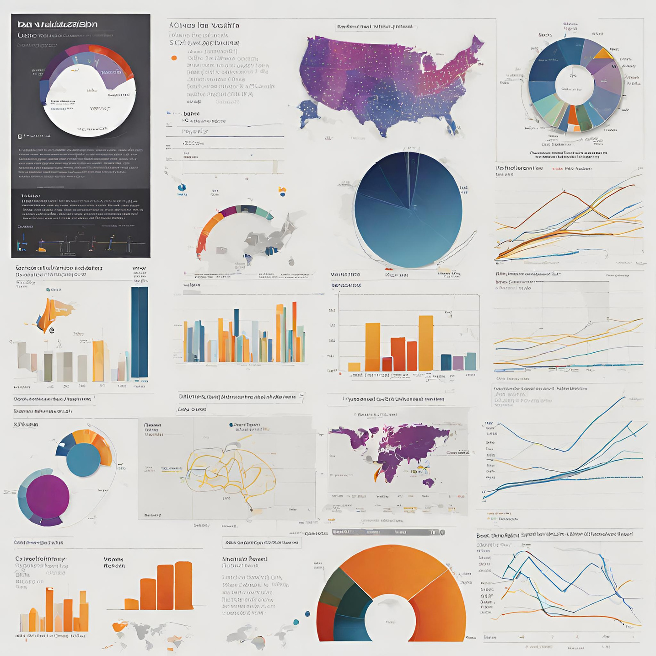
Enhanced Data Visualization
We have improved the data visualization capabilities of the DARPG portal/tool. This allows users to better understand and interpret complex data, leading to more informed decision-making.

Slide 7
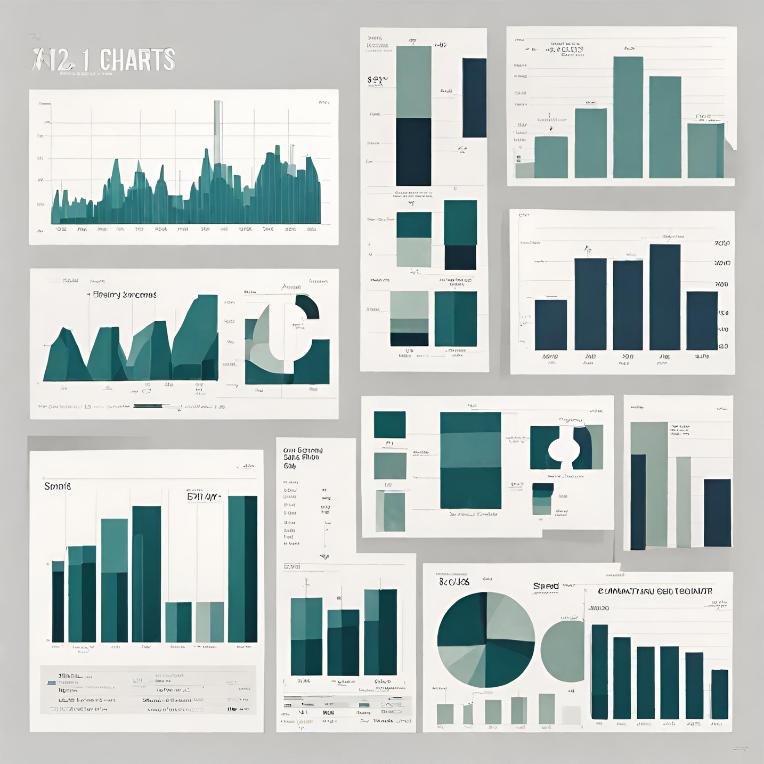
Interactive Charts and Graphs
Our UI/UX solutions include interactive charts and graphs that enable users to analyze data in a more dynamic and intuitive way. This enhances the usability of the portal/tool and facilitates data-driven insights.
Technologies Used:
UI tools : Figma /Adobe XD

Slide 8
Key Takeaways
Improving adoption and usability of the DARPG portal/tool is crucial for enhancing efficiency and transparency in governance.
The DARPG portal/tool, such as the Tree Dashboard and IGMS website, plays a vital role in streamlining processes and providing easy access to information.
By enhancing the user experience and making the portal/tool more user-friendly, we can encourage greater participation and engagement from stakeholders.
Continuous improvement and regular updates are necessary to address user feedback and ensure the portal/tool remains relevant and effective.

Slide 9
Conclusion
Collaborative Innovation
The DARPG HACKATHON presents an exciting opportunity for diverse professionals to collaboratively innovate and drive a positive change with technology.
Visionary Impact
It is our strong belief that the outcomes of this venture will contribute significantly towards advancing the realms of speech recognition technology.

Slide 10
Thank
you!

