Slide 1

Assignment Work

Slide 2
Agenda
Design Overview
Solution Design
Technical Design
Technical Implementations
Resources
Platform & Tools setup
Analytics
Analysis & Findings
Conclusion
Q&A

Slide 3
Solution Design
Design: Dataware house with 3 layer approach (RAW, Stage, DataVault)
Modeling: DataVault 2.0
Tool choices
Database storage/compute: Snowflake
Ingestion/Extraction: out of scope (but loaded data into Source schema)
Transformation: DBT Core

Slide 4
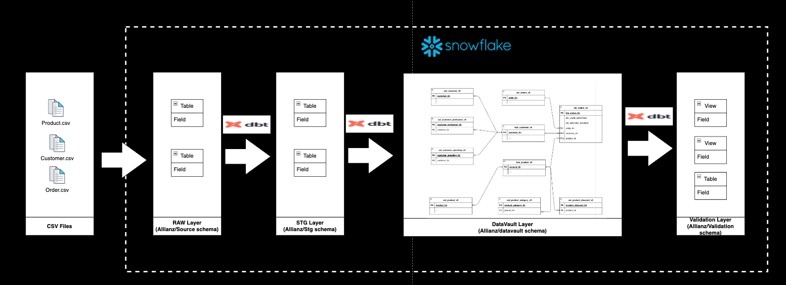
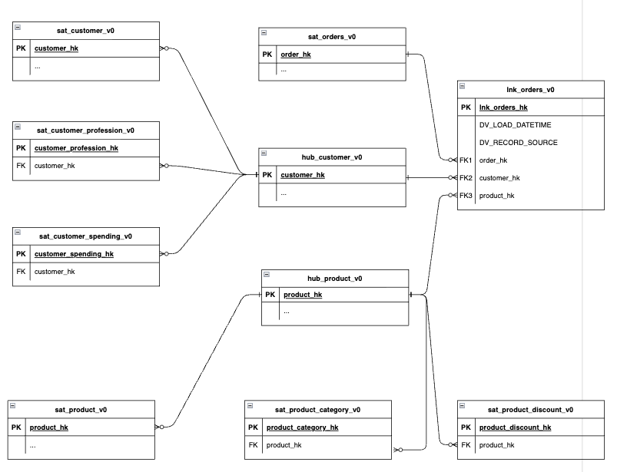
Technical Design
Design: Dataware house with 3 layer approach
Data Model:
Data Model: Link to GitHub

Slide 5
DBT & Snowflake Setup
DBT Project & Folders
DBT Models
Stage Models
Datavault Models
Macros for common logics
DBT Tests
Dbt model contracts
Technical tests by defining in *.yml file (schema folder)
Functional tests as dbt test models
Snowflake
Database & Schema (for each layers)
Tables, Type of Load and Views

Slide 6
Resouces
Git Hub repo - https://github.com/vijay-palanisamy-1986/Allianz/
Snowflake database details:
Portal link – https://app.snowflake.com/tprjbgm/uh01600/#/homepage
Username: VijayPalanisamy
Password: w}2f#-3pDZbkr2JN
DBT Snowflake connection profile file: https://github.com/vijay-palanisamy-1986/Allianz/blob/main/3_Design/profiles.yml

Slide 7
Q & A

