Slide 1

Project Title -Seasonal Agriculture Performance Analysis
Student Name: Vijay Surybhan Sonavane
College Name- Sinhgad Institute of Technology, Lonavala
AICTE STU ID: STU65a2e36c70d161705173868

Slide 2

PROBLEM STATEMENT
Agricultural activities are influenced by seasonal variations in environmental conditions, farming practices, resource availability and market conditions. As a result, agricultural performance may differ from one season to another. However, raw agricultural data does not clearly explain how agricultural performance changes across seasons or what patterns can be observed in different seasonal conditions. The problem is to analyze the given agricultural dataset and investigate seasonal differences in agricultural performance by identifying meaningful patterns, trends, relationships and variations within the available data.

Slide 3
Project Description The Seasonal Agriculture Performance Analysis project investigates how farming practices, environmental conditions, and crop outcomes in India vary across the Kharif, Rabi, and Zaid seasons. By analyzing a dataset of 4,000 farm records, the project aims to identify meaningful patterns in crop yield, resource efficiency, and economic profitability to support data-driven agricultural planning.

Slide 4

WHO ARE THE END USERS?
Farmers & Agronomists
Can leverage insights to optimize their irrigation methods (such as selecting Drip vs. Sprinkler) and choose crops suited for specific seasonal profiles to maximize yield and boost overall profitability.
Government & Policy Makers
Can utilize these seasonal risk patterns to strategically prioritize agricultural subsidies, crop insurance, or market price support—especially during the highly volatile Zaid season.

Slide 5

Technology Used
Python
The primary programming language utilized for orchestrating data processing and complex statistical analysis.
Pandas & NumPy
Essential for dataframe manipulation, missing value imputation, and calculating season-wise comparative metrics.
Visualization
Matplotlib and Seaborn enabled the creation of correlation heatmaps, boxplots, and visual distribution analyses.

Slide 6
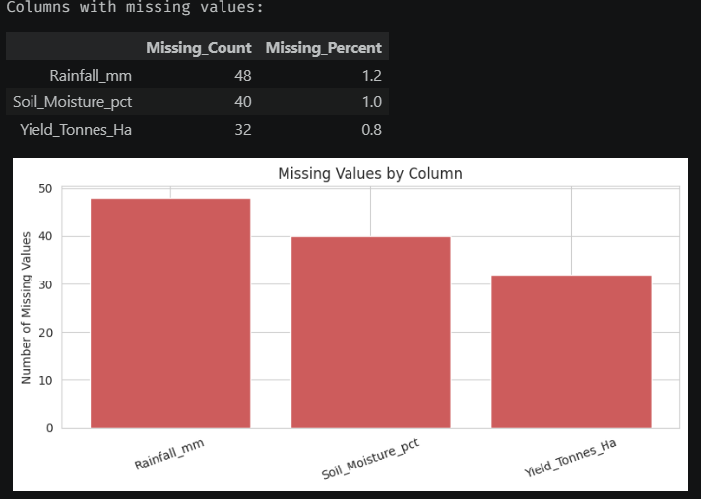
RESULTS
Missing values:

Slide 7
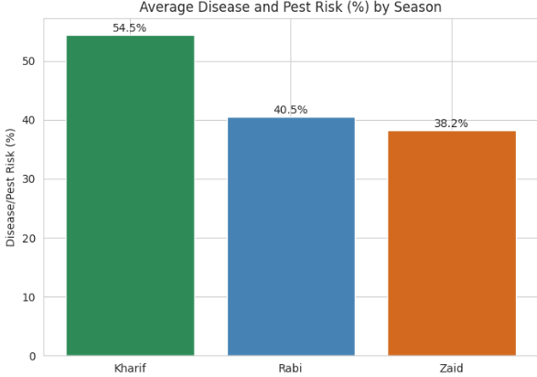
RESULTS
Disease and pest risk is highest in Kharif (~54%), likely linked to the higher rainfall and humidity, and lowest in Zaid (~38%), the driest season.
This is a useful counterpoint to Kharif's otherwise strong performance — higher yields there come with higher crop-protection risk.

Slide 8
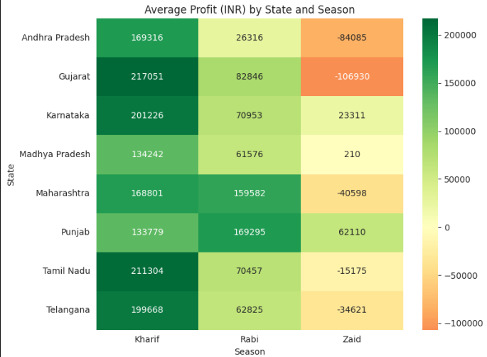
RESULTS
Six of the eight states swing to a negative average profit in Zaid.
Punjab stands out as the only state with a positive average profit in all three seasons, including Zaid (~₹62,000), suggesting its farming conditions or practices are more resilient to the hot, dry summer season than the rest of the dataset.

Slide 9
RESULTS
The Risk of Loss
49% Total Farms Operating at a Loss
A Systemic Challenge
Nearly half of all farm records operate at a loss overall. This share rises steadily from Kharif to Zaid, demonstrating a clear and consistent seasonal risk pattern.
Disease and pest risk is actually highest in Kharif (~54%), meaning its strong yield and profit performance comes bundled with higher crop-protection demands.

Slide 10
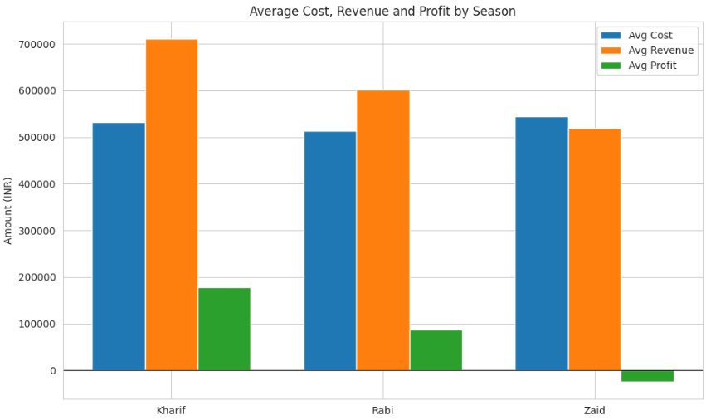
RESULTS
Average profit falls sharply from Kharif (~₹1.79 lakh) to Rabi (~₹0.88 lakh), and turns negative in Zaid (~-₹25,000) — even though average cost stays roughly similar across all three seasons.
This means the drop in profit is driven mainly by lower revenue (lower yield and/or lower prices), not by higher costs.

Slide 11
Future scope
Machine Learning Forecasts: Develop predictive algorithms to forecast crop yields using pre-season environmental and resource indicators.
Interactive Dashboards: Create localized tools for farmers to input specific farm conditions and receive real-time, season-specific recommendations.
Longitudinal Analysis: Expand the dataset to include multi-year trends, allowing for better accounting of climate change and extreme weather.
Outlier Investigation: Conduct deeper studies on extreme-loss outlier farms and highly resilient regions (like Punjab) to refine agricultural best practices.

Slide 12
GitHub Link
https://github.com/vijay-sonavane9/Seasonal-Agriculture-Performance-Analysis.git

Slide 13
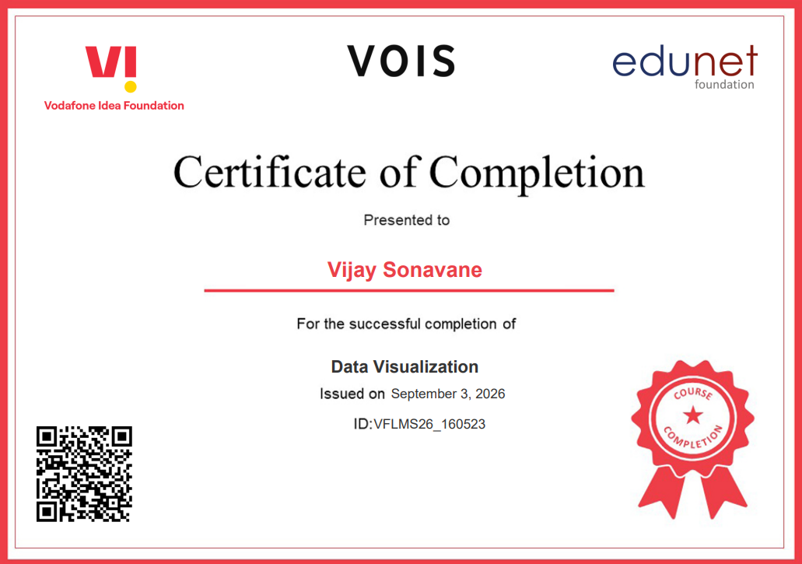
VOIS Course completion certificate - Course name- Data Visualization

Slide 14
Thank you
A sincere thank you to VOIS and the Edunet Foundation for providing this incredible internship opportunity.
Your support and guidance have been invaluable in developing these skills.
.
.

