Slide 1

presentation on
Title-
Publication Summary Generator for Faculty profile building
Submitted to the Savitribai phule pune university ,pune
In the partial fulfilment of the requirements for the award of degree of
Bachelor of engineering (computer engineering)
Submitted by
Name of Student:
1. Ashitosh Warghade B400420381
2. Swaroop Gaikwad B400420225
3. Sumeen Gharat B400420229
4. Vijay Sonavane B400420350
Guide Prof. S. B. Nimbekar
DEPARTMENT OF COMPUTER ENGINEERING
STES Sinhgad institute of technology, Lonavala
SAVITRIBAI PHULE PUNE UNIVERSITY
Academic Year-2024-25

Slide 2

Publication Summary Generator
AI-Powered Document Understanding Tool
PROJECT TITLE
It is a web application developed using Next.js, React, and TypeScript.
The app allows users to upload PDF files and use AI to:
Generate summaries (short, medium, detailed)
Extract keywords
Chat with the content in the PDF

Slide 3
To develop a smart web application that helps users understand PDF documents quickly and easily using Artificial Intelligence.
An AI chatbot to answer questions based on the uploaded document
The goal is to save time and improve accessibility by providing:
Automatic summaries of uploaded PDFs
Important keywords from the content
It is designed especially for:
Students who study from PDFs
Faculty and researchers who read research papers
Professionals dealing with lengthy reports and manuals
Overall, the purpose is to simplify document understanding using AI tools in a user-friendly way.
Purpose of The Project

Slide 4
📚 Real-World Problem: Reading long PDF documents (research papers, reports, etc.) takes a lot of time and effort. Users often need just the main idea, keywords, or specific information.
🤖 AI is the Solution: With the rise of AI, we saw an opportunity to use powerful models (like Gemini) to automatically process and understand documents.
💬 Limitations of Existing Tools: Tools like ChatGPT or Gemini are general-purpose — they don’t directly work with uploaded PDFs in a focused way.
Why This Project

Slide 5
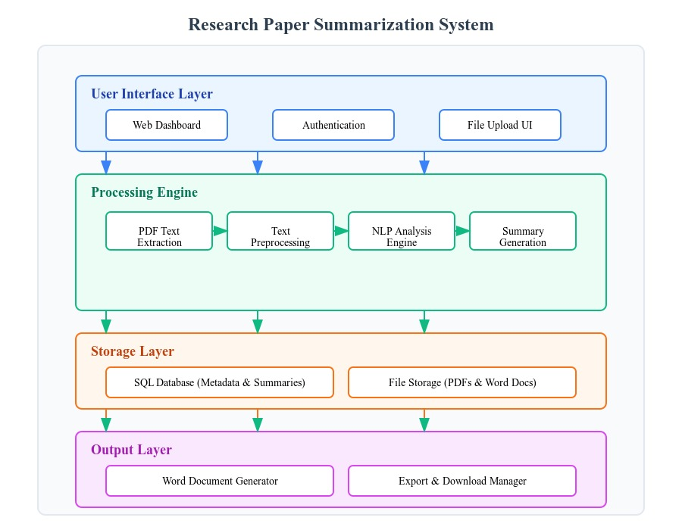
System Architecture
Fig. System Architecture

Slide 6
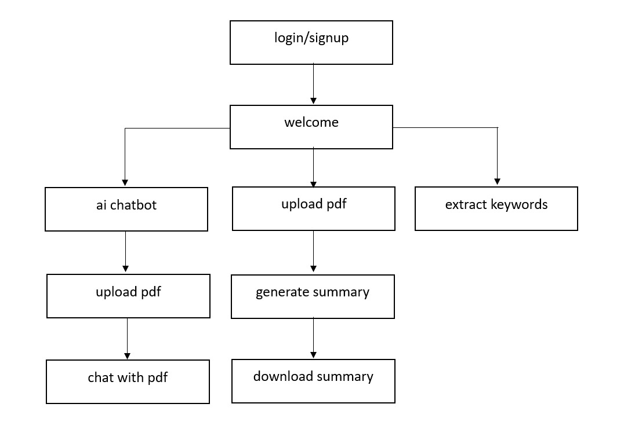
System Architecture
Fig.System Architecture

Slide 7
Next.js
Used to build the structure of your web app.
It handles routing, page transitions, and server-side rendering (for performance).
React
Builds the actual UI components like buttons, forms, cards, modals, etc.
Used throughout the app in pages like Dashboard, Summary Viewer, Chatbot, etc.
TypeScript
Adds type safety to your code.
Helps catch bugs during development and makes your code more reliable and readable.
Front End Technologies

Slide 8
ShadCN UI
Provides pre-designed UI components like buttons, modals, cards, tabs.
Used to make your app look polished and professional without designing from scratch.
React Context API
Manages global state such as:
Whether the user is logged in
Theme preference (light/dark)
Possibly selected summary options
React Hook Form + Zod
Used in the Login, Registration, and Feedback forms.
Makes form handling smooth and validates input data to prevent errors.
Local Storage
Saves users' past summaries in the browser.
Allows users to go back to "My Summaries" even after refreshing or reopening the app.
Front End Technologies

Slide 9
FastAPI
Acts as the bridge between the frontend and Python backend
Accepts uploaded PDFs and routes them to processing modules
Returns the final summary/output
2. Text Extraction & Preprocessing
Extracts raw text from PDFs using Python libraries
Applies NLP preprocessing:
Stopword Removal
Lowercasing
Lemmatization
Ensures clean, meaningful input for the summarization model.
3. Hugging Face – Summarization Model
Core model used to generate summaries from the cleaned text
Pretrained transformer-based model designed for long document summarization.
Returns concise, human-readable summaries in seconds.
Backend (Server Side / AI Integration)

Slide 10
4. Gemini AI (via Genkit)
Used only for the chatbot-style question-answer functionality
Users can ask questions about the uploaded PDF
Gemini responds based on PDF content only, ensuring context-aware answers
5. Firebase Authentication
Manages user login, registration, and password reset
Ensures only verified users can:
Generate and download summaries
View summary history
Access the Q&A chatbot feature
Backend (Server Side / AI Integration)

Slide 11
Current Scope (What it does now):
Users can upload PDFs and get:
Short, medium, or detailed summaries (paragraph + point-wise)
Important keywords
AI chatbot that answers questions based on PDF content
Supports user authentication, local summary history, and responsive design
Works well for students, teachers, researchers, and professionals
Future Scope (What can be added later):
Save summaries to cloud database (not just local storage)
Add multiple document support (summarize more than one file at once)
Use voice input for chatbot interaction
Enable OCR to handle scanned image-based PDFs
Support for summarizing research paper in multiple language to enhance global accessibility.
Project Scope

Slide 12
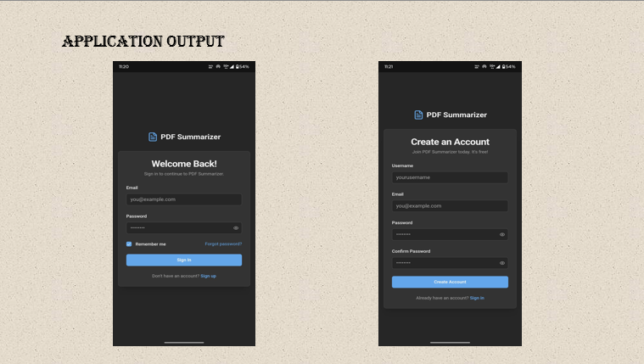

Slide 13
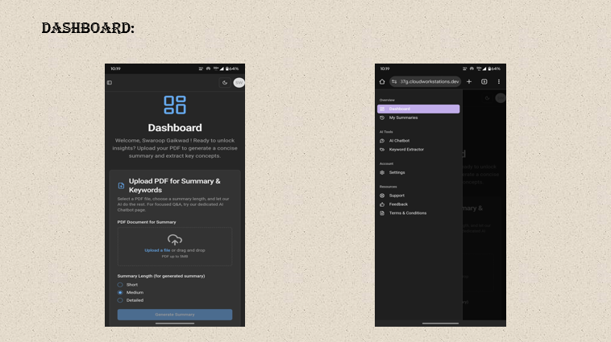
Selecting a Research Paper PDF

Slide 14
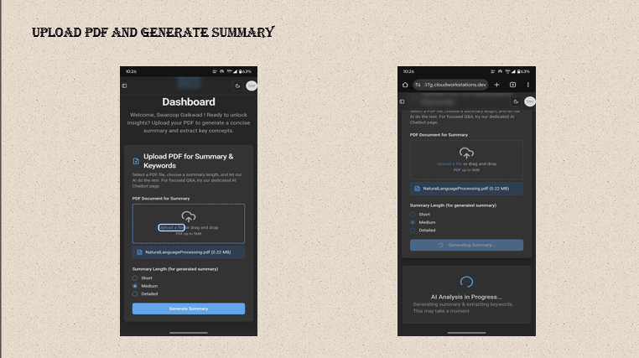

Slide 15
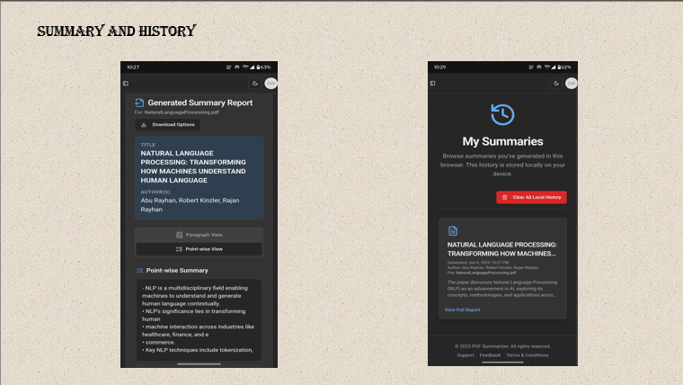

Slide 16
THANK YOU

