Slide 1
GANs in Biomedicine
CS580: Topics in Computers in Biomedicine
Akanksha Reguri
Khyati Doshi
Vijay Souri
Vijay Swaminathan

Slide 2
An overview of biological data generation using
generative adversarial networks

Slide 3
PData
( x)
DATA
Pg
( x )

Slide 4
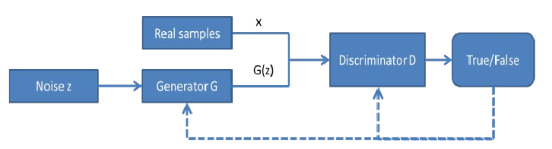
Generative Adversarial Networks
Notes:
Zero Sum Game / MinMax Game Input is random vector

Slide 5

Objective Function
Notes:
Ex∼pdata​(x)​[logD(x)] is the expected value of the logarithm of the discriminator's output for real data x.
Ez∼pz​(z)​[log(1−D(G(z)))] is the expected value of the logarithm of the inverse of the discriminator's output for generated data. This represents the discriminator's ability to correctly classify fake data (generated by G) as fake. Ex∼pdata​(x)​:
This part denotes the expected value (mean) over the distribution of real data, where xx is a sample from the true data distribution pdatapdata​.
EE is a statistical expectation, indicating that we are calculating an average over many instances of xx.
x∼pdata(x)x∼pdata​(x) means xx is drawn from the real data distribution pdatapdata​.
Problems and solutions: Wasserstein Generative
Adversarial Networks (WGAN) – problem of vanishing gradient problem of vanishing gradient
Deep Convolutional Generative Adversarial
Networks (DCGAN) – (CNN), but the pooling
layers and up-sampling layers are not retained

Slide 6
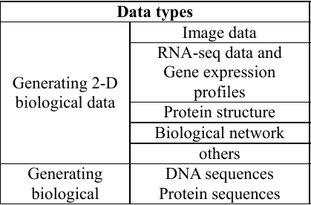
Possible data generation with GANs
Biological Sequences
Two-dimensional data
Notes:
DCGAN to the synthesis of cells images – Simpler global structure, first, Goldsborough, morphological profiling
RNA-seq – CGAN, L1 loss norm,, semi-supervised GAN
Protein – experimental results indicated that this GAN model is able
to complete the missing residues in protein structures. Contact MAP
FOR BIOLOGICAL SEQUWENCES – WGAN, synthetic DNA sequence and tuning, One hot encoding nucleotides A, C, G, T.

Slide 7
CytoGAN - Generative Modeling of Cell Images
Notes:
So we will see how the paper "CytoGAN: Generative Modeling of Cell Images" leverages the capability of GANs to generate 2-D data (cell images) to advance the field of morphological profiling in cell biology.

Slide 8
Problem Statement
Goal : Address the challenges in Morphological Profiling
Existing Methods :
Classical Image Processing - Uses traditional CV techniques and requires manual effort to tune segmentation
Transfer Learning - Miss out on cell specific features
Solution : Leverage GANs to generate single cell images
Notes:
The paper tackles the challenge of analyzing and categorizing cell images based on their physical and structural characteristics, a process known as morphological profiling.
Current techniques for morphological profiling broadly fall in two categories:
The first one is classical image processing, using specialized software like CellProfiler to capture representations by manually tuning segmentation and using traditional computer vision pipelines. But this method require a lot of manual effort and are limited in the types of features they can analyze.
and the second one is transfer learning which outperforms classical methods but failed to discover relations of biologically meaningful channels.
To solve these issues, the paper introduces the use of Generative Adversarial Networks (GANs) that can help generate realistic single cell images

Slide 9
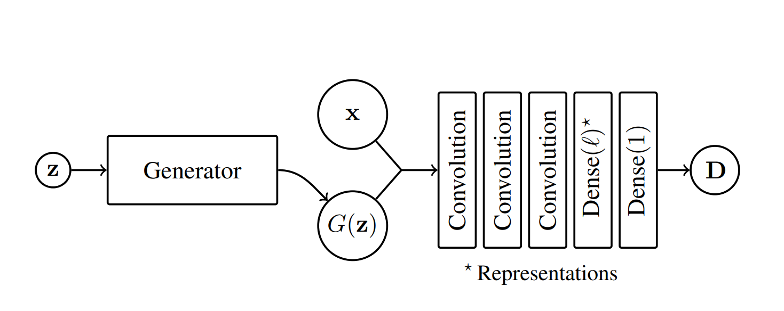
Architecture
Dataset : BBBC021 dataset of human breast cancer cell lines
DCGAN : Enhances the original GAN with deep convolutional layers. Uses Binary Cross Entropy Loss
WGAN : DCGAN with Wasserstein loss
LSGAN : DCGAN with Least Squares loss
DCGAN
Notes:
The paper employs GANs to build a generative model of single cell images BBC021 dataset, which consists of high-resolution images of human cells (a type of breast cancer cell line).. GANs are composed of two parts: a generator that creates images and a discriminator that evaluates them. The GANs are trained to generate new, synthetic images of cells that maintain the essential characteristics of the original dataset.
The study explores different GAN architectures DCGAN, WGAN & LSGAN. DCGAN is a variant of the original GAN that primarily uses convolutional layers in the neural networks. This makes it more effective for image data. It has the standard GAN loss function - Binary Cross entropy loss.
WGAN is DCGAN with Wasserstein loss instead of binary cross-entropy. This loss function provides smoother gradients and improves the training process.
And finally LSGAN with loss function being least squares, penalizes samples that are far from real data distribution. This approach leads to more stable GAN training and mitigates the issue of vanishing gradients.
The LSGAN architecture, in particular, was found to be most stable and effective in generating high-quality cell images.
The paper terms the advantages of GANs as being able to Capture intrinsic relationships between biologically meaningful channels. The generative abilities of this method also enable useful visualizations of cells to help translate data variations into biological phenotypes

Slide 10
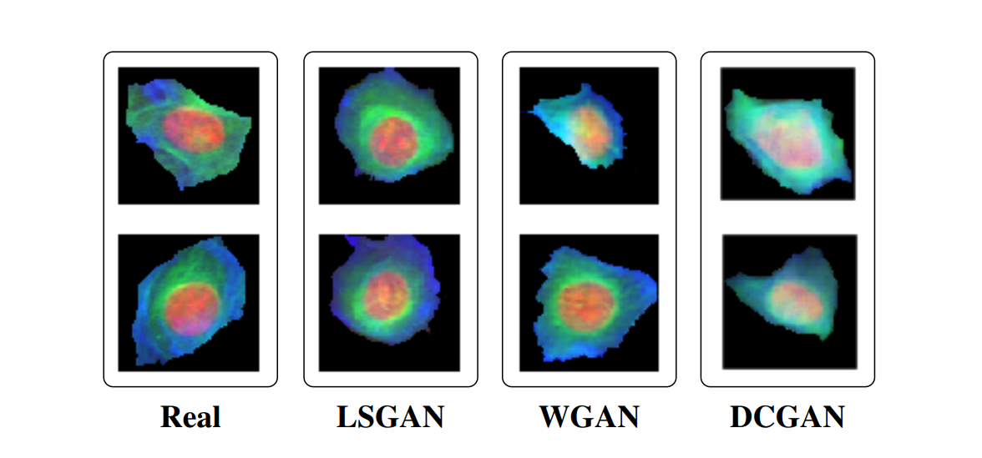
Results
Notes:
Coming to results, to assess the quality of synthesized images the researches of the paper presented three expert biologists with 50 real cell images and 50 artificial cells generated with LSGAN. They randomized the order of images and asked the experts to judge whether each cell was real or fake. On average, 30% of the time the synthetic cells were realistic enough to fool the human jurors into believing they were real.

Slide 11
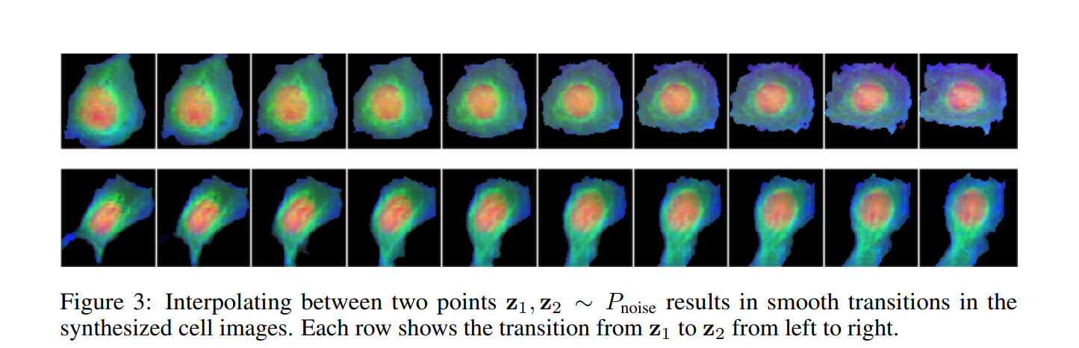
Results
Notes:
Here we see an interesting result of how interpolating between two noise samples leads to smooth transitions in synthesized cells. This supports the fact that the generator learned a low-dimensional manifold of the images.

Slide 12
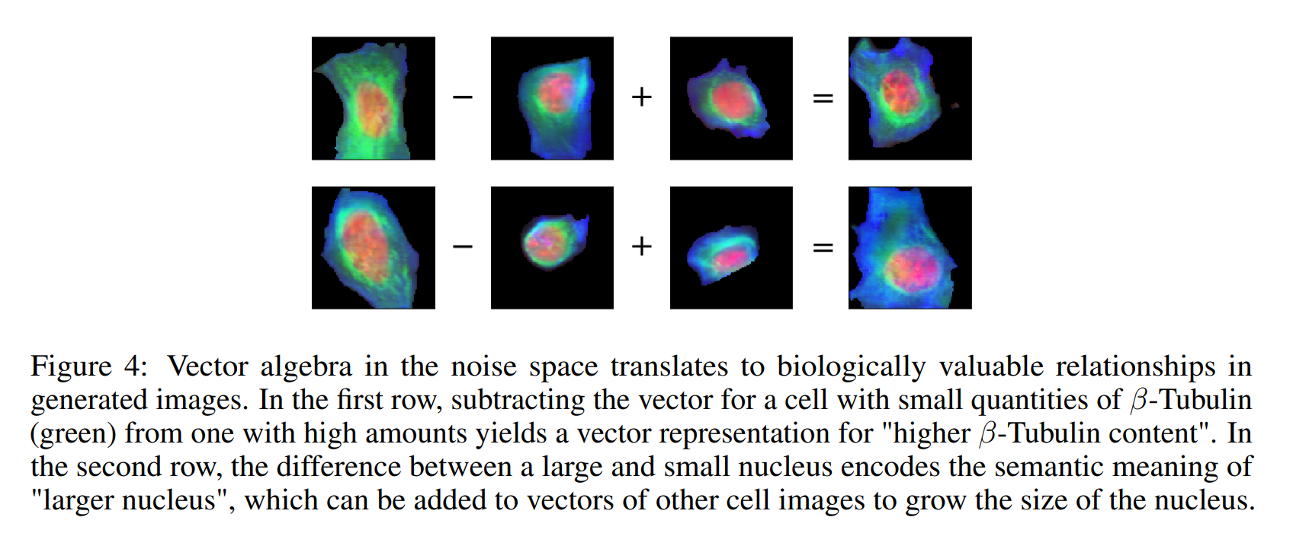
Limitations
Notes:
The paper highlights that the vector algebra in noise space translates to noise space encodes semantic relationships, enabling
algebra on interpretable properties of the images such as size of the nucleus or β-Tubulin
content. While there is no way to encode images into Pnoise with the GAN architectures presented so far, they believe more advanced architectures that enable this will be highly valuable if they can maintain these remarkable semantic properties.

Slide 13
Generative Modeling for Protein Structures

Slide 14
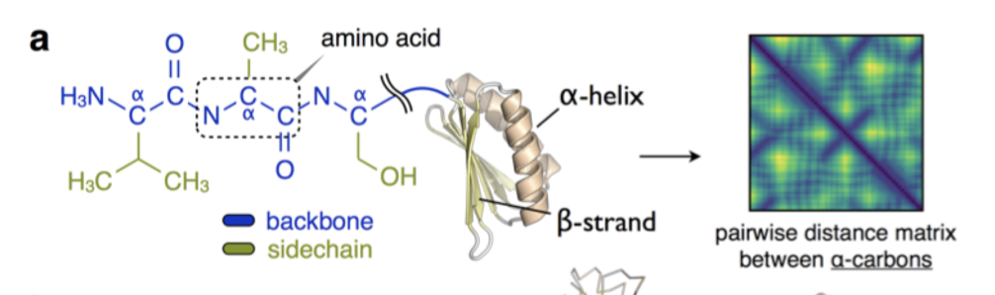
Data Representation

Slide 15
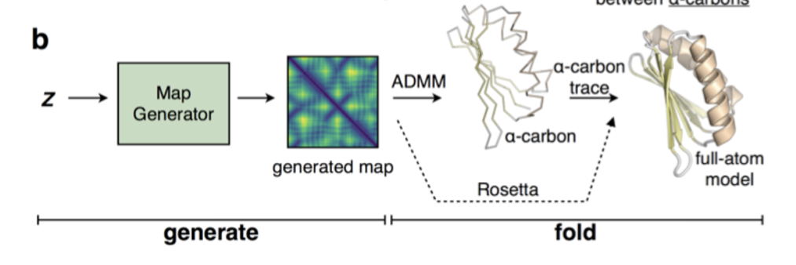
Pipeline Architecture

Slide 16
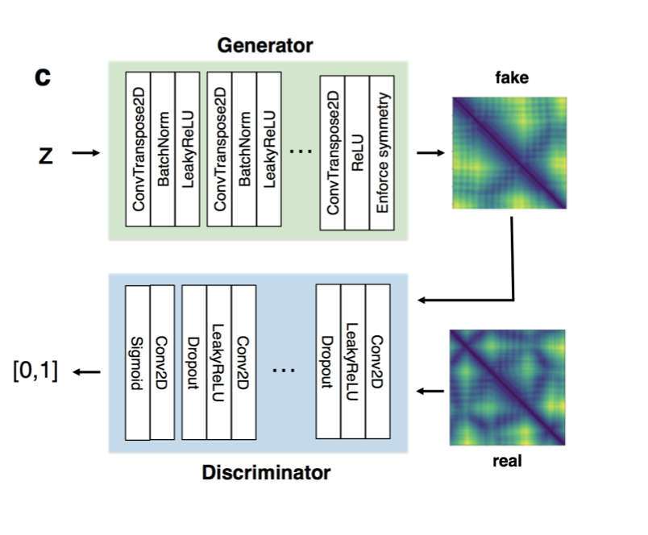
Map generator Model Architecture
DCGAN Map Generator Model used to generate pairwise distances maps in Å between the 𝛼-carbons on the protein backbone
The generator inputs the pairwise distance maps in the dataset
It outputs a fake distance map to fool discriminator, which, in turn predicts if inputs are real (dataset samples) or fake (generator output).

Slide 17
ADMM: A Key Player in Protein Structure Recovery
Alternating Direction Method of Multipliers (ADMM) is a crucial optimization algorithm used in the recovery of protein structures.
It transforms 2D pairwise distances into 3D Cartesian coordinates, enabling the reconstruction of protein structures from generated maps.
Post-ADMM process: while ADMM is fast, it may not be able to correct errors in local structure. Therefore, a subsequent step called the "carbon trace script" is used to trace an idealized peptide backbone geometry.

Slide 18
Results
Baseline: TorusDBN and FB5-HMM - which are hidden Markov Models (HMMs)
The authors demonstrate that their GAN-based method is capable of quickly producing structurally plausible solutions for completing corrupted protein structures. They show that the method outperforms the baselines in terms of structure generation and recovery.
On comparison with the structures generated using the Rosetta modeling suite, while the Rosetta method produces locally correct structures, it is slower and cannot correct errors in local structure as effectively as their GAN-based method.

Slide 19
Conditional GAN for gene expression inference

Slide 20
Problem Statement
Goal : Inferring large-scale gene expression profiles
Existing Methods :
Linear Model - Lack of capacity to capture non linear relationships
Kernel Model - Expensive Kernel Matrix
Solution : Leverage GANs to map landmark genes to the target genes

Slide 21
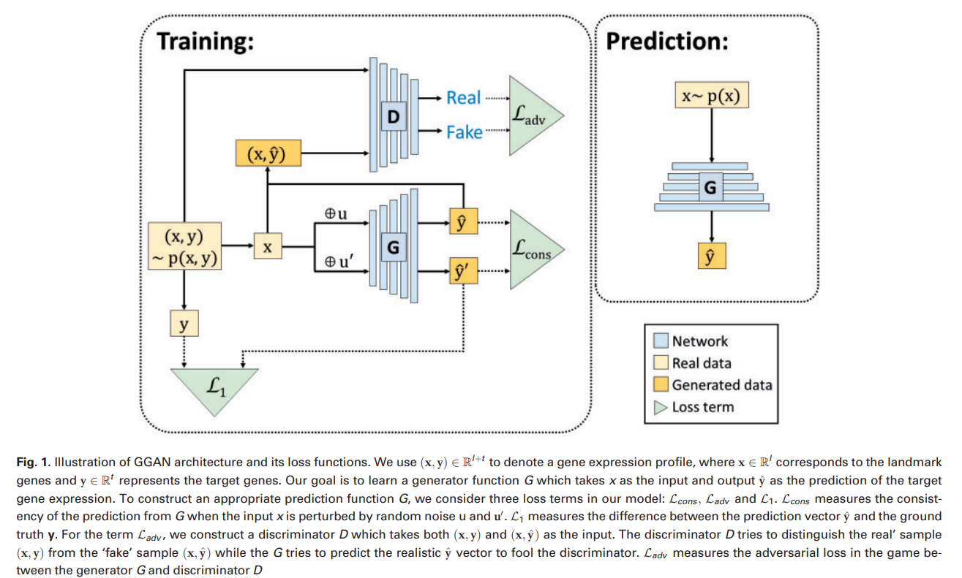
Architecture

Slide 22
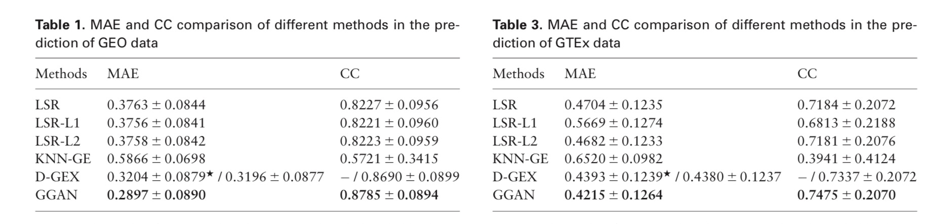
Results

