Slide 1
SOC TRIAGE CLASSIFIER
Model Selection Justification
Comparing 7 classifiers across two independent evaluations to select the production fallback model
10,000
17
7
70.5%
training tickets
engineered features
models compared
unanimous agreement
SIEM / SOC AI Program

Slide 2
METHODOLOGY
How the comparison was run
01
Dataset
02
Sanity check
10,000 synthetic tickets, probabilistically labeled (55% False Positive / 25% True Positive / 20% Needs Review).
Realistically labeled — the same alert can be a false alarm or a real threat depending on context, not just which rule fired.
A rule-name-only baseline classifier scores 62.2% accuracy — well below the 95% threshold that would signal a trivial, non-informative comparison.
03
Features
04
Models
17 engineered features per ticket: severity, user/host context, timing, historical TP/FP counts, command-line entropy, MITRE tactic, and two interaction terms.
XGBoost, LightGBM, CatBoost, Random Forest, Logistic Regression, SVM (RBF), and KNN — each run with one fixed, untuned configuration. No model is hand-tuned to win.
05
Fairness controls
06
Two evaluations
Identical partial class-balanced sample weighting applied to all 7 models. Sole exception: KNN has no sample_weight support in scikit-learn — a library limitation, disclosed, not a choice to exclude it.
Tested twice: first by splitting the training data 5 different ways, then again on a completely separate set of tickets the models had never seen before.

Slide 3
RESULTS — CROSS-VALIDATION
5-fold cross-validation, 10,000 tickets
Model | Accuracy | F1 (macro) | Train time | Inference | Size
XGBoost | 70.2% | 0.621 | 111.7 ms | 0.0008 ms/ticket | 488 KB
LightGBM | 70.0% | 0.621 | 408.1 ms | 0.0020 ms/ticket | 508 KB
CatBoost | 70.4% | 0.612 | 150.7 ms | 0.0025 ms/ticket | 65 KB
SVM (RBF) | 68.8% | 0.578 | 4,743.6 ms | 0.161 ms/ticket | 1,003 KB
Random Forest | 68.9% | 0.556 | 117.4 ms | 0.0088 ms/ticket | 1,036 KB
Logistic Regression | 68.1% | 0.550 | 86.9 ms | 0.0001 ms/ticket | 2 KB
KNN | 67.0% | 0.541 | 1.2 ms | 0.0346 ms/ticket | 1,408 KB
Sorted by F1-macro (the fair metric under class imbalance). Highlighted row: best F1-macro. XGBoost and LightGBM are effectively tied.

Slide 4
RESULTS — INDEPENDENT VALIDATION
Independent validation set, different random seed
Model | Accuracy | F1 (macro) | Needs-Review F1
XGBoost | 70.8% | 0.623 | 0.383
CatBoost | 70.8% | 0.612 | 0.347
LightGBM | 70.3% | 0.619 | 0.383
SVM (RBF) | 69.3% | 0.576 | 0.248
Random Forest | 69.2% | 0.546 | 0.167
Logistic Regression | 68.8% | 0.548 | 0.174
KNN | 67.0% | 0.540 | 0.202
Never used in training — tests generalization beyond the CV fold structure. Same ranking holds: boosted trees (XGBoost / LightGBM / CatBoost) lead by a wide, consistent margin over RF / SVM / LogReg / KNN.

Slide 5
PATTERNS ACROSS BOTH EVALUATIONS
What the results actually show
Boosting beats bagging, linear, and instance-based
Within the top 3, differences are noise
The real gap is XGBoost / LightGBM / CatBoost (F1 0.61-0.62) vs. Random Forest / SVM / Logistic Regression / KNN (F1 0.54-0.58) — consistent in both CV and validation.
XGBoost, LightGBM, and CatBoost sit within each other's cross-validation fold-to-fold standard deviation (±0.8-1.0%) — not a meaningful separation on their own.
70.5% unanimous agreement
Needs-Review is the hard class for everyone
Seven independently-configured models reach the identical verdict on 7 in 10 tickets. Disagreement concentrates in the genuinely ambiguous remainder.
Every model scores noticeably lower on Needs-Review than on False Positive / True Positive — a property of the problem, not of any one model.

Slide 6
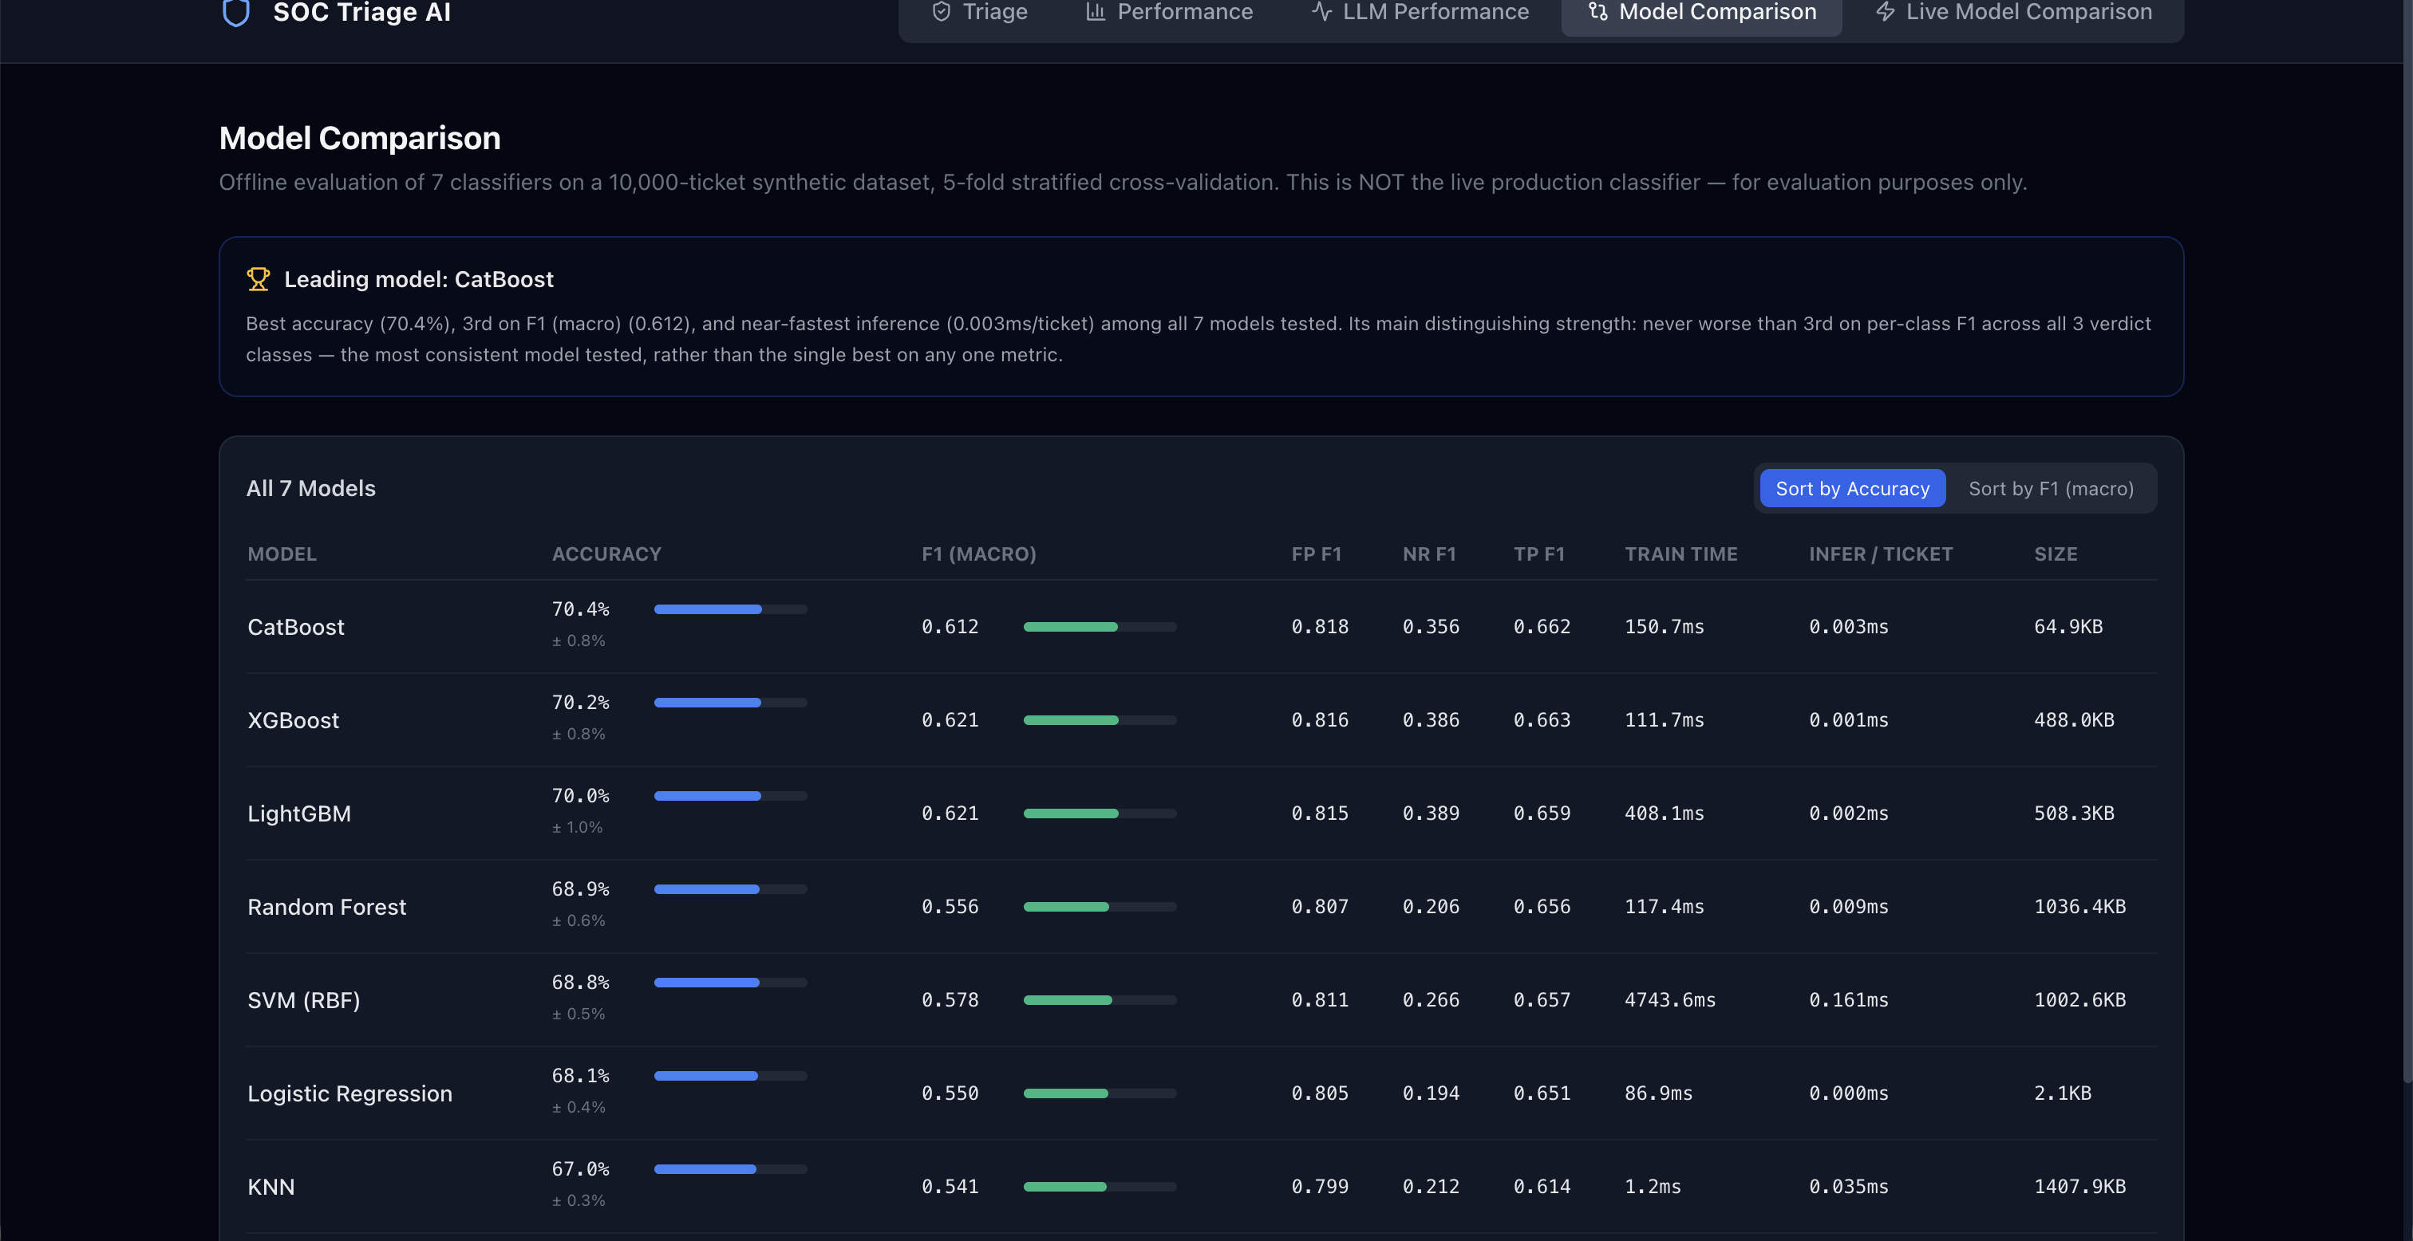
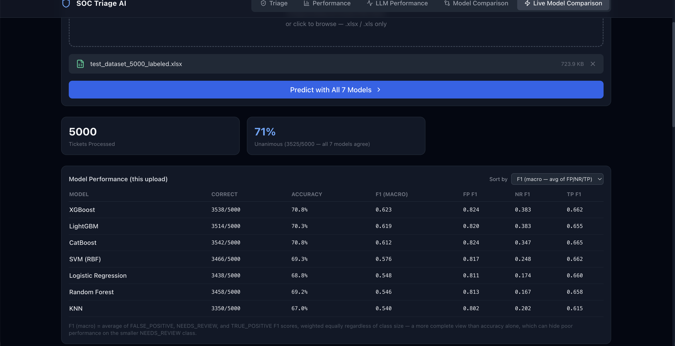
CROSS-CHECK
Confirmed in the live product
Model Comparison — 5-fold CV (backend)
Live Model Comparison — 5,000-ticket upload
The app's own badge favors CatBoost on raw accuracy (70.4%) — but its own text flags CatBoost 3rd on F1-macro (0.612), picking it for per-class consistency, not for being the single best on any one metric.
The same independent validation set used in this deck: XGBoost leads F1-macro at 0.623, with 71% (3,525/5,000) unanimous agreement across all 7 models.
Same story, not a conflict: accuracy rewards the majority False-Positive class and can hide weak Needs-Review performance — the app's own F1-macro tooltip makes this exact point. Both views agree on the same closely-matched top-tier trio; they differ only in which single metric breaks the tie.

Slide 7
SELECTION
Why XGBoost
1
Best-or-tied F1-macro in both evaluations
The only model that leads (or ties the lead) in both the CV benchmark and the independent validation set.
2
Fastest inference
0.0008 ms per ticket — satisfies the millisecond latency requirement for the offline fallback path.
3
Reasonable model size
488 KB — smaller than Random Forest, SVM, and KNN, though larger than CatBoost's 65 KB.
4
Consistent per-class performance
Top 2-3 on all three class F1 scores — not leading one class at the expense of another.
5
Already in production
Already integrated into the live pipeline (backend/pipeline/classifier.py) — a practical consideration alongside the metrics above, not a performance claim.

Slide 8
LIMITATIONS & SCOPE
What this comparison does not settle
Narrow top-tier margin
Synthetic data only
XGBoost's edge over LightGBM / CatBoost is within cross-validation fold-to-fold noise — a defensible choice among a closely-matched top tier, not a large, unambiguous advantage.
All figures come from generated tickets. Production-grade validation is contingent on Option A shadow-mode testing against real, analyst-confirmed dispositions per the governing TSD.
Needs-Review is hard — for everyone
Sensitive to configuration
Best F1 on this class is ~0.38-0.39 across all 7 models. That reflects genuine problem difficulty, not a weakness specific to XGBoost.
Ranking has shifted under different settings in prior testing. A materially different configuration — e.g. emphasizing Needs-Review recall — could reorder the top 3.

Slide 9
RECOMMENDATION
XGBoost is selected as the production
SOC triage classifier
Best-or-tied F1-macro across both the cross-validation benchmark and an independent validation set it never trained on, with the fastest inference and a consistent per-class profile — a defensible choice among a closely-matched top tier, backed by two separate evaluations rather than one.
0.621 / 0.623
0.0008 ms
2 of 2
F1-macro, CV & validation
inference per ticket
evaluations led or tied

