Slide 1
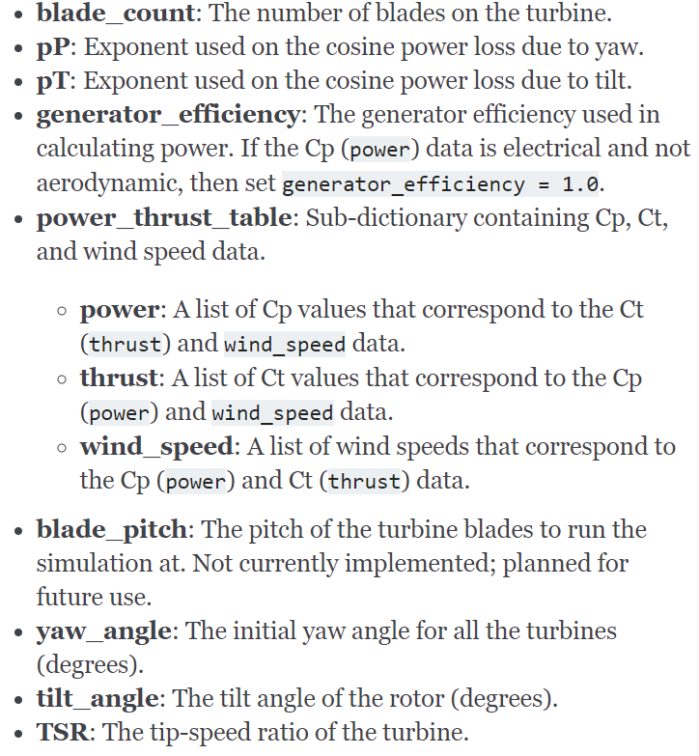
Inputs to FLORIS
Outputs of my Model
FLORIS: A steady-state wake characteristics of the farm
My Model:
A two-mass model consisting of wg, \theta_tw, wt
Inputs to My Model
Outputs of FLORIS
Mechanical Torque
= Pm/wt
2. Generator Torque
(control input)
Mechanical power, Pm
Elec
Pwr,
Pe

Slide 2
How do we do generator torque control with this augmented model?
My idea:
Let TSR be the control handle
Then, GenTorque input to my model is
Te = Kopt wg^2
Where Kopt can be computed as 0.5 rho A R^3 Cp(TSR,beta)/TSR^3
3. Cost function = sum(Pe_i), i = 1,2,….. No. of Turbines

