Slide 1
Deep Reinforcement Learning for Automatic Generation Control of Wind Farms
Sanjana Vijayshankar, Paul Stanfel, Jennifer King, Elina Spyrou, Kathryn Johnson

Slide 2
Outline
A2e2g overview
Deep reinforcement learning
Problem setup
Results
Future work

Slide 3
Outline
A2e2g overview
Deep reinforcement learning
Problem setup
Results
Future work

Slide 4
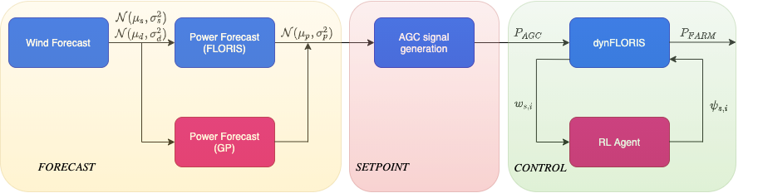
A2e2g
Today’s focus

Slide 5
Outline
A2e2g overview
Deep reinforcement learning
Problem setup
Results
Future work

Slide 6
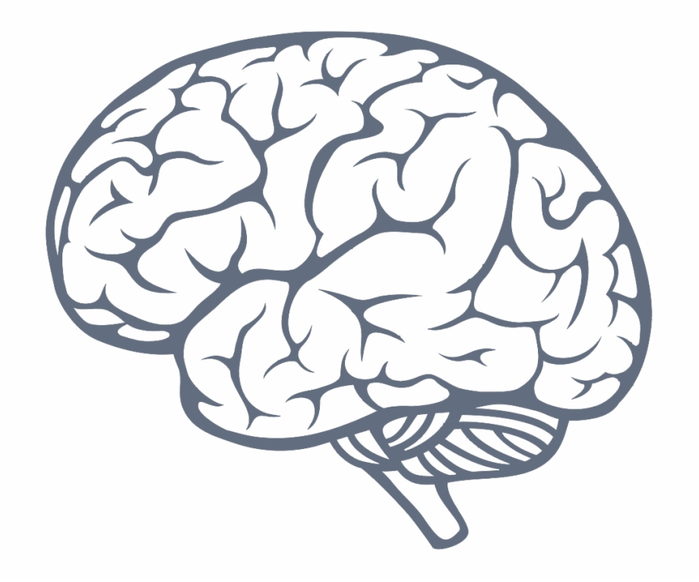
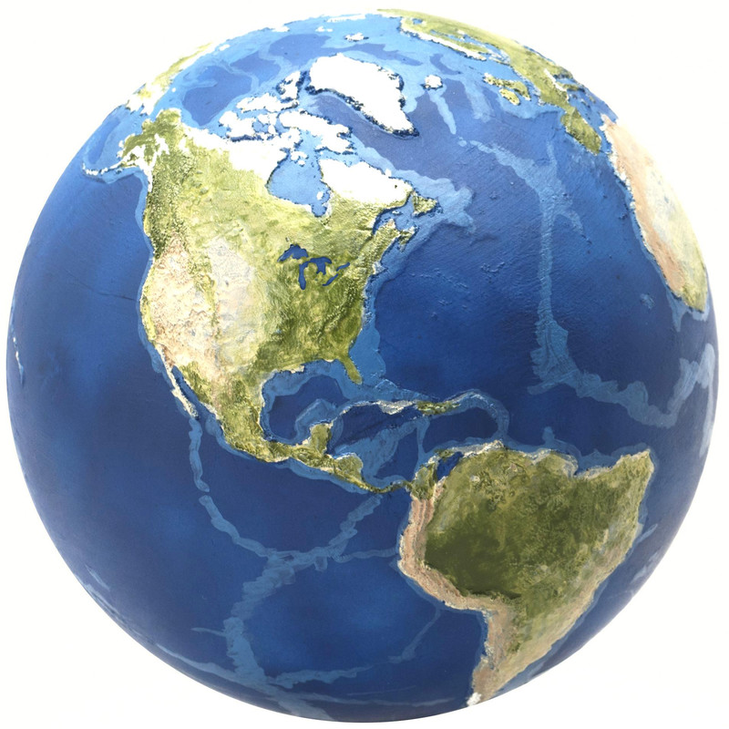
Reinforcement Learning (RL)
RL is a general-purpose framework for decision-making
An agent selects actions
Its actions influence future observations
Success is measured by a scalar reward signal
Goal: Select actions to maximize future rewards
Observations
Rewards
Actions

Slide 7

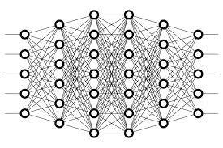

Deep Learning
Deep learning is a general-purpose framework for representation learning
Given an objective
Learn a representation that achieves objective
Directly from raw inputs
Using minimal domain knowledge
Cat
Cat
Borat

Slide 8
Deep Reinforcement Learning
We seek an agent that can solve a task
Reinforcement learning defines the objective
Deep learning gives the mechanism

Slide 9
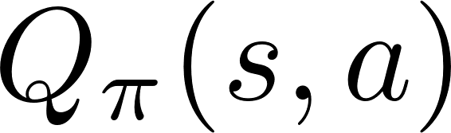



SARSA
State-action value function:
Expected return when starting in , performing and following
SARSA: Use any policy to estimate Q that maximizes future reward:
Q directly approximates Q* (Bellman optimality equation)
Independent of the policy followed
Only requirement: keep updating each (s,a) pair
Learning Rate
Discount Factor
New State
Old State
Reward

Slide 10
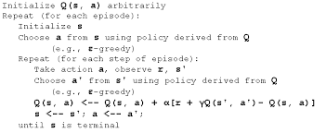
Value Iteration: Non-NN Approach
Learning Rate
Discount Factor
New State
Old State
Reward
 | A1 | A2 | A3
S1 | 0 | -1 | 2
S2 | -1 | 1 | 2
S3 | 2 | 0 | 0

Slide 11
Value Iteration: Non-NN Approach
Learning Rate
Discount Factor
New State
Old State
Reward
 | A1 | A2 | A3
S1 | 0 | -1 | 2
S2 | -1 | 1 | 2
S3 | 2 | 0 | 0
Extremely high dimensional

Slide 12
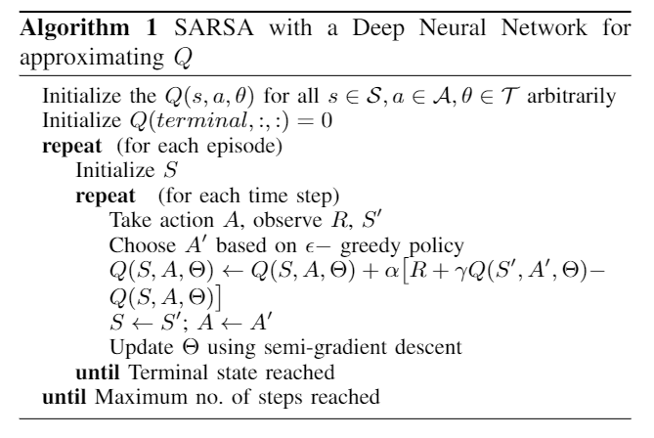
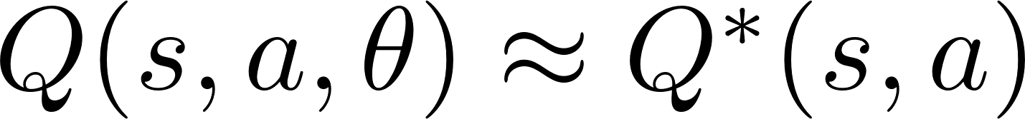
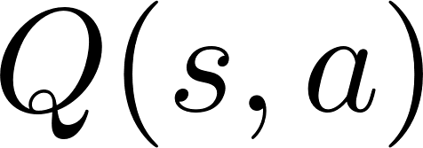

Deep SARSA
Use a neural network to approximate the Q-function
Function Approximator

Slide 13
Outline
A2e2g overview
Deep reinforcement learning
Problem setup
Results
Future work

Slide 14
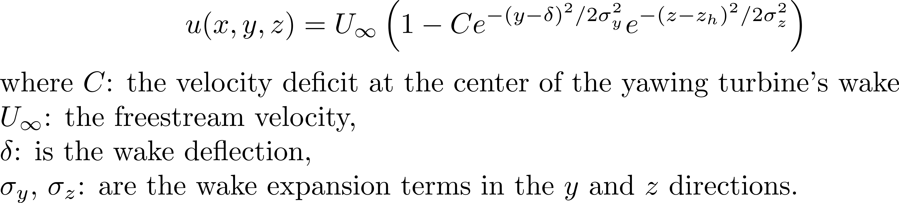
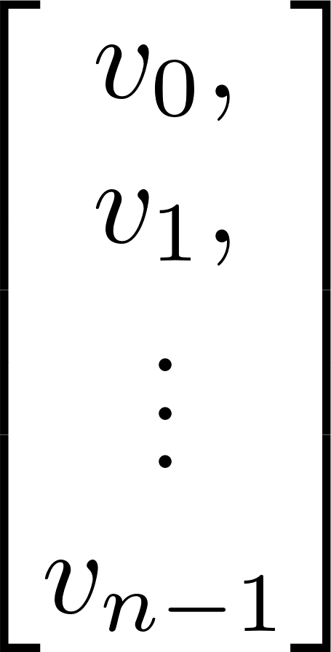
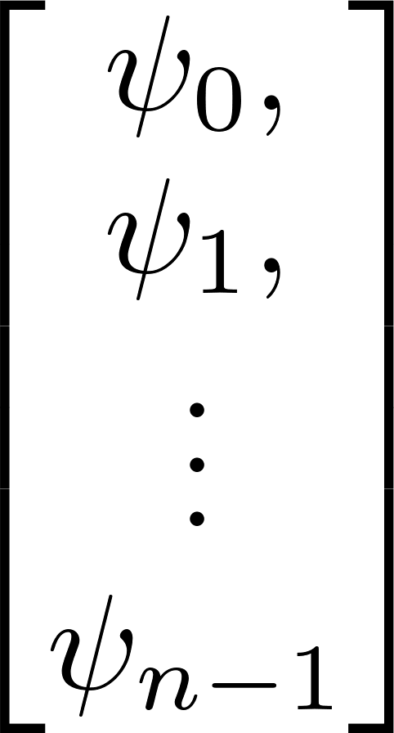
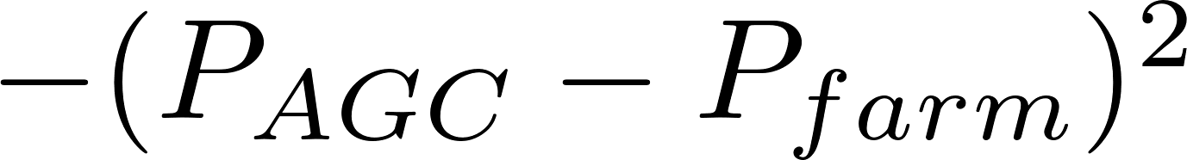
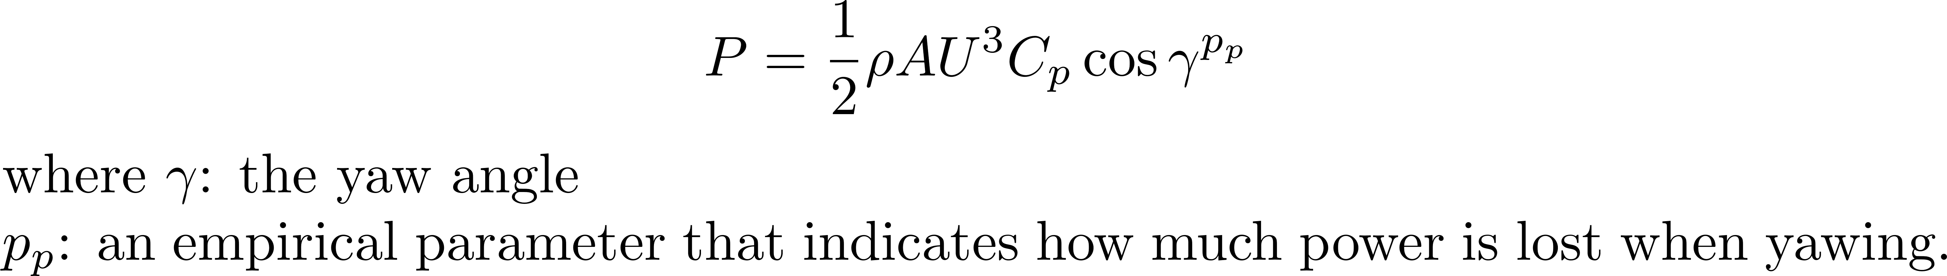
Problem Setup
Agent
Gaussian Model
Power
FLORIS
Steady-state simulator

Slide 15
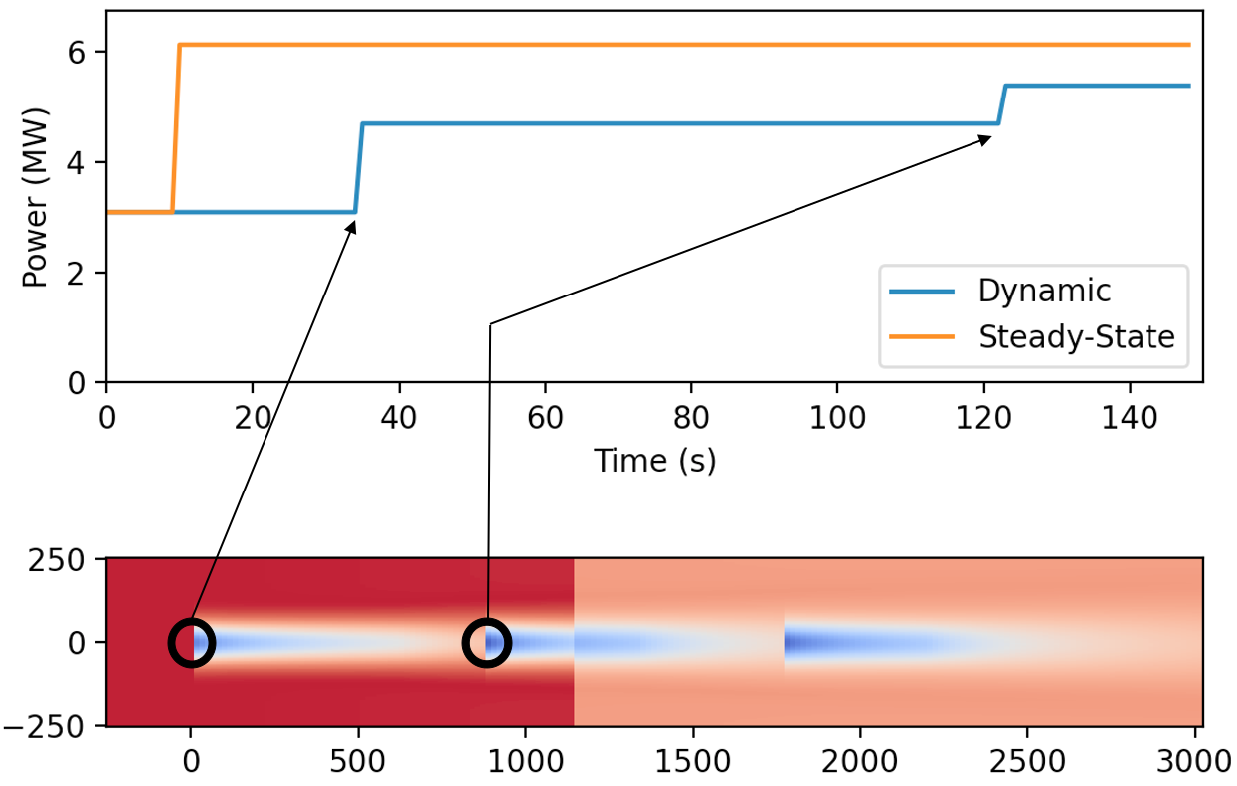
Problem Setup
Agent
Approximate dynamic wake behavior
dynFLORIS

Slide 16
Problem Setup
The AGC system aims to correct power system imbalances that might result in interconnection frequency deviating from 60 Hz.
It monitors the system frequency and sends active power dispatch signals to resources providing regulation every 2 to 4 seconds
Historical price and regulation deployment data from two US Regional Transmission Operators: ERCOT and PJM respectively.
Agent
dynFLORIS

Slide 17
Outline
A2e2g overview
Deep reinforcement learning
Problem setup
Results
Future work

Slide 18
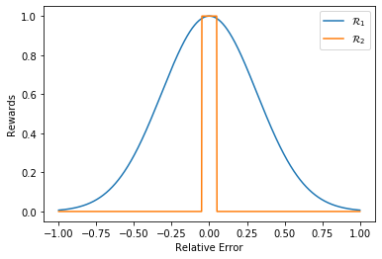
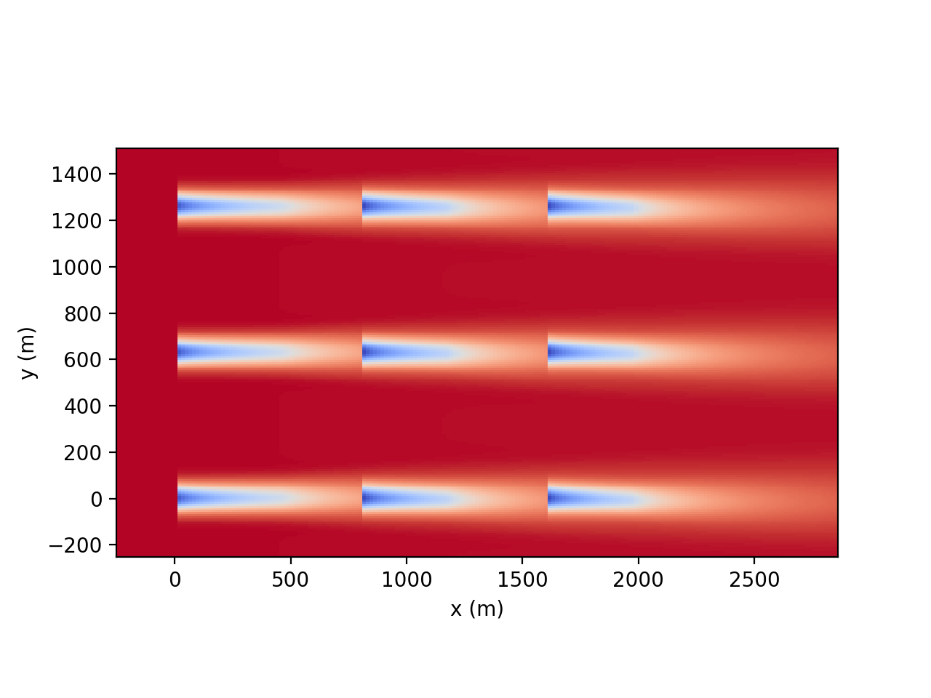
Reward function and Layout
Agent
Rewards
dynFLORIS

Slide 19
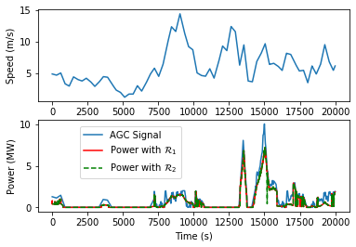
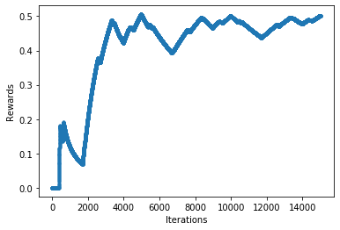
Results

Slide 20
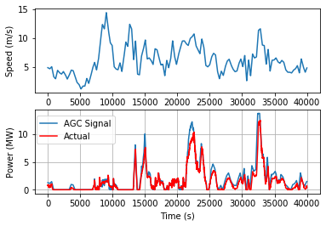
Actor Critic

Slide 21
Outline
A2e2g overview
Deep reinforcement learning
Problem setup
Results
Future work

Slide 22



Challenges
Open challenges:
Real world observation + trial and error
Realistic simulation + transfer learning
1. Improve transfer learning
2. Improve dynFLORIS
Simulation
Real world

Slide 23
Immediate focus
Axial induction control
Policy gradient methods
Integrate LPV model from FAST
Uncertainty in wind data

