Slide 1
Adding emissions information to LCDMPC
August 3rd 2022

Slide 2
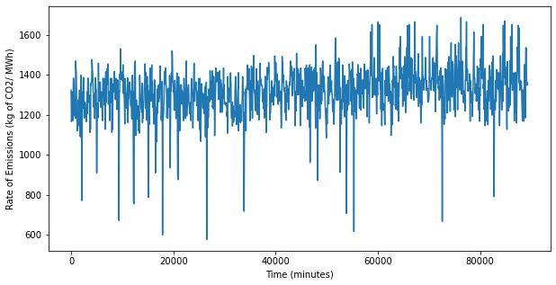
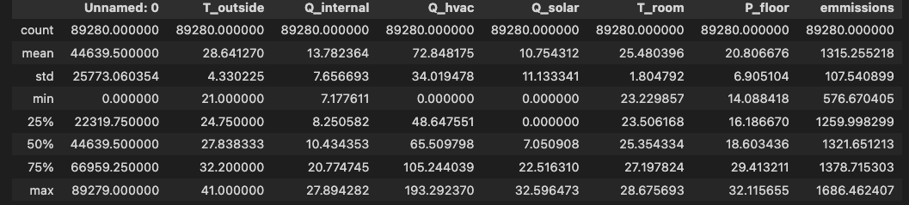
Emissions Data

Slide 3
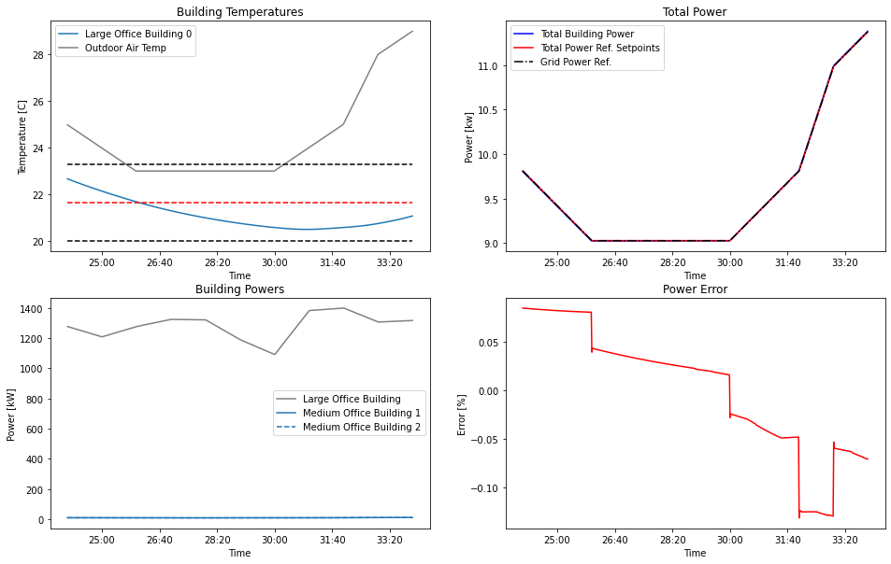
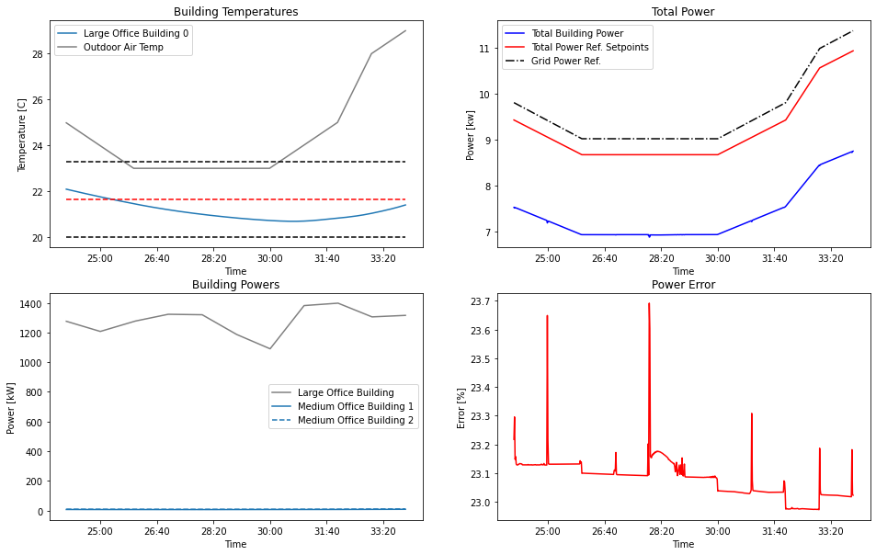
Tracking with and without emissions
Tracking error increases
Simulation without considering emissions in the objective
Simulation considering emissions in the objective

