Slide 1
Minimizing Emissions in LC-DMPC

Slide 2
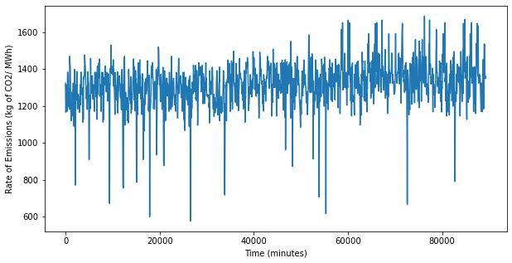
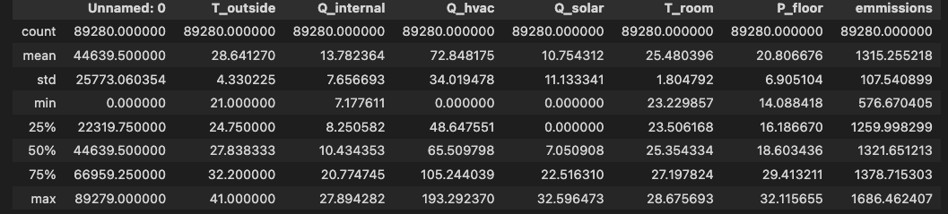
Emissions Data
Add as disturbance

Slide 3
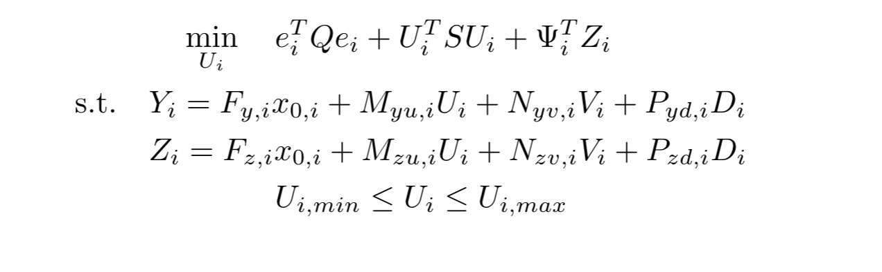
Formulation – Vanilla LC-DMPC

Slide 4
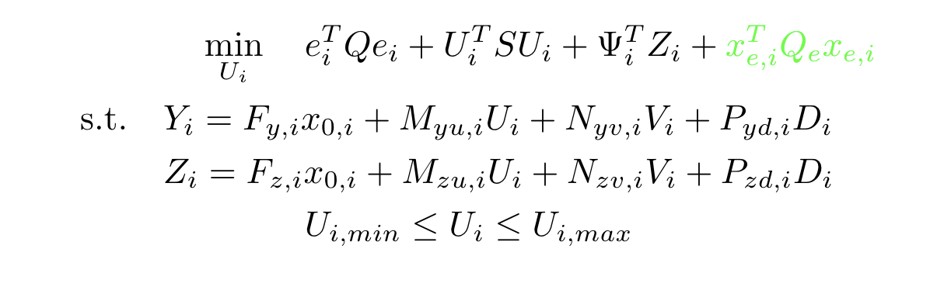
Formulation – LC-DMPC with emissions

Slide 5
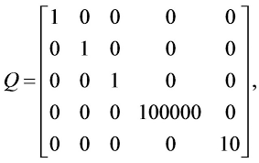




Q matrix structure
$$q_{temp}$$
$$q_{abs_p}$$
$$q_{track}$$
$$q_{emissions}$$

Slide 6
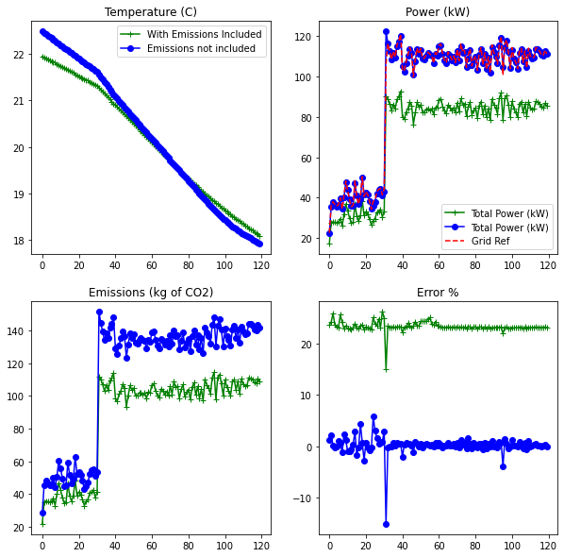
Consequences of minimizing emissions on power tracking performance (no temp tracking)
Temperature is comparable.
Emissions are lowered at the cost of tracking performance.

Slide 7
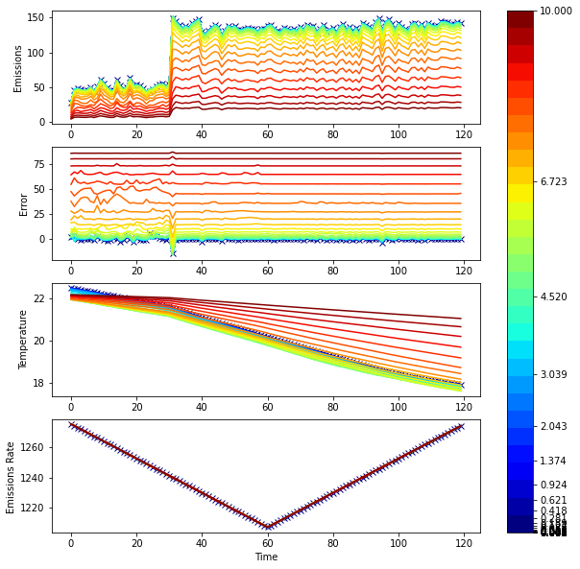
Varying Q
Emissions (kg of CO2)
As Q increases, tracking worsens.
Power tracking error %
Temperature (C)
Emission rate (kg of CO2 /MWh)

Slide 8
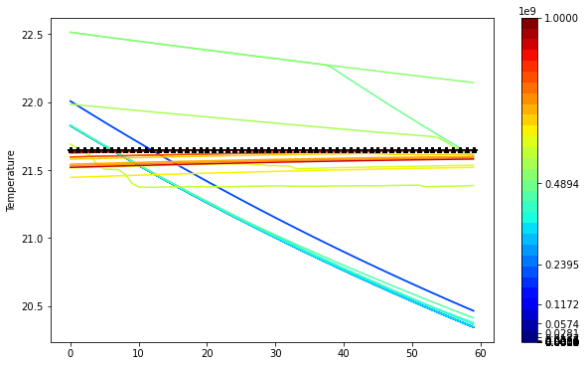
Temperature Tracking
Terms wrt emissions and power tracking set to 0
The sweet spot is 1e8 – 1e9
Reference temperature : 21.65
Q_temp

Slide 9
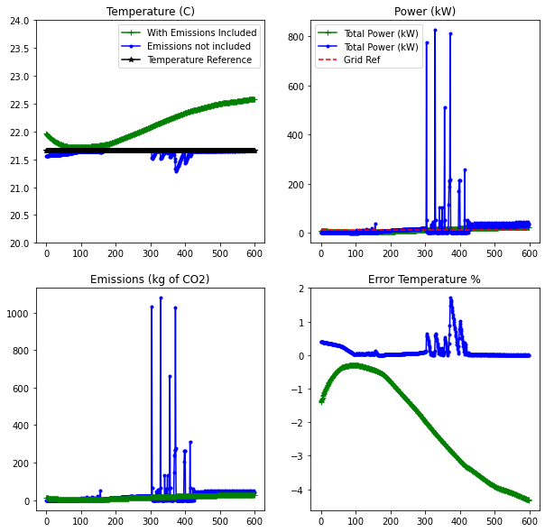
Temperature tracking
Set Q wrt emissions and power to 0
Set Q_temp = 1e9 (This is what seems to be working)
Tracking is good when emissions not included
Worsens when Q_emissions = 0.5
Power tracking isn’t happening as weight set on it is 0

Slide 10
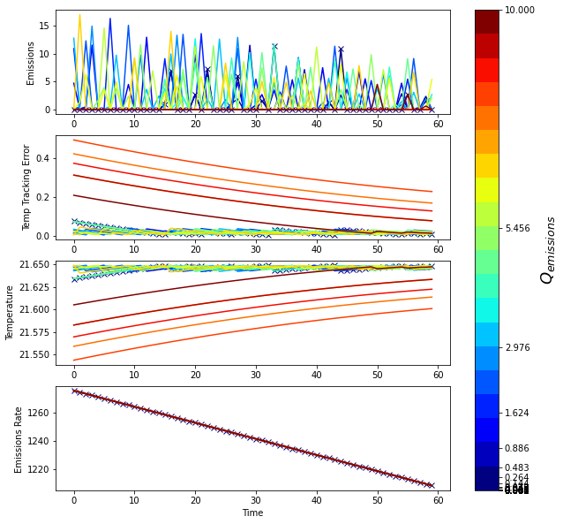
Temperature tracking with varying Q_emissions
Temp tracking is set to 1e9.
As emphasis on emission increases, tracking performance deteriorates.
Here, temp ref = 21.65

Slide 11
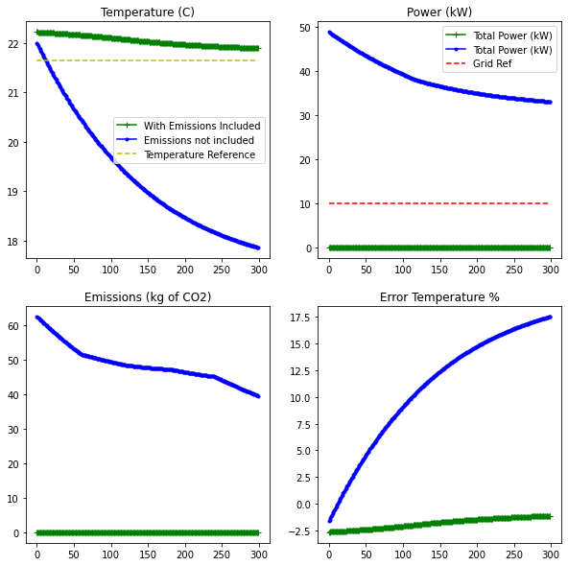
Emission Minimization ONLY
Q_emissions = 100/0
Q_powertracking = 0
Q_temptracking = 0
Emissions are minimized but tracking is not achieved

Slide 12
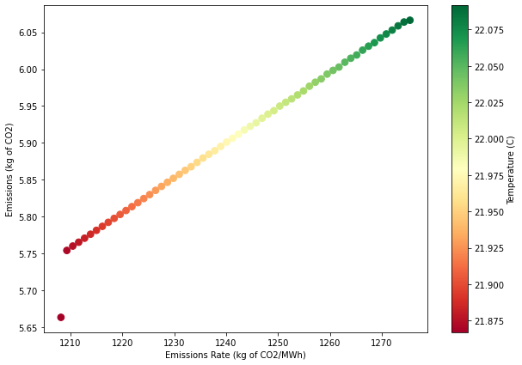
Emissions vs Emissions Rate
A little counter-intuitive as the emissions should have reduced with emissions rate.
Maybe power supersedes the effect of emission rate?

Slide 13
Updating Q on the fly
Need a formal way of tuning the Q matrix
We do observe some trends in the plots when we tune the Q matrix but seems like the parameter sweep is an expensive approach especially when dealing with multi-objective problems.
Bayesian optimization to the rescue?
Will require a forecast of the grid reference signal.

Slide 14
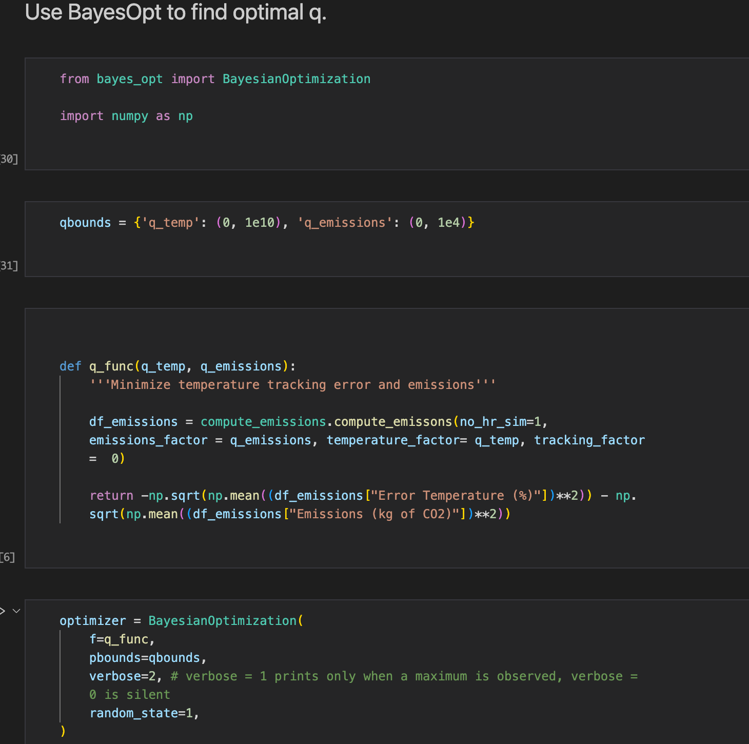
Bayesian Optimization using bayes_opt

Slide 15
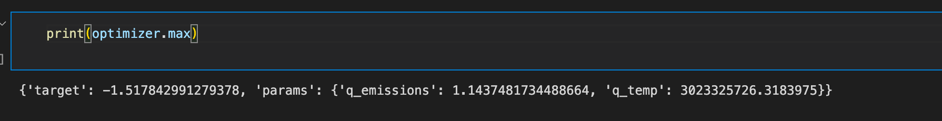
Bayesian Optimization using bayes_opt

