Slide 1

ACS567- Group Project – E-Commerce Data Analysis Tool
Team No.: 1
Keerthika Mulagani
Harshita Anand
Vijay Anand Pandian
Siddhartha Reddy

Slide 2
Project Overview
Our Application helps managers/sales managers of an E-Commerce Platform to get a data analysis of the sales data of their company like getting the highest sold category, highest sold product, total revenue, average sale etc.

Slide 3
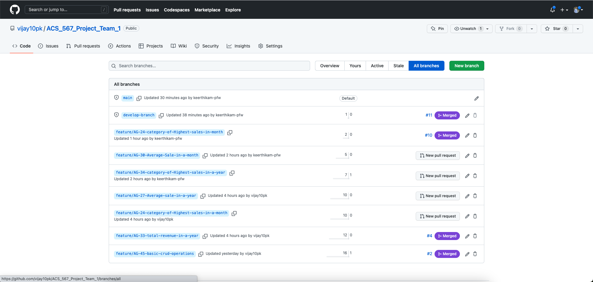
Branching Strategy

Slide 4
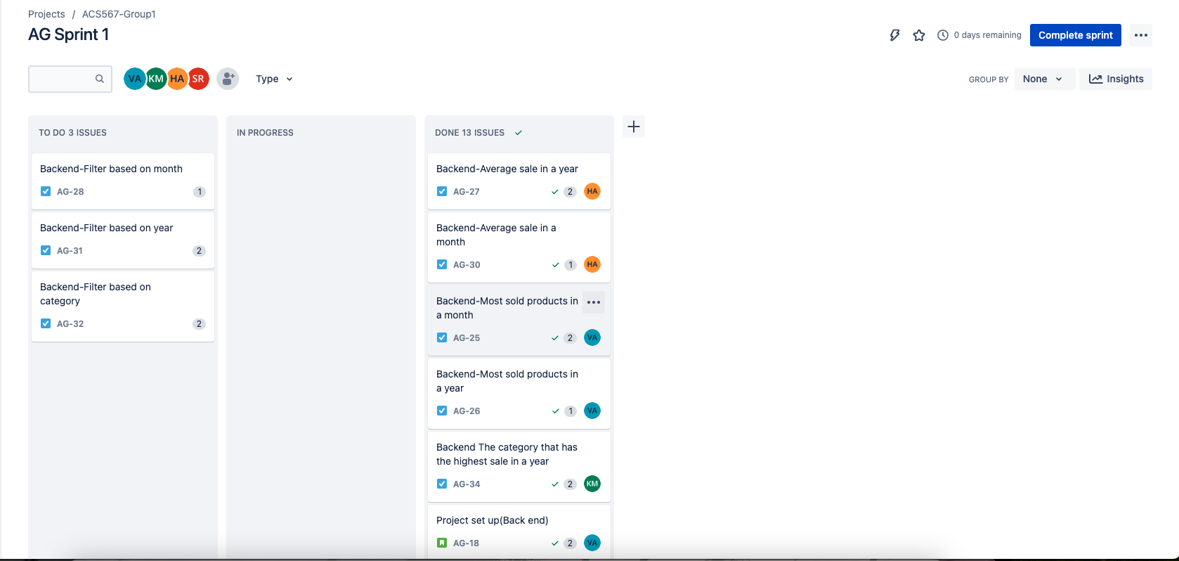
Sprint 1 Plan

Slide 5
Sprint 1 Retrospective
What went well?
We have completed most of the backend features as we planned.
We have completed most of the main features in the backend.
We had a good understanding of the cards.
We followed a strict and good git branching strategy, which everyone understood very well.

Slide 6
Sprint 1 Retrospective
What didn’t go well?
We couldn’t be able to find a good dataset which cost more time.
We were unable to finish 2-3 cards as we planned.

Slide 7
Sprint 1 Retrospective
What needs to be improved?
Need more team coordination.
Team need to work on time management.

Slide 8
Repository Details:
Link: https://github.com/vijay10pk/ACS_567_Project_Team_1

Slide 9
Thank You…!

