Slide 1

ACS567- Group Project – E-Commerce Data Analysis Tool
Team 1:
Keerthika Mulagani
Harshitaa Anand
Vijay Anand Pandian
Siddhartha Reddy

Slide 2

Project Overview
Our Application helps managers/sales managers of an E-Commerce Platform to get a data analysis of the sales data of their company like getting the highest sold category, highest sold product, total revenue, average sale etc.
It also helps them predict the trend based on the analysis done from past years, where we can predict on the category tending to be sold more in the upcoming months or years, as well as we can predict the total revenue it can generate in the next few years.

Slide 3
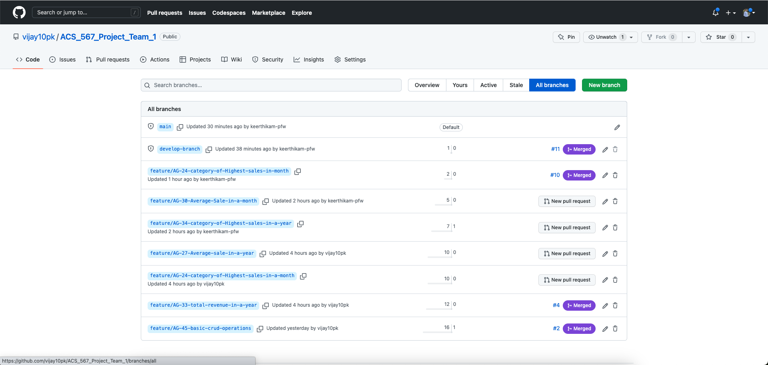
Branching Strategy
We have a total of 30+ branches in our GitHub repository and about 60+ PRs, each branch representing a feature worked on.
We have maintained the naming of our branches following the naming conventions throughout the development. For example:- feature/AG-62-Frontend-Search-by-Product-Name and likewise others similarly.
After working on our respective feature branch, we merged into the developer-branch before merging into the main branch.
Once all functionalities being checked in the develop-branch we merge it into the main branch.
We added two review approvals if one tends to merge his/her code to the main branch and added one review approval to merge into develop-branch.
We also maintained a hot fix branch to fix the bugs and clean the code for readability.

Slide 4
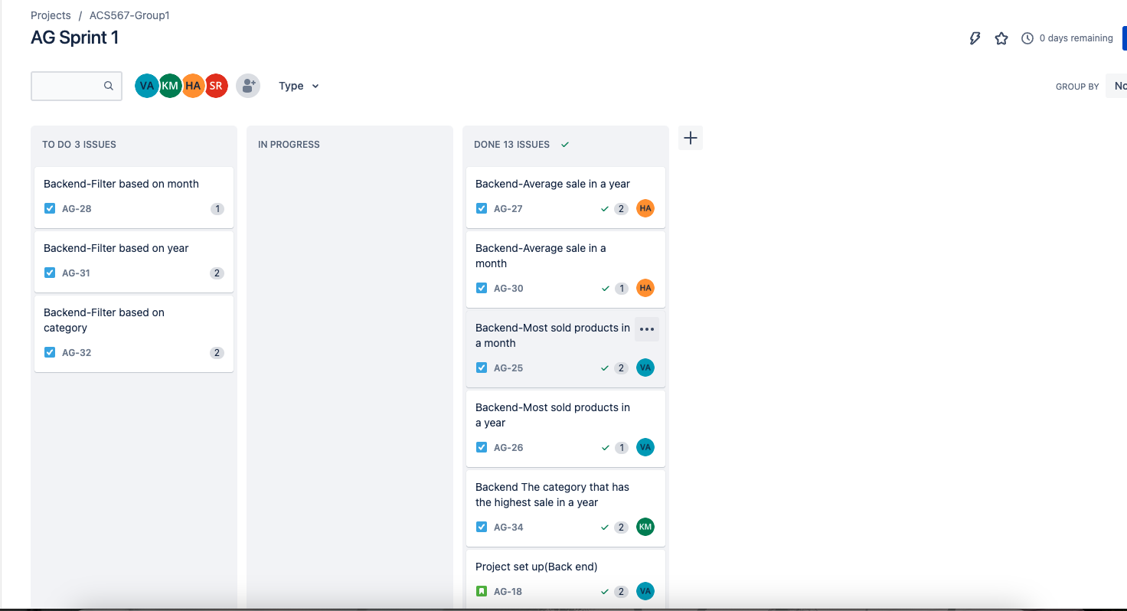
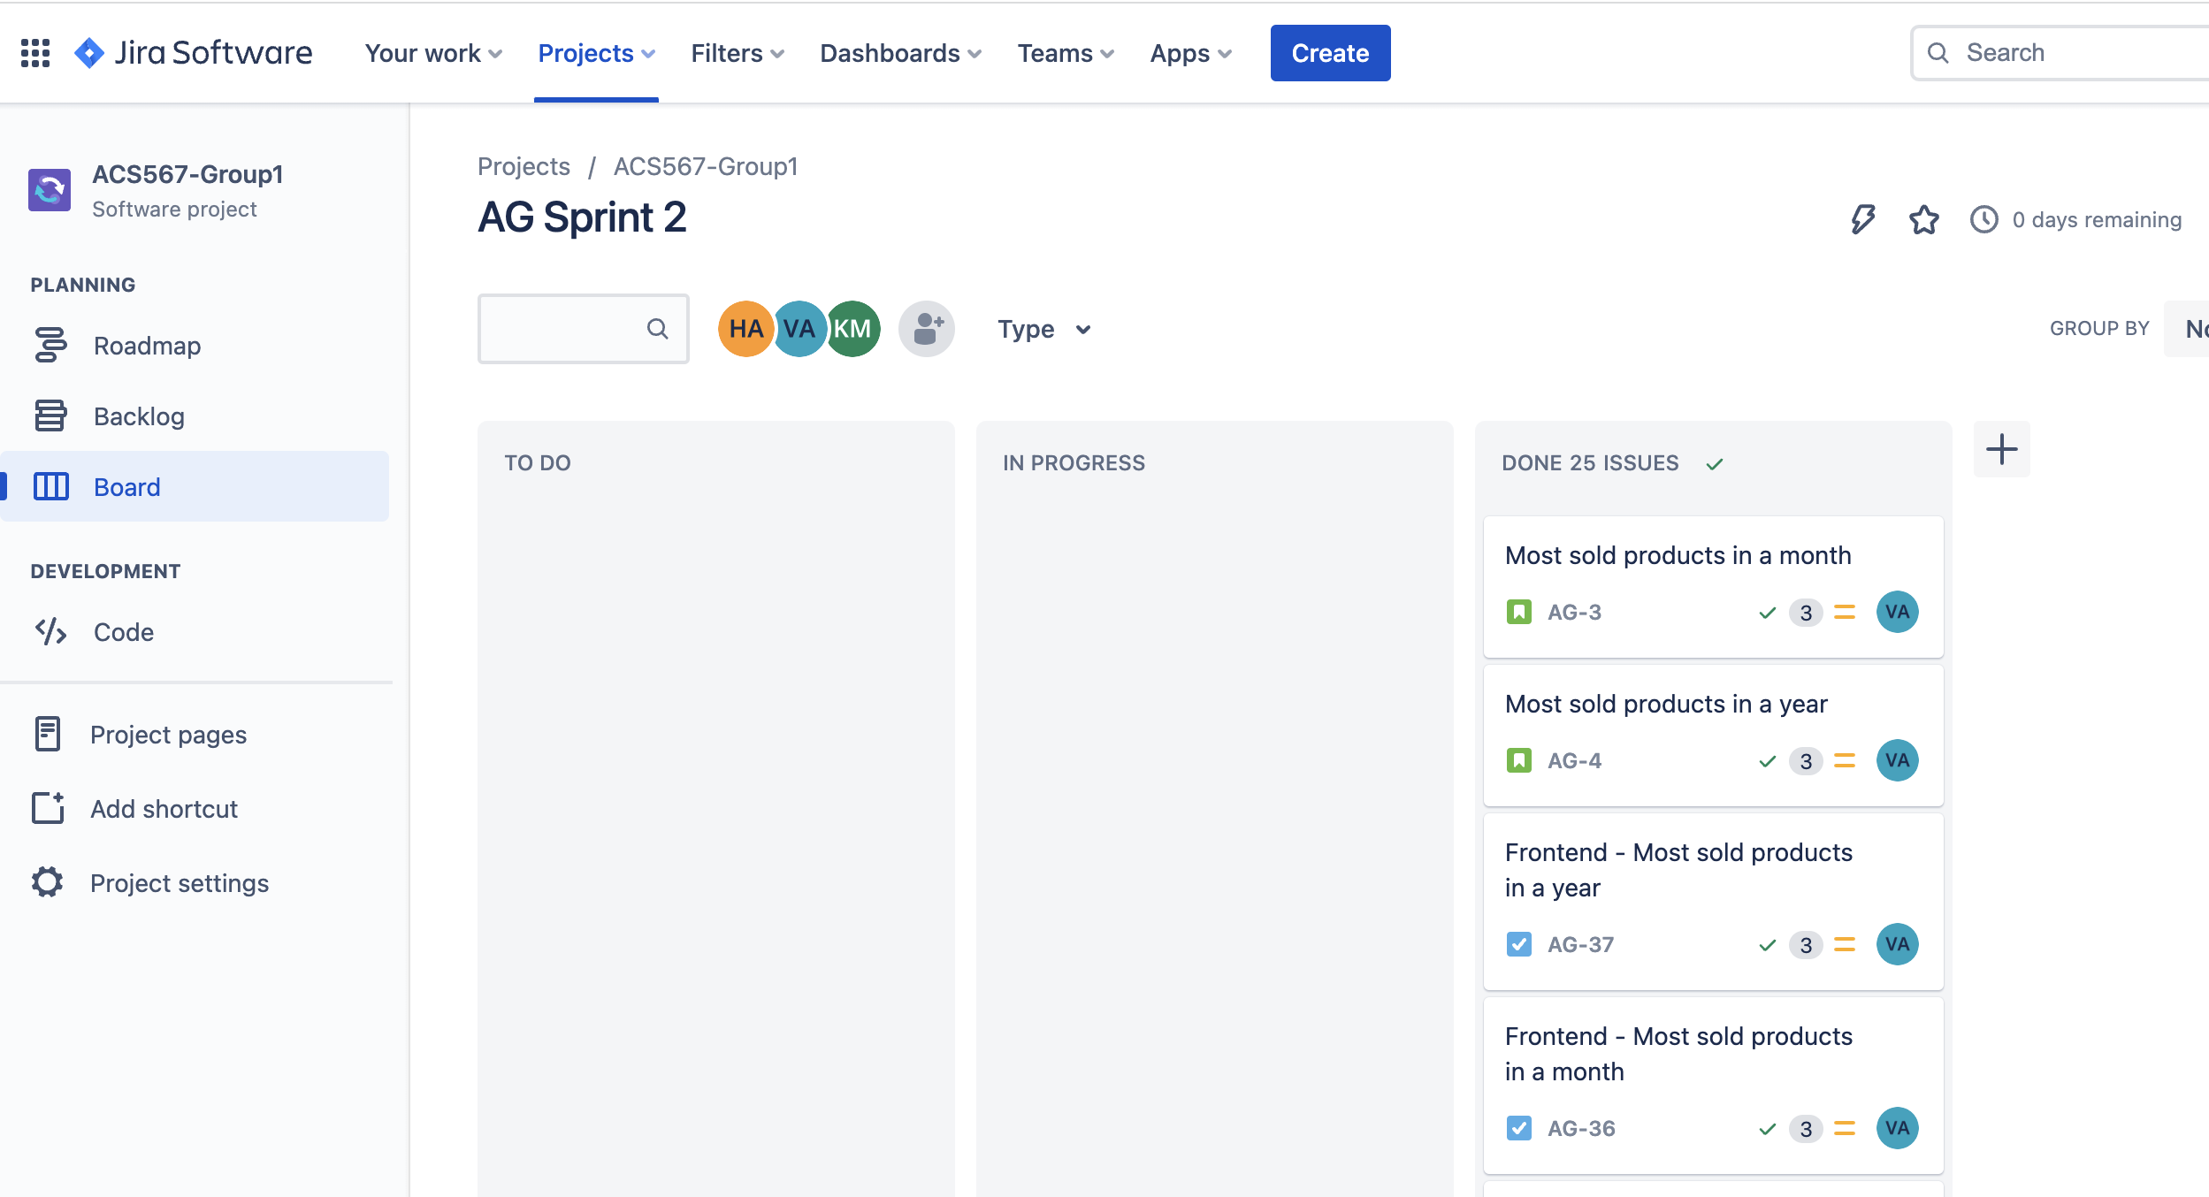
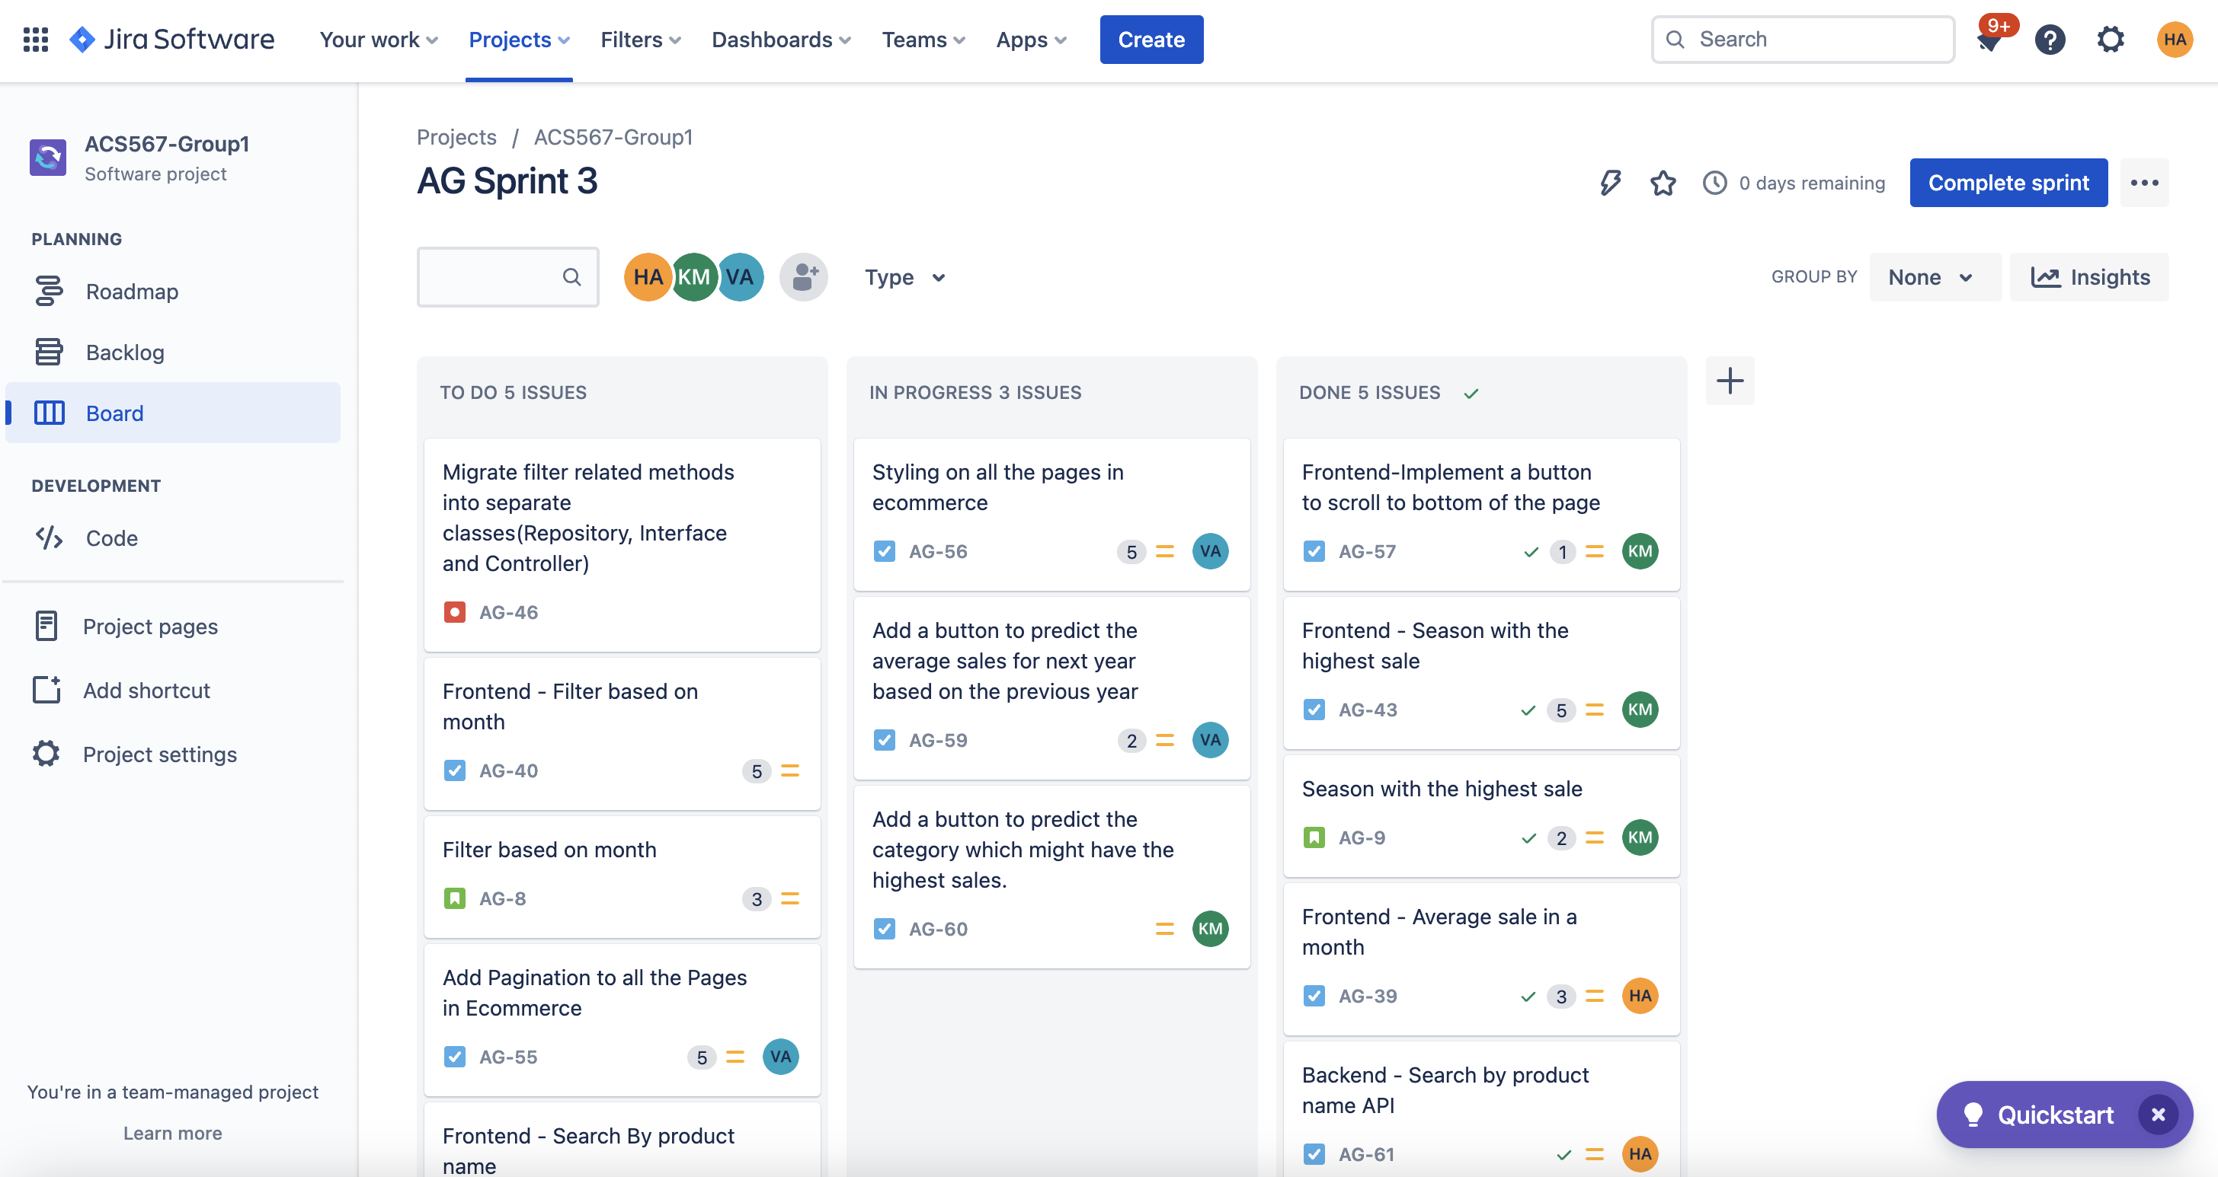
JIRA Board
We created user stories for all the three sprints.
Respective are the images of Sprint 1,2,3 user stories.
We maintained the backlog where we added the uncompleted user stories from the sprint.
We updated the user stories periodically as and when we made any progress on it.
We followed the naming strategy for all the user stories created. For example Frontend - Filter based on year
We have added the description, acceptance criteria and estimated story points for each user story.
We added relevant comments and screenshots of the tasks done, to the user stories for documentation purpose.

Slide 5
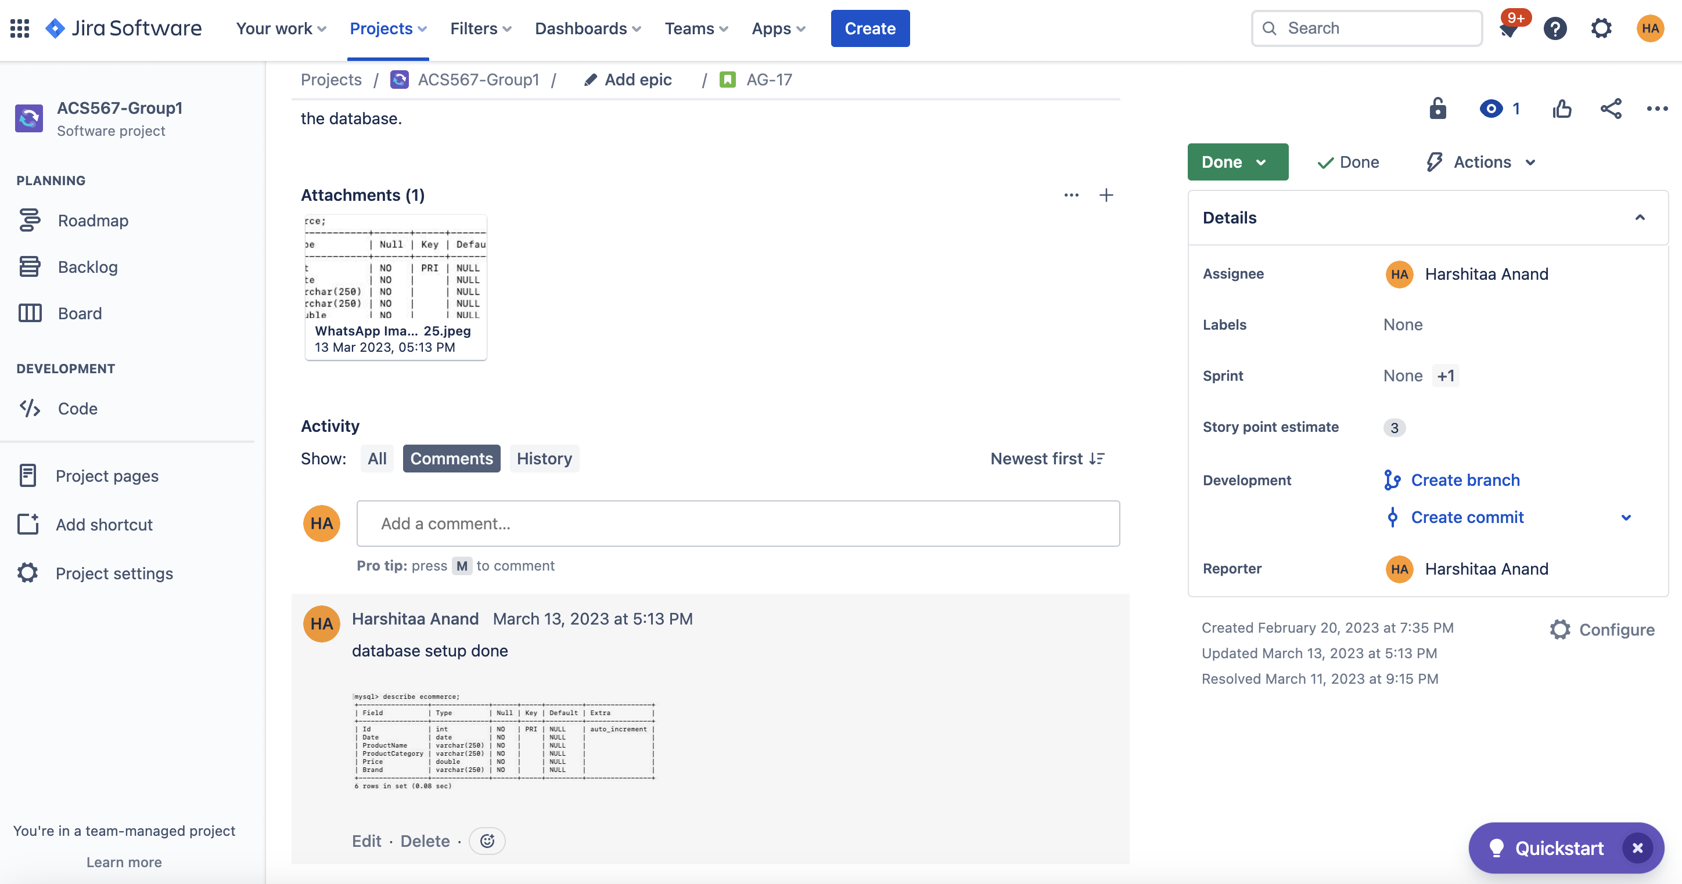
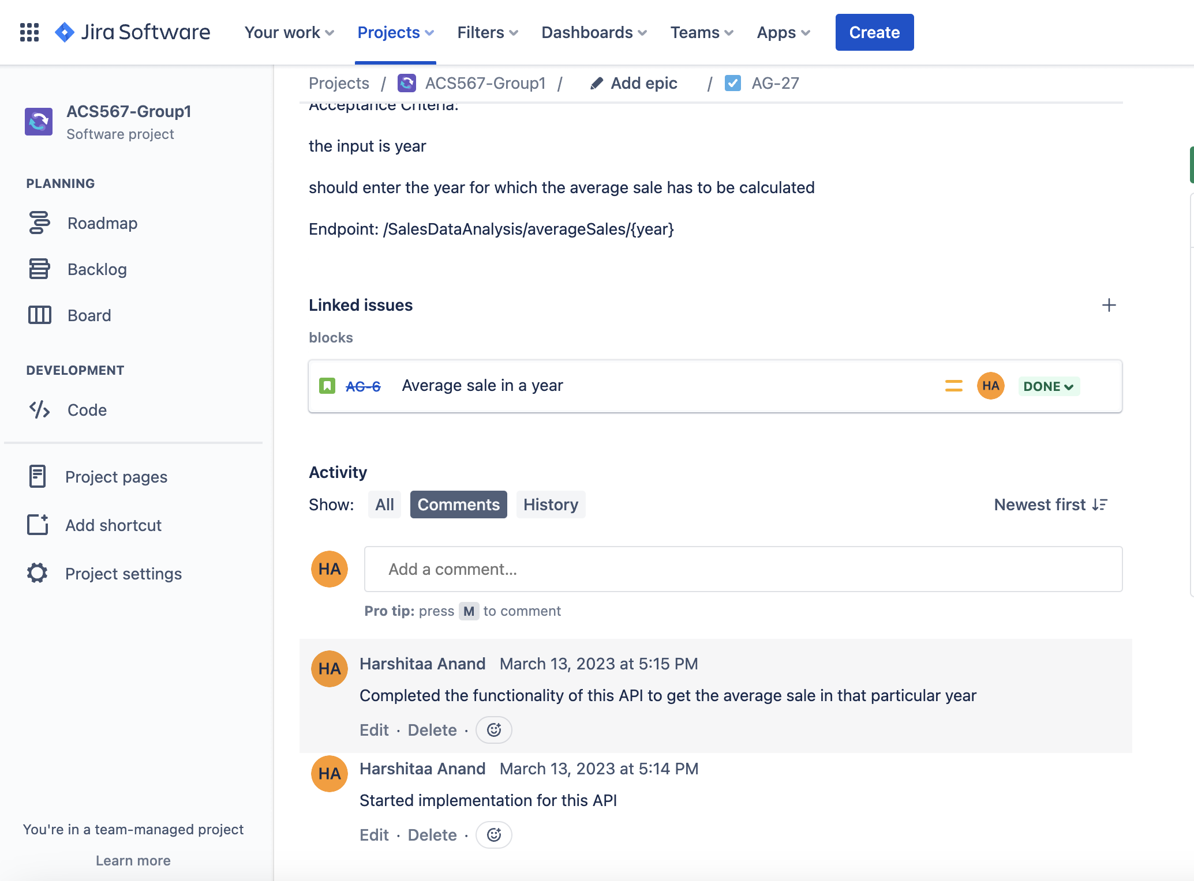
Comments and screenshot added for the user story AG-17 and AG-27 respectively in JIRA

Slide 6

DEMONSTRATION

Slide 7

Repository Details
Link: https://github.com/vijay10pk/ACS_567_Project_Team_1

Slide 8
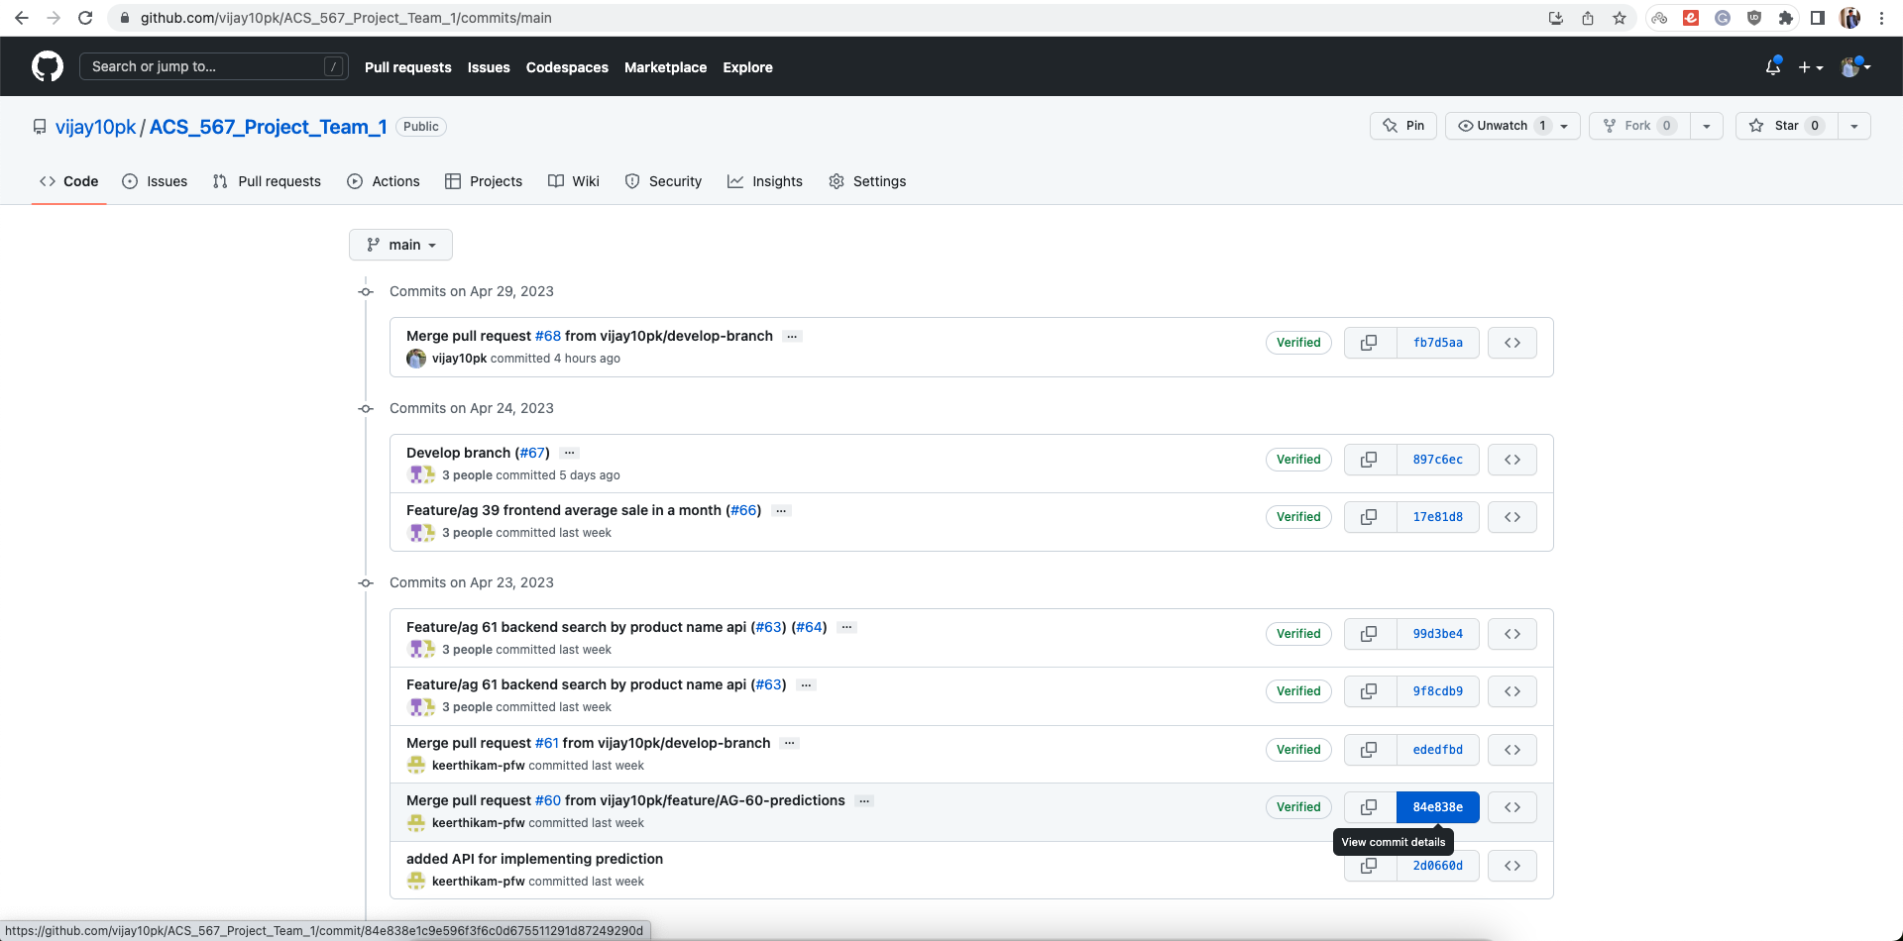
Commits Since Apr 3, 2023

Slide 9
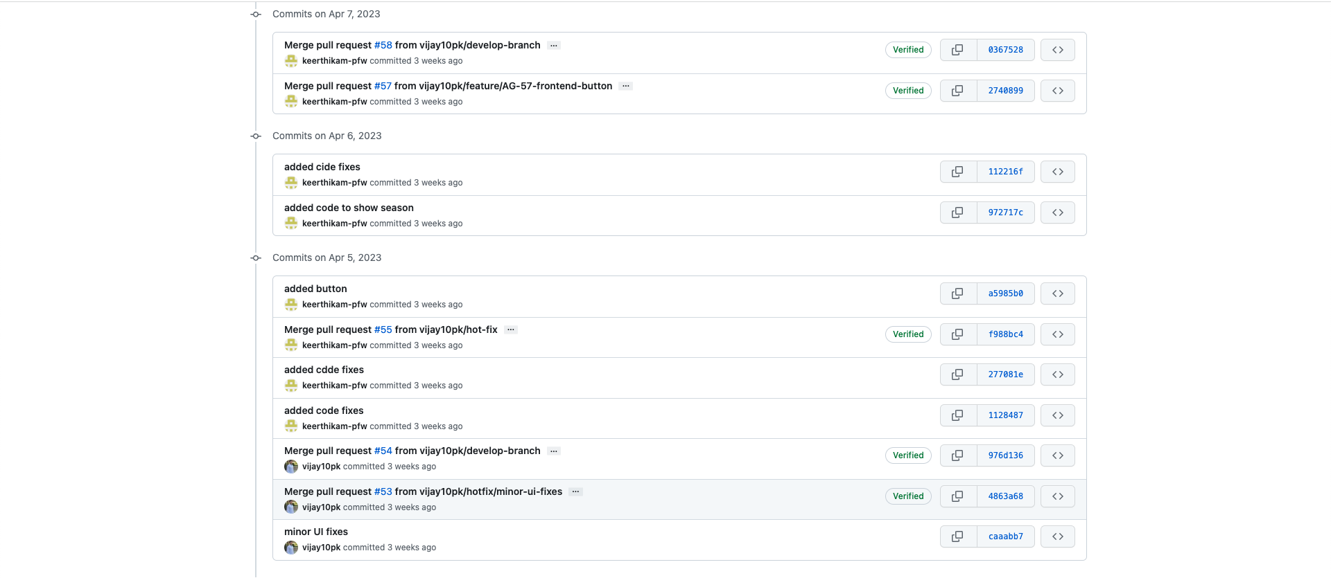
Commits Since Apr 3, 2023

Slide 10
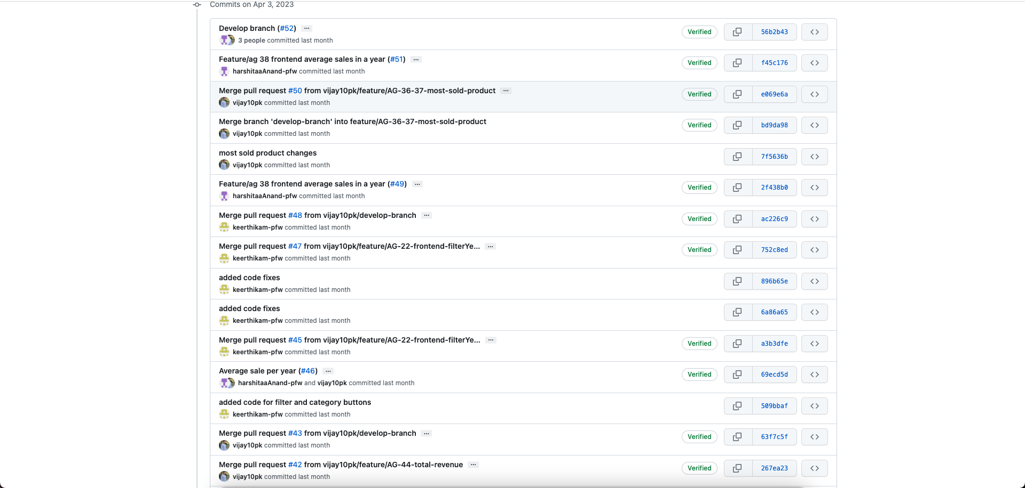
Commits Since Apr 3, 2023

Slide 11

Thank you

