Slide 1

ACS567- Group Project – E-Commerce Data Analysis Tool
Team No.: 1
Keerthika Mulagani
Harshita Anand
Vijay Anand Pandian
Siddhartha Reddy

Slide 2
Project Overview
Our Application helps managers/sales managers of an E-Commerce Platform to get a data analysis of the sales data of their company like getting the highest sold category, highest sold product, total revenue, average sale etc.

Slide 3
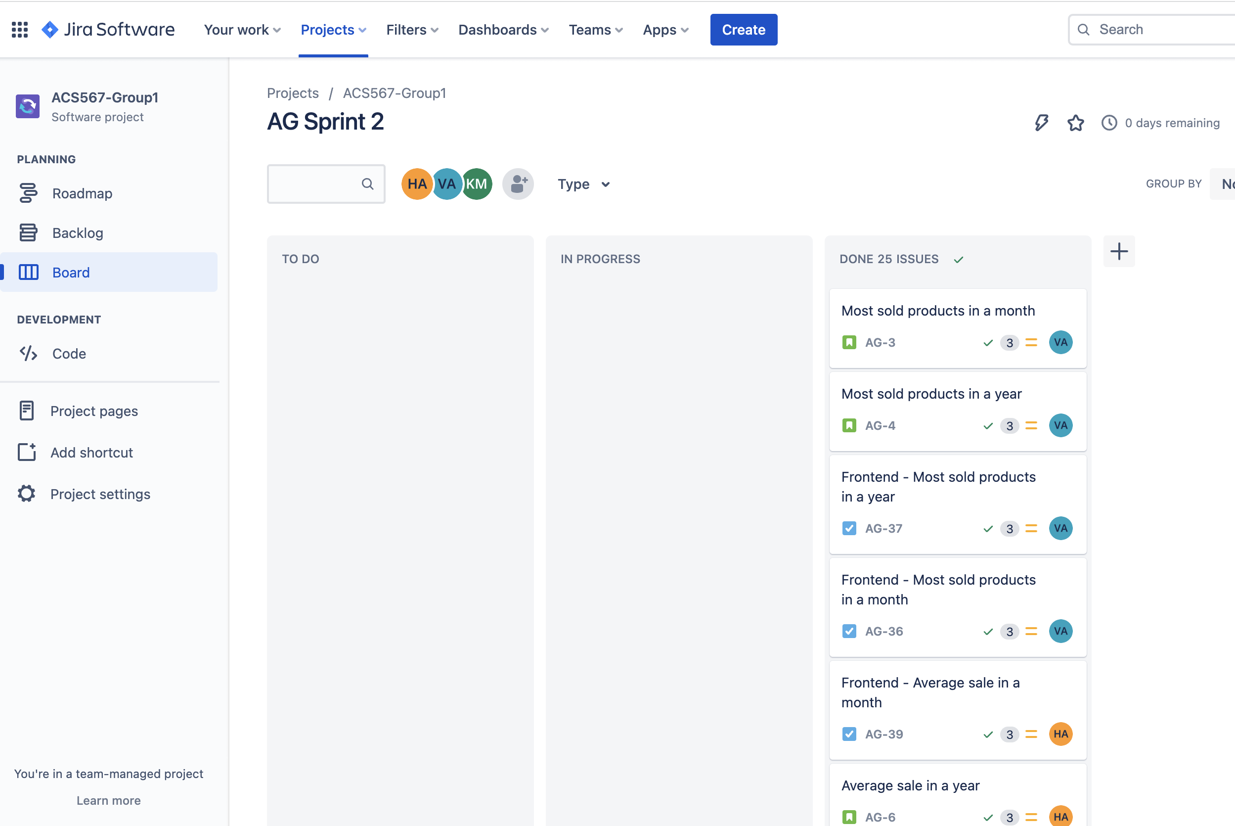
Sprint 2 Board

Slide 4
Sprint 2 Retrospective
What went well?
We have completed most of the Frontend features as we planned.
Every one in the team followed branching strategy.
We added rules to merge PR with two approvals, this helped team to be on same page.
We had a good understanding of the cards.
We worked in group in fixing issues.

Slide 5
Sprint 2 Retrospective
What didn’t go well?
As Razor application was new to all the team members, it took more than required time to implement the functionalities as we had to learn before working on it.
We had more dependencies on the given tasks with respect to other tasks as we were working on the single page.

Slide 6
Sprint 2 Retrospective
What needs to be improved?
Need more team coordination.
Team need to work on time management.
Spend time learning about razor framework.
Need improvement in the UI/UX.

Slide 7
Repository Details:
Link: https://github.com/vijay10pk/ACS_567_Project_Team_1

Slide 8
Thank You…!

