Slide 1
CASSANDRA
        Vijay

Slide 2
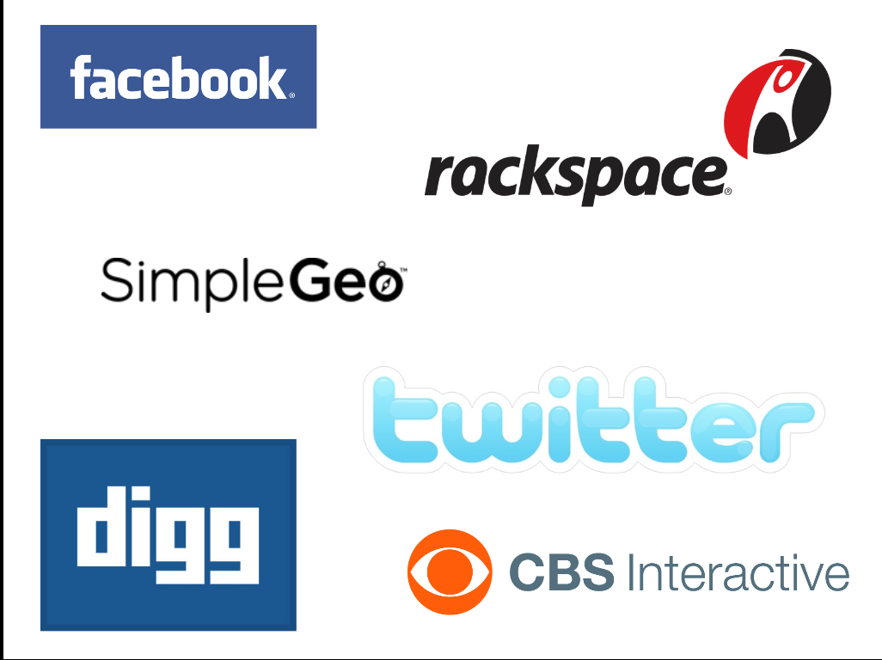


Companies using Cassandara

Slide 3
Why Cassandra ?

Slide 4

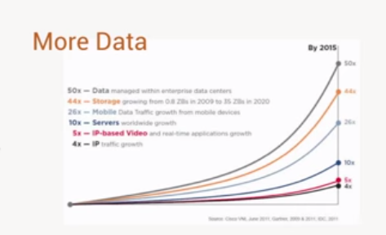
The World has changed!
More Connected
Amount of Data:

Slide 5
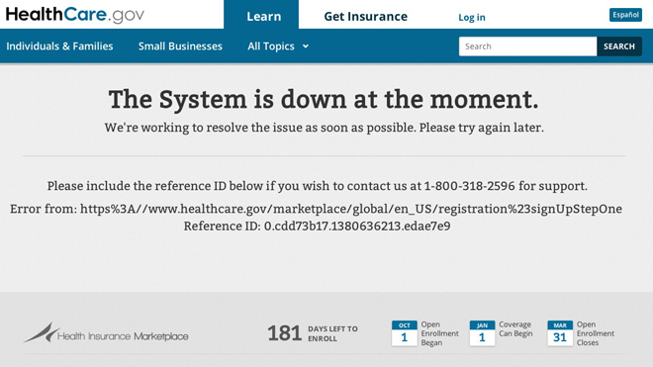

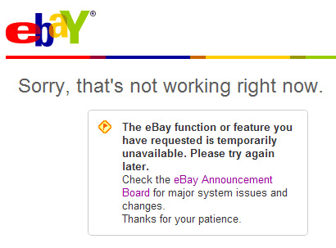
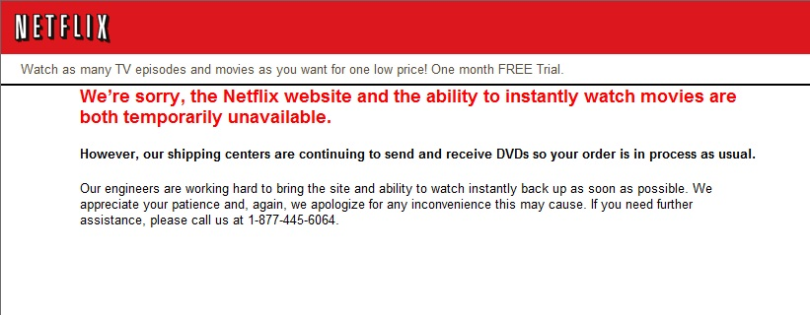

Slide 6

Traditional Solutions
May Not Fit

Slide 7
What were missing?
Distributed System
High Performance
Availability
Extremely Scalable
Fault tolerant

Slide 8

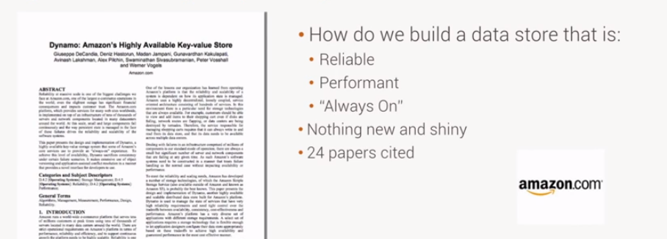
Dynamo Paper (2007)

Slide 9

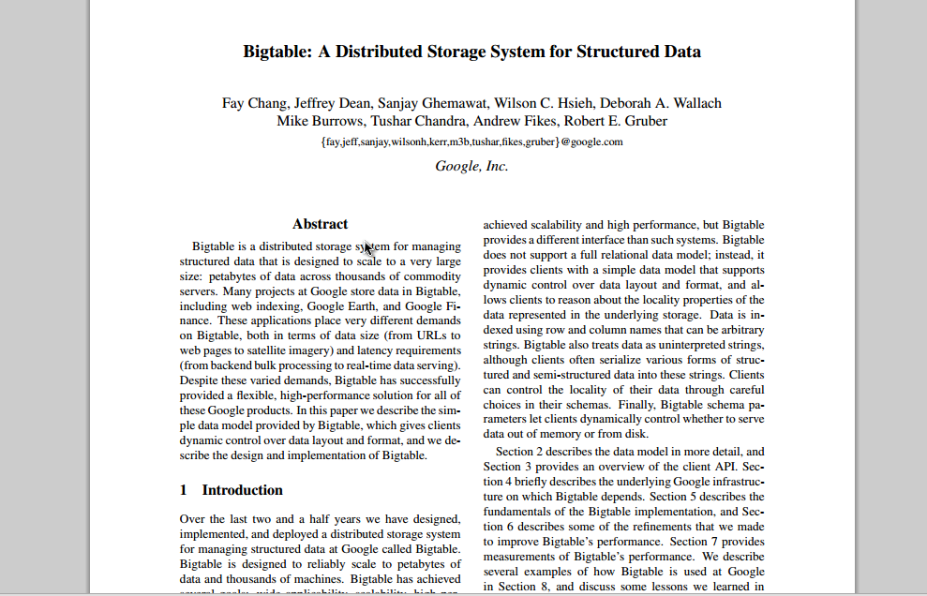
BigTable(2006)
Data Model
Richer
Fast Sequential access
1 Key , Lots of Values

Slide 10






Slide 11
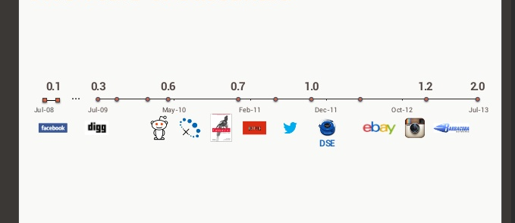

Five Years Of Cassandara
2008
2010

Slide 12
What Is Cassandara
Cassandra is a distributed storage system for managing very large amounts of structured data spread out across many commodity servers, while providing highly available service with no single point of failure.

Slide 13
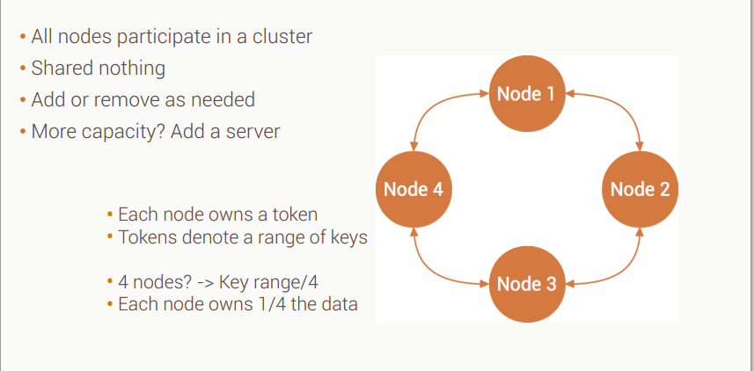
Cassandara – More than one Server

Slide 14
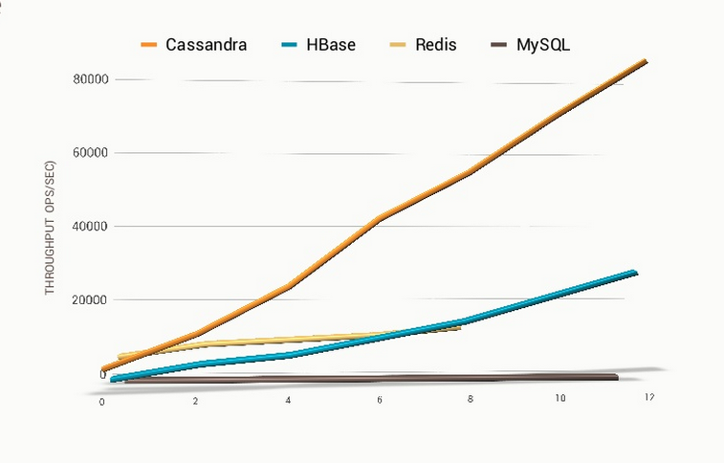

Slide 15
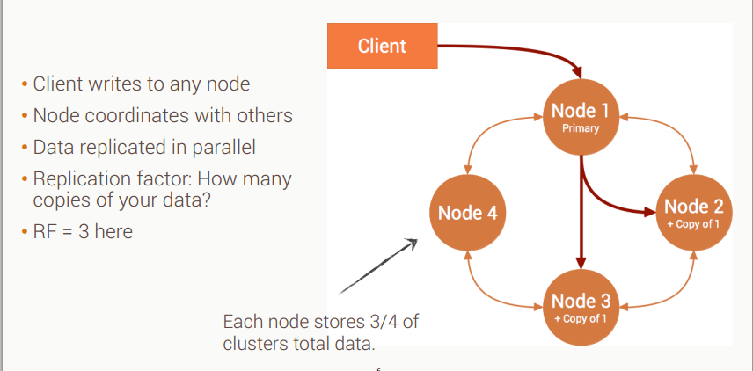
Cassandra - Locally Distributed

Slide 16
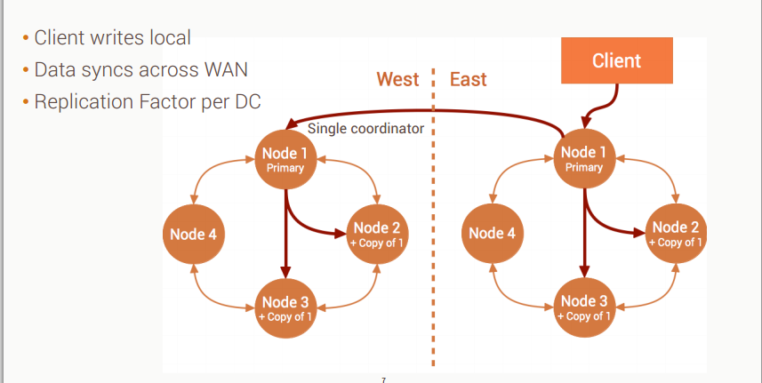
Cassandra - Geographically Distributed

Slide 17
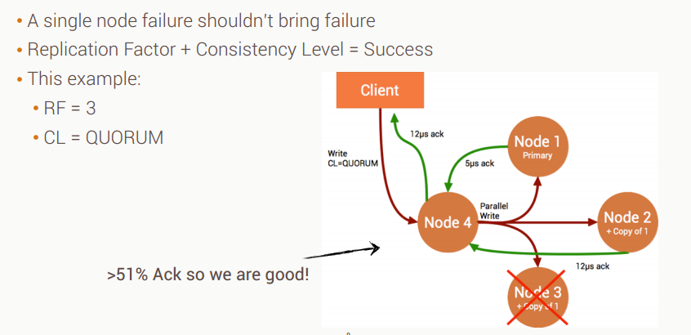
Cassandra – No Single Point Of Failure

Slide 18
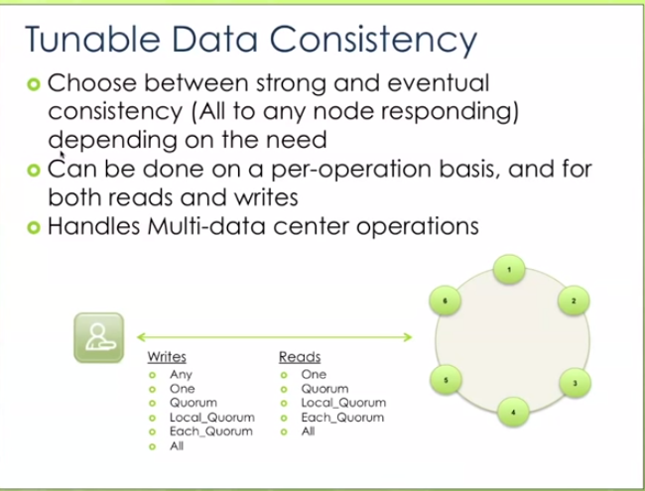
Cassandra - Consistency

Slide 19
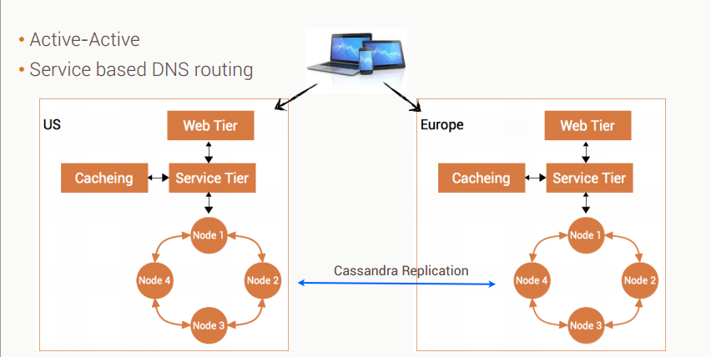

Slide 20
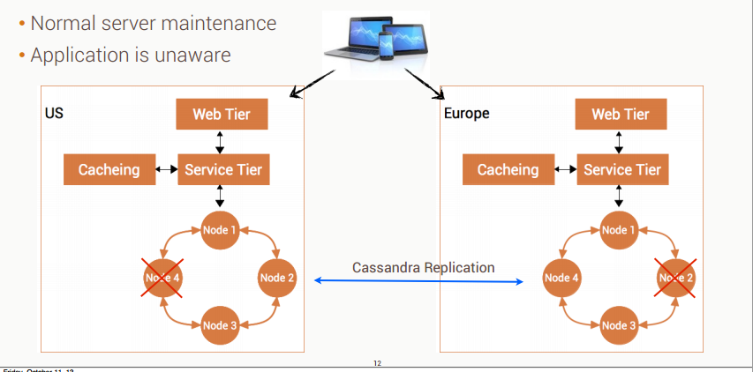

Slide 21
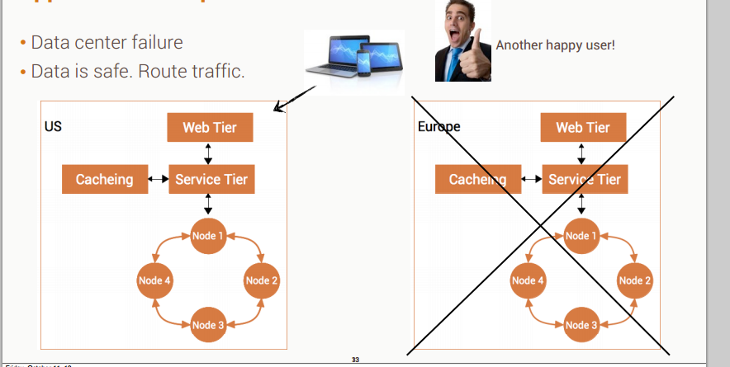

Slide 22
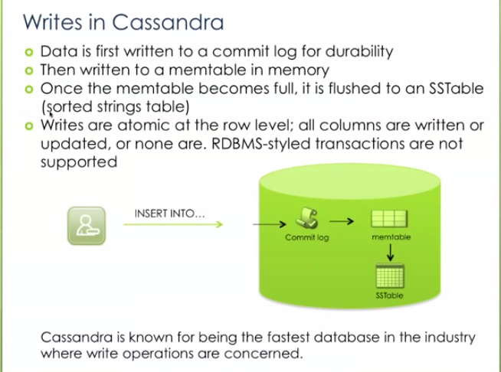

Slide 23
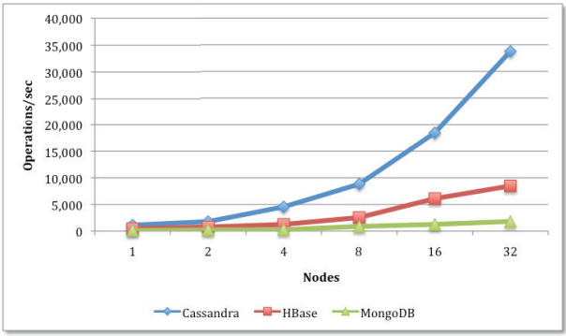
Read/Write Workload

Slide 24
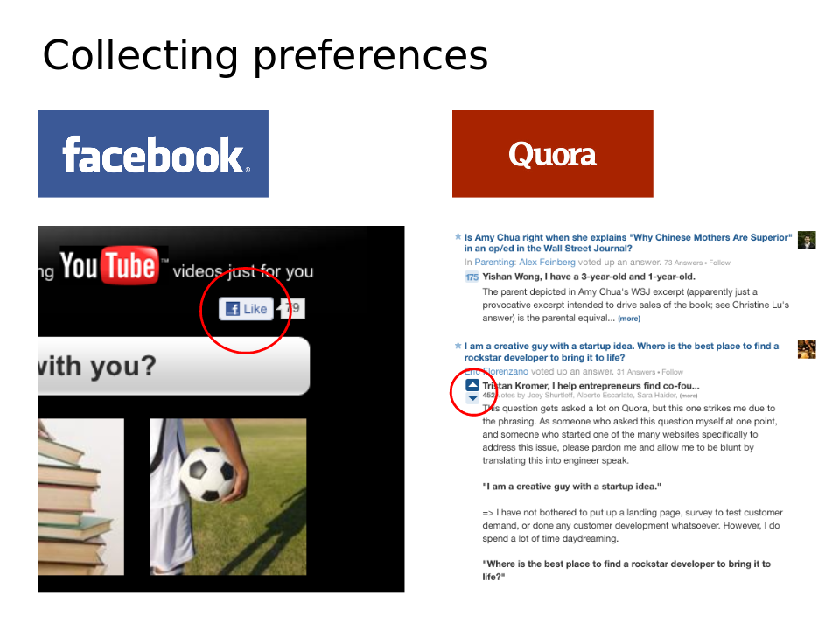

Slide 25
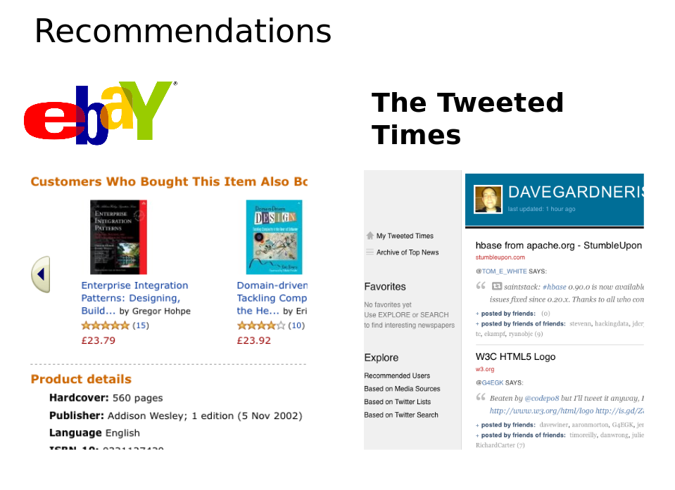

Slide 26
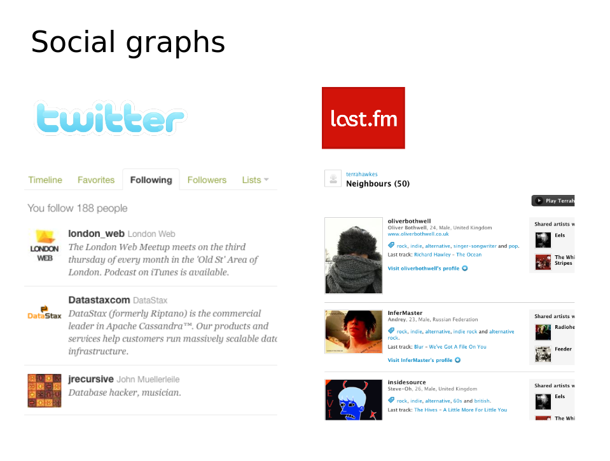

Slide 27

Cassandara - Data Model

Slide 28
Cassandara – Data Model
In traditional relational databases (MySQL, Microsoft SQL Server, and Oracle), data is stored in tables.
Each table consists of rows and a fixed number of predefined columns.

Slide 29
Cassandara – Data Model
All data in one single table
Consists of Rows
Unique key indexing
Column Families

Slide 30
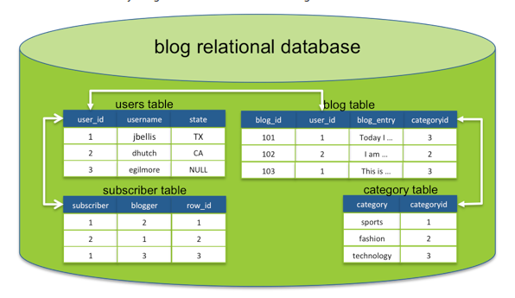
Cassandara – Data Model

Slide 31
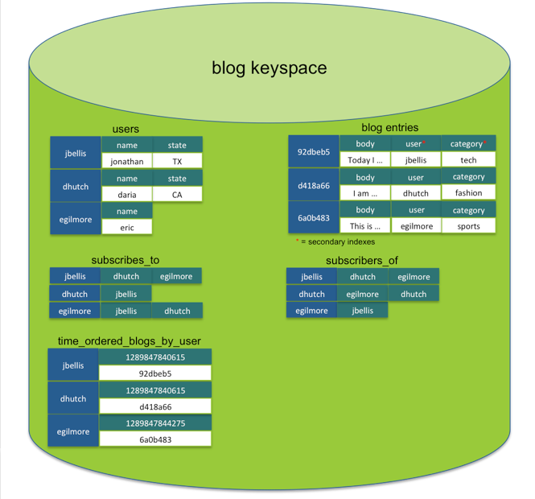
Cassandara – Data Model

Slide 32
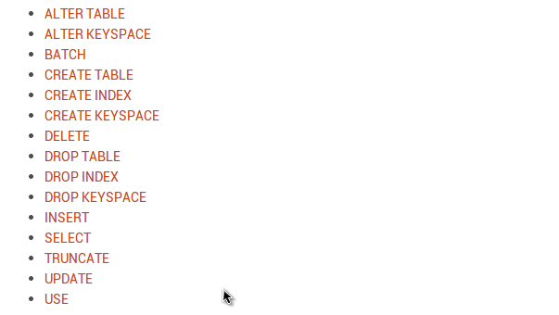
CQL- Cassandara Query Language

Slide 33
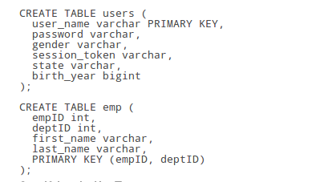
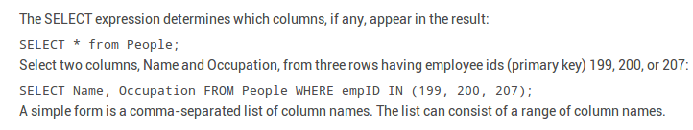


Slide 34
How to Install Apache Cassandra
Sudo apt-get install Cassandra
Python Driver for Apache Cassandra
        $ pip install cassandra-driver

Slide 35
DEMO

Slide 36
Thank You

