Slide 1


TWITTER BOOTSTRAP
Vijay

Slide 2
Problem Faced
Designing a Website is a painful process
CSS based layouts are difficult to create and maintain and don’t render uniformly across different browsers.
Default , non-standardized HTML are fairly ugly

Slide 3
It is a challenge for non front end Engineers to create a good looking HTML apps for their API's

Slide 4
I Want to build my website
Why can't I Center this heading tag?
This looks terrible in IE
WHERE DO I START
This does not work on my Iphone
Why Can't I align this text?

Slide 5
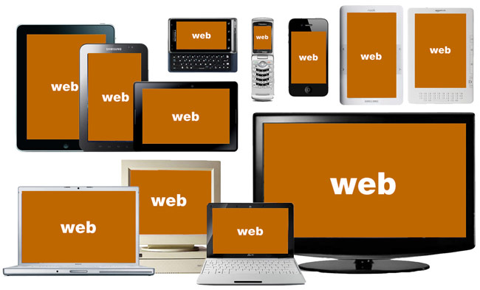
State of Today's Web World
Source: http://bradfrostweb.com/
Notes:
This is the challenge.
How do you design for all of this?
How do you manage the budget (staff, resources)?

Slide 6
I am a developer , not a “Designer” . So some help is appreciated!!!!

Slide 7

SOLUTION

Slide 8
What is Bootstrap?
A web development toolkit
An open source front-end framework
HTML,CSS,JavaScript
Started at twitter by Mark Otto and Jacob Thornton
Available on GitHub

Slide 9
Why Bootstrap is Powerful?
Makes Web development faster
Provides a clean and uniform solution
It's Simple
Good Documentation and An open source project on GitHub
Light Weight Framework
Works Across all Browsers
Responsive Design

Slide 10
Some Features
Base CSS
Components
JavaScript Tools

Slide 11
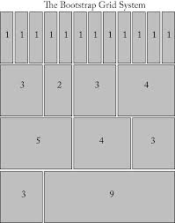
BASE CSS
Grid System( Responsive and Fluid)

Slide 12
Classes:
.col-xs-(1-12) - Extra Small
.col-sm-(1-12) – Small
.col-md-(1-12) - Medium
.col-lg-*-(1-12) – Large

Slide 13
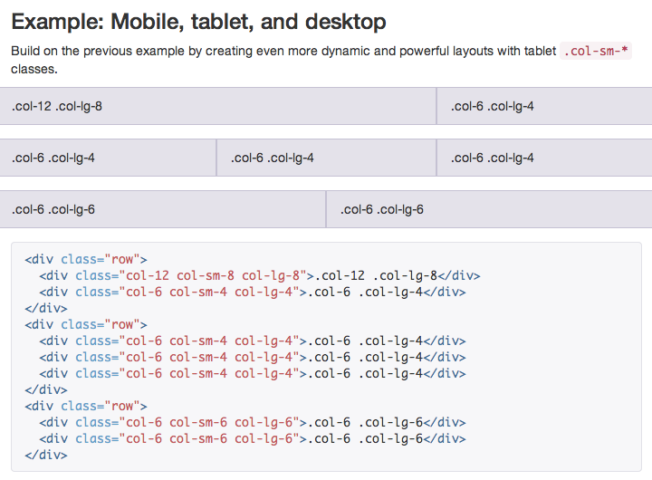

Slide 14
Other CSS Features
Typography
Tables
Forms
Buttons
Images

Slide 15
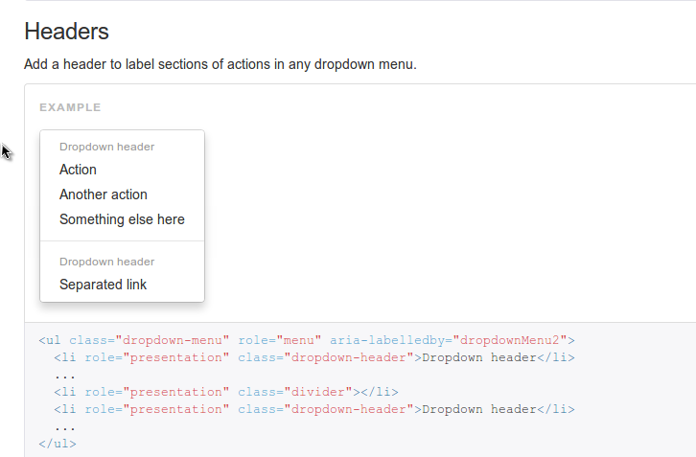
Bootstrap Components
Dropdown

Slide 16
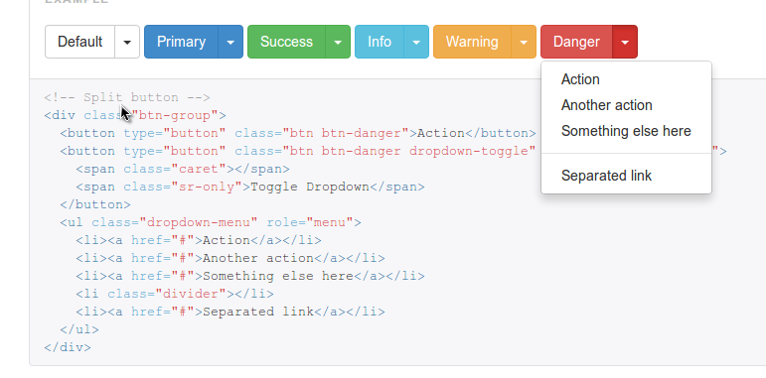
Buttons

Slide 17
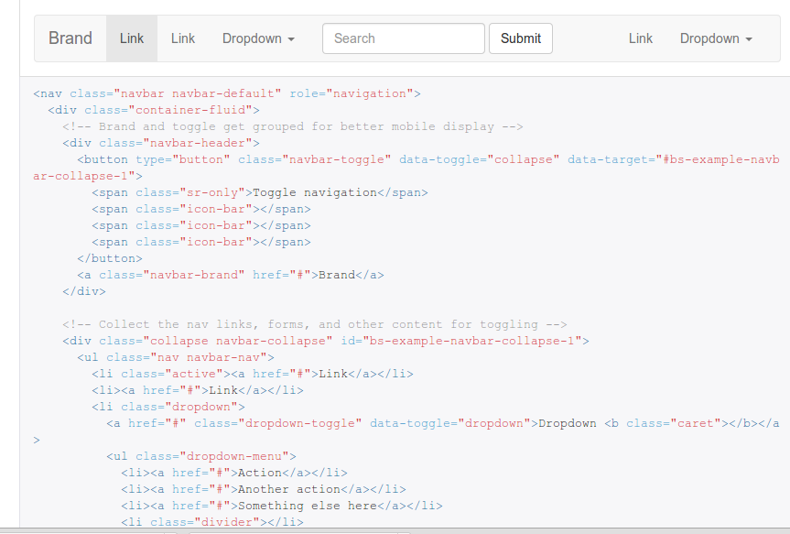
Nav Bars

Slide 18
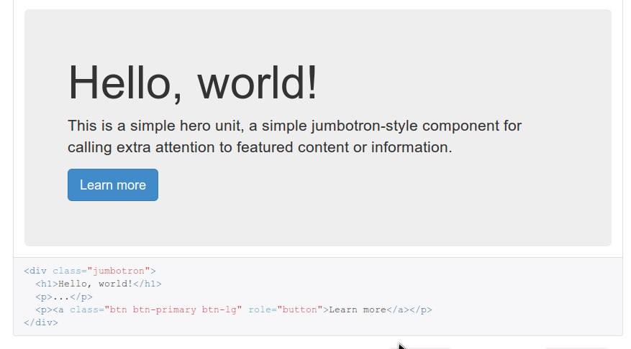
Jumbotron

Slide 19
JavaScript Tools
Bring Bootstrap's components into life by including over a dozen of customized Jquery plugin

Slide 20
SOME USEFUL PLUGINS
Modal
Transition
Dropdown
Scrollspy
Tab
Tooltip
Popover
Alert
Button
Collapse

Slide 21
DEMO TIME

Slide 22
Thank you

