Slide 1
Rental Data Pipeline
CodeFlux

Slide 2
Team Members
Mallika Shree K C
Sakshath Shetty
Smita Hegde
Vijay Kumar E
Gokul Raj S

Slide 3
Overview
The project Rental Data Pipeline is designed to build a scalable and automated data processing workflow that extracts, transforms, and loads (ETL) vehicle rental data from raw CSV files into optimized, query-ready Parquet format using PySpark and AWS.
The main goal of the ETL pipeline is to:
Extract raw datasets from Amazon S3 storage.
Transform the data using PySpark.
Load the processed, enriched data back into S3 in Parquet format, partitioned by year and month.

Slide 4
Use Cases
Automate the end-to-end rental data workflow on AWS
Maintain data quality, consistency, and reliability
Enable KPI-based decision-making through analytics
Provide a scalable foundation for future data-driven applications

Slide 5
Input Data Overview
Datasets Used:
rental_transactions.csv - Transaction-level details
users.csv - User demographics
vehicles.csv - Vehicle details and pricing
locations.csv - Pickup and drop-off locations

Slide 6
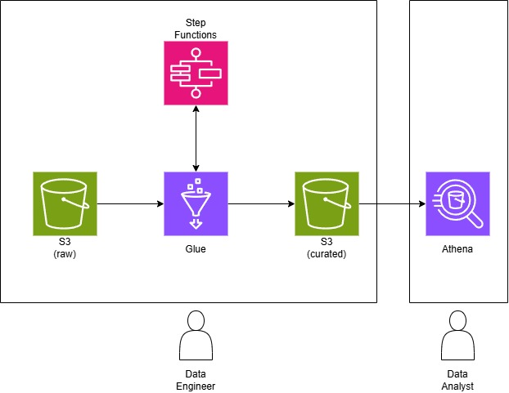
High-Level Architecture
Architecture diagram showing the complete AWS ETL workflow

Slide 7
Data Modeling
Source Data (Inputs) :
- users table
- vehicles table
- locations table
reference keys :
- user_id
- vehicle_id
- location_id
Processed Data : rental_processed
Users.csv
Vehicles.csv
rental_transactions.csv
Locations.csv

Slide 8
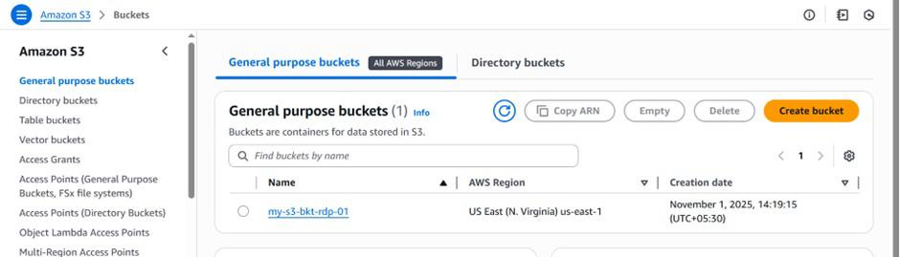
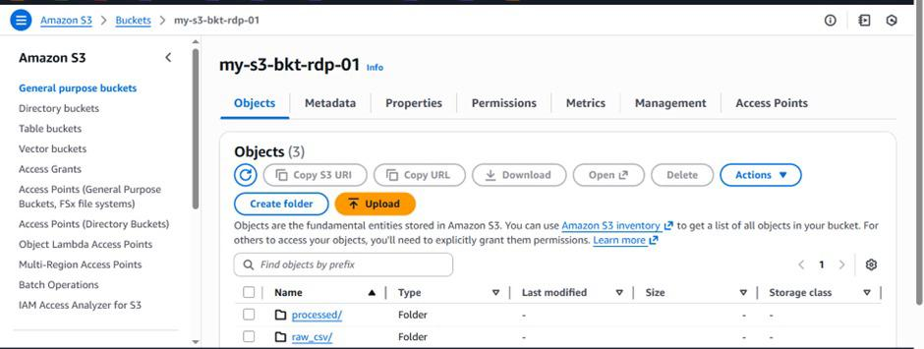
Implementation Snapshots

Slide 9
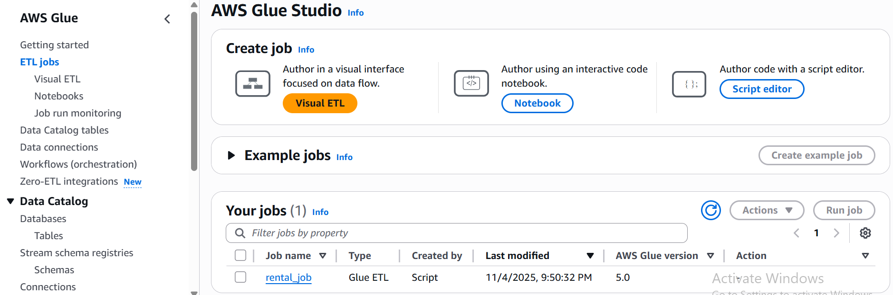

Slide 10
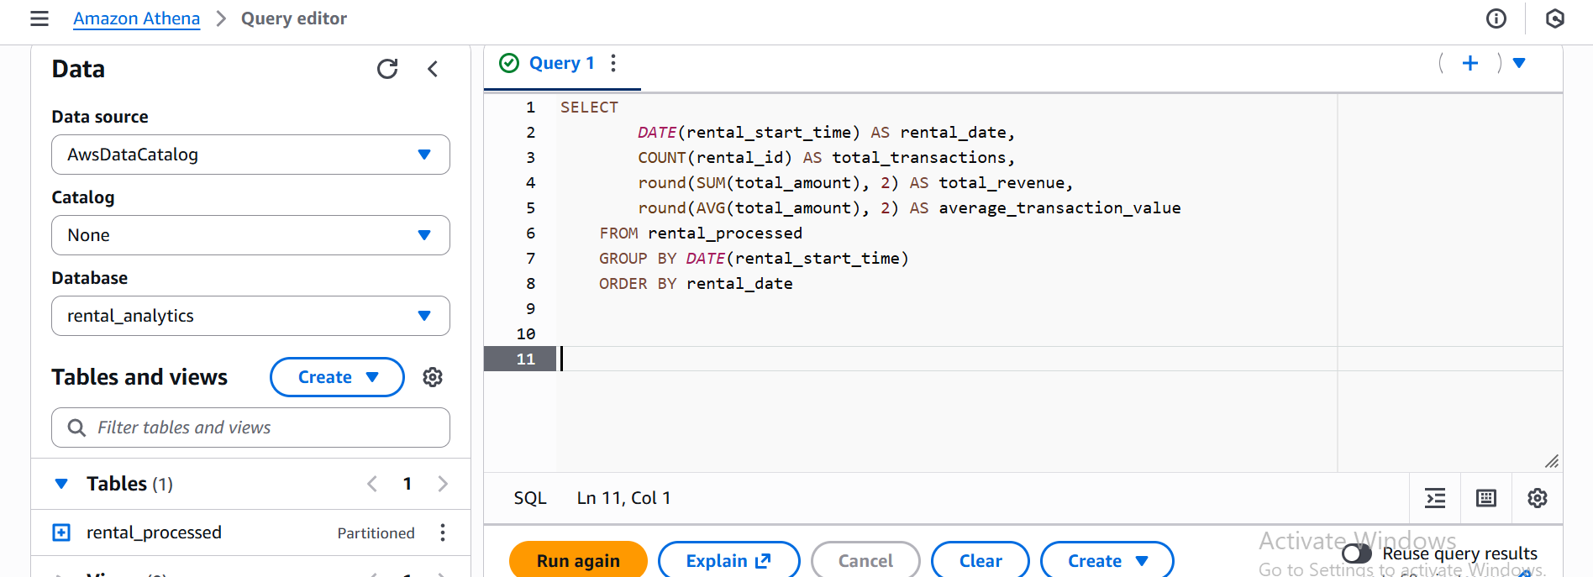
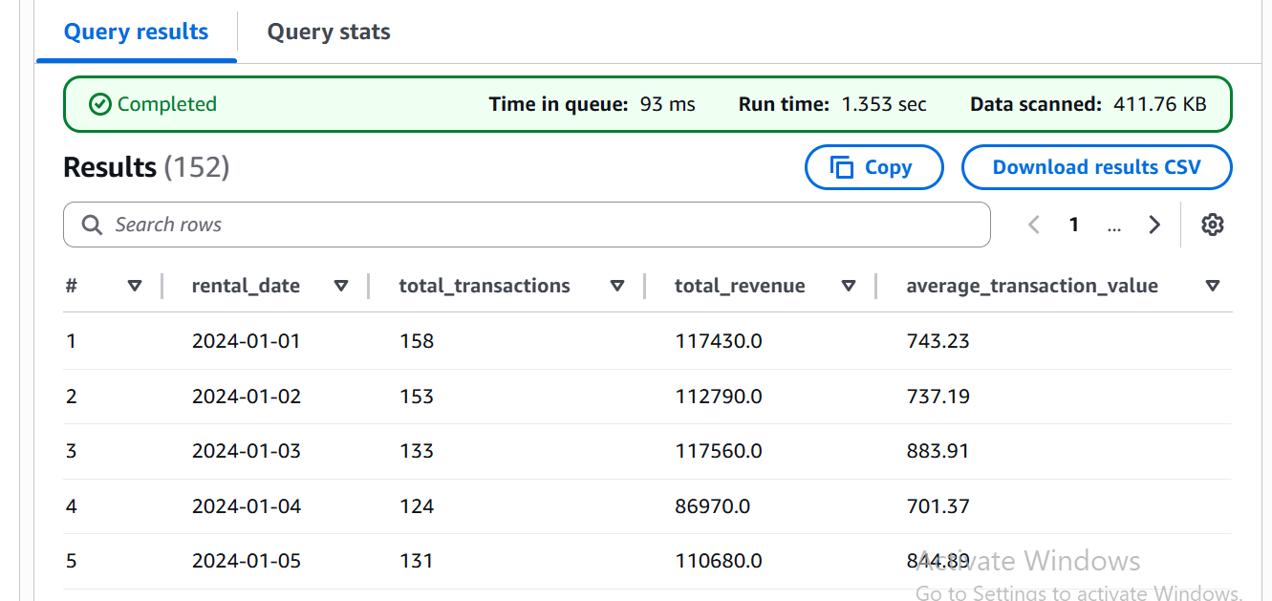

Slide 11
Performance & Optimization
Processed to Parquet format, reducing storage and improving query speed.
Partitioned data by year/month for faster and cost-efficient Athena queries.
Optimized Glue job execution by enabling bookmarks.

Slide 12
Business KPI’s
Tracks daily rentals and revenue to monitor the business's day-to-day performance.
Identifies the most valuable customers by showing their total spending and rental frequency.
Shows which vehicle types and brands are the most profitable and most rented.
Ranks the rental locations by revenue to see which ones are the most successful.

Slide 13
Key Learnings
Gained hands-on experience with AWS Glue for ETL and data cataloging.
Learned to orchestrate workflows efficiently using Step Functions.
Improved understanding of Athena query optimization for faster analysis.
Strengthened knowledge of data dependencies and pipeline automation.
Understood the importance of IAM roles and permissions in AWS services.

Slide 14
Future Scope
Integrate Boto3 SDK :
Automate Glue job execution and S3 operations directly from Python scripts.
Add Visualization Layer :
Use tools like Amazon QuickSight to display metrics visually.
Add Error Alerts :
Configure SNS notifications for job failures.

Slide 15
Demo

Slide 16
THANK YOU

