Slide 1
REDUX

Slide 2
What is Redux
Redux is a library for front end development
Data flows through the components.
  Unidirectional Data flows from parent to child components
  Data is organized and controlled better.
  Application’s state is contained in specific stores
  The rest of the components remain loosely coupled.
  Makes application more flexible leading to increased efficiency.
  Can Manage both data-state and UI-state

Slide 3
Principles Of Redux
State is read-only:
  The only way to change the state is to trigger an action.
  An action is a plain JS object describing the change.
  Just like the state is the minimal representation of data, the action is the minimal representation of the change to that data.
  An action must have a type property (conventionally a String constant).
  All the changes are centralized and occur one by one in a strict order.

Slide 4
Principles Of Redux
Changes are made with pure functions:
  In order to specify how the state tree is transformed by actions, you need pure functions.
  Pure functions are those whose return values depend solely on the values of their arguments.
  Reducers are just pure functions that take the previous state and an action and return the next state.
  You can have a single reducer in your application and as it grows, you can split it off into smaller reducers.
  These smaller reducers will then manage specific parts of the state tree.

Slide 5
Principles Of Redux
Redux follows three fundamental principles:
Single source of truth:
  The state of the entire application is stored in an object/ state tree within a single store.
  The single state tree makes it easier to keep track of the changes over time and debug or inspect the application.
  For a faster development cycle, it helps to persist the application’s state in development.

Slide 6
Redux
Redux provides a “store”
  Place keep the application state together.
Components can “dispatch” state changes to the store
  Not directly to the other components.
Components that need the updates about the state changes
  “subscribe” to the store.
Initiating component does not have to worry about the list of components needing the state change
  It simply dispatch the change to the store.

Slide 7
Environment Setup
npm install -g create-react-app
create-react-app my-simple-app
cd my-simple-app
npm install --save redux
npm install --save react-redux

Slide 8
Components Of Redux
Redux has four components.
  Action
  Reducer
  Store
  View

Slide 9
ACTION

Slide 10
Action
Plain JavaScript objects
  Main source of information
  Used to send data from the application to the store.
  Created using action creators
Actions Must have a type property.
  It May contain anything else to describe the action
  {
  type: "USER_LOGGED_IN",
  username: “ramesh"
  }

Slide 11
Action Creator
Redux has “action creators” to create actions
  A best practice to wrap action within a function.
  export const userLoggedIn = (text)=>{
    return {
    type:’USER_LOGGED_IN',
    ‘userName’:text
    }
  }

Slide 12
REDUCER

Slide 13
Reducer
  Take “state” from Redux “action” object
  Returns a new “state” to be stored back in Redux.
Calculates the next state depending on the action type.
  should return at least the initial state when no action type matches.
  When the action type matches a valid clause the reducer calculates the next state and returns a new object.

Slide 14
Reducer
  let array = [1,2,3,4,5]
  let sum = array.reduce((accumulator,currentValue) =>
  accumulator + currentValue)
  console.log(sum) //15
Can avoide mutations in Redux by Using the following method
  Using concat(), slice(), and …spread for arrays
  Using Object.assign() and …spread for objects

Slide 15
Reducer
  const reducer = (prevState={text:'Hello'},action)=>{
  switch(action.type) {
    case 'BIRTHDAY':
    return Object.assign({},action); // return {...action};
    case 'WEDDINGDAY':
    return Object.assign({},action);
    default:
    return prevState;
  }
  }

Slide 16
Spread In Object Literals
  const prevState ={
  name:"ram"
  }
  const nextState ={
  age:45
  };
  console.log({...prevState,...nextState});

Slide 17
STORE

Slide 18
Redux Store -Methods
State of the whole application lives inside the store.
  Created by wrapping up the state.
Redux store exposes a simple API for managing the state.
getState()
  for accessing the current state of the application
Dispatch()
  for dispatching an action
Subscribe()
  for listening on state changes

Slide 19
Redux Store -Methods
createStore()
  to create a store
  takes a reducer as the first argument
  Can also pass initial state
  const store = createStore(reducer);
  store.subscribe(()=>{console.log('redux action called')})
  export default store;

Slide 20
Provider
An high order component coming from react-redux.
It gets the store as a prop.
Wraps up React application and makes it aware of the entire Redux’s store.
  React must get state and actions by accessing the store
  ReactDOM.render(
  <Provider store={store}>
  <App/>
  </Provider>,document.getElementById("root"));

Slide 21
connect
connect.
  connects a portion of the Redux state to the props of a React component.
  Takes mapStateToProps() as an argument
  const mapStateToProps =(state)=> {
  return {
  text: state.text
  }; }
  export default connect(mapStateToProps)(Greeting);

Slide 22
Redux Data Flow
Steps of the Data Lifecycle in Redux
  An event inside app triggers a call to store.dispatch(actionCreator(payload)).
  Store calls the reducer with the current state and the action.
  Reducer combines the output into a single state tree.
  Store saves the complete state tree returned by the reducer.
  The new state tree is now the nextState of app.
  dispatch(action) -> reducer -> new state -> re-render

Slide 23
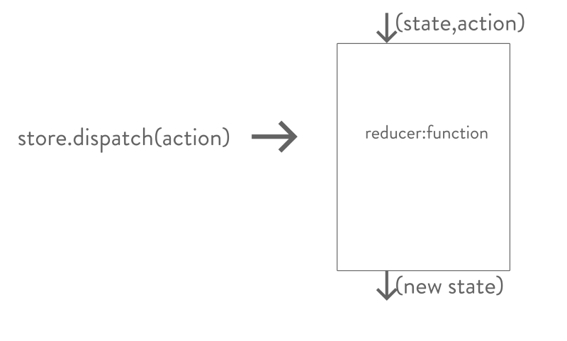
Redux Data Flow

Slide 24
Redux Example - Actions
  export const showBirthday= (text)=>{
  return {
  type:'BIRTHDAY',
  text
  }
  }
  export const showWeddingDay= (text)=>{
  return {
  type:'WEDDINGDAY',
  text
  }
  }

Slide 25
Store - Reducer
  import { createStore } from 'redux';
  const reducer = (prevState={text:'Hello'},action)=>{
  switch(action.type) {
  case 'BIRTHDAY':
  return Object.assign({},action);
  case 'WEDDINGDAY':
  return Object.assign({},action);
  default:
  return prevState;
  } }
  const store = createStore(reducer);
  store.subscribe(()=>{console.log(store.getState())})
  export default store;

Slide 26
Parent Component
  class Greeting extends React.Component {
  birthday = ()=>{
  store.dispatch(showBirthday('Happy Birthday'));
  }
  weddingday =() =>{
  store.dispatch(showWeddingDay('Happy Anniversarry'));
  }

Slide 27
Parent Component ..contd
  render() {
  return (
  <div>
  <h1>{this.props.text}</h1>
  <HelloWorld action={this.weddingday} label={"Wedding Day"}/>
  <HelloWorld action={this.birthday} label={"Birth Day"}/>
  </div>
  ); } }

Slide 28
Parent Component ..contd
Connect
  Imported from 'react-redux';
  const mapStateToProps =(state)=> {
  return {
  text: state.text
  };
  }
  export default connect(mapStateToProps)(Greeting);

Slide 29
Child Component
  const HelloWorld = (props) => {
  return (
  <div >
  <button onClick={props.action}>{props.label}</button>
  </div>
  );
  }
  export default HelloWorld;

Slide 30
Application
  class App extends React.Component {
  render() {
  return (
  <div className="App">
  <Greeting/>
  </div>
  );
  }
  }
  export default App;

Slide 31
MIDDLEWARE

Slide 32
Middleware
A Redux middleware is a function that is able to intercept actions and act before it reaches the reducer.
  A place for abstracting REST calls, business logic etc,
Benefits of a Redux middleware
  Reusable pieces of Logic can live outside React
  Keep the components clean
Two Popular middleware are redux-thunk and Saga.

Slide 33
Need for Middleware
Two Types of actions in redux are
Synchronous Action
  Returns a plain Java Script object from action creators
  No Need to make any Ajax Calls.
  The reducer will return the next state.
  Data is typically fetched in componentDidMount
Asynchronous Action
  May return Plain Object and also functions from action creators.
  Inside the function Ajax calls to REST APIs,
  May have delay in the dispatch of an action
  Data is not fetched on the Component

Slide 34
Redux-thunk
A “thunk” is uncommon word for a function
  It’s a function that’s returned by another function
  function wrapperFunction() {
    return function thunk() {
    console.log('do some thing now');
    };
  }
Invoked as wrapperFunction()();

Slide 35
thunk as middleware
“actions” are plain objects and “reducers” are pure functions
  can’t do any API calls or dispatch actions inside them
“thunk” function
  Can move API calls like actions to live inside this function.
  Looks at every action that passes through the system
  If there is a function Call then its Invoked.

Slide 36
thunk Function
  function logOutUser() {
  return function(dispatch, getState) {
  return axios.post('/logout').then(function() {
  dispatch(userLoggedOut());
  });
  };
  }
npm install --save redux-thunk

Slide 37
Configuring Thunk-Reducer -Store
  import { createStore,applyMiddleware } from 'redux';
  import thunk from 'redux-thunk';
  Import reducer from ‘./reducer/reducer’
  import { createLogger } from 'redux-logger'
  const loggerMiddleware = createLogger()
  const store = createStore(reducer,
  applyMiddleware(thunk, loggerMiddleware)
  );
  store.subscribe(()=>{console.log('redux action called')})
  export default store;

Slide 38
Action Creator
  const url='http://localhost:4040/requests';
  export const fetchRequests = (requests) => {
  return {
  type: 'FETCH_REQUEST',
  requests
  }
  };

Slide 39
This is the Thunk 😊
  export const fetchAllRequests = () => {
  return (dispatch) => {
  return axios.get(url)
  .then(response => {
  dispatch(fetchRequests(response.data))
  })
  .catch(error => {
  throw(error);
  });
  };
  };

Slide 40
fetchAllRequests
It returns a function and not a plain javascript object.
It’s the async action creator used with Thunk middleware
When the a response from API has arrived
  Its dispatched to action creator fetchRequests with json from the API as parameter .
Can also call If any other Action Creator before the API Call

Slide 41
Thunk-Reducer
  const nameInitialState = [{ }]
  const fetchReducer = (state = nameInitialState, action) => {
  switch (action.type) {
  case 'FETCH_REQUEST':
  return action.requests;
  default:
  return state
  } }
  export default fetchReducer;

Slide 42
Dispatch Actions
Passed as the second argument to connect
  Used for dispatching actions to the store.
With Redux, components need to access the store by using connect
  Component can receive a props.dispatch and can dispatch actions
Connect can accept mapDispatchToProps
  Which can create functions
  Can pass those functions as props to component.

Slide 43
Mapping Props
  const mapStateToProps =(state)=> {
  return {
  requestList: state.requests,
  }; }

Slide 44
Mapping Action
  const mapDispatchToProps = dispatch => {
  return {
  getData: () =>
  dispatch(fetchAllRequests())
  } }
  export default connect(
  mapStateToProps,mapDispatchToProps
  )(ShowRequests);
  <button onClick={this.props.getData}>Users</button>

Slide 45
Redux Dev Tools
Used to completely control the currently running application’s actions/state
  npm install --save redux-devtools-extension
ComponseWithDevTools added into store file
  import { composeWithDevTools } from ‘redux-devtools-extension’;
  const store = createStore(fetchReducer, composeWithDevTools(
  applyMiddleware(thunk, loggerMiddleware))
  );

Slide 46
Using Axios
  import axios from 'axios';
  import {createStore,applyMiddleware} from 'redux';
  import thunk from 'redux-thunk';
  import {createLogger} from 'redux-logger';
  import { composeWithDevTools } from 'redux-devtools-extension';
  const logger = createLogger();
  const url = 'http://localhost:4000/agents';

Slide 47
Action Creator
  const fetchAgents = (agentList,loading)=>{
  return{
  type:'FETCH_AGENTS',
  agentList,
  loading:false
  }
  }

Slide 48
Reducer
  const agentReducer = (initalState={agentList:[{id:101,name:'ram',phone:45050}]},action)=>{
  switch (action.type) {
  case 'FETCH_AGENTS':
  console.log(action);
  return {...initalState,...action};
  default:
  return initalState;
  }
  }

Slide 49
Thunk
  export function getAllAgents(){
  return function(dispatch){
  return axios.get(url).then(resp =>{
  dispatch(fetchAgents(resp.data,true));
  });
  }
  }
  const restStore =
  createStore(
  agentReducer,
  composeWithDevTools(applyMiddleware(thunk,logger)));
  export default restStore;

Slide 50
View
  class ShowAgents extends React.Component {
  render() {
  return (
  <div >
  <div>
  <ul>
  {
  this.props.agentList.map((eachAgent)=>{
  return(
  <li key={eachAgent.id}>{eachAgent.name}</li>
  );
})
}
</ul>
</div>

Slide 51
View ..contd
<button onClick={this.props.getAll}>Show Agents</button>
</div>
); } }
const mapStateToProps = (state ) => {
return {
agentList: state.agentList
} }
const mapDispatchToProps = (dispatch) => {
return {
getAll: () => {
dispatch(getAllAgents())
} } }
export default connect(mapStateToProps,mapDispatchToProps)(ShowAgents);

Slide 52
PROMISE MIDDLEWARE

Slide 53
Introduction
A simple, robust handling of async action creators
  const asyncAction = () => ({
  type: 'PROMISE',
  payload: new Promise(...),
  })
The middleware transforms the action representing the states of a asyncronous function
  Separate pending , fulfilled and rejected action
Can be combined with Redux Thunk to chain action creators.
npm i redux-promise-middleware

Slide 54
Using Promise Middleware
  import axios from 'axios';
  import {createStore,applyMiddleware} from 'redux';
  import thunk from 'redux-thunk';
  import {createLogger} from 'redux-logger';
  import { composeWithDevTools } from 'redux-devtools-extension';
  import promise from 'redux-promise-middleware';
  const logger = createLogger();
  const url = 'http://localhost:4000/agents';
  const initialState ={ fetching:false,
  fetched:false, agentList:[],
  error:null
  };

Slide 55
Action Creator
  export const fetchAgents = (dispatch) =>{
  return{
  type:'FETCH_AGENTS',
  payload:axios.get(url)
  }
  }

Slide 56
Reducer
  const agentReducer = (state =initialState, action) =>{
  switch (action.type) {
  case 'FETCH_AGENTS_PENDING':
  return {...state,fetching:true};
  case 'FETCH_AGENTS_FULFILLED':
  return {...state,fetching:false,fetched:true,agentList:action.payload};
  case 'FETCH_AGENTS_REJECTED':
  return {...state,fetching:false,error:action.payload};
  default:
  return state;
  } }

Slide 57
Store
  const middleware = applyMiddleware(promise,thunk,logger);
  const promiseStore = createStore(agentReducer,composeWithDevTools(middleware));
  export default promiseStore;

Slide 58
Connect
  const mapStateToProps = (state) => {
  return {
  agentList: state.agentList.data
  } }
  const mapDispatchToProps = (dispatch, ownProps) => {
  return {
  getAll: () => {
  dispatch(fetchAgents());
  } } }
  export default connect(mapStateToProps, mapDispatchToProps)(PromiseAgent)

Slide 59
REDUX-FORM

Slide 60
Redux Form
A collection of reducer creators and action creators
  Implementing complex and custom forms with React and Redux simple and efficent
npm install react react-dom redux react-redux --save
It keeps track of all common application form state such as:
  The fields that are in the form;
  The values of each field;
  The focused field;
  If the field values are valid;
  If the form is being submitted;

Slide 61
ReduxForm
Reducer
  Listens to dispatched redux-form actions to maintain form state in Redux.
Component decorator
  Wraps entire form in a HOC
  Provides information about form state and functions to submit the form
Field component
  Connects individual field inputs to the Redux store.
Action Creators
  Interacting with forms throughout the application.

Slide 62
Redux-form Reducer
  import { createStore, combineReducers } from 'redux'
  import { reducer as formReducer } from 'redux-form'
  const reducers = {
  form: formReducer
  // Can Configure other reducers also
  }
  const reducer = combineReducers(reducers)
  const store = createStore(reducer)

Slide 63
Decorating Form Component
import { reduxForm } from 'redux-form';
Form Component Decorated with reduxForm
  ContactForm = reduxForm(
  { form: 'contact' // a unique name for this form }
  )(ContactForm);

Slide 64
Field
import { Field } from 'redux-form';
Brings the application state to the input component
  Does binding the event handlers to update the state in store.
name:
  A required prop
  Corresponding to a value in the form values.
The component
  A required Prop
  A Component or a a stateless function
  <Field component='input' type='text' name='customerName'></Field>

Slide 65
Working of Redux Form
A form component wrapped with reduxForm().
  Form component has wrapped <Field/>.
Data Flow
  User clicks on the input,
  "Focus action" is dispatched,
  “formReducer” updates the corresponding state slice,
  State is then passed back to the input.

Slide 66
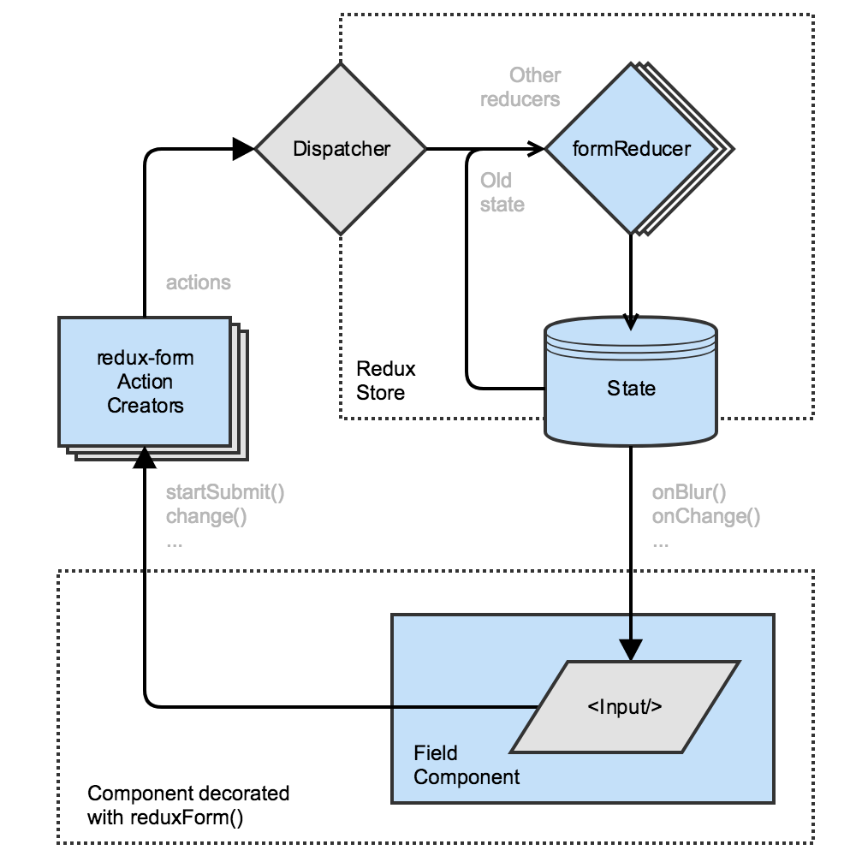
Redux- Form Working

Slide 67
Action Creators
redux-form exports has many internal action creators
  change(form:String, field:String, value:any)
  startSubmit(form:String)
  submit(form:String)

Slide 68
React-Form - Store
  import {createStore,combineReducers} from 'redux';
  import {reducer as reduxFormReducer} from 'redux-form';
  const reducer = combineReducers({form:reduxFormReducer});
  const store =createStore(reducer);
  export default store;

Slide 69
Form – UI View Component
  import React from 'react';
  import {Field,reduxForm} from 'redux-form';
  const InvoiceForm = props => {
  const { handleSubmit, pristine, reset, submitting } = props;
  return(
  <form onSubmit={handleSubmit}>
    <label>Customer Name</label>
    <Field component='input' type='text' name='customerName'></Field>

Slide 70
Form – UI View Component …contd
  <label>Invoice Amount</label>
  <Field component='input' type='text' name='amount'></Field>
  <button type="submit" disabled={pristine || submitting}>Submit</button>
  <button type="button" disabled={pristine || submitting} onClick={reset}>
  Clear Values
  </button>
  </form>
  )
  }
  export default reduxForm({
  form:'InvoiceForm'
  })(InvoiceForm)

Slide 71
Application
  function App() {
  return (
  <div className="App">
  <h2>React -Redux-form</h2>
  <InvoiceForm onSubmit={showResults} />
  </div>
  );
  }

Slide 72
Posting the Form State
  import axios from 'axios';
  export default function showResults(values) {
  axios.post(`http://localhost:4000/invoice`, values )
  .then(res => {
  console.log(res);
  console.log(res.data);
  })
  }

Slide 73
FORM VALIDATION WITH REDUX

Slide 74
Validation
Done By providing a redux-form with a validation function
  Takes an object of form values and returns an object of errors.
The parameters to the validation function are:
value
  The current value of the field
  If the value is valid, the validation function should return undefined.
  If the value is invalid, the validation function should return an error.
allValues
  The values of the entire form

Slide 75
Reducer -Store
  import { createStore, combineReducers } from 'redux';
  import { reducer as formReducer } from 'redux-form';
  const rootReducer = combineReducers({
  form: formReducer
  });
  const store = createStore(rootReducer);
  export default store;

Slide 76
Validations
  const validate = values => {
  const errors = {}
  if (!values.firstName) {
  errors.firstName = 'Required'
  } else if (values.firstName.length < 2) {
  errors.firstName = 'Minimum be 2 characters or more'
  }
  return errors
  }
  export default validate;

Slide 77
Form
  import { Field, reduxForm } from 'redux-form';
  import validate from './Validations';
  const renderField = ({ input, label, type, meta: { touched, error, warning } }) => (
    <div>
    <label>{label}</label>
    <div>
  <input {...input} placeholder={label} type={type} />
  {touched && ((error &&
  <span className="text-danger">{error}</span>) ||
  (warning && <span>{warning}</span>))}
  </div>
  </div>
  )

Slide 78
Form .. contd
  let FormCode = props => {
  const { handleSubmit, pristine, submitting } = props;
  return (
  <form onSubmit={ handleSubmit }>
  <Field name="firstName" component={renderField} label="First Name" />
  <button type="submit" disabled={pristine || submitting} >Submit</button>
  </form> )
  FormCode = reduxForm({
  form: 'contact',
  validate,
  })(FormCode);

Slide 79
Application
  import FormCode from './FormCode/FormCode.react';
  class App extends Component {
  submit = (values) => {
  console.log(values);
  }
  render() {
  return (
  <div className="container">
  <h3>Redux Form Validation</h3>
  <FormCode onSubmit={this.submit} />
  </div>
  );
  } }

Slide 80
Immutable Js
A library for creating collections of data, which, once created, cannot be changed.
Modelled on javaScript’s Array, Map and Set objects,
  Has Methods to add, delete or update data in a collection
  But do not mutate the collection being acted upon.
push()
  Adds the item to a new copy of the List
  Leaving the original List collection completely unchanged.

Slide 81
Immutable
  mutating List.push
  const collection = Immutable.List.of(Ramesh');
  collection.push(‘Suresh');
  Resulting Collection => Array [ “Ramesh”]
  Non-mutating List.push
  const collection = Immutable.List.of(‘Ramesh');
  const newCollection = collection.push(‘Suresh');
  newCollection;
  [
  “Ramesh",
  “Suresh",
  ]

Slide 82
Immutable Redux-Form
By default, redux-form uses plain javascript objects to store its state in Redux
Can also maintain Redux state with Immutable JS
  By importing from redux-form/immutable instead of redux-form .
  {
  "immutable": "^4.0.0-rc.12",
  "redux-immutablejs": "^0.0.8",
  }
  import { Field, reduxForm } from 'redux-form/immutable';

Slide 83
REDUX SAGA

Slide 84
Generators
Generators, are functions that can be paused and resumed
  function returns an iterator
Used for Two purposes
  Implementing iterables
  Blocking on asynchronous function calls
It return a generator Object ready to begin execution of function body
Executes on the first invocation of next() on the generator object itself.

Slide 85
Generators
  function* genFour() {
  yield 1;
  yield 2;
  yield 3;
  return 4;
  }
let four = genFour();
Suspends on every yield and allows other code to run until the next time it resumes

Slide 86
Passing Arguments to Iterators
Can pass arguments to the iterator through the next() method.
Argument becomes the value of the yield statement inside a generator.
  Used mainly in cases of asynchronous programming.
Created by Using yield statement with assignment
  Right side of the expression is evaluated on the first call to next()
  left side is evaluated on the second call to next()

Slide 87
Passing Arguments to Iterators
  function *createIterator() {
  let first = yield 1;
  let second = yield first + 2; // 4 + 2
  Let third =yield second + 3; // 5 + 3
  }
let iterator = createIterator();
console.log(iterator.next()); // "{ value: 1, done: false }" console.log(iterator.next(4)); // "{ value: 6, done: false }" console.log(iterator.next(5)); // "{ value: 8, done: false }" console.log(iterator.next()); // "{ value: undefined, done: true }"

Slide 88
Saga
Redux middleware library, to simplify handling side effects in redux app simple
Leveraging Generators,
  Allows to write asynchronous code that looks synchronous
The Multiple Call backs in thunk is eliminated and actions stay pure.
  STATE(before call) →STATE(during call) →STATE(answer received)

Slide 89
action
  export const getUsers = () => ({
  type: 'GET_USERS',
  });

Slide 90
Reducer
  const reducer = (state = {}, action) => {
  switch (action.type) {
  case 'GET_USERS':
  return {...state, loading: true };
  case 'USERS_RECEIVED':
  return {...state, users: JSON.stringify(action.json[0]), loading: false }
  default:
  return state;
  }
  };
  export default reducer;

Slide 91
Saga API
Put
  Dispatches an action to the Redux store.
  It returns a plain object that can be inspected
takeLatest
  Allows one function handler to run at a time
  If another action is fired when the handler is still running,
    It will cancel it, and run again with the latest data available.

Slide 92
All()
  import { call } from 'redux-saga/effects'
  const todos = yield call(fetch, '/api/todos')
  const user = yield call(fetch, '/api/user')
While making Two call the second fetch() won’t be executed until the first one succeeds.
All
  Used to execute both of them in parallel, promise will not be resolved until both call() completes
  const [todos, user] =
  yield all([ call(fetch, '/api/todos'),
  call(fetch, '/api/user') ])

Slide 93
Sagas.js
  import { put, takeLatest, all } from 'redux-saga/effects';
  function* fetchUsers() {
  const json = yield fetch('https://jsonplaceholder.typicode.com/users')
  .then(response => response.json(), );
  yield put({ type: "USERS_RECEIVED", json: json, });
  }

Slide 94
Sagas.js
  function* actionWatcher() {
  yield takeLatest('GET_USERS', fetchUsers)
  }
  export default function* rootSaga() {
  yield all([
  actionWatcher(),
  ]);
  }

Slide 95
Store
  import rootSaga from './sagas';
  const sagaMiddleware = createSagaMiddleware();
  const store = createStore(
  reducer,
  applyMiddleware(sagaMiddleware, logger),
  );
  sagaMiddleware.run(rootSaga);

Slide 96
Component
  import React from 'react';
  import Button from '../containers/Button';
  import UserItem from '../containers/UserItem'
  import Loading from '../containers/Loading'
  let App = () => ( <div>
  <Button/>
  <Loading/>
  <UserItem/>
  </div>
  );
  export default App;

Slide 97
Initializing Saga
Initialize Redux Saga by first importing it,
Then by applying a saga as a middleware to the Redux Store:
const sagaMiddleware = createSagaMiddleware()
const store = createStore( reducers, applyMiddleware(sagaMiddleware)
)
The last step is running the saga. We import it and pass it to the run method of the middleware:
  sagaMiddleware.run(rootSaga);

Slide 98
SESSION HANDLING

Slide 99
Session Handling
  import React from 'react';
  const App = () => {
  const [value, setValue] = React.useState('');
  React.useEffect(() => {
  localStorage.setItem('myValueInLocalStorage', value); },
  [value]);
  const onChange = event => setValue(event.target.value);
  return (
  <div> <h1>Hello React with Local Storage!</h1>
  <input value={value} type="text" onChange={onChange} /> <p>{value}</p>
  </div> );
  };

Slide 100
Session Handling
  import React from 'react';
  const App = () => {
  const [value, setValue] =
  React.useState(
  localStorage.getItem('myValueInLocalStorage') || '' );
  React.useEffect(() => { localStorage.setItem('myValueInLocalStorage', value); }, [value]);
  const onChange = event => setValue(event.target.value);

Slide 101
Session Handling
  return ( <div>
  <h1>Hello React with Local Storage!</h1>
  <input value={value} type="text" onChange={onChange} />
  <p>{value}</p> </div> ); };

Slide 102
CONTEXT API

Slide 103
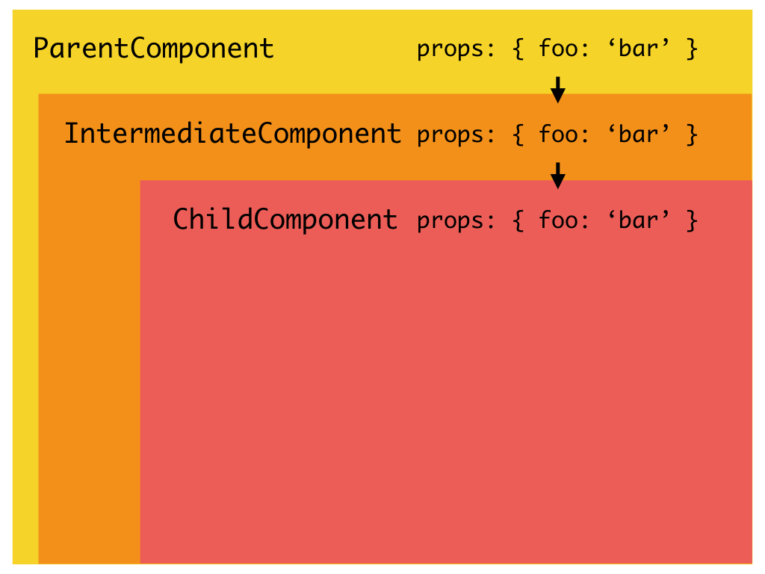
Context API

Slide 104
Introduction
Introduced from React 16.3
  A way to pass data through the component tree without having to pass props down manually at every level
Can set a state that can be seen globally to the entire application.
A context provider (<Provider />) to define the data to be sending around
A context consumer (<Consumer />) that grabs that data and uses it where called.
  Declare the state once, and then use via the context consumer

Slide 105
Context API
React.createContext
  Used to create the context Object
const MyContext = React.createContext(defaultValue);
Can read the current context value from a closest matching Provider
defaultValue
  used when the component does not have the matching Provider above it in the tree.
  Helpful for testing components in the isolation without wrapping them.

Slide 106
Context Provider
<MyContext.Provider value={/* some value */}>
Every Context object comes with the Provider React component
  Accepts the value prop to be passed to the consuming components that are the descendants of this Provider.
  One Provider can be connected to the many consumers.
  Providers can be nested to override the values deeper within a tree.
  It can wrap around all components that share state.

Slide 107
Context Consumer
It is the React component that subscribes to the context changes.
  receives a current context value and returns the React node.
  The value argument passed to a function will be equal to a value prop of the closest Provider for this context above in the tree.
If there are no Providers for the context
  Will have the defaultValue that was passed to createContext().
  <MyContext.Consumer>
  render something based on the context value
  </MyContext.Consumer>

Slide 108
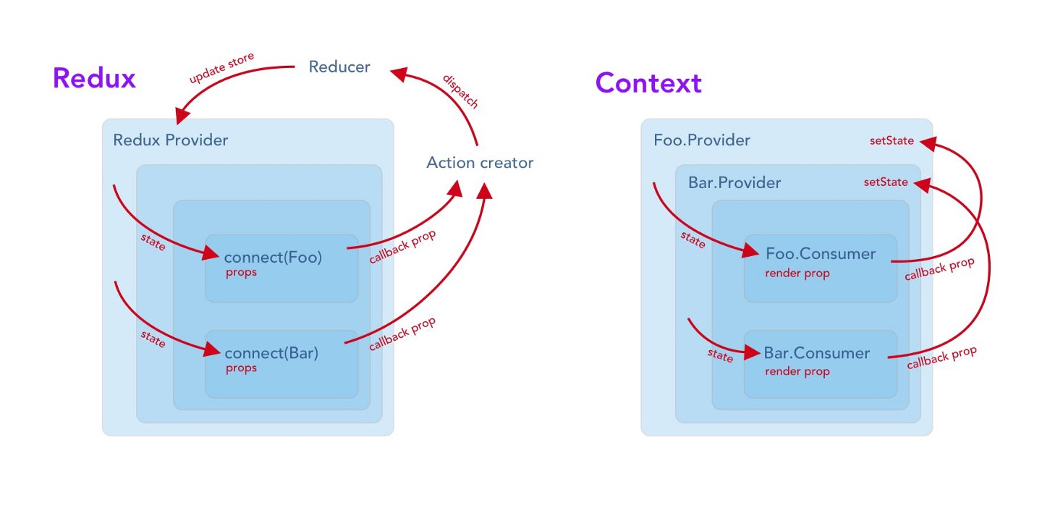
When to Use Context API
Used for simple prop drilling solution that can scale
  Use Redux for applications that have multiple (and more complex) states, reducers, etc,

Slide 109
Context API - Provider
  export const AppContext = React.createContext()
  class ContextProvider extends Component{
  state = {
  name : "Passing Values with Context",
  }
  render(){
    return(
    <AppContext.Provider value={this.state}>
    {this.props.children}
    </AppContext.Provider>
    ) } }
  export default ContextProvider;

Slide 110
Context API Consumer
  import React from 'react';
  import {AppContext} from '../Highest/Highest.react';
  const Lowest = () => {
  return (
  <AppContext.Consumer>
  {({ name }) => <h1>Welcome {name}! </h1>}
  </AppContext.Consumer>
  );
  }
  export default Lowest;
  <Highest> <Lowest/> </Highest>

Slide 111
User Context
  export const userCtx = React.createContext({
  userName:'',
  updateUserName: () =>{}
  });

Slide 112
Context Provider
  class UserContext extends React.Component {
  updateUserName = (updateName) =>{
  this.setState({userName:updateName})
  }
  state = {
  userName:'ramesh',
  updateUserName:this.updateUserName
  }

Slide 113
Context Provider
  render() {
  return (
  <div >
  <userCtx.Provider value={this.state}>
  {this.props.children}
  </userCtx.Provider>
  </div>
  );
  }
  }
  export default UserContext;

Slide 114
Context Consumer
  import React from 'react';
  import {userCtx} from '../UserContext/UserContext.react';
  const UserMessage = () => {
  return (
  <userCtx.Consumer>
  {({ userName }) => <h1>Welcome {userName}!</h1>}
  </userCtx.Consumer>
  );
  }
  export default UserMessage;

Slide 115
Context Consumer
  const UserSettings = () => {
  return (
  <userCtx.Consumer>
  {({ updateUserName }) => (
  <div>
    <h2>Settings</h2>
    <label htmlFor="username">Username: </label>
    <input id="username“ type="text“ onChange={event => {
    updateUserName(event.target.value);
    }} />
  </div>
  )}
  </userCtx.Consumer>
  ); }
  export default UserSettings;

Slide 116
Application
  <UserContext>
  <UserMessage/>
  <UserSettings/>
  </UserContext>

Slide 117
SERVER SIDE RENDERING

Slide 118
Next.Js
Next.js open-source Java Script framework to write server-rendered React apps easily
Ease of use
  No need t0 setting up webpack, react router, react and react-dom.
  It’s all included right out of the box!
Code splitting
  out of the box.
Performance
  for first page load.
Improved Search Engine Optimization

Slide 119
Rendering – Client and Server Side
Client side rendering
  Browser will download a minimal HTML page, and the content will be filled in by JavaScript.
Server side rendering
  initial content is generated on the server
  Browser can download a page with HTML content already in place.
  Updates to the content are handled in the browser.
Cons of server side rendering
  Can improve performance in many situations
  SSR is more work for server
  Need for Search Engine Optimization on Google, Bing, Yahoo
  An working React app, need the best possible performance, and are willing to pay for the extra server resources.

Slide 120
Creating Pages
Need to create inside pages folder
  Pass that page name after the root URL, to access that page.
Server-side rendering is very convenient for first-page load
Navigating inside client-side, speed up the page load and improve the overall user experience.
  A Link component can be used to build links.

Slide 121
Package.json
  { "scripts":
    { "dev": "next" }
  }
Start up a development server using
  npm run dev.
  { "scripts":
    { "dev": "next",
    "build": "next build",
    "start": "next start"
    }
  }

Slide 122
Root/pages/index.js
  import React from 'react';
  import Link from 'next/link'
  const Index = () =>{
  return(
  <div>
  <h2>Welcome to Server side Rendering</h2>
  <Link href="/home">
  <a>Home</a>
  </Link>
  </div>
  )
  }
  export default Index;

Slide 123
Home.js
  import React from 'react';
  export default () => (
  <div>
  <p>
  <h2>Customer</h2>
  </p>
  </div>
  )

