Slide 1
Abishek Kumar
Vijay Kumar
Ranjith
Abishek@kumar.com

Slide 2


Slide 3


Slide 4


Slide 5
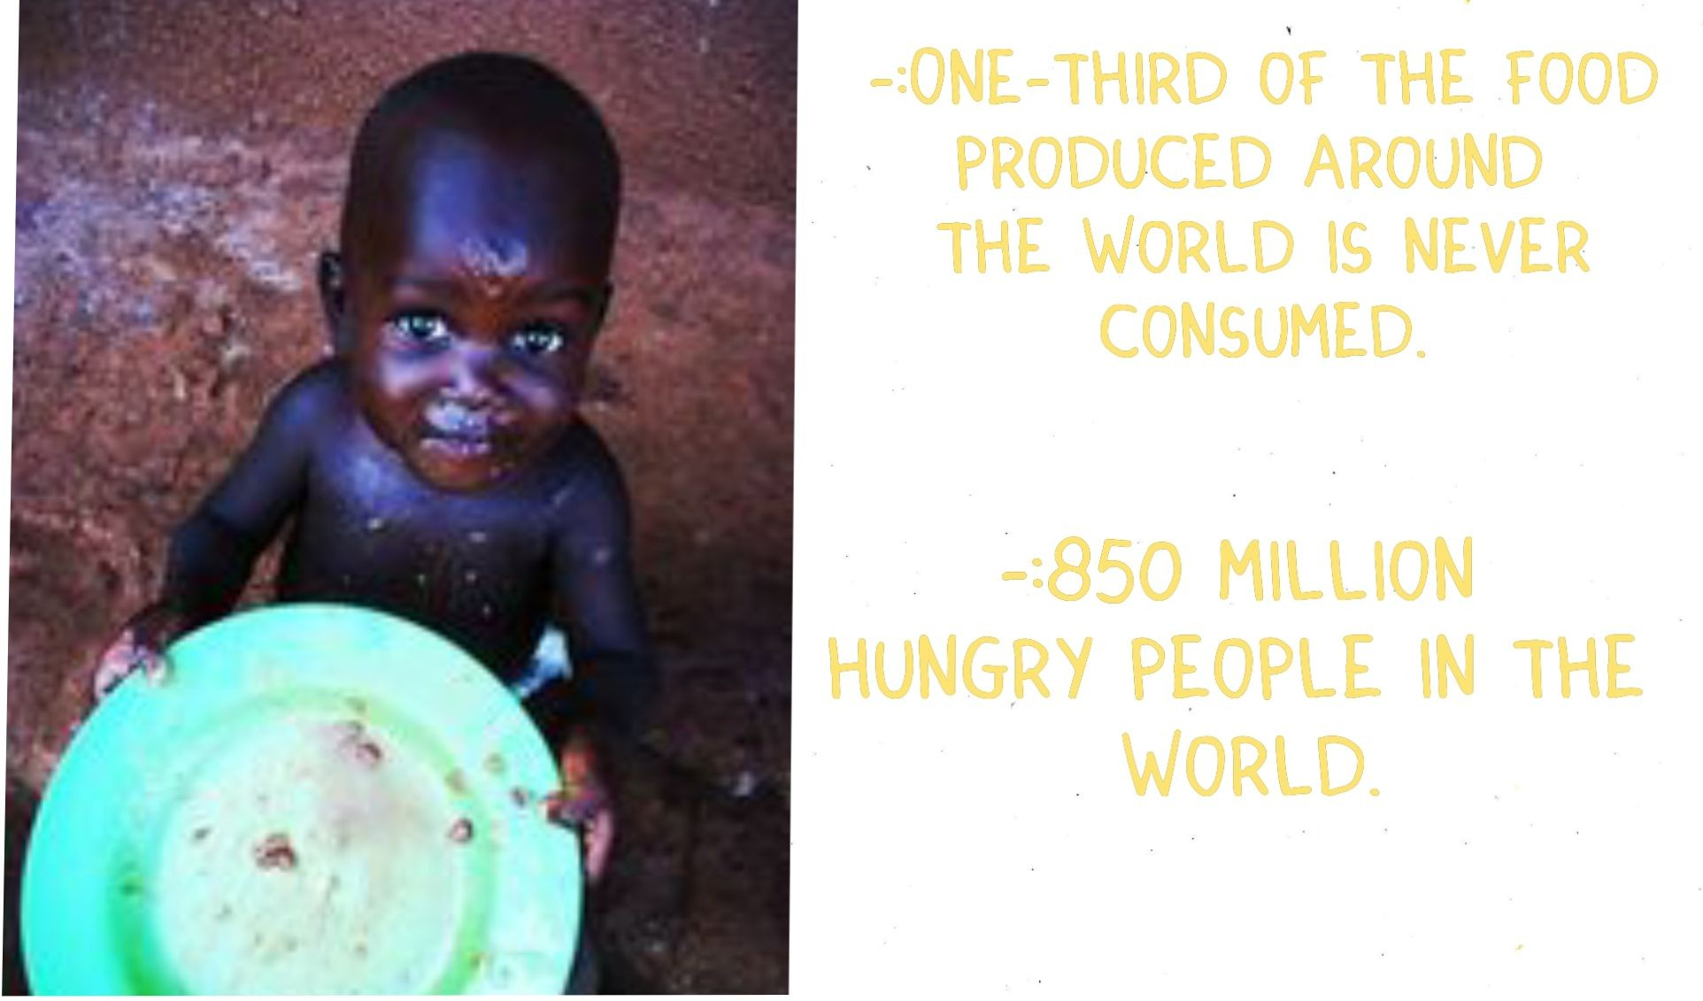

Slide 6
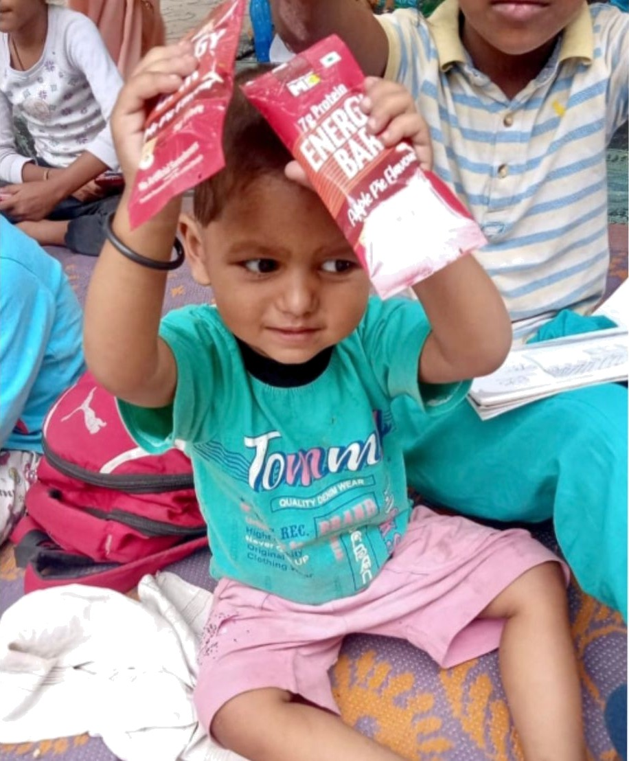

MISSION
OUR GOAL IS TO REDUCE HUH6ER AHD 700O NASTF BY RFDISTRIBUTIHO SURPLUS 700O TO UXDFRPRIVILFGED
COhhufllTlEs.

Slide 7


Slide 8

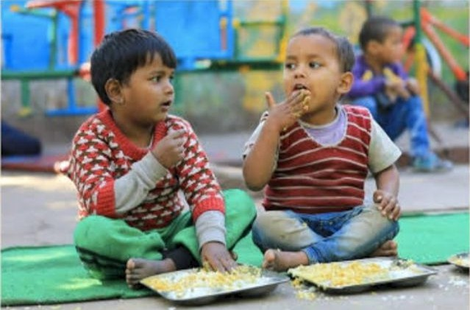

FREE D OM FROM H UNGER *
EmnŠÍÎY
•' •<•*B
Phone: +°*°°****°°^°*
+0I058532MIø3,
+eIe3YeIe34zz
.
D ••

Slide 9


