Slide 1

PGDM/MBA in Business Analytics
Introduction to Data Management (6 Credits)
Batch 03
Assessment 2: Pima Indian diabetes dataset
Vijaykumar Gotakhindi

Slide 2
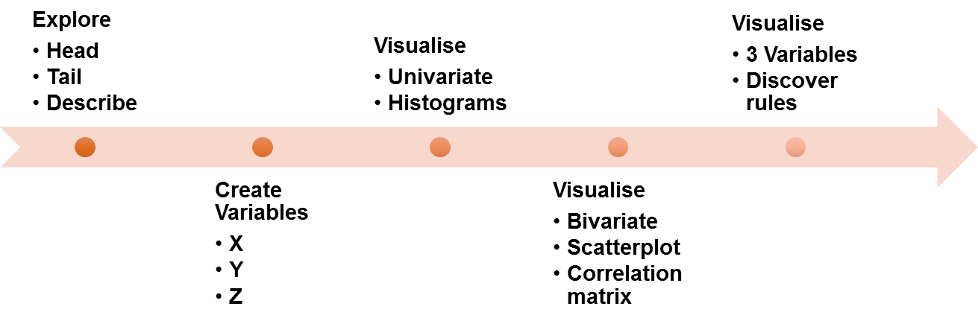
Explore the Diabetes data set with the template and data pipeline as below:

Slide 3
Explore: Data Set
Pregnancies: Number of times pregnant
Glucose: Plasma glucose concentration in saliva
BloodPressure: Diastolic blood pressure
SkinThickness: Triceps skin fold thickness
Insulin: Two hours serum insulin
BMI: Body mass index (Weight/Height)
DiabetesPedigreeFunction: Diabetes pedigree function
Age: In years
Outcome: 1:Diabetes, 0:Not
This data set containing 768 observations
768 rows × 9 columns

Slide 4
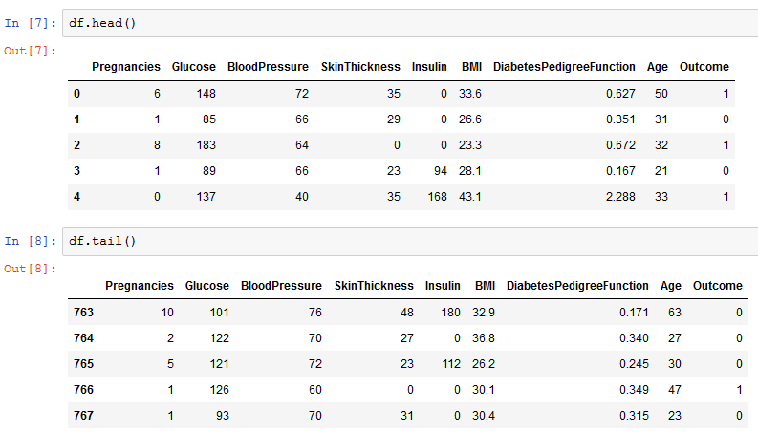
Explore: Data Set
head() & tail()

Slide 5
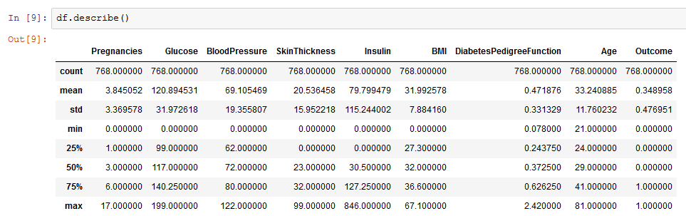
Explore: Data Set
Describe()

Slide 6
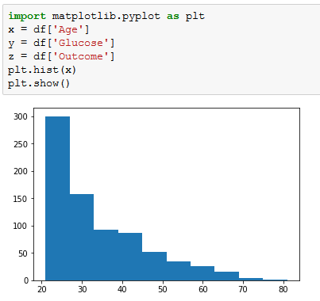
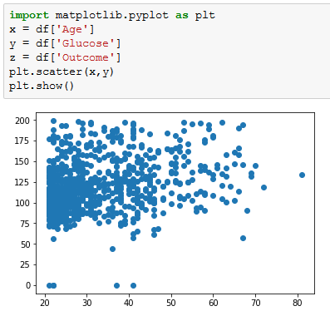
Variables:
x = Age
y = Glucose
z = Outcome
Visualize:

Slide 7
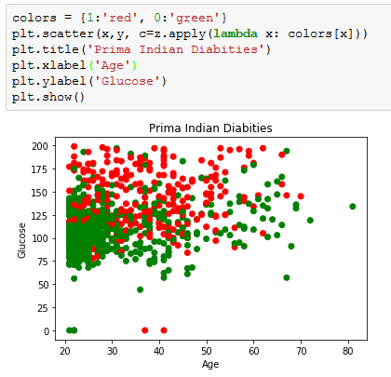
Visualize: Age vs Glucose
Identifying how age and glucose level affecting +ve diabetes
Interpretation:
If age is below 30 & glucose level are below 120 then she is probably not a diabetic.
If Glucose levels are below 75 then probability of having diabetic is very negligent
If the Glucose levels are above 125 then mostly you are suffering from diabetics

Slide 8
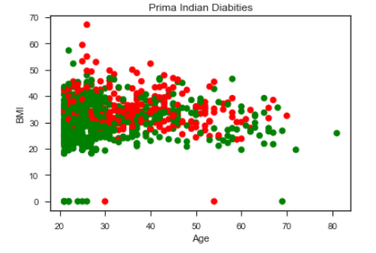
Visualize: Age vs BMI
Identifying how age and BMI affecting diabetes
Interpretation:
If age is below 35 & BMI levels are below 30 then she is probably not a diabetic.
If the BMI levels are above 30 then mostly you are suffering from diabetics

Slide 9
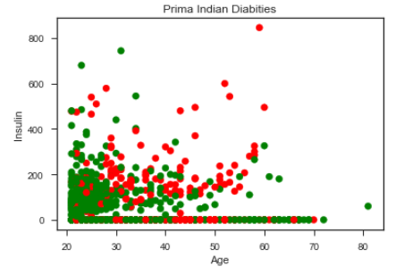
Visualize: Age vs Insulin
Identifying how age and Insulin levels affecting diabetes
Interpretation:
If age is more than 30 & Insulin levels are above 100 then she is probably a diabetic.

Slide 10
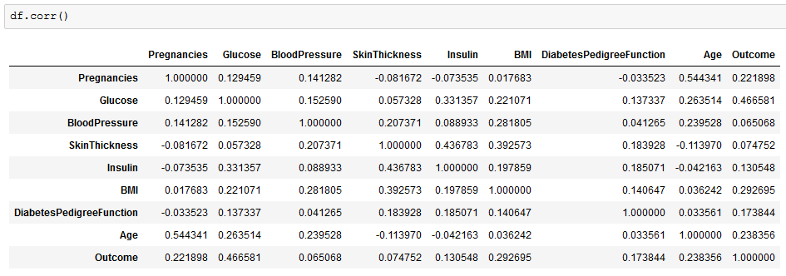
Correlation:

Slide 11
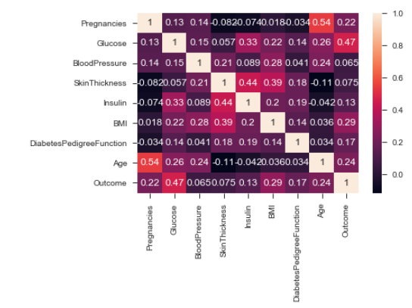
Correlation contd..:

Slide 12
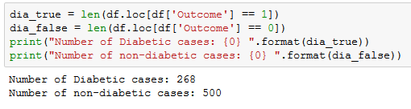
Observation:
Conclusion:
In the provided data set, there are 268 diabetic patients who has more than 125 Glucose level
500 are non-diabetic and their Glucose levels are below 125.
GitHub link:

