Slide 1

DEPARTMENT OF ELECTRONICS AND COMMUNICATION ENGINEERING
Project Title
Design of Smart Car Control System For Gesture
UNDER THE GUIDANCE OF
MS.K.SAJIDA
PRESENTED BY
C.Sireesha 182G1A0472
G.Hema 182G1A0483
R.Siriprasad Naik 182G1A04A5
G.Vinay 182G1A0482
B.Arif Khan 182G1A0468

Slide 2
ABSTRACT
A smart car control system, based on Bluetooth control for gesture recognition is designed, which uses the MPU60S0 six-axis attitude sensor to collect attitude information as well as through multi-angle fusion and direction closed-loop control tm create the corresponding digital gestures for different ö instructions.
After the digital recognition, the relevant instructions are transmitted to the Arduino smart car via radio frequency, which realizes the remote control of the intelligent vehicle through human gestures to complete the corresponding command actions.
The experimental results show that this design realizes the function of controlling the direction off the smart car through gesture changes.
The movement trajectory of the smart car can better feedback the movement of the hand; at the same time, it also shows that the system operates stably and has a strong anti-interference ability.

Slide 3
INTRODUCTION
With the increasing advancement of technology and the rapid development of the automotive indust1Y, the design of somatosensory remotely controls cars in its fancy. In intelligence, it is necessary to conduct human-computer interaction [¹ -³] in a mote humane, concise, and natural way.
Through human-computer interaction, related equipment can complete remote operation tasks on unmanned platforms in unknown environments. The operator can remotely and wirelessly control the smart car by wearing related equipment.
Gesture recognition is a new starting point for the transformation of human-computer interaction mode The conversion of gestures is used as a signal change to control the physical device so that the physical device helps people complete the specified tasks.

Slide 4
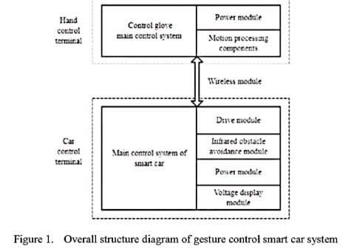
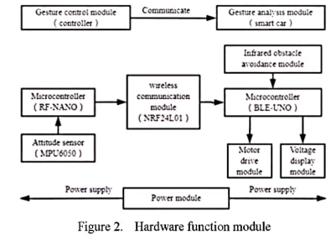
ARCHITECTURE

Slide 5
CONCLUSION
platforms in unknown environments. The operator can remotely and wirelessly control the smart car by wearing related equipment.

Slide 6


