Slide 1
LENDING CLUB ASSIGNMENT SUBMISSION
Name: Vijay Mishra

Slide 2
Total Defaulter By Category
In this case we categories the loan amounts into categories
Divide the loan amount into 3 categories High, medium and low.
High - Loan amount is greater than 20000
Medium -Loan amount is between 10000 to 20000
Low -Loan amount is less than 10000

Slide 3
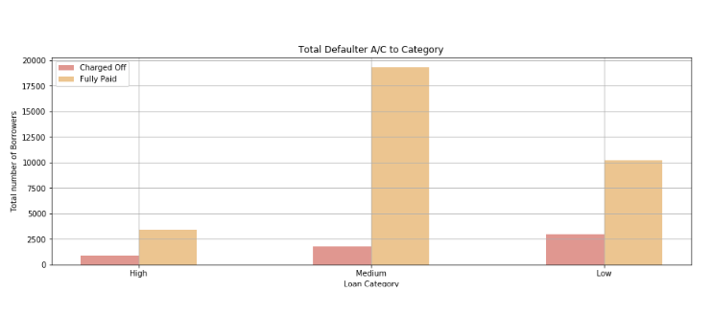
Total Defaulter By Category

Slide 4
Average Defaulter By Grade
Convert the loan status values charge off =1 and fully paid =0.
Find the average value of loan status values and group by grade
Values are lies between the 0 to 1 shows the percentage of defaulter

Slide 5
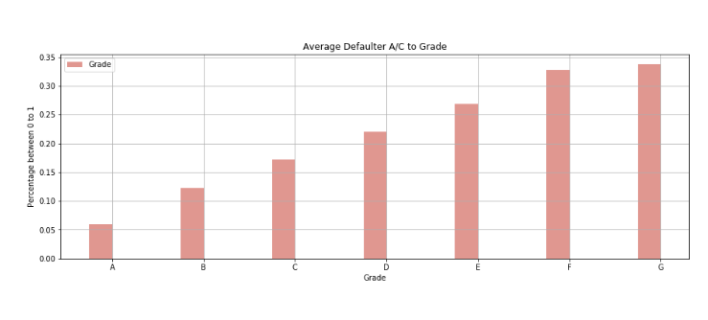
Average Defaulter By Grade

Slide 6
Total Defaulters By Term
Convert the month term into year.
List out the charge off and fully paid
Find out the defaulter on the basis on term

Slide 7
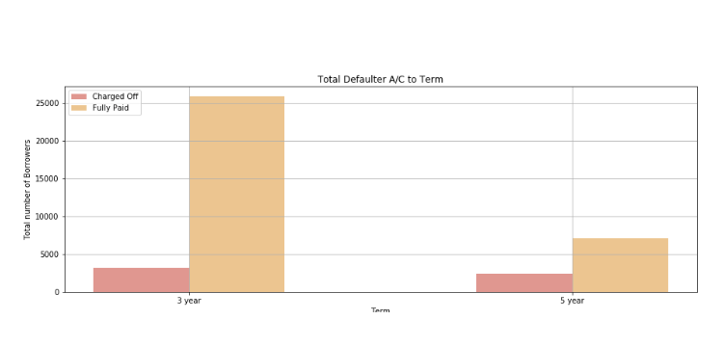
Total Defaulters By Term

Slide 8
<Results>
Plot 2

Slide 9
<Results>
Plot 3

Slide 10
<Conclusions>

