Slide 1
Liver Disease Prediction using ML Classification Techniques
Prepared by: [Your Name]
Department: CSE
College: [Your College Name]
Year: 2025

Slide 2
Introduction
- Liver is the second largest organ in the human body.
- Liver diseases like Hepatitis and Cirrhosis are serious health issues.
- Early detection can help doctors save lives.
- Machine Learning can assist doctors by predicting disease based on medical data.

Slide 3
Objective
- To predict liver disease from patient medical reports.
- Use classification algorithms like Logistic Regression, Decision Tree.
- Build a simple web application for doctors to check reports online.

Slide 4
Dataset - ILPD
- Dataset: Indian Liver Patient Dataset (ILPD)
- 583 patient records from Andhra Pradesh, India.
- Features: Age, Gender, Total Bilirubin, Albumin, Enzymes etc.
- Target Column: Disease Present (1) or Absent (0)
- Data Source: UCI Machine Learning Repository.

Slide 5
Methodology
Steps followed:
1. Data Preprocessing
- Fill missing values
- Encode categorical values
2. Exploratory Data Analysis (EDA)
3. Model Training
- Logistic Regression
- Decision Tree
4. Evaluation and Comparison
5. Web Application Development

Slide 6
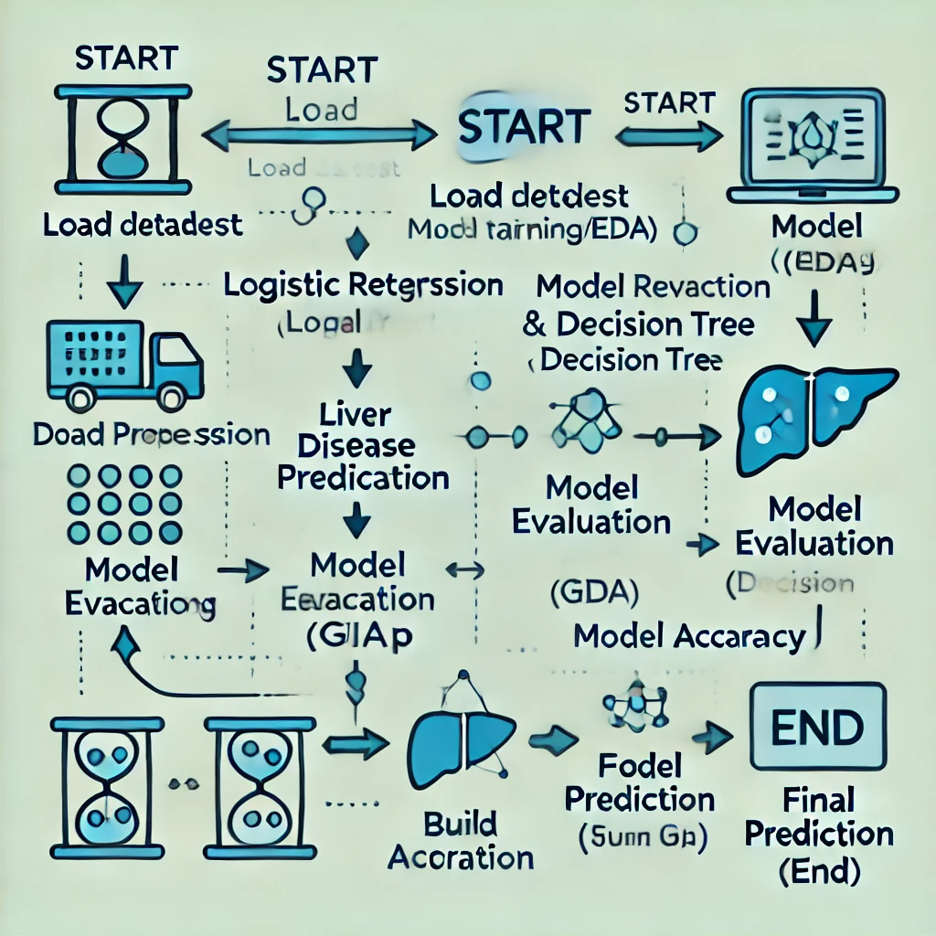
Methodology Flowchart

Slide 7
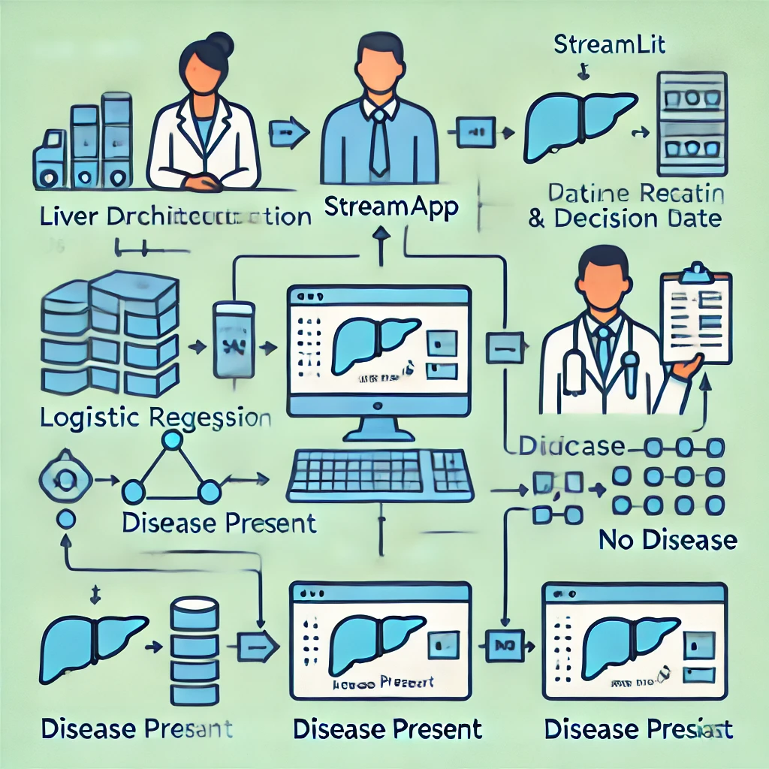
System Architecture

Slide 8
Algorithms Used
- Logistic Regression:
- Suitable for binary classification (Disease or No Disease).
- Finds a linear relationship between features and target.
- Decision Tree:
- Tree-like structure that splits data into branches.
- Easy to understand and interpret.

Slide 9
Model Comparison
Model Accuracy:
1. Logistic Regression: 71%
2. Decision Tree: 68%
3. (Optional) Add other models if needed in future.

Slide 10
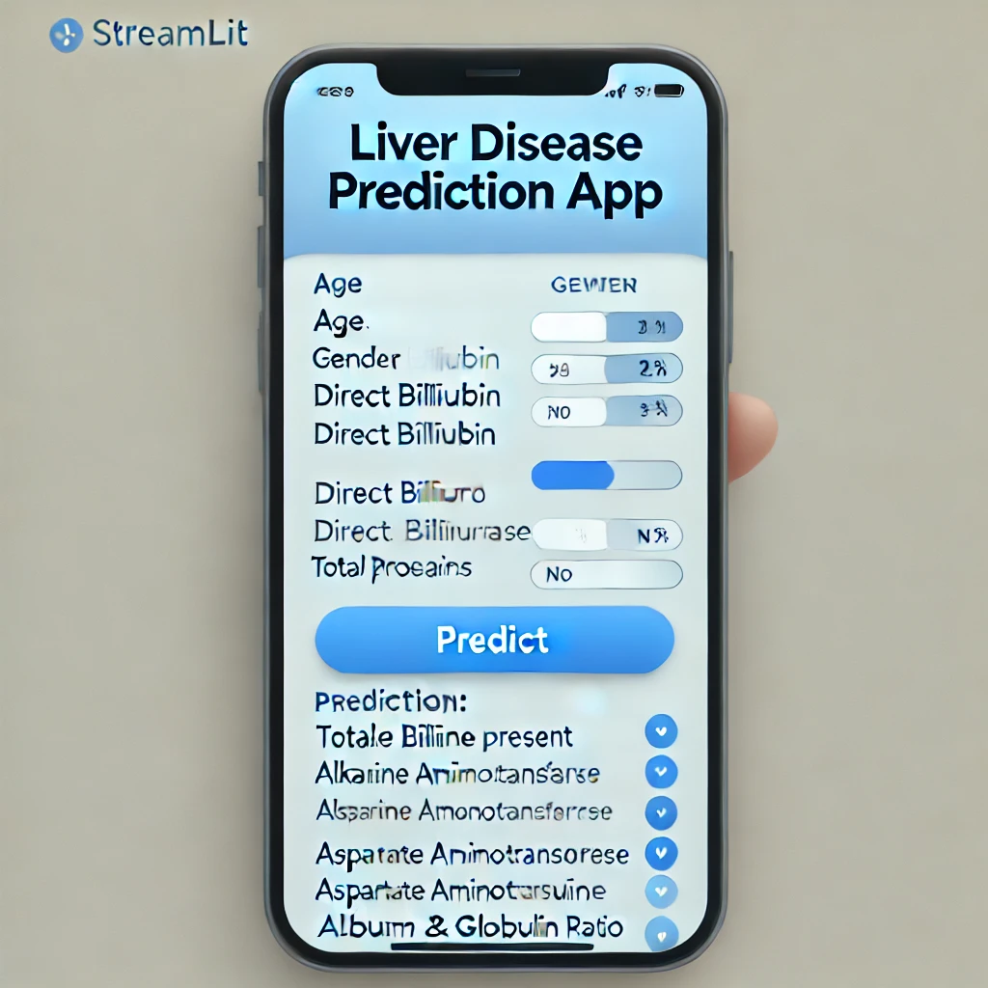
User Interface - Streamlit App

Slide 11
Tools & Technologies
- Programming: Python
- Libraries: Pandas, NumPy, scikit-learn
- Visualization: Matplotlib, Seaborn
- Deployment: Streamlit
- Notebook: Jupyter
- Dataset Source: UCI Repository

Slide 12
Benefits & Impact
- Fast preliminary diagnosis for liver disease.
- Supports doctors in decision-making.
- Simple web app that even rural hospitals can use.
- Cost-effective technology for early screening.

Slide 13
Future Scope
- Add more advanced models like Random Forest, SVM, Neural Networks.
- Collect larger and more diverse dataset from multiple hospitals.
- Add real-time data entry and report generation in the app.
- Integrate the system with hospital management software.

Slide 14
Thank You
Questions & Feedback are Welcome

