Slide 1
Liver Disease Prediction using Machine Learning Classification Techniques
Prepared by: [Your Name]
Department: Computer Science Engineering
College: [Your College Name]
Year: 2025

Slide 2
Introduction
- Liver is a vital organ.
- Liver diseases are common and dangerous if detected late.
- Early detection can save lives.
- This project uses machine learning to predict liver disease.

Slide 3
Objective
- Predict liver disease from medical test data.
- Use machine learning classification models.
- Build a web app for doctors to check patient data.

Slide 4
Dataset
- Indian Liver Patient Dataset (ILPD)
- 583 patient records
- Features like Age, Gender, Bilirubin, Enzymes, Proteins, etc.
- Label: Disease Present / No Disease

Slide 5
Methodology
- Data Preprocessing (handling missing values, encoding gender)
- Exploratory Data Analysis (EDA)
- Model Training (Logistic Regression, Decision Tree)
- Model Evaluation (Accuracy Check)
- Streamlit App Development

Slide 6
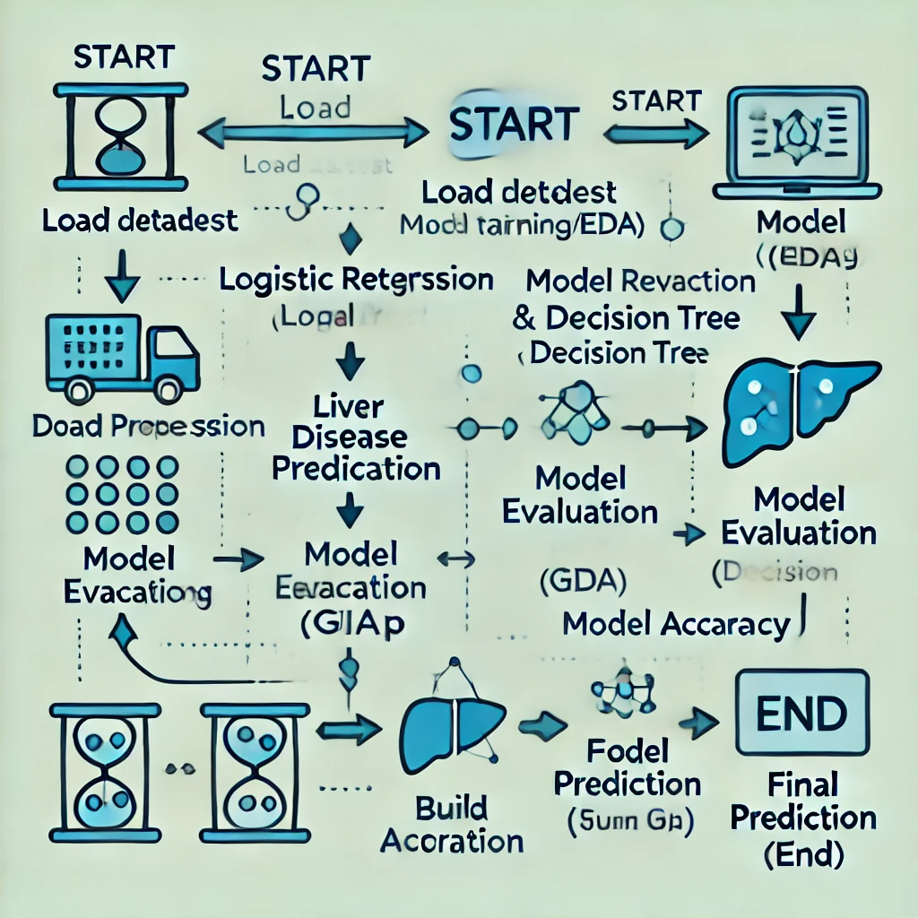
Methodology Flowchart

Slide 7
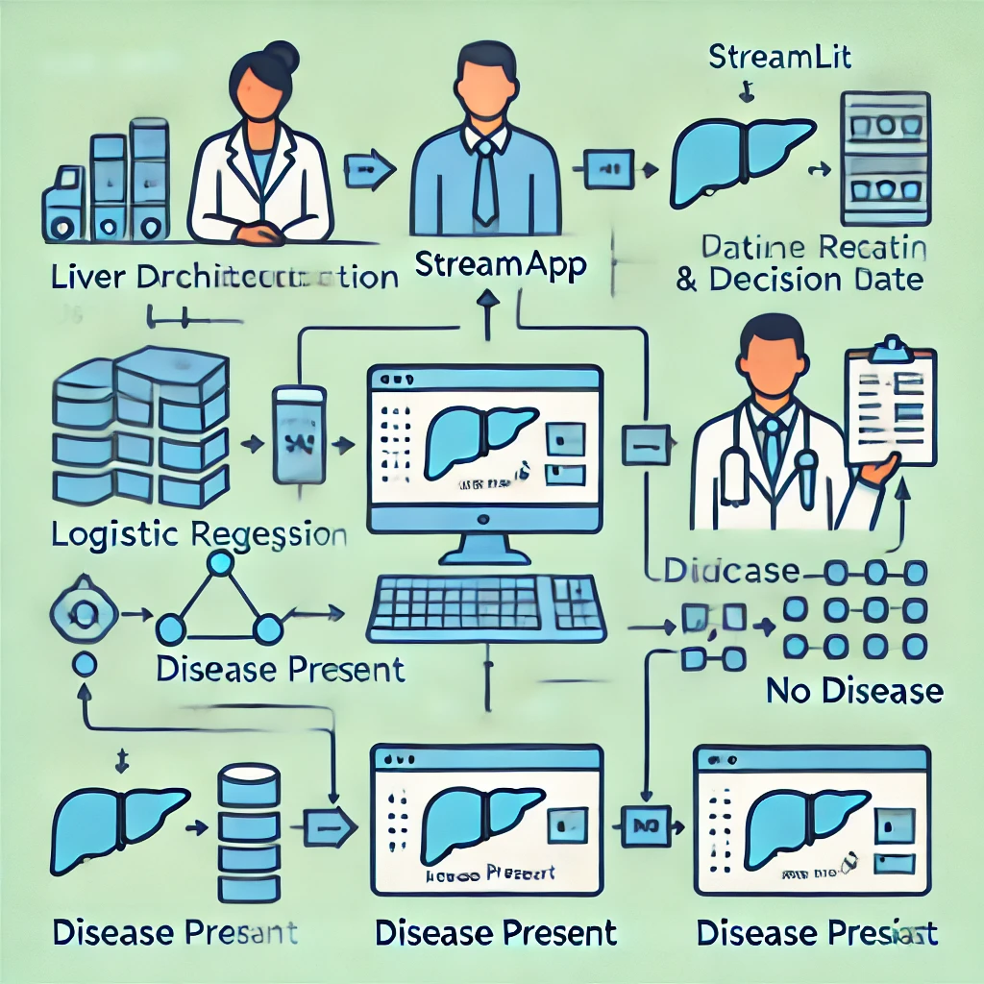
System Architecture Diagram

Slide 8
Result & Comparison
| Model | Accuracy |
|------------------|-----------|
| Logistic Regression | 71% |
| Decision Tree | 68% |

Slide 9
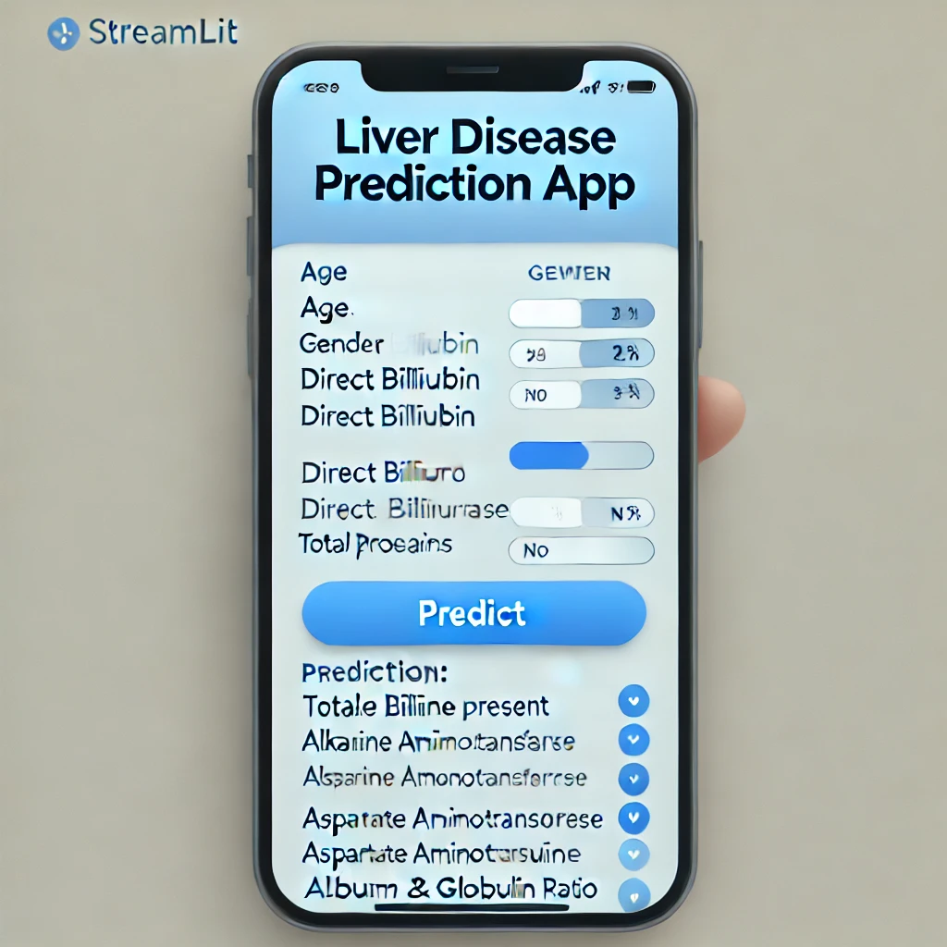
Streamlit App Screenshot

Slide 10
Tools & Technologies
- Python
- Pandas, NumPy
- scikit-learn
- Streamlit
- Jupyter Notebook

Slide 11
Conclusion
- Machine learning helps in early liver disease detection.
- Logistic Regression gave better results than Decision Tree.
- Doctors can easily use the app to predict liver disease.

Slide 12
Future Scope
- Use deep learning models
- Collect larger and more detailed dataset
- Predict more liver disease types

Slide 13
Thank You
Questions & Answers

