Slide 1

WingBuy
An Online Shopping Website

Slide 2
TEAM INFORMATION
TEAM MEMBERS:
VIJAY DHAKAD (TEAM LEADER)-
PSNO: 10671396
VISHAL SINGH
PSNO: 10671399
GNAPIKA ANKAM
PSNO: 10671349
KIRTIRAJ BHAGAT
PSNO: 10671525

Slide 3
PROBLEM STATEMENT
WingBuy is a project in E-Commerce domain which will provide several individuals and companies to sell their products .The system will be available to all users but compare and checkout component will require user to signup or login. Goal of our application is to provide a quick and easy to use interface for all the Users and Retailers
The goal of our system is not just to sell the products to buyer , but also to make him aware of what he/she is buying.

Slide 4
OBJECTIVES
WingBuy is an online shopping website to ease the way of shopping. It provides wide range of Mobiles, Electronics, Appliances, and many more . The retailers are prior verified and quality products are added for sale by our Admin. WingBuy provides safe and easy online shopping to all its customers.
YOUR WISH , OUR PASSION!!!

Slide 5

GLIMPSE OF THE PROJECT
.

Slide 6
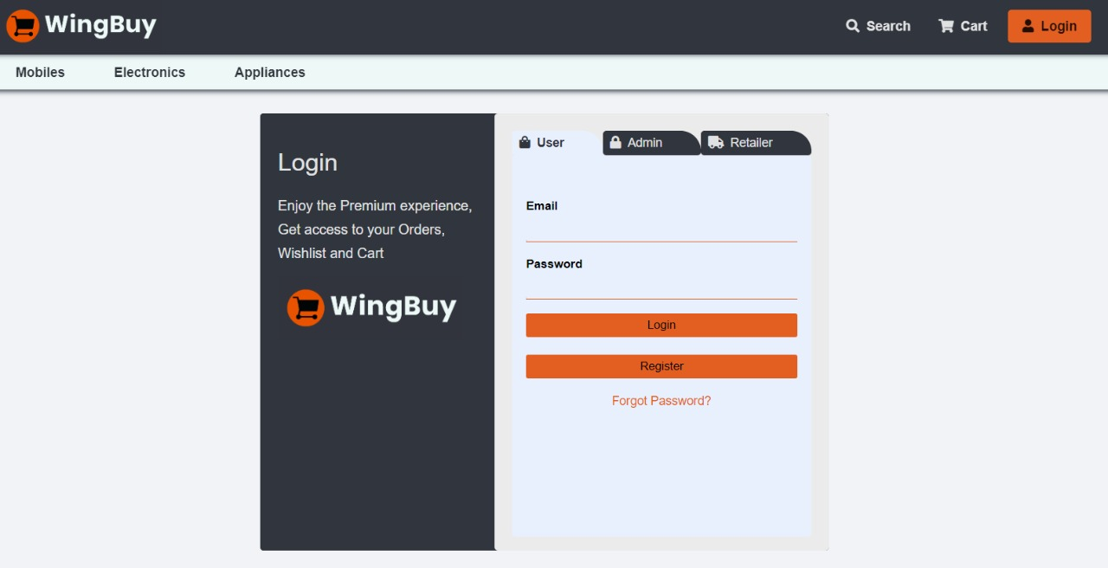
.

Slide 7
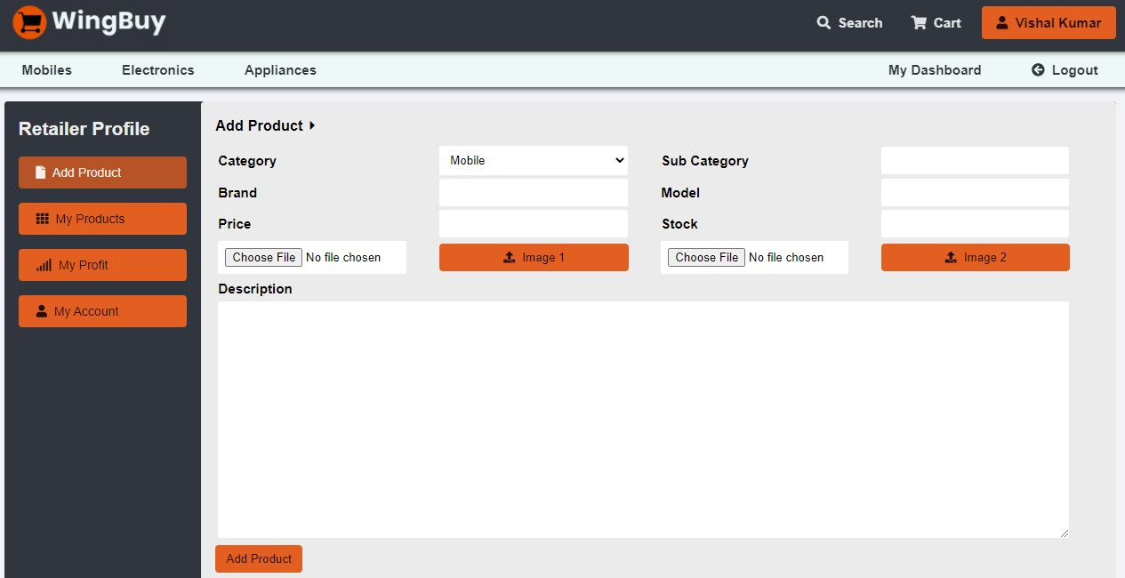

Slide 8
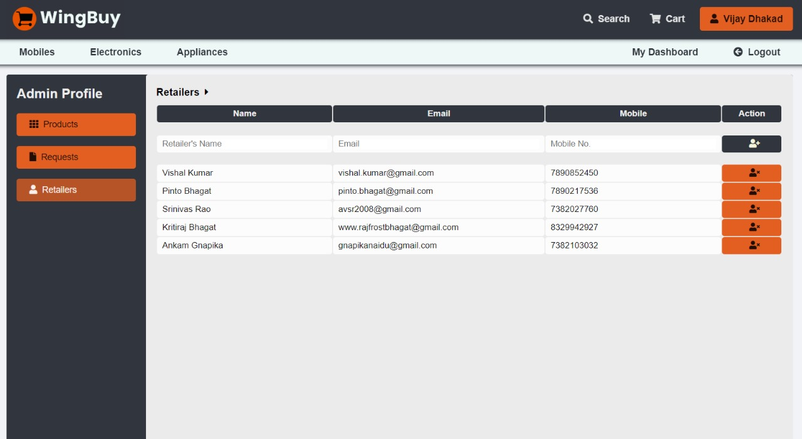
.
.

Slide 9
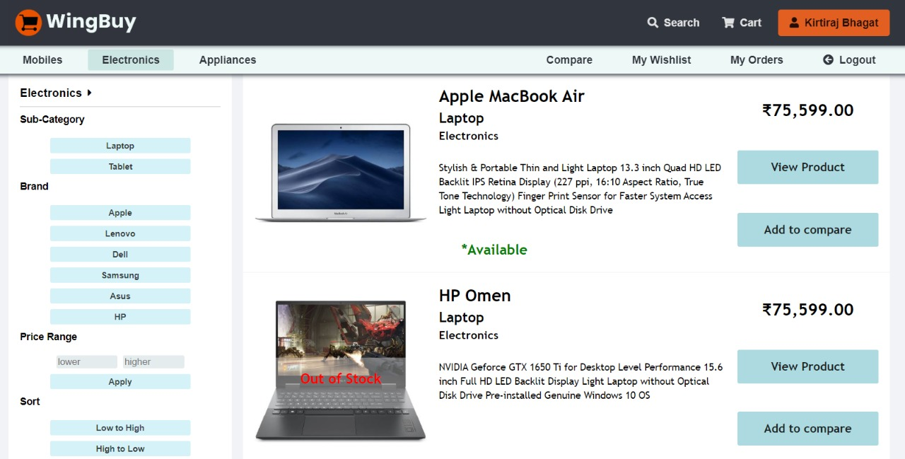

Slide 10
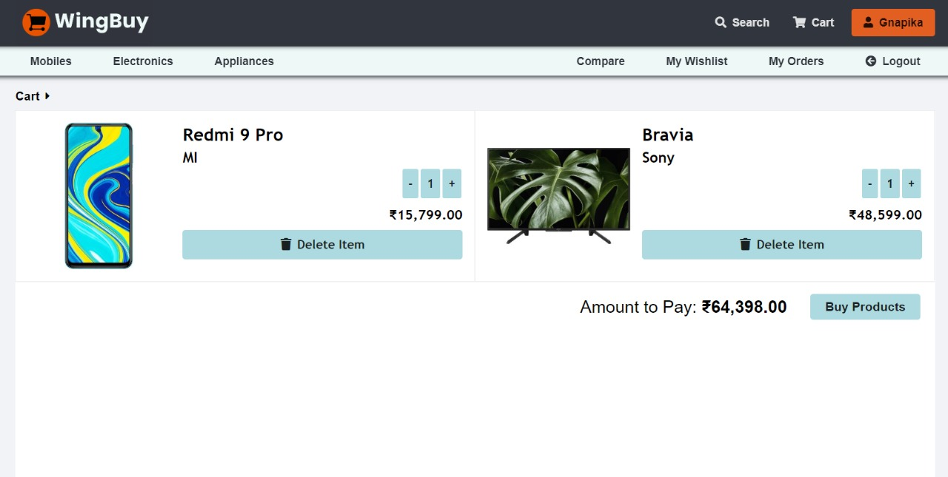
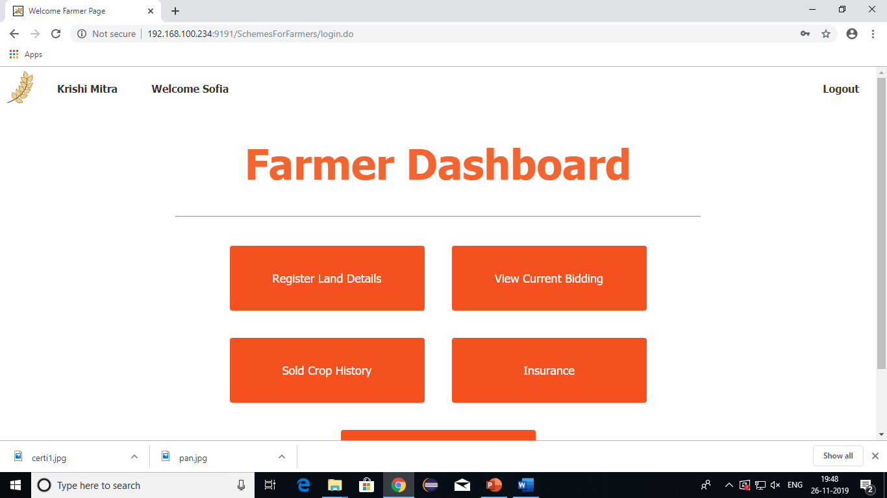

Slide 11
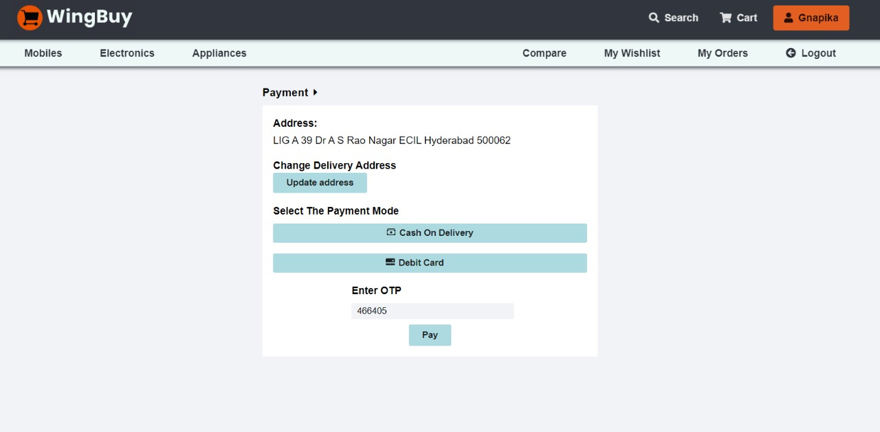

Slide 12
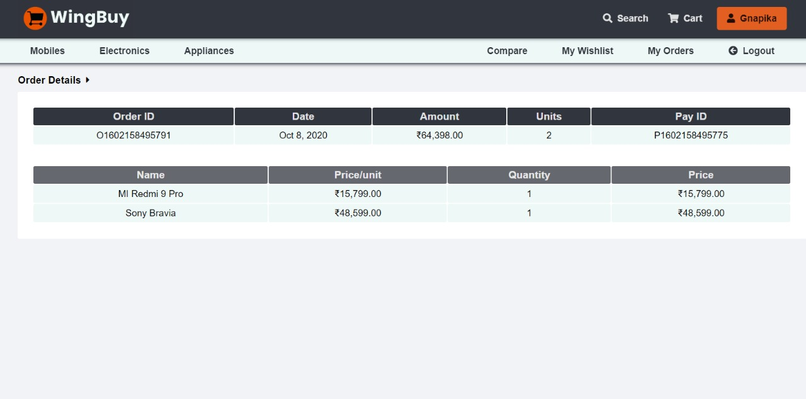

Slide 13
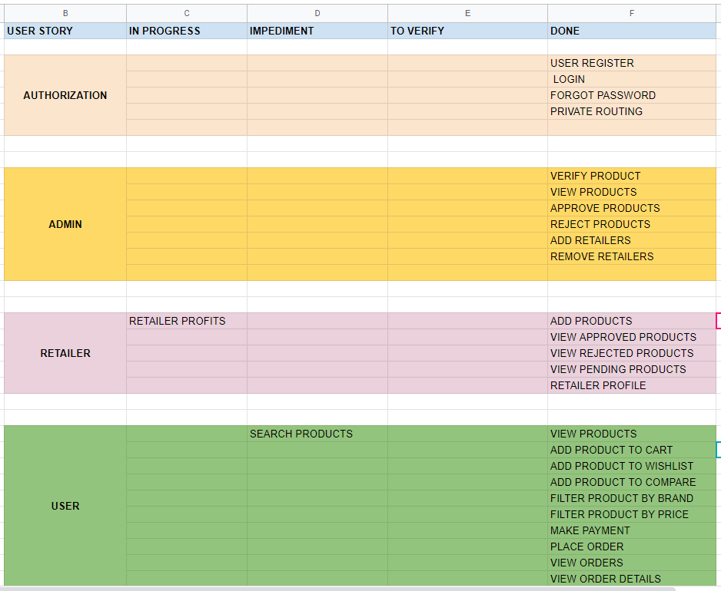
SCRUM TABLE

Slide 14
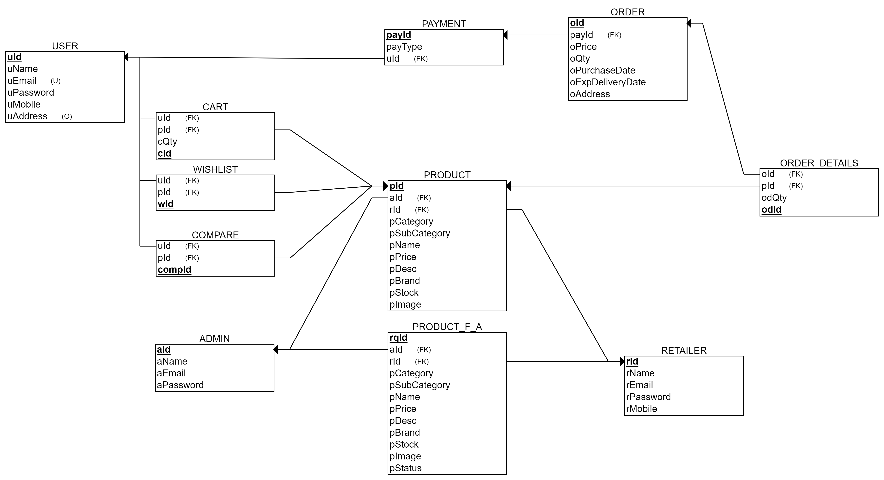

Slide 15
CONCLUSION
The Project will help the many small scale retailers who would never be in business if they had to incur the high cost of owning a brick and mortar store .
The UI will be user-friendly and working with it will be efficient , thus an easy to use interface for all users .
All the products are verified by our admin so quality is ensured.

