Slide 1

SQL Project
Employee Management System
Vijay Kumar
Shoyab
Rohith
BATCH- 495

Slide 2
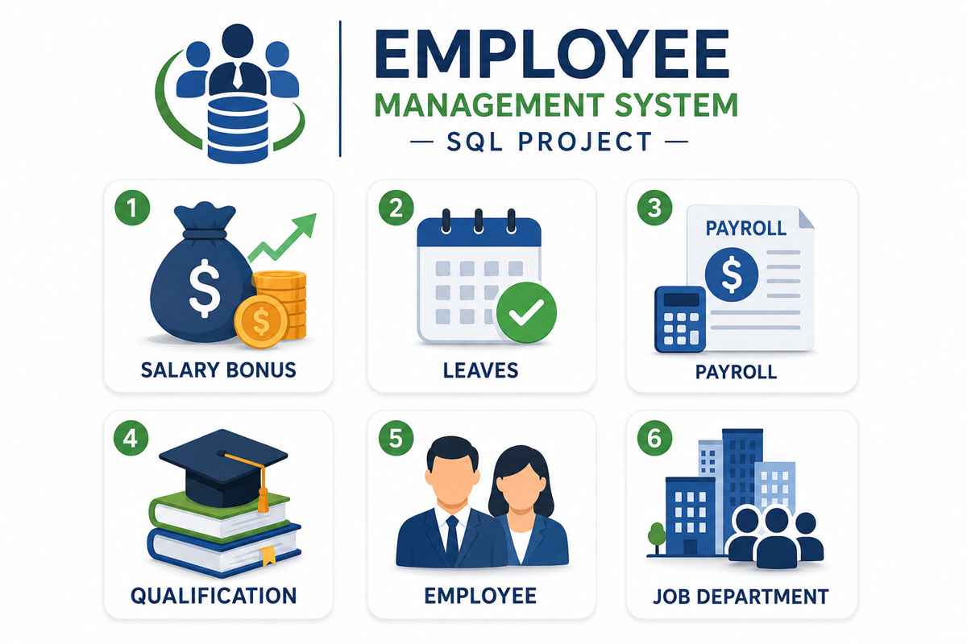

Slide 3
INTRODUCTION
1. Salary Bonus
This module manages employee bonus details. It stores extra payments given to employees based on performance, achievements, or company rewards.
2. Leaves
This module tracks employee leave information. It helps manage sick leave, casual leave, paid leave, and leave approvals.
3. Payroll
This module manages employee salaries and payments. It calculates salary, deductions, taxes, and generates payroll details every month.
4. Qualification
This module stores employee education and skill details. It includes qualifications, certifications, courses, and experience information.
5. Employee
This module contains complete employee information. It stores employee ID, name, phone number, email, job role, salary, and joining date.
6. Job Department
This module manages company departments and job roles. It helps organize employees into departments like HR, IT, Finance, Sales, and Marketing.

Slide 4
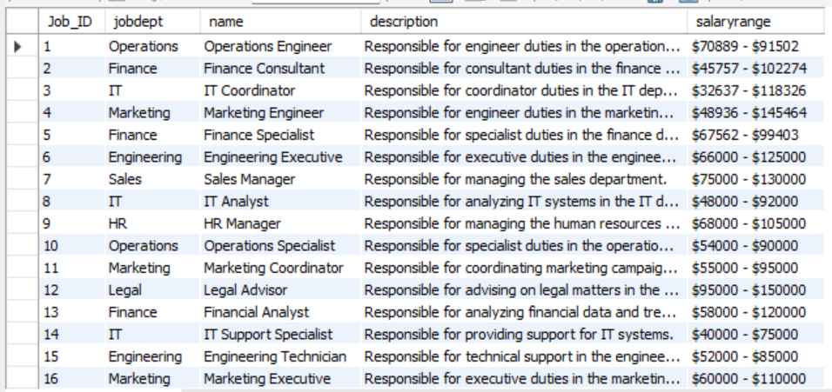
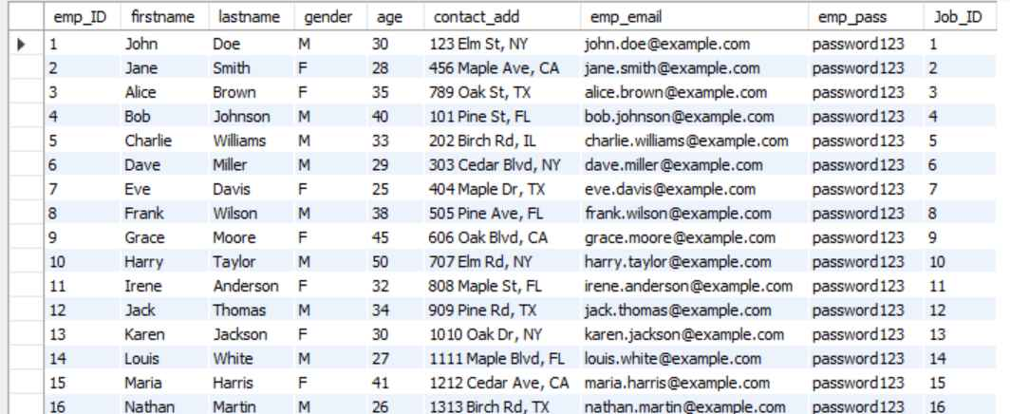
Tables
JOBDEPARTMENT
EMPLOYEE

Slide 5
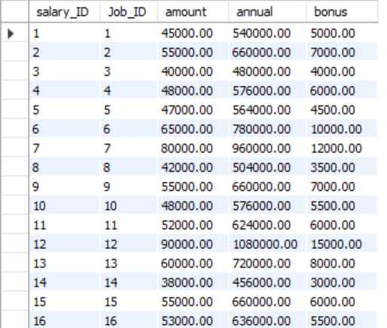
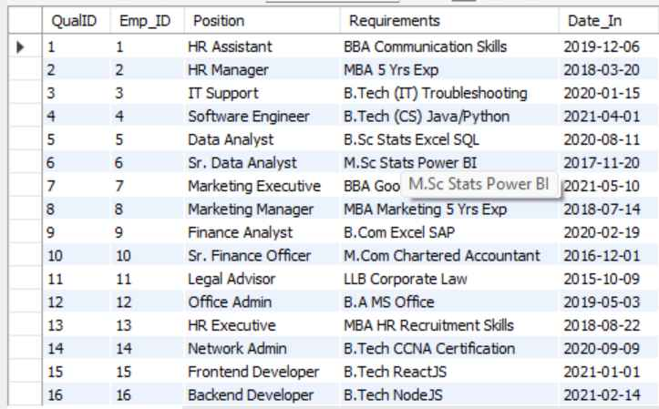
SALARYBONUS
QUALIFICATION

Slide 6
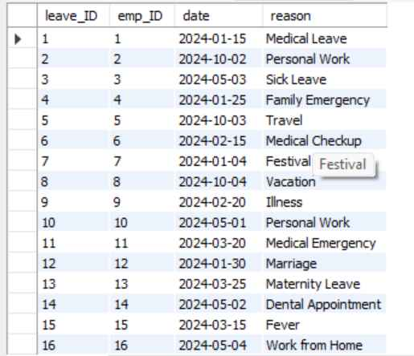
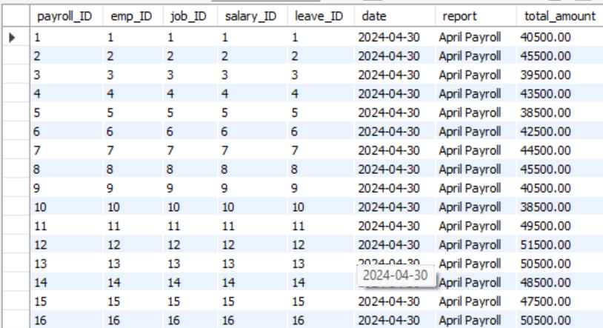
LEAVES
PAYROLL

Slide 7
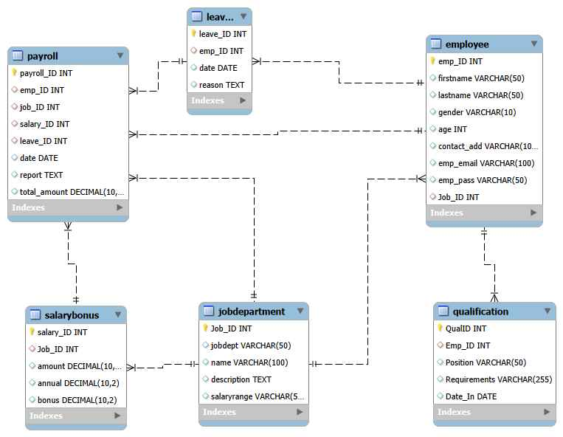
ER Diagram
Notes:
ER diagram

Slide 8
Problem Statement:
The objective of this project is to design and implement an Employee Management System that efficiently stores and manages employee-related data within an organization. The system needs to track various aspects of employee information, including personal details, job roles, salary structures, qualifications, leave records, and payroll data. The system should ensure the integrity and consistency of data by using relational tables with appropriate foreign keys and cascading actions.
The system should allow for easy management and querying of employee data, providing insights such as payroll calculation, leave tracking, and department-specific job roles. The goal is to streamline HR operations, ensuring that all relevant employee data is accessible and accurately updated across different modules.

Slide 9


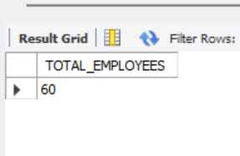
1.How many unique employees are currently in the system?

Slide 10
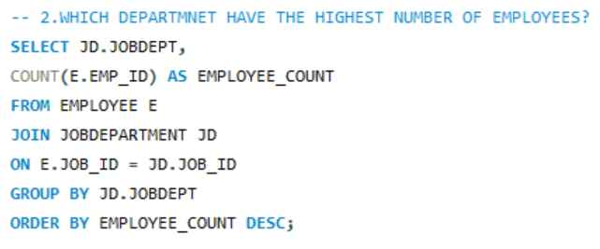
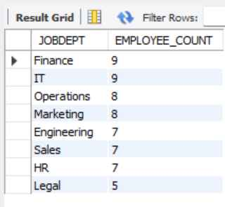

2.Which departments have the highest number of employees?

Slide 11
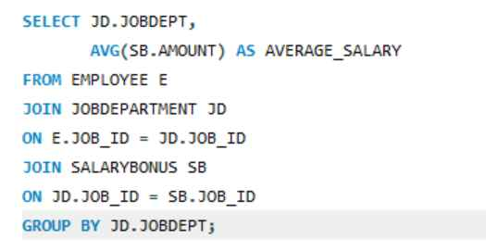

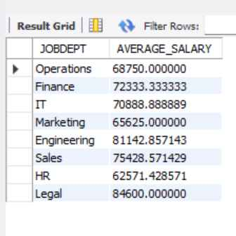
3.What is the average salary per department?

Slide 12
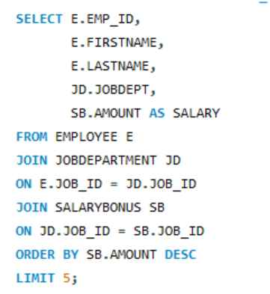

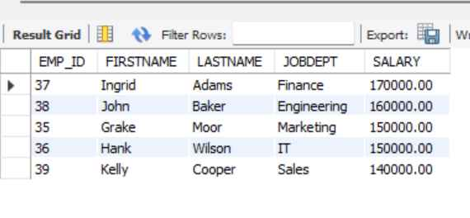
4.Who are the top 5 highest-paid employees?

Slide 13
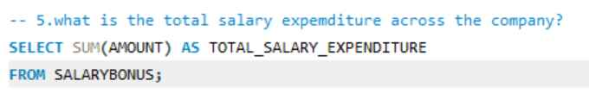

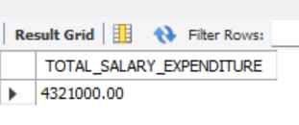
5.What is the total salary expenditure across the company?

Slide 14
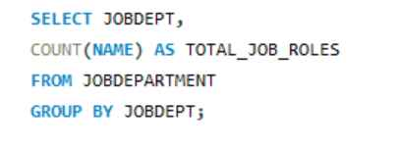

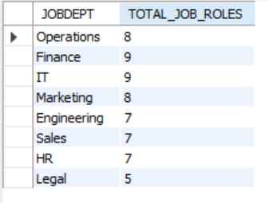
JOB ROLE AND DEPARTMENT ANALYSIS
1.How many different job roles exist in each department?

Slide 15
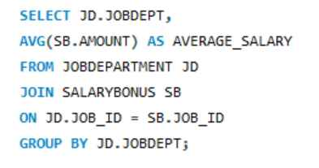

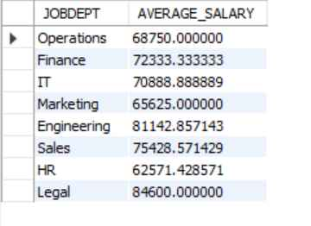
2.What is the average salary range per department?

Slide 16
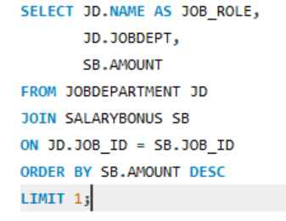


3.Which job roles offer the highest salary?

Slide 17
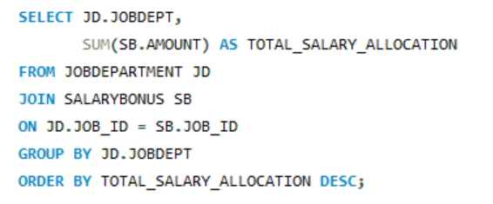

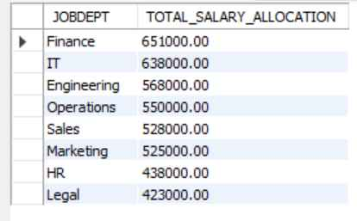
4.Which departments have the highest total salary allocation?

Slide 18
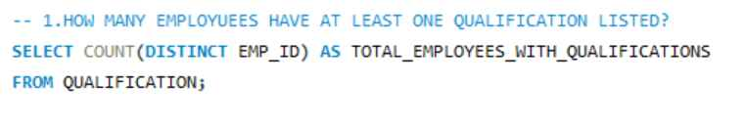

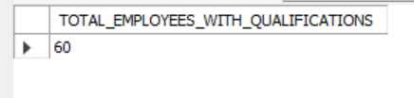
QUALIFICATION AND SKILLS ANALYSIS
1.How many employees have at least one qualification listed?

Slide 19
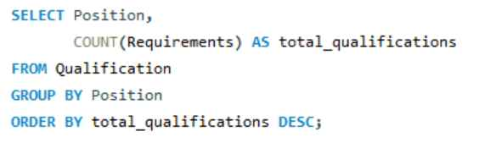

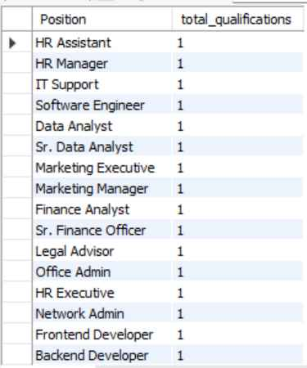
2.Which positions require the most qualifications?

Slide 20
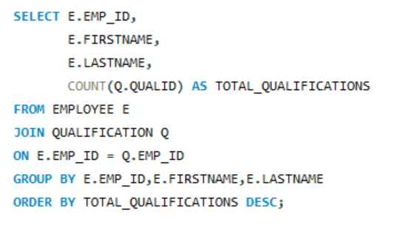
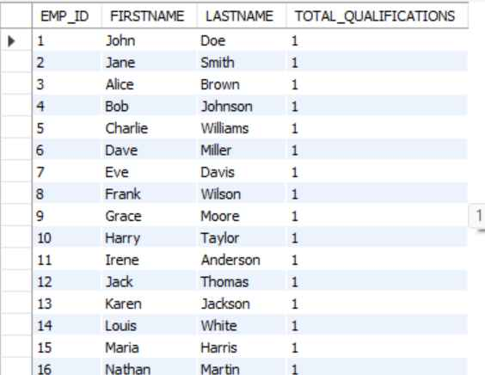

3.Which employees have the highest number of qualifications?

Slide 21
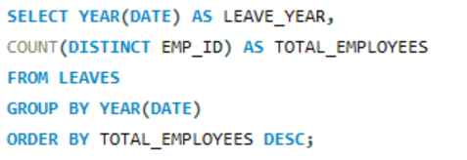

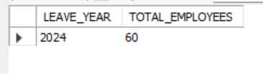
LEAVE AND ABSENCE PATTERNS
1.Which year had the most employees taking leaves?

Slide 22
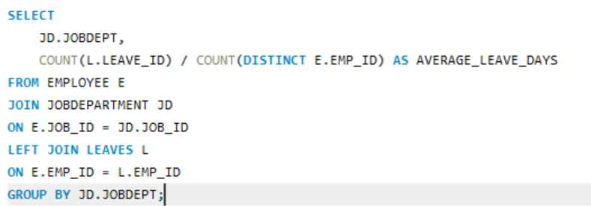

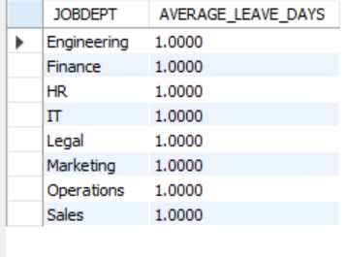
2.What is the average number of leave days taken by its employees per department?

Slide 23

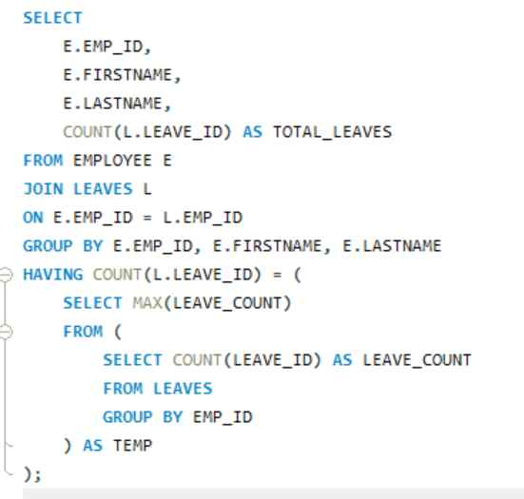
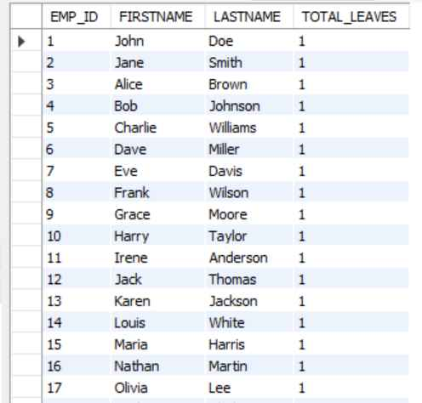
3.Which employees have taken the most leaves?

Slide 24



4.What is the total number of leave days taken company-wide?

Slide 25
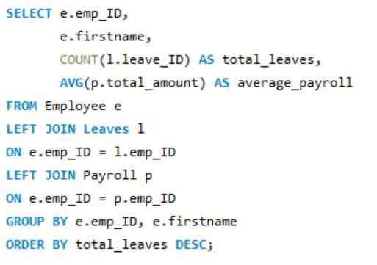

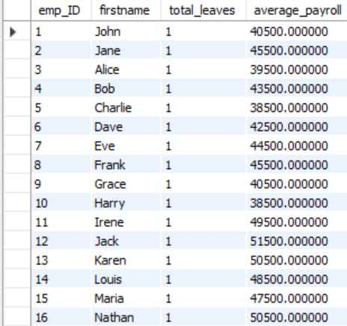
5.How do leave days correlate with payroll amounts?

Slide 26
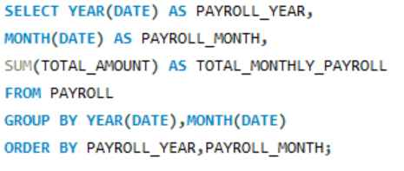

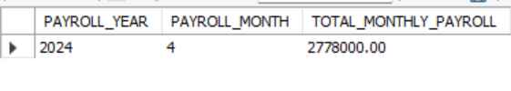
PAYROLL AND COMPENSATION ANALYSIS
1.What is the total monthly payroll processed?

Slide 27
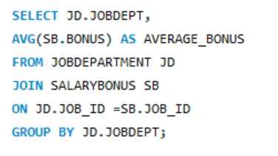
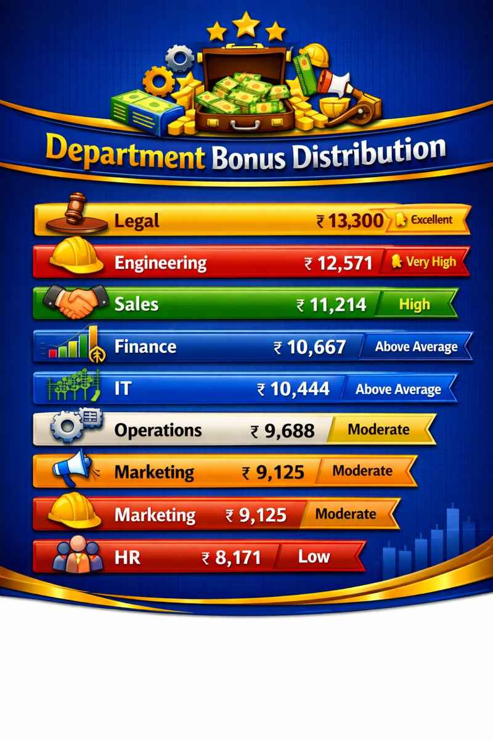
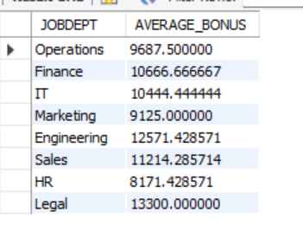
2.What is the average bonus given per department?

Slide 28
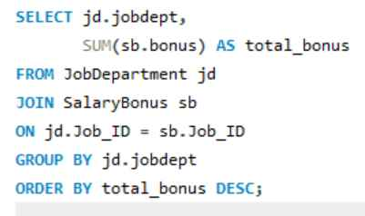
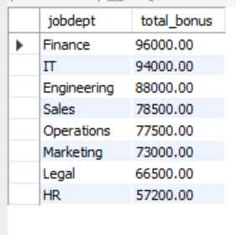
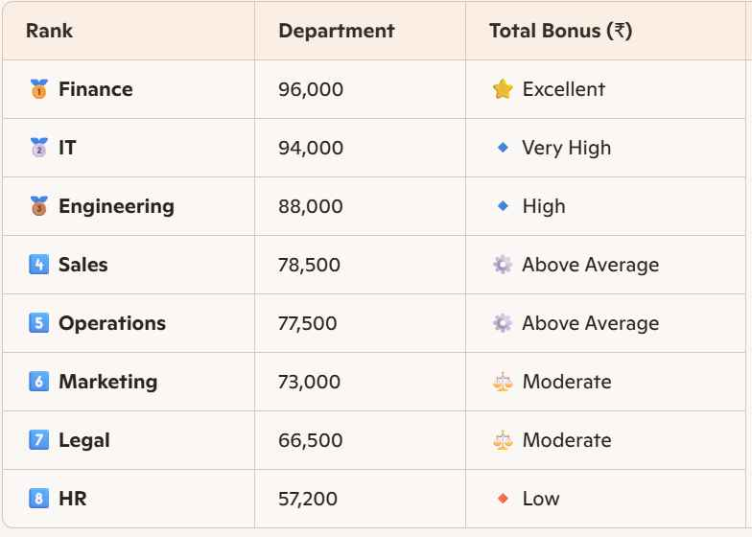
3.Which department receives the highest total bonuses?

Slide 29

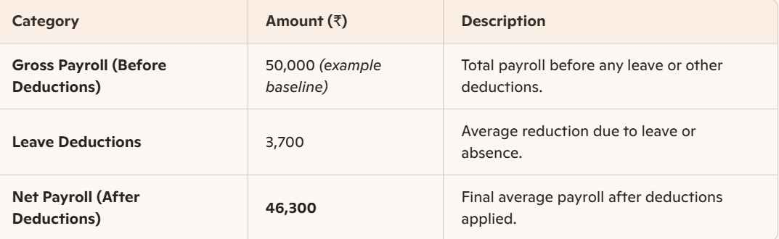

4.What is the average value of total_amount after considering leave deductions?

Slide 30


