Slide 1




INFOSYS SPRINGBOARD INTERNSHIP 5.0
AMAZON DATA FINANCIAL ANALYSIS USING POWERBI
TEAM MEMBERS
(TEAM 1)
VIJAY REDDY MALLIDI
AADARSH PATEL
AKHILA POLU
BALA ABINAV
JIGYASA KHANNA
PHANINDRA PARVATH
Project Mentor - Ajith kumar S

Slide 2


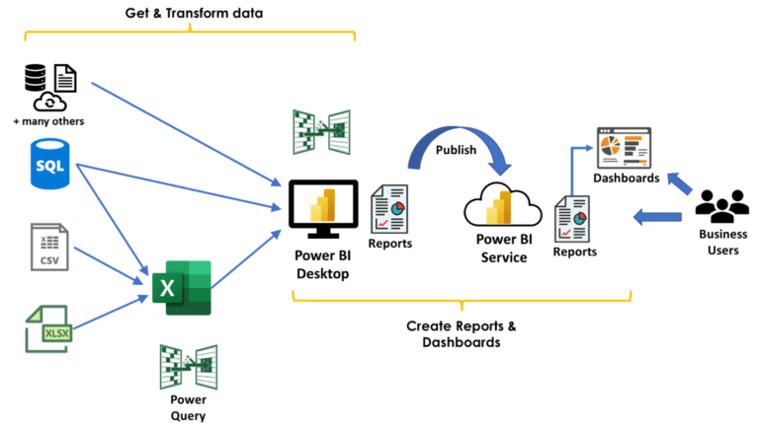
DATA TRANSFORMATION
The dataset captures detailed Amazon sales insights, including order details, fulfillment methods, product specifics, shipping information, transaction amounts, and applied promotions
Order Details: Order ID, Date, and Status (e.g., Shipped, Cancelled)
Fulfilment: Type (Amazon/Merchant), Sales Channel, Fulfilled By
Product Information: Style, SKU, Category, Size
Shipping Details: Ship City, State, Postal Code, Country
Transaction: Quantity, Currency, Amount
Promotions: IDs for applicable discounts/offers
Additional: Ship service level, B2B indicator

Slide 3
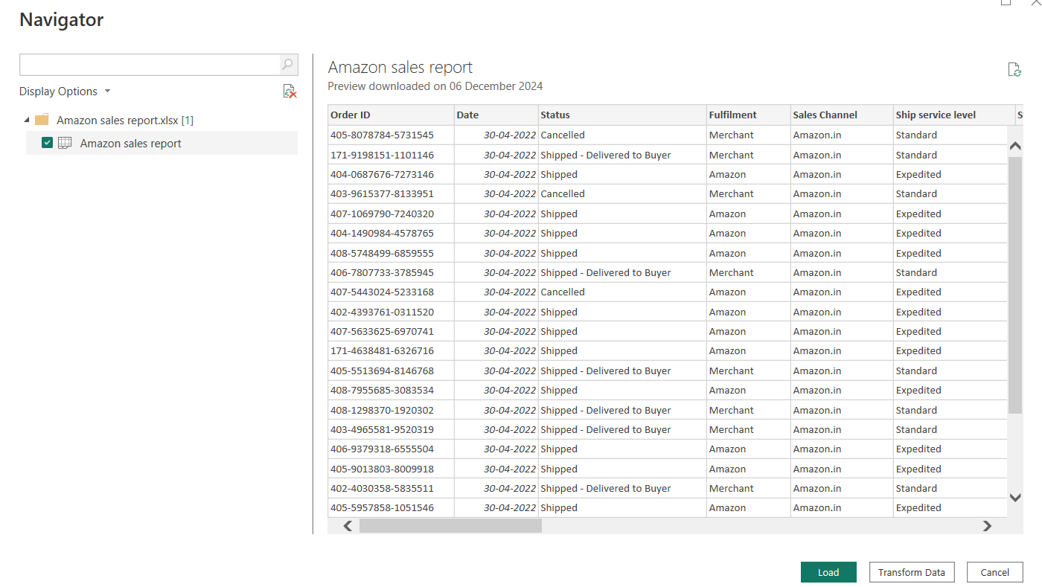


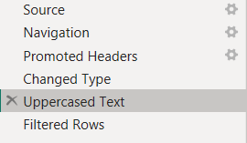

DATA LOADING
LIST OF ROWS UPPERCASED
Amazon Sales report - Ship city, Ship state, Category
Sales report - Colour
Profit and loss - Category
TABLES CREATED
Bridge table – consists of all the SKU in amazon sales report & international sales report without duplicates
Top 5 sku’s
M QUERY
Table.TransformColumns(#"Changed Type",{{"Ship city", Text.Upper, type text}, {"Ship state", Text.Upper, type text}, {"Category", Text.Upper, type text}})
Table.TransformColumns(#"Filtered Rows",{{"Color", Text.Upper, type text}})

Slide 4
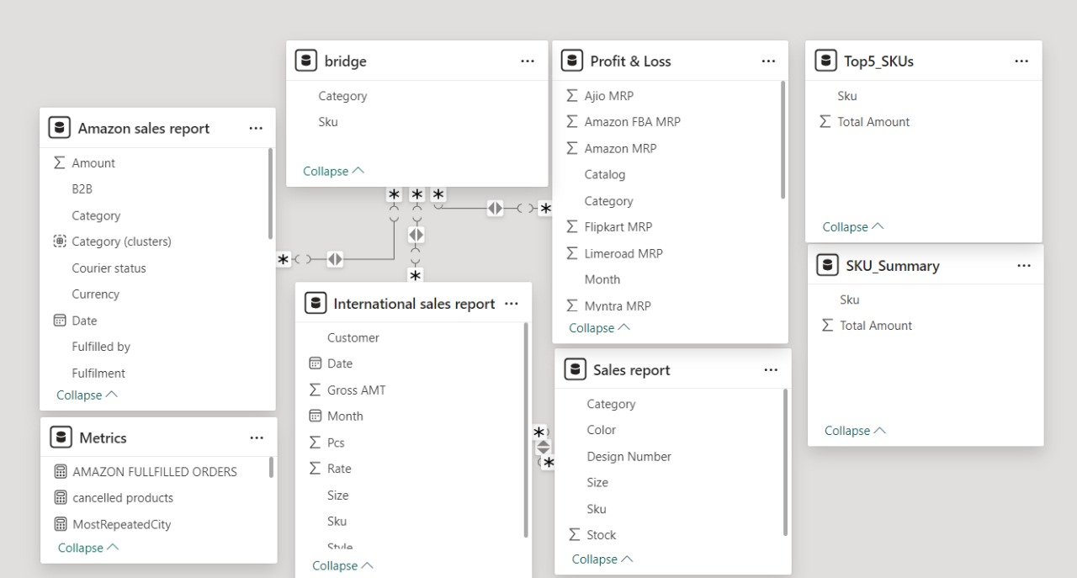
DATA MODELLING
Data Modeling refers to the process of connecting, organizing, and structuring data from different sources into a unified and efficient format for analysis and visualization
We can also create new relationships by just clicking, dragging and dropping
There are 4 cardinality in relationships and 2 cross filter direction
Bridge table connects SKU of amazon sales report, international sales report and profit and loss

Slide 5
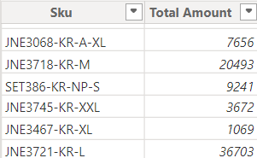
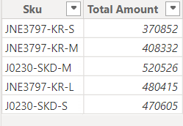
DAX CALCULATIONS
DAX formulas are used in measures, calculated columns, calculated tables, and row-level security
DAX Measures used:
Total sales = CALCULATE(SUM('Amazon sales report'[Amount]))
Cancelled Products =
CALCULATE(COUNT('Amazon sales report'[Courier status]),'Amazon sales report'[Courier status]="Cancelled")
NO Of Orders June15 =
CALCULATE(COUNTROWS('Amazon sales report'),'Amazon sales report'[Date]=DATE(2022,6,15)) ….......
CALCULATED TABLES:
Sku Summary Table
SKU_Summary =
SUMMARIZE(
'Amazon sales report',
'Amazon sales report'[Sku],
"Total Amount", SUM('Amazon sales report'[Amount])
)
Top5_SKUs
Top5_SKUs = TOPN(5,SKU_Summary,SKU_Summary[Total Amount],DESC)

Slide 6
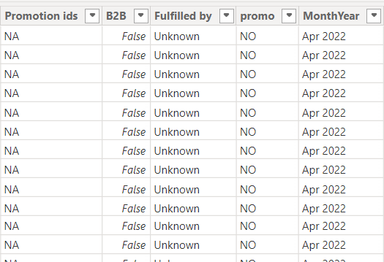
DAX CALCULATIONS
Calculated Columns:
Promo column: To check if a product had promotions or not
promo = IF('Amazon sales report'[Promotion ids]="NA","NO","YES")
Month Year :to get month and year from date column
MonthYear = FORMAT('Amazon sales report'[Date], "MMM YYYY")

Slide 7
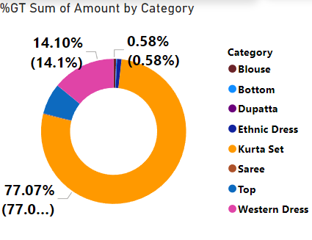
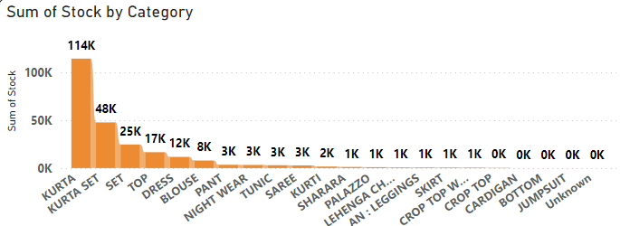
ANALYTICS CANVAS
PRODUCT WISE SALES
KEY INSIGHTS : Kurta set leads in sales
Why Donut chart?
Donut chart highlights top and lowest sellers
Shows overall sales distribution by product
SUM OF STOCK BY CATEGORY
KEY INSIGHTS : Kurta has higher stock due to its strong sales performance
Why stacked column chart?
Compact and ideal for multiple category comparisons
Allows easy comparison of stock levels across products

Slide 8
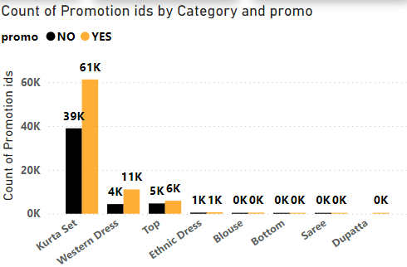
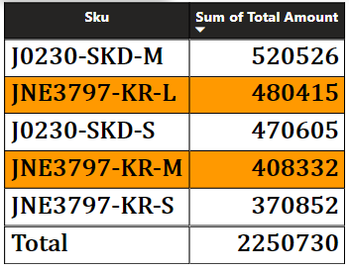
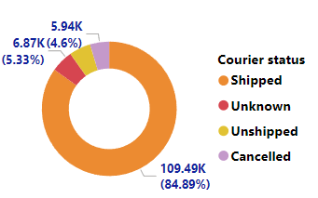
ANALYTICS CANVAS
PRODUCT PROMOTED
KEY INSIGHTS : Highlights which categories have promotions based on promotion ID count
WHY CLUSTERED COLUMN CHART?
Places product categories side by side for easy comparison
Clearly distinguishes between products with and without promotions
TOP 5 SKU SALES
KEY INSIGHTS : J0230-SKD-M tops sales at ₹520,526, followed by JNE3797-KR-L and J0230-SKD-S
Why Table Visual?
For a clear comparison of SKU sales performance
DELIVERY STATUS
KEY INSIGHTS : Shipped leads with 84.89% (109.49K). Minor statuses: Unknown (5.33%), Cancelled (4.6%), Unshipped
Why Donut Chart?
Quickly shows Shipped's dominance and compares other statuses

Slide 9
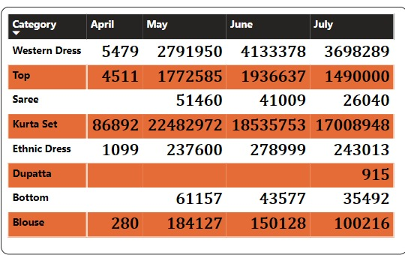
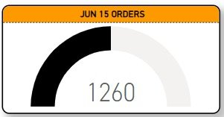
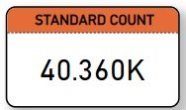
ANALYTICS CANVAS
SALES MONTHLY COMPARISON
KEY INSIGHTS : Kurta Set leads with ₹22,482,972 in May. Saree and Dupatta decline
Why MATRIX?
Highlights monthly trends and product performance clearly
ORDERS PLACED IN JUNE
KEY INSIGHTS : 1260 orders have been processed as of June 15th
Why Gauge Chart?
It is effective for illustrating progress towards a target
ORDERS DELIVERED IN STANDARD MODE
KEY INSIGHTS : Highlights the total orders delivered via "Standard" shipping mode.
Why Card Visual?
To showcase a single key metric clearly and instantly

Slide 10
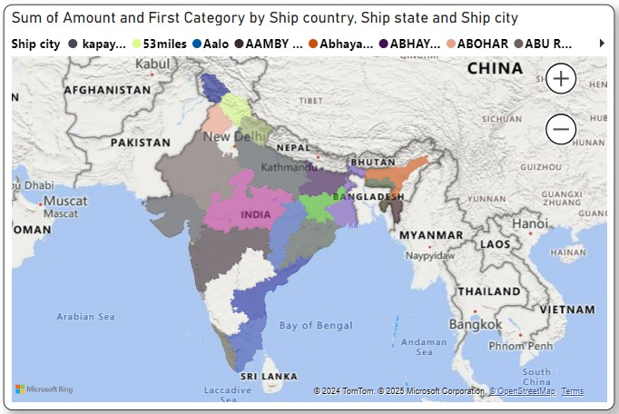
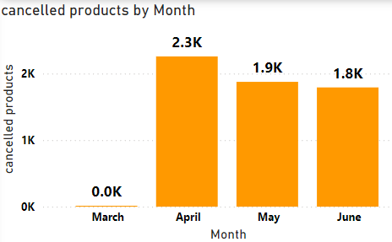
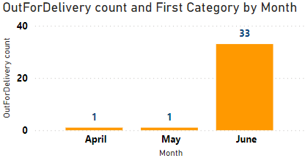
ANALYTICS CANVAS
PRODUCTS CANCELLED MONTHLY
KEY INSIGHTS : There seems to be a seasonal trend
Why Bar Chart?
This bar chart helps us understand how many products were cancelled in each month
STATE AND CITY BREAKUP & SALES
KEY INSIGHTS : Sales distribution across regions with colour coding indicating different sales categories and amounts
Why Map?
Best for visualizing data tied to location, enabling easy comparison of sales performance across regions
MONTHLY OUT-OF-DELIVERY
KEY INSIGHTS : June had the highest count (33), marking a peak
Why Bar Chart?
The bar chart highlights monthly trends, making it easy to spot peaks and anomalies

Slide 11
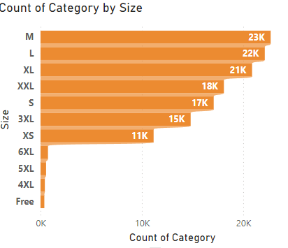
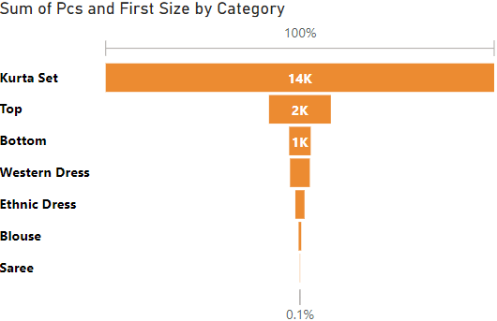
ANALYTICS CANVAS
COUNT OF PRODUCT BY SIZE
KEY INSIGHTS : Medium (M) tops with 20,000+ products; smaller sizes dominate
Why Stacked Bar Chart ?
Highlights size distribution for inventory planning
INTERNATIONAL PRODUCT SALES
KEY INSIGHTS : Kurta Sets are the most popular product internationally
Why Funnel Chart?
This chart helps us see how many of each product type are sold internationally

Slide 12
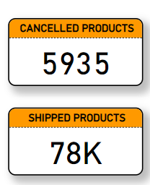
ANALYTICS CANVAS
PRODUCTS CANCELLED AND SHIPPED
Key Insight:
5,935 products have been cancelled
78,804 products have been shipped
Why CARD:
Cards are a simple and effective way to display key metrics or statistics.
The use of colour (orange) can draw attention to the information.
Cards can be easily arranged and combined to create dashboards or reports.
cancelled products =
CALCULATE(COUNT('Amazon sales report'[Courier status]),'Amazon sales report'[Courier status]="Cancelled")
shipped products = CALCULATE(COUNT('Amazon sales report'[Status]),'Amazon sales report'[Status]="shipped")

Slide 13
CONCLUSION: Unlocking Amazon's Potential
The financial analysis of Amazon has illuminated critical insights to drive growth and efficiency:
Sales Trends: Kurta sets lead the market, while seasonal trends affect other categories. Focused promotions can boost underperforming segments.
Regional Insights: Untapped regions and international markets present immense potential for expansion through localized strategies. Bangalore city has the most sales
Comparison: Product wise comparison of on various e-commerce website was done so that cost management can be done to compete in the market
Cancelled orders: April month had the most cancelled orders

Slide 14
THANK YOU !
TEAM MEMBERS
VIJAY REDDY MALLIDI
AADARSH PATEL
AKHILA POLU
BALA ABINAV
JIGYASA KHANNA
PHANINDRA PARVATHI

