Slide 1



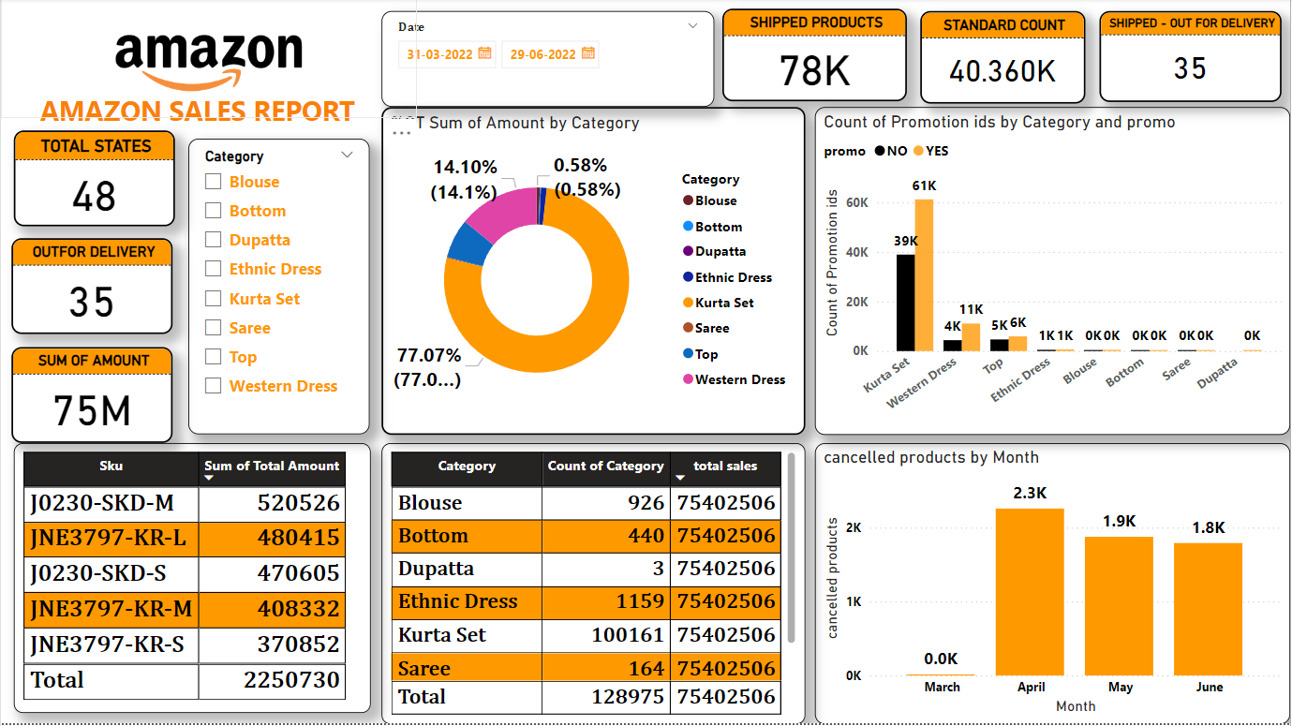
THE ECONOMIC ORCHESTRA
FINANCIAL ANALYSIS OF AMAZON
TEAM 1
AADARSH PATEL
AKHILA POLU
BALA ABINAV
JIGYASA KHANNA
PHANINDRA PARVATHI
VIJAY REDDY MALLIDI

Slide 2
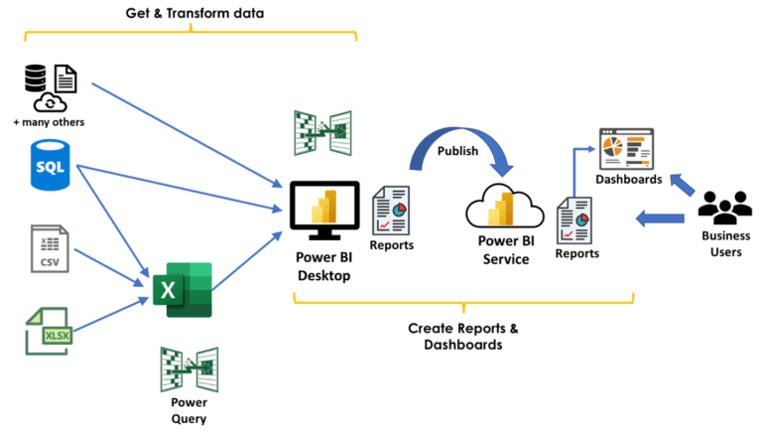
DATA TRANSFORMATION- SCULPTING THE RAW MATERIAL
The dataset captures detailed Amazon sales insights, including order details, fulfillment methods, product specifics, shipping information, transaction amounts, and applied promotions
Order Details: Order ID, Date, and Status (e.g., Shipped, Cancelled)
Fulfilment: Type (Amazon/Merchant), Sales Channel, Fulfilled By
Product Information: Style, SKU, Category, Size
Shipping Details: Ship City, State, Postal Code, Country
Transaction: Quantity, Currency, Amount
Promotions: IDs for applicable discounts/offers
Additional: Ship service level, B2B indicator

Slide 3
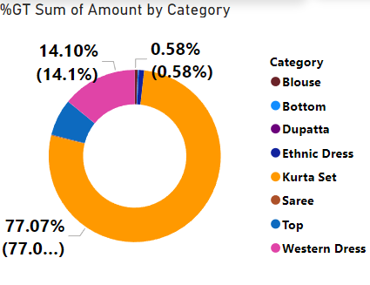
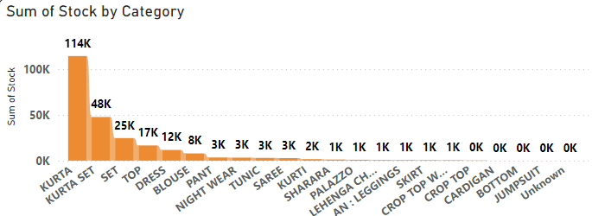
ANALYTICS CANVAS
PRODUCT WISE SALES
KEY INSIGHTS : Kurta set leads in sales
Why Pie chart?
Pie chart highlights top and lowest sellers
Shows overall sales distribution by product
SUM OF STOCK BY CATEGORY
KEY INSIGHTS : Kurta has higher stock due to its strong sales performance
Why stacked column chart?
Compact and ideal for multiple category comparisons
Allows easy comparison of stock levels across products

Slide 4
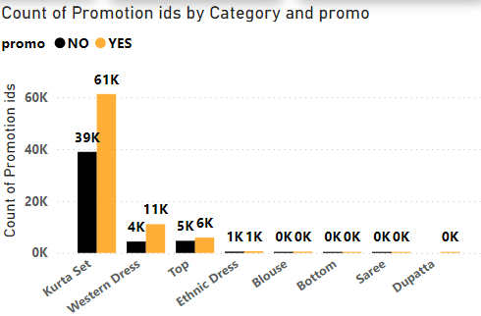
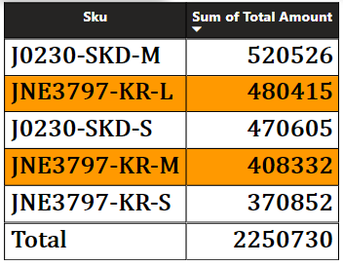
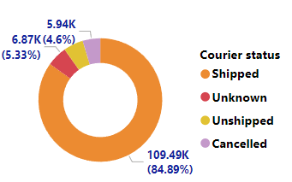
ANALYTICS CANVAS
PRODUCT PROMOTED
KEY INSIGHTS : Highlights which categories have promotions based on promotion ID count
WHY CLUSTERED COLUMN CHART?
Places product categories side by side for easy comparison
Clearly distinguishes between products with and without promotions
TOP 5 SKU SALES
KEY INSIGHTS : J0230-SKD-M tops sales at ₹520,526, followed by JNE3797-KR-L and J0230-SKD-S
Why Table Visual?
For a clear comparison of SKU sales performance
DELIVERY STATUS
KEY INSIGHTS : Shipped leads with 84.89% (109.49K). Minor statuses: Unknown (5.33%), Cancelled (4.6%), Unshipped
Why Doughnut Chart?
Quickly shows Shipped's dominance and compares other statuses

Slide 5
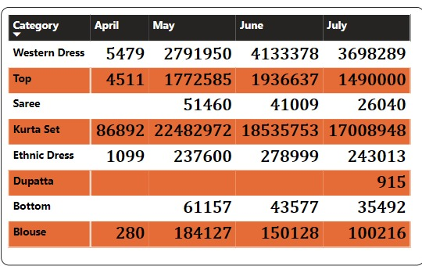
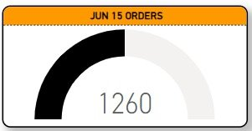
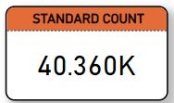
ANALYTICS CANVAS​
SALES MONTHLY COMPARISON
KEY INSIGHTS : Kurta Set leads with ₹22,482,972 in May. Saree and Dupatta decline
Why MATRIX?
Highlights monthly trends and product performance clearly
ORDERS PLACED IN JUNE
KEY INSIGHTS : 1260 orders have been processed as of June 15th
Why Gauge Chart?
It is effective for illustrating progress towards a target
ORDERS DELIVERED IN STANDARD MODE
KEY INSIGHTS : Highlights the total orders delivered via "Standard" shipping mode.[
Why Card Visual?
To showcase a single key metric clearly and instantly

Slide 6
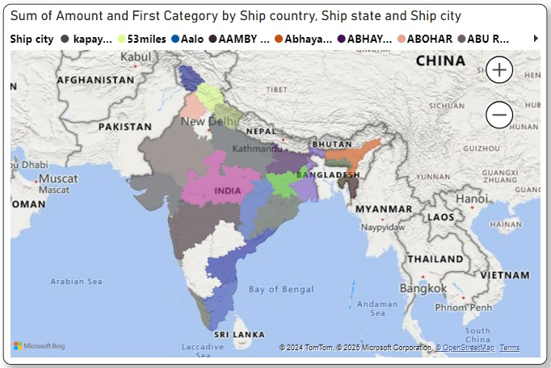
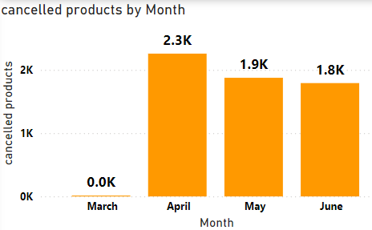
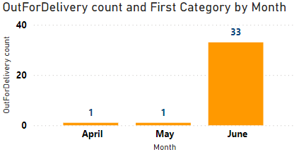
ANALYTICS CANVAS
PRODUCTS CANCELLED MONTHLY
KEY INSIGHTS : There seems to be a seasonal trend
Why Bar Chart?
This bar chart helps us understand how many products were cancelled in each month
MONTHLY OUT-OF-DELIVERY
KEY INSIGHTS : June had the highest count (33), marking a peak
Why Bar Chart?
The bar chart highlights monthly trends, making it easy to spot peaks and anomalies
STATE AND CITY BREAKUP & SALES
KEY INSIGHTS : Sales distribution across regions with colour coding indicating different sales categories and amounts.
Why Map?
Best for visualizing data tied to location, enabling easy comparison of sales performance across regions.

Slide 7
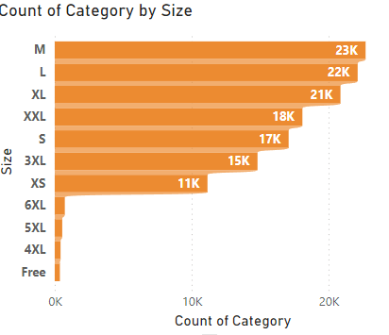
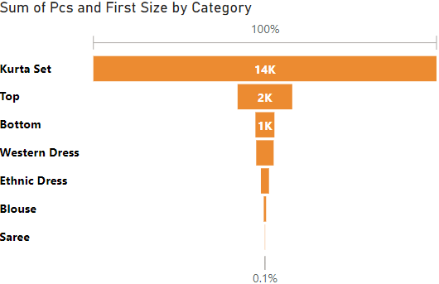
ANALYTICS CANVAS
COUNT OF PRODUCT BY SIZE
KEY INSIGHTS : Medium (M) tops with 20,000+ products; smaller sizes dominate
Why Stacked Bar Chart ?
Highlights size distribution for inventory planning
INTERNATIONAL PRODUCT SALES
KEY INSIGHTS : Kurta Sets are the most popular product internationally
Why Funnel Chart?
This chart helps us see how many of each product type are sold internationally

Slide 8
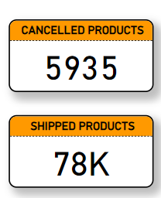
ANALYTICS CANVAS
PRODUCTS CANCELLED AND SHIPPED
Key Insight:
5,935 products have been canceled.
78,000 products have been shipped.
Why CARD:
Cards are a simple and effective way to display key metrics or statistics.
The use of color (orange) can draw attention to the information.
Cards can be easily arranged and combined to create dashboards or reports.
cancelled products =
CALCULATE(COUNT('Amazon sales report'[Courier status]),'Amazon sales report'[Courier status]="Cancelled")
shipped products = CALCULATE(COUNT('Amazon sales report'[Status]),'Amazon sales report'[Status]="shipped")

Slide 9
THE ROAD AHEAD
Throughout this analysis, we explored patterns in sales trends, regional performance, customer behaviour, and product success. Together, these insights form a strategic roadmap for future growth. Here’s how we can use this knowledge to take action:
Invest in Growing Categories: Our data highlights emerging categories with significant potential. By reallocating resources to these high-growth segments: Focus on expanding the product range to meet rising demand.
Enhance marketing efforts to boost visibility and capture market share.Collaborate with suppliers to ensure supply chain efficiency for these products.
2. Expand Marketing in Untapped Regions: The geographic analysis reveals areas with lower penetration despite existing demand.
Localized marketing strategies can tap into these markets.
Partnerships with regional distributors or logistics providers can improve access.
Targeted promotions and offers tailored to regional preferences will drive engagement and conversions.
3. Leverage Data to Refine Product Offerings:
Customer preferences and SKU performance are clear indicators of what works.
Discontinue or rethink underperforming products to free up resources for best-sellers.
Customize offerings based on customer segments, focusing on high-value customers
.Analyze customer feedback and reviews to inform design improvements and innovation.

Slide 10


