Slide 1



Insightful Business Explorer

Slide 2



Insightful Business Explorer
Imagine a hardware company that was swiftly rising in the market, only to be struck by a major setback, resulting in significant losses

Slide 3

Insightful Business Explorer
This scenario reflects the stark reality faced by AtliQ in Latin America.

Slide 4

About me
Vijaya Mense
I’m Vijaya, an aspiring data analyst. In this presentation, I'll be showcasing a dashboard that I've developed with the assistance of our Code Basics Bootcamp 3.0. Before delving into the dashboard itself, let me outline the agenda for this presentation.

Slide 5

Agenda
01 Problem Statement
02 Goals
03 Dashboard
04 Insights and Recommendation

Slide 6
Insightful Business Explorer

Slide 7




Croma
Croma is an Indian retail chain of consumer electronics and durables run by retail, a subsidiary of the Tata Digital.
Customer Segments
Amazon
Amazon is a multinational technology and e-commerce company based in Seattle Washington, United States.
Flipkart
Flipkart is an Indian e-commerce company headquartered in Bengaluru, Karnataka, India

Slide 8
01 Insightful Business Explorer
The company suffered financial losses due to the opening of a store in America without sufficient information. Recognizing the need to compete with savvy competitors like HP and Dell, who use data for decision-making, AtliQ understands the importance of having data-minded individuals in their team. They aim to leverage data to make smarter choices and ensure their survival in the industry.

Slide 9
01 Goals to achieve
The company aims to gather data from various departments, create important metrics and visuals, and develop an easy-to-use dashboard for their teams. By using data to inform their decisions, they aim to improve their current products and expand into new markets in the coming quarters.

Slide 10

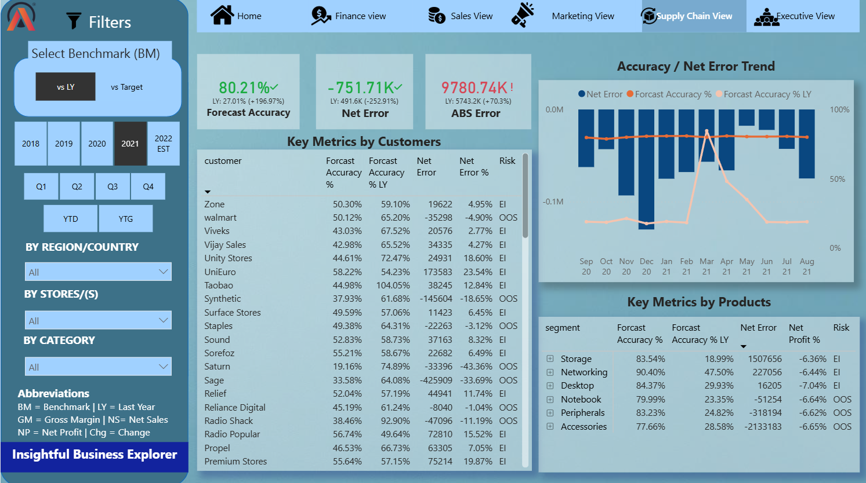
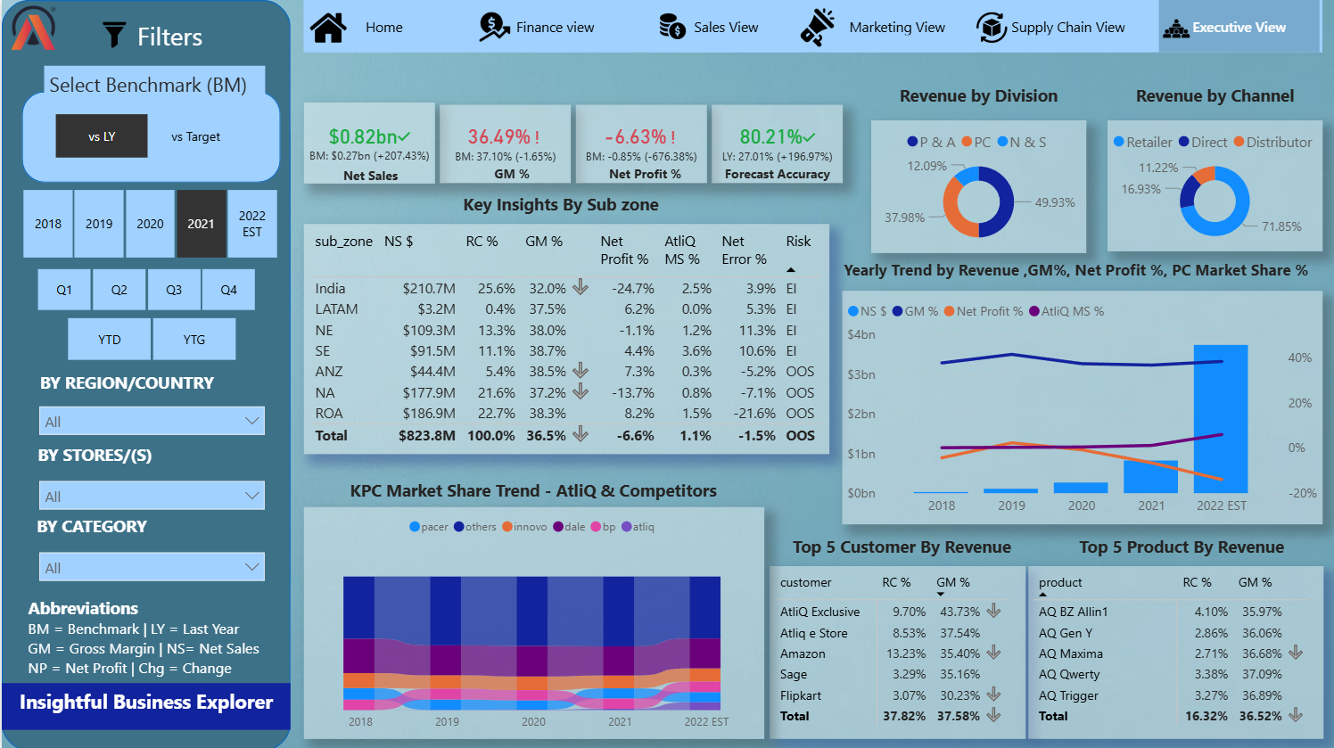
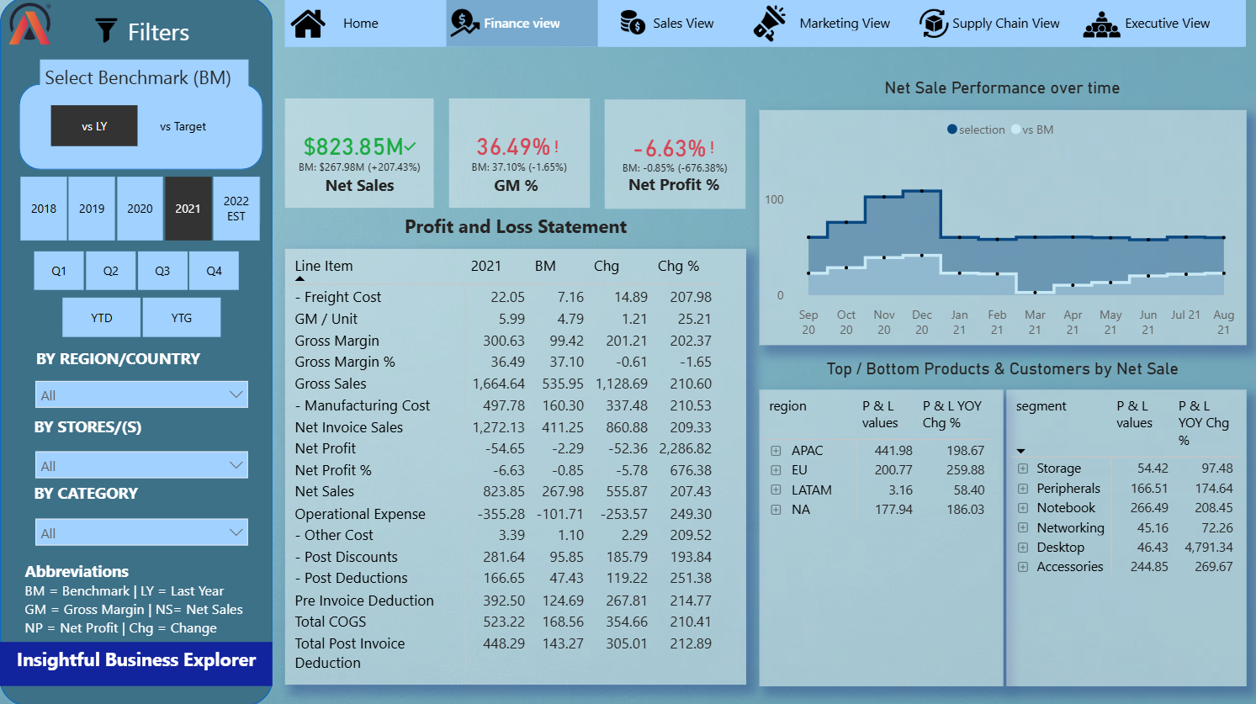
03 Dashboard
Let's, explore the Dashboard

Slide 11

Insights
AtliQ Hardware faces financial challenges due to high expenses on discounts and operations, leading to overall losses.
Amazon is the vital contributor underscoring the need for a strong partnership. “AQ Home Allun 1 Gen 2” excels, suggesting growth opportunities.
US segment reports losses, requiring detailed investigation for strategic decisions.
AtliQ hardware’s market share from 1.1% in 2021 to 5.9% increase signals positive market traction.

Slide 12

Recommendations
They should evaluate and optimise their discounting strategy so that it will help them to reduce the cost of the product.
Amazon and “AQ Home Allun 1 Gen 2” is doing great job for AtliQ hardware. So, we apply the same marketing campaign for the other products also. So that it will help them to increase the product line.
I would suggest that they should investigate each area where they are facing losses.
They should continuously monitor their financial performance

Slide 13

Thank You

