Slide 1
Churn Modelling analyis Using ML and DL

Slide 2
Team Members:
M.Vijayalakshmi(TL)
L.Sahithya
K.Narendra Gopi
K.Lakshmi Bhavani
M.Purnachandra Rao
Under the guidance of
A.Malathi Madam

Slide 3
Abstract:
Customer churn refers to the loss of customers over time,which is a critic metric for business.This project builds predictive models using machine learning and deep learning techniques to analyse customer data,such as purchase history and interaction records,to predict churn probability.The system provides insights into retention strategies and identifies high-risk cutomers,enabling proactive engagement

Slide 4
Introduction
Churn prediction is a critical field of study in data science, and several machine learning (ML) and deep learning (DL) algorithms are being applied to this problem. Techniques such as XGBoost, decision trees, and artificial neural networks (ANNs) have proven successful in building predictive models that not only detect churn but also highlight the reasons behind it, enabling businesses to tailor their retention strategies more effectively.
Customer churn, also known as customer attrition, refers to the loss of customers over a specific period of time. For many businesses, particularly in service-based and subscription-based models such as telecommunications, banking, and Software as a Service (SaaS) platforms, customer retention is crucial to long-term success and profitability. Businesses aim to create lasting relationships with customers, but due to various factors, customers may decide to discontinue using their products or services, often leading to a significant loss in revenue.

Slide 5
Advantages
Data security and correct data retrieval made possible
Easy access to patient data with correct patient history
Easy monitoring of supplies in inventory
Cost optimization
Improved customer satisfaction
Data-driven insights

Slide 6
Applications:
Customer segmentation
E-Commerce
Banking
Telecommunication
Price optimization

Slide 7
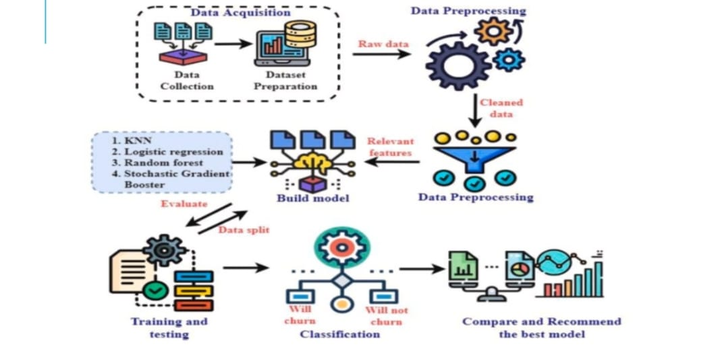
Architecture

Slide 8
Code
# Collect input from the user
# Collect input from the user
age = float(input("Enter age: "))
gender = input("Enter gender (Male/Female): ")
tenure = float(input("Enter tenure (years): "))
num_of_products = float(input("Enter number of products: "))
balance = float(input("Enter balance: "))
Enter age: 10
Enter tenure (years): 10
Enter tenure (years): 10
Enter number of products: 200
Enter balance: 10
The churn prediction is: Yes

Slide 9
Reference
XGBoost
Artificial neural network(ANN)
Long Short-Term Memory(LSTM)
Random forest

Slide 10
Any queries

