Slide 1
Predicting customers churning in the telecommunications industry: A machine learning approach
Presented by
Chandana Katta,700740478
Lakshmi Vaishali Batchu , 700724732
Vijaya Lakshmi Kandukuri,700742323

Slide 2
Roles , Responsibilities and Contribution
Problem description and dataset formation: This phase includes the problem description and also drafting of clear objectives and outcomes, and the dataset is gathered using the references. This task is accomplished by Chandana Katta,700740478.
Data analysis and null value management: This phase includes the dataset loading and also listing the required modules in python and then checking for the null values and filling them using the mean value. This task is accomplished by Lakshmi Vaishali Batchu, 700724732
Exploratory Data Analysis: Here all the columns in the dataset are studied well and correlation matrix and graphs are generated to finalize the features for modeling and also various correlation charts such as multicollinearity with variance inflation factor. This task is accomplished by Vijaya Lakshmi Kandukuri,700742323
Model building , Comparison of various models , analysis of the accuracy metric and error rates , tuning of the parameters for better rituals and prediction , confusion matrix and plotting of data was done equally between the teammates in the project.
Contributions:
Chandana Katta, 700740478 33.3%
Lakshmi Vaishali Batchu, 700724732 33.3%
Vijaya Lakshmi Kandukuri, 700742323 33.3%

Slide 3
Motivation:
To detect early signs of potential churn, one must first develop a holistic view of the customers and their interactions across numerous channels. As a result, by addressing churn, these businesses may not only preserve their market position but also grow and thrive.
The more customers they have in their network, the lower the cost of initiation and the larger the profit. As a result, the company's key focus for success is reducing client attrition and implementing an effective retention strategy.
It is highly difficult task to find out the reason why customers or a group of customers stop using the service or product of an organization or company. This needs much data analysis and also the accurate prediction as it will effect the revenue of the company at the end.

Slide 4
Objectives:
Finding the % of Churn Customers and customers that keep in with the active services.
Analyzing the data in terms of various features responsible for Customer Churn
Finding the most suited machine learning model for the correct classification of Churn and non churn customers.

Slide 5
Related Work
Kriti [1] in their paper Customer churn: A study of factors affecting customer churn using machine learning has used various factors affecting customer churn (price sensitivity, technology, customer service, tenure, security) to predict the customer churn rate
Essam Abou El Kassem and Shereen Ali Hussein [2] in their paper clearly described that Customer churn is a problem for most companies because it affects the revenues of the company when a customer switches from service provider company to another .
Praveen Lalwani and Manas Kumar Mishra [3] in their paper has Compared the time taken to train the model and accuracy of various ML algorithms.
Saran Kumar A. [4] In his paper had conducted a survey on various ML algorithms and techniques to predict customer attrition or churn rate .
Pradeep B and Sushmitha Vishwanath Rao [5] in their paper have explained how to use various ML algorithms to analyze customer attrition or churn rate in the logistics industry

Slide 6
Problem Statement
To understand the behavior of the company's customers, we want to analyze relevant customer data and develop a solution that will help determine whether a customer will churn . We will use the provided dataset to implement the solution. In addition, we will help relevant stakeholders understand the potential of your developed solution.
We also want to create a classification machine learning model to carry out the forecasts. The method will include feature engineering to guarantee that the dataset factors are ideal for the data modeling process, resulting in more accurate forecasts.

Slide 7
Proposed Solution
As Churning is the problem, using ML we analyzed various ways that leads to customer churning and post that we applied ML classification algorithms to solve this problem and found out churn rate based on the customers behaviors such that we can predict if the customer is able to churn or not.

Slide 8
Results/Simulations
Loading the libraries
Data Loading
Data preprocessing
Label Encoding
KNN
Logistic Regression
SVM
Random forest
Ada boost
Gradient Boosting Classifier
Final Confusion Matrix

Slide 9
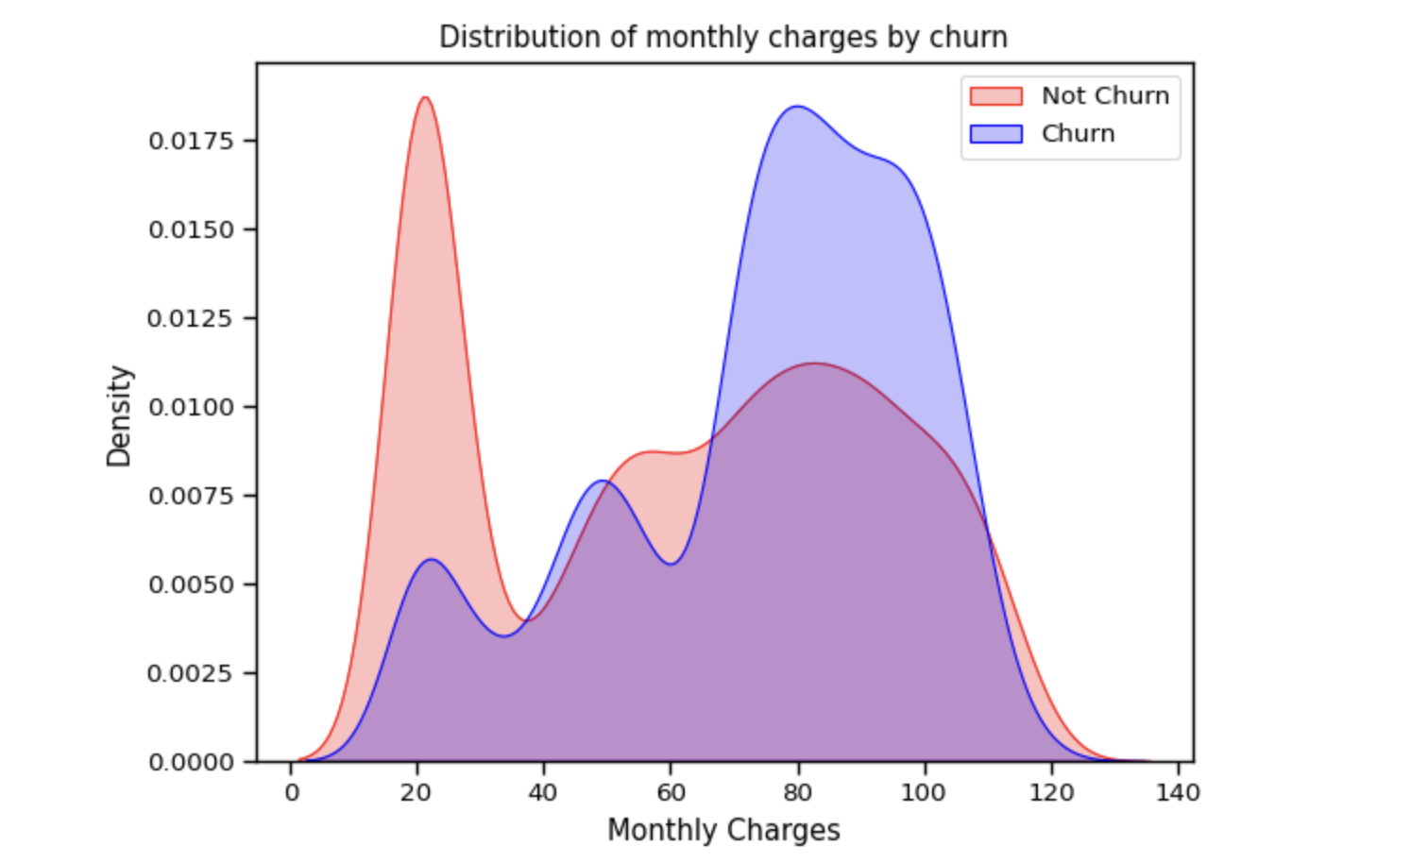
Distribution of monthly charges by churn

Slide 10
KNN Classifier and SVM Classifier
KNN accuracy: 0.776303317535545
SVM accuracy is : 0.8075829383886256

Slide 11
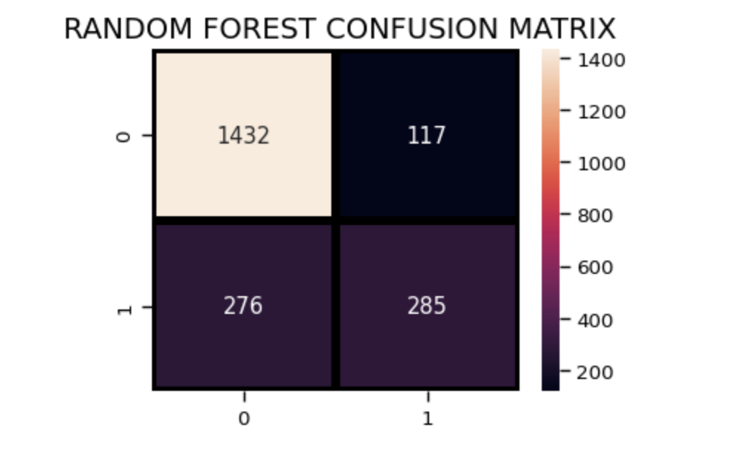
Random Forest Classifier
Random Forest accuracy is : 0.8137440758293839

Slide 12
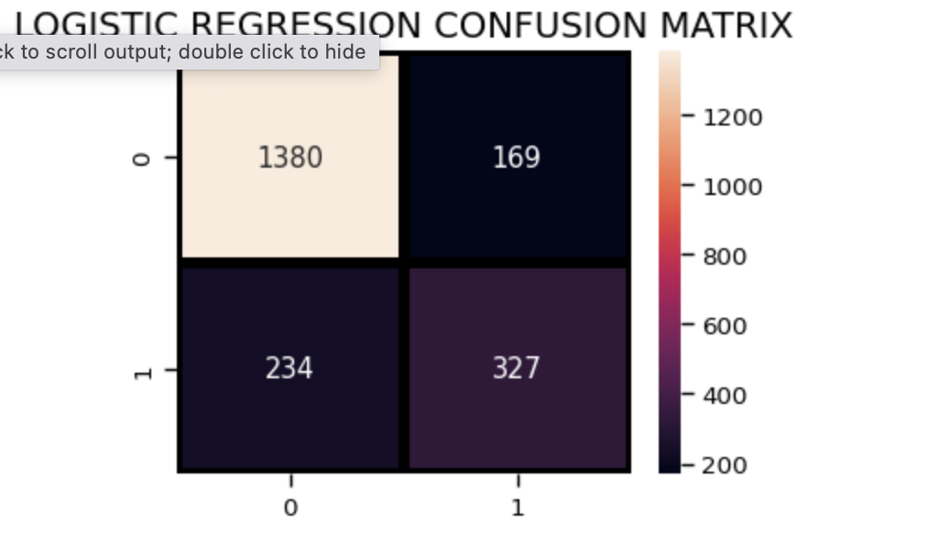
Logistic Regression
Logistic Regression accuracy is : 0.8090047393364929

Slide 13
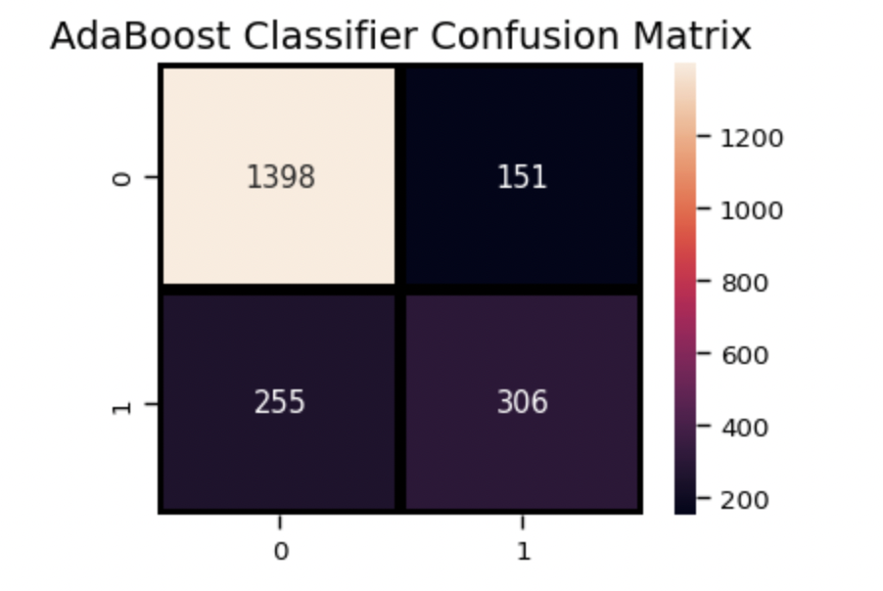
AdaBoost Classifier
AdaBoost Classifier accuracy 0.8075829383886256

Slide 14
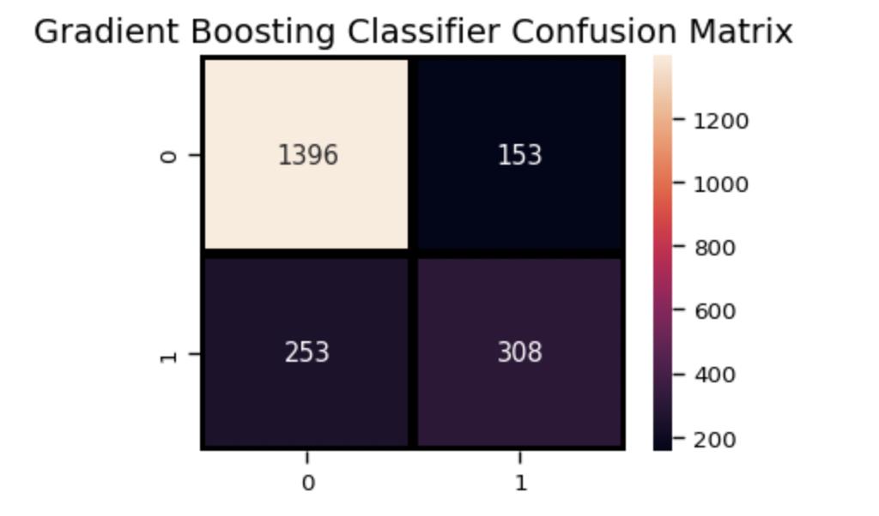
Gradient Boosting Classifier
Gradient Boosting Classifier 0.8075829383886256

Slide 15
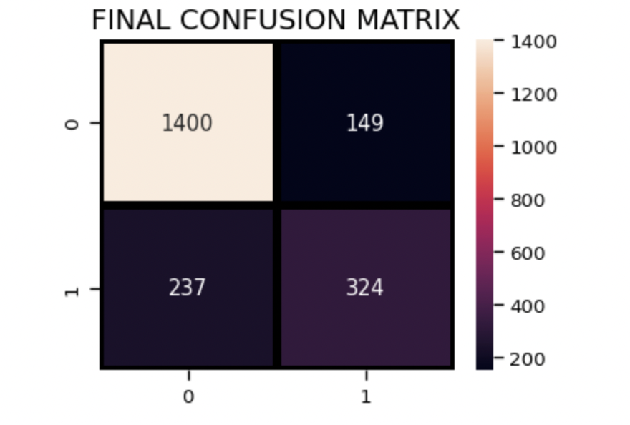
Voting Classifier
Final Accuracy Score 0.8170616113744076
It is evident from the confusion matrix that there are total 1400+149=1549 actual non-churn values and the algorithm predicts 1400 of them as non churn and 149 of them as churn. While there are 237+324=561 actual churn values and the algorithm predicts 237 of them as non churn values and 324 of them as churn values.
Notes:
It is evident from the confusion matrix that there are total 1400+149=1549 actual non-churn values and the algorithm predicts 1400 of them as non churn and 149 of them as churn. While there are 237+324=561 actual churn values and the algorithm predicts 237 of them as non churn values and 324 of them as churn values.

Slide 16
References
Gerpott TJ, Rams W, Schindler A. Customer retention, loyalty, and satisfaction in the German mobile cellular telecommunications market. Telecommun Policy. 2001;25:249–69.
Wei CP, Chiu IT. Turning telecommunications call details to churn prediction: a data mining approach. Expert Syst Appl. 2002;23(2):103–12.
Yu W, Jutla DN, Sivakumar SC. A churn-strategy alignment model for managers in mobile telecom. In: Communication networks and services research conference, vol. 3. 2005. p. 48–53.
Barthelemy M. Betweenness centrality in large complex networks. Eur Phys J
B. 2004;38(2):163–8. https://doi.org/10.1140/epjb/e2004-00111-4.
He Y, He Z, Zhang D. A study on prediction of customer churn in fixed communication network based on data mining. In: Sixth international conference on fuzzy systems and knowledge discovery, vol. 1. 2009. p. 92–4.
Brandusoiu I, Toderean G, Ha B. Methods for churn prediction in the prepaid mobile telecommunications industry. In: International conference on communications. 2016. p. 97–100.

