Slide 1
Insights of SanFranscisco City Employee’s Salaries
Presented by : Vijayalakshmi
Last Updated : 13th, January 2023

Slide 2
Table of Contents
Objective of the Analysis
Insights of the Dataset
Conclusion

Slide 3
1. Objective of the Analysis
This dataset, "San Francisco City Employee Salary Data," contains information about salaries and benefits for employees of the City and County of San Francisco. The data is often sourced from public records.
The main Objectives of this analysis are :
Budget Planning
Public Transparency and Accountability
Performance Evaluation

Slide 4
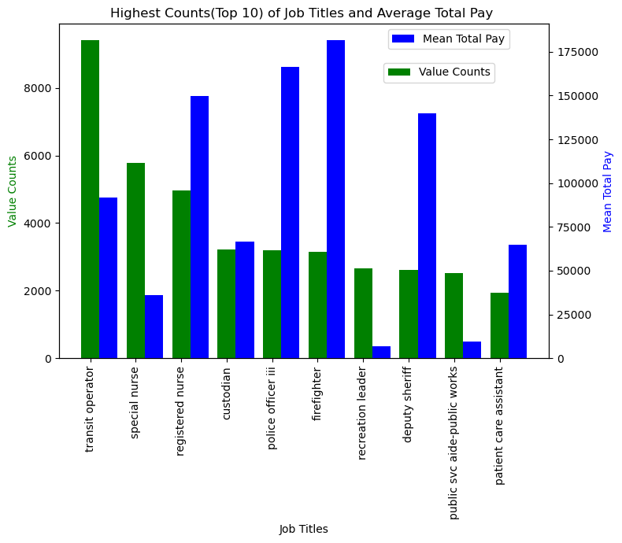
2. Insights
This displays the most common job titles together with their mean salary.
It illustrates how closely related the particular employment roles are to city service.
There are more workers in such departments than in others.

Slide 5
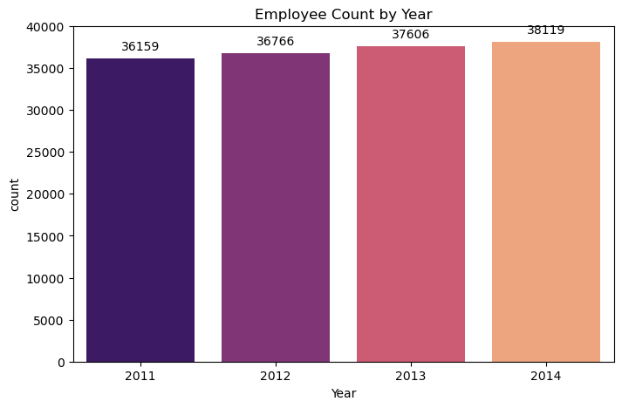
A picture of the number of employees working on county welfare is shown.
Its annual growth is encouraging for the direction of development.

Slide 6
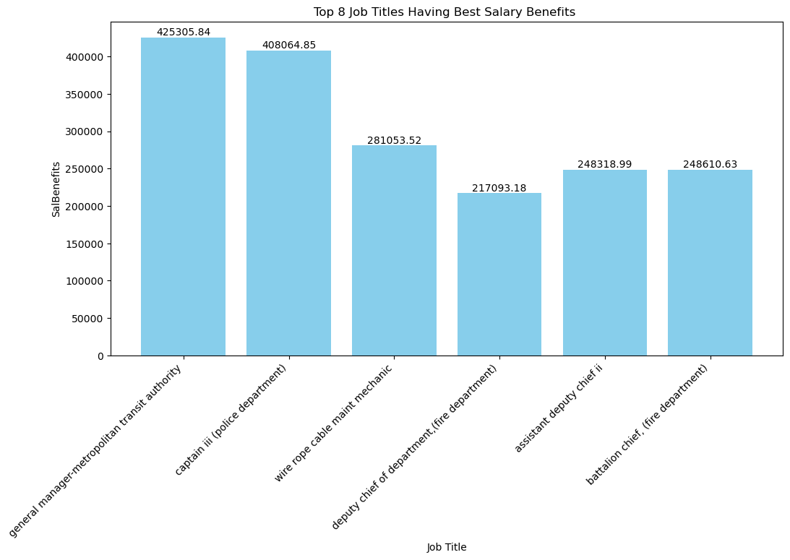
The public can use this to determine which departments offer the highest remuneration.
The significance of those particular departments and their employees are evident.
Also tells, Total comprehensive view of the cost of employment for different roles and departments.

Slide 7
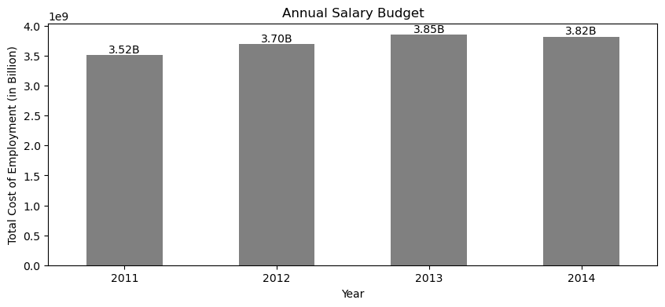
It illustrates that a budget of $3–4.0 billion will be set aside annually for salaries.
Making this data accessible to the public promotes accountability and transparency by enabling citizens to comprehend the use of public expenditures.

Slide 8
3. Conclusion
The Analysis provides valuable insights such as:
Compensation and workforce in the City and County of San Francisco.
Comparative Study on salaries across different sectors
Cost of Employment
budget planning and resource allocation
An examination by year reveals changes in employment and pay.
Trends in salary changes, workforce composition
It serves both administrative and societal goals by promoting
fairness
transparency
informed decision-making within the city government

Slide 9
Thank You !

