Slide 1
Analysis on iFood
Presented by : Vijayalakshmi
Last Updated : 13th, January 2023

Slide 2
Table of Contents
Objective of the Analysis
Insights of the Dataset
Conclusion

Slide 3
1. Objective of the Analysis
iFood is the leading food delivery app in Brazil, present in over a thousand cities. Keeping a high customer engagement is key for growing and consolidating the company’s position as the market leader.
The main Objective of this analysis is to provide insights and value to business.
To achieve this Following EDA are performed:
Products wise purchase analysis
Income Vs Purchase Analysis
Households Vs Purchase Analysis
Marital Status VS Income Vs Purchase Analysis
Deals & Campaign –are really attracting the purchases?
Store Purchase or Web Purchases Analysis

Slide 4
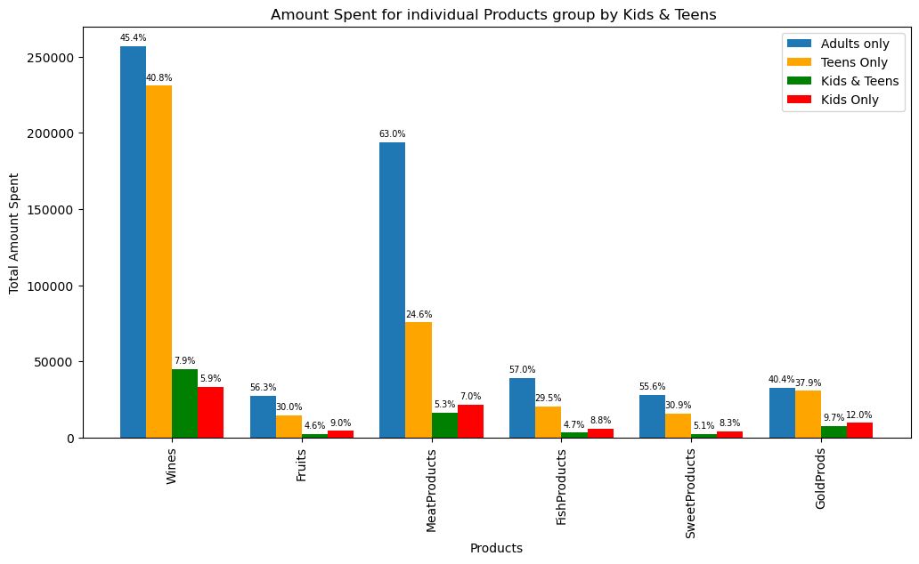
2. Insights
It shows approx.50% of the products are consumed by the customers who don’t have kids.
Except Gold, they are witnessed a very low % of Amount spent
Adults Household customers are better than Kids Household. But still, not to the peak.

Slide 5
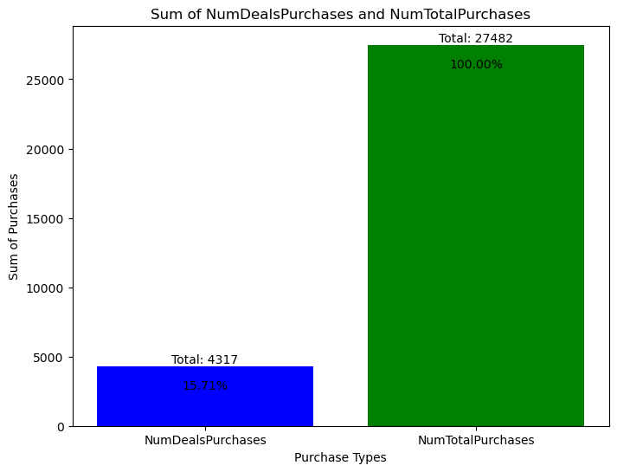
Deal Purchases are worth full
It directly hikes the business if it is increased

Slide 6
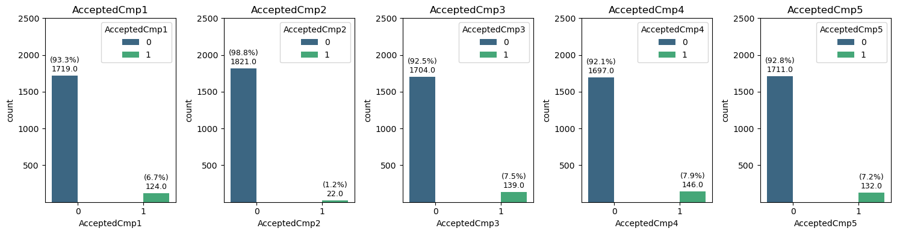
6-7% of customers are accepting the campaigns except campaign no:2

Slide 7
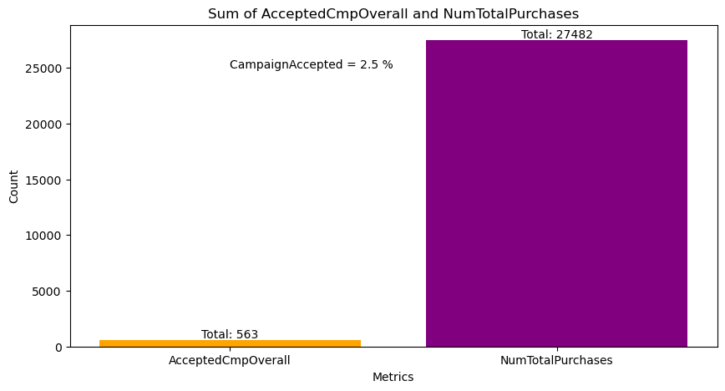
From the above , we can conclude only 2.5 % purchases are happened if customer accepted any of the campaigns.

Slide 8
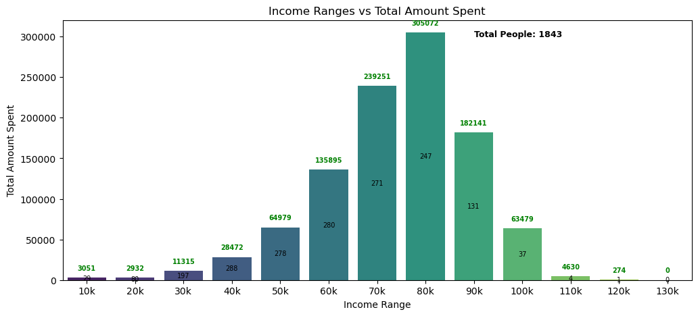
Upt0 80 K , the income is reflecting in the purchases. Then it is immediately cut down like a bell curve.

Slide 9
3. Conclusion
The elements listed below have been determined to be the main movers in the business.
The likelihood that a consumer will purchase products is adversely correlated with the number of young children and teenagers living in their home.
Income is also a key factor but for certain range(upto 80K) only it is reflecting.
The Highest Income Customers are consuming less than others, this to be boosted.
Through Marketing Campaign 2 % purchases happened.
Deals accounted for 15% of all purchases.

Slide 10
Recommended Solutions:
Food items that are primarily consumed or drawn to children and teenagers can be offered in addition to sweet products. For example: milk powders, cakes, bread, meat/fish, fruits, and sugary items that can be modified for use with children.
In order to encourage more purchases, deals and discounts should be expanded. Ex: Daily, Weekly, and Monthly discounts.
Customers with the highest incomes can be persuaded to buy gold products. Also, can run a Health Awareness campaigns encouraging people to eat more fish, meat, and fruits. This awareness program explores how people's work cultures and lack of time cause them unhealthy.
In this dataset, campaigns generate a profit margin of 2%. Nonetheless, there are other tactics that should be used to boost sales.

Slide 11
Thank You !

