Slide 1
Think Async in Java 8

Slide 2

Asynchronous
Single threaded
Asynchronous
Multi threading
Synchronous
Way to Think in Async

Slide 3

synchronous

Slide 4
Synchronous
Single-Threaded

Slide 5
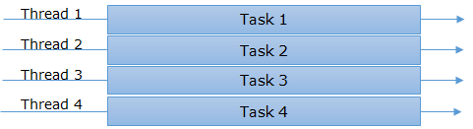
Synchronous
Multi-Threaded

Slide 6
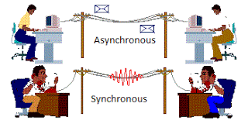
Asynchronous

Slide 7
Asynchronous
Single-Threaded

Slide 8
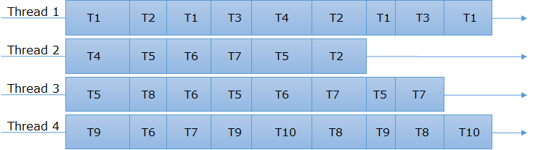
Asynchronous
Multi-Threaded

Slide 9

Asynchronous
It can be really faster
Its non-blocking
No gap between tasks

Slide 10
Asynchronous vs Multi-thread
Synchronous Single Threaded
Synchronous Multi-Threaded
Asynchronous Single Threaded
Asynchronous Multi-Threaded

Slide 11
Asynchronous in Java
Java 1
Runnable
Do not have the option to notify in case of any error

Slide 12
Asynchronous in Java
Java 1
Java 5
Runnable
Callable
Have option to notify in case of any error

Slide 13
Asynchronous in Java
Java 1
Java 5
Java 5
Java 5
Runnable
Callable
Executer Service
Future

Slide 14

Asynchronous use case
Callable<String> task = () --‐> "select user from User"
executorService.submit (task)
Future<String>

Slide 15
Future
main
Thread 1
Submit()
get()
Result ready

Slide 16

Future
main
Thread 1
Submit()
get()
Blocking the main thread
Result ready

Slide 17
Future
main
Thread 1
Submit()
Don’t have the ability to attach a callback function
get()
Result ready

Slide 18
Asynchronous use case
main
Thread 1
Thread 2
Thread 3
task1
task2
task3
task4
Notes:
The Future interface was added in Java 5 to serve as a result of an asynchronous computation, but it did not have any methods to combine these computations or handle possible errors.

Slide 19
Asynchronous use case
main
Thread 1
Thread 2
Thread 3
task1
Multiple Futures cannot be chained together
task2
task3
task4
Notes:
The Future interface was added in Java 5 to serve as a result of an asynchronous computation, but it did not have any methods to combine these computations or handle possible errors.

Slide 20
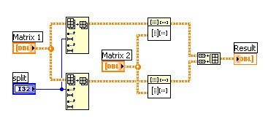
Asynchronous use case
Can not combine multiple Futures together

Slide 21
“We have to make callback”

Slide 22
Callbacks
Event
Timer
Main
Thread
Async API
Calls
Thread pool
File I/O
User code
Callback method

Slide 23

Callbacks
public void processAsync( ExecutorService executor, Supplier supplier, Consumer onSuccess ) {
executor.submit(() -> {
List lines = supplier.get();
onSuccess.accept(lines);
});
}
Consumer onSuccess
onSuccess.accept(lines);

Slide 24
Callbacks
public void processAsync( ExecutorService executor, Supplier supplier, Consumer onSuccess , Consumer onFail ) {
executor.submit(() -> {
try {
List lines = supplier.get();
onSuccess.accept(lines);
catch(Exception e) {
onFail.accept(e);
}
});
}
Consumer onSuccess
Consumer onFail
onSuccess.accept(lines);
onFail.accept(e);

Slide 25
Drawbacks of Callbacks
Do not scale well for even moderately complex asynchronous code
Multiple callback function hard to read, easy to break, and hard to debug

Slide 26

“How to achieve asynchronicity in java”

Slide 27
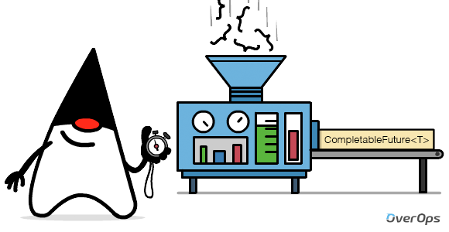
Asynchronous in Java 8
We have new tools in Java 8 to handle this precise case It brings new solutions to chain tasks

Slide 28

Asynchronous in Java 8
Handle both asynchronous and multithreaded programming

Slide 29
CompletableFuture Intro
Future<T>
CompletionStage<T>
CompletableFuture<?>

Slide 30
CompletableFuture Intro
It has a state:
Future<T>
CompletionStage<T>
task may be running
task may have Complete normally
task may have complete exceptionally
CompletableFuture<?>

Slide 31


Slide 32
Creating Method
new
supplyAsync()
runAsync()

Slide 33
Creating a CompletableFuture
`
CompletableFuture
With no-arg
constructor
CompletableFuture<String> cf = new CompletableFuture<>();
Blocks until the Future is complete
String result = cf.get();
String result = cf. complete(“ Killed !! ”);
Complete a Future manually

Slide 34
Running asynchronous
Java 7
ExecutorService es = Executors.newCachedThreadPool();
es.execute (new Runnable() { public void run() { System.out.print("Hello Java“); } });
es.execute
Java 8
CompletableFuture<Void> cf = CompletableFuture.runAsync (
() -> { System.out.print("Hello Java“); });
CompletableFuture.runAsync

Slide 35
Running asynchronous
Java 7
ExecutorService es = Executors.newCachedThreadPool();
Future<String> future = es.submit(new Callable<String>() { public String call() throws Exception { return "Hello Java"; } });
es.submit
Java 8
CompletableFuture<String> cf =
CompletableFuture.supplyAsync(() -> { return "Hello Java"; });
CompletableFuture.supplyAsync

Slide 36
Create Method
CompletableFuture() cf = new CompletableFuture();
CompletableFuture<U> :: supplyAsync( Supplier<U>supplier )
Supplier<U>supplier
CompletableFuture<U> :: runAsync ( Runnable runnable )
Runnable runnable

Slide 37
Create Method
CompletableFuture<U> :: supplyAsync (Supplier<U>supplier)
supplyAsync
ForkJoinPool :: commonPool()
CompletableFuture<U> :: runAsync (Runnable runnable)
runAsync

Slide 38
Create Method
CompletableFuture<U> :: supplyAsync ( Supplier<U>supplier , Executor executor )
Executor executor
CompletableFuture<U> :: runAsync(Runnable runnable , ,Executor executor )
Executor executor

Slide 39
Attach Callback Method
thenApply()
thenAccept()
thenRun()

Slide 40
thenApply
CompletableFuture<String> cf =
CompletableFuture.supplyAsync(() -> {
return "Hello ";
}).thenApply ( s -> {
return s + "World ";
}).thenApply (s -> {
return "First " + s + " Programe!!";
});
cf.get() → “First Hello World Programe”
thenApply
thenApply

Slide 41
thenAccept
CompletableFuture.supplyAsync(() -> {
return "Hello ";
}).thenApply ( s -> {
return s + "World ";
}).thenApply (s -> {
return "First " + s + " Programe!!";
}).thenAccept (result -> {
System.out.print(result);
});
cf.get() → “First Hello World Programe”
thenAccept

Slide 42
thenRun
CompletableFuture.supplyAsync(() -> {
return "Hello ";
}).thenApply ( s -> {
return s + "World ";
}).thenRun (() -> {
//TODO: some other work
});
thenRun

Slide 43
Async Callback
Executed in the same thread where the supplyAsync() task is executed
CompletableFuture.supplyAsync(() -> {
return "Hello ";
}).thenApply ( s -> {
return s + "World ";
});
thenApply
Executed in a different thread from ForkJoinPool.commonPool()
CompletableFuture.supplyAsync(() -> {
return "Hello ";
}).thenApplyAsync ( s -> {
return s + "World ";
});
thenApplyAsync

Slide 44
Combining together
thenCompose()
thenCombine()
allOf()
anyOf()

Slide 45
thenCompose
CompletableFuture<User> cf =
CompletableFuture.supplyAsync((Long id) -> {
return getUserInfo(id);
});
CompletableFuture<User>
I wanted to call the method inside the user object and also need to chain..?

Slide 46
thenCompose
CompletableFuture<String> cf =
CompletableFuture.supplyAsync((Long id) -> {
return getUserInfo(id);
}). thenCompose (user -> {
return user.getName();
});
Monads
thenApply
thenCompose
thenCompose

Slide 47
thenCombine
Callback method is invoked both task is completed
CompletableFuture<String> cf1
= CompletableFuture.supplyAsync(() -> "Hello“
CompletableFuture<String> cf2
= CompletableFuture.supplyAsync(() -> “World“
CompletableFuture<String> result
= cf1.thenCombine (cf2, (s1, s2) -> { s1 + s2 } );
thenCombine
( s1, s2 ) -> { s1 + s2 }

Slide 48
allOf and anyOf
CompletableFuture <Void> :: allOf ( CompletableFuture<?>... Cfs )
<Void>
CompletableFuture<?>... cfs
CompletableFuture <Object> :: anyOf ( CompletableFuture<?>... cfs )
<Object>
CompletableFuture<?>... cfs

Slide 49
Exception Handling
exceptionally()
handle()

Slide 50
exceptionally
CompletableFuture.supplyAsync(() -> {
//TODO: some work here
}). exceptionally ( ex -> {
System.out.print(“exception occurred in future:” + ex);
//TODO: some other work
});
exceptionally
ex

Slide 51
handle
CompletableFuture.supplyAsync(() -> {
//TODO: some work here
}). handle (( res, ex ) -> {
//TODO: some other work
});
It is called whether or not an exception occurs
handle
res, ex

Slide 52
CompletableFuture for Async
When we program asynchronously we usually think in terms of workflows, events and tasks
Chaining
Do this then that
Do this and/or that
Joining
Do this on failure
Recovering

Slide 53

This is your presentation title

