Slide 1
Temporal Trajectory Models
Vijayaditya Peddinti

Slide 2

Error predictors for classifiers in an ensemble
Given an ensemble of classifiers predict the error of these classifiers for the given test instance.
Error prediction metrics can be used for
Dynamic ensemble selection
Dynamic weighted fusion
Adaptation of the classifiers in the ensemble
For discriminative classifiers :
Train error prediction models
Classifier confidence estimators

Slide 3
Error prediction in mismatched conditions
Use proxy measures in lieu of error rate, based on*
Familiarity similarity of classifier behavior for test data and training data
Conformity deviation of classifier behavior from gold standard data
Stability stability of classifier to minor changes in input
Conformity
Measure performance of the classifier output on tasks that it is not trained for, but performance on which is deemed necessary for low error
Acoustic models are trained to estimate phone posterior probabilities, however they are not trained to ensure posterior trajectory quality over time
Measure the “quality” of the posterior trajectory
*As categorized by Emmanuel Dupoux

Slide 4
Design Requirement
Design an error estimator which
has low data requirement
has low computational load
can be used as a cost function for unsupervised adaptation or as auxiliary function for supervised training

Slide 5


Design Decisions
 |  | Distance
 |  | Deviation of model on test instance from model on train data | Likelihood of test instance given model on train data
Complexity of Models | Simple Models | Requires estimation of only few parameters | A variety of non-speech sources could produce high likelihood instances
 | Complex Models | Too many parameters to estimate, data sparsity problem | Very specific to speech Reliable measure derived with minimal data

Slide 6
Temporal Trajectory Models
Speech signal has very specific temporal characteristics which are distinct from noise signals
Build temporal trajectory models using training data and score the posterior vector trajectories of the test instances
This is similar to measuring likelihood of the utterance using HMM-DNN hybrid model where the HMM places constraints on posterior trajectory

Slide 7

















HMM-DNN Hybrid Decoder
DNN - emission probabilities
HMM transition probabilities
a1
a2
a3
p(sk/sk-1)
. .
p(S2/x)
. .
. .
. .
b1
b2
b3
p(Sn-1/x)
p(Sn/x)
e1
e2
e3

Slide 8





Temporal Trajectory Models
s(a)
a1
a2
a3
s(b)
b1
b2
b3
s(e)
e1
e2
e3

Slide 9








t1
t2
t3
tT-2
tT-1
tT
p(s2/s1)
………
………
p(s2/s2)
………
………
p(s4/s4)
………
p(s4/s5)
………
………
………

Slide 10
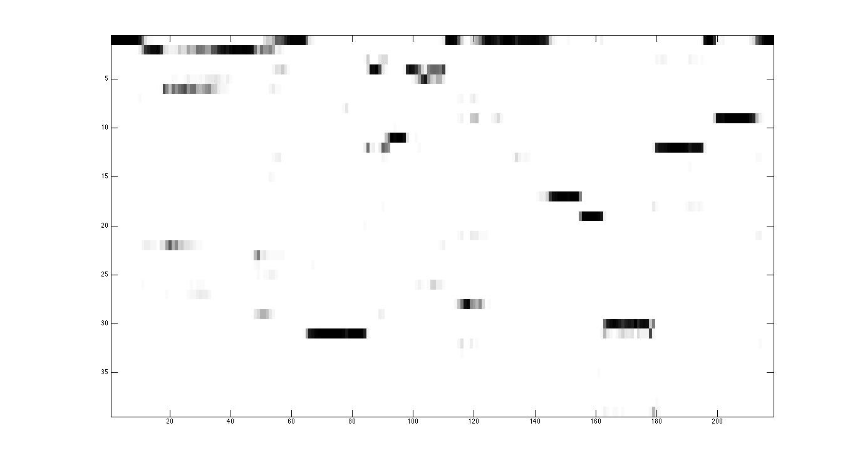
Mean Posterior along best path
Mean Phone Confusion
Mean Likelihood of segment durations
Posterior Probability of Phones
time

Slide 11
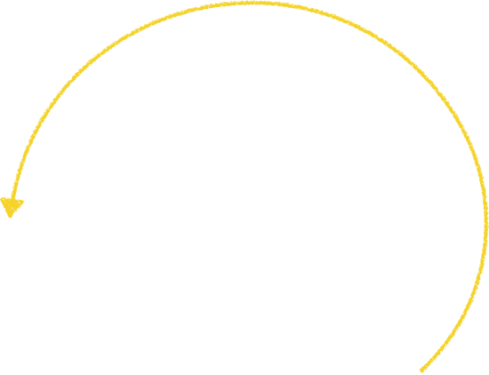




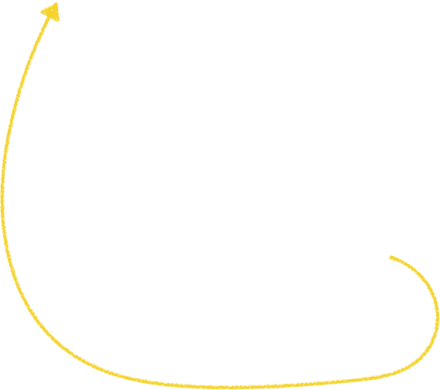













Phone Bigram Model
a1
a2
a3
b1
b2
b3
e1
e2
e3

Slide 12
Clean training data

Slide 13
Best Path Scores
well correlated 10.34 clean MTLS0_SX380 lmwt 11
49.5 decode_test_noisy_exhall_band4_new_snr_0 FMLD0_SI822

Slide 14
Noisy training data

Slide 15
Metric Vs Time

Slide 16
Best path scores
Sum of posteriors along the best path
Likelihood of the best path given a segmental duration model

Slide 17
Evaluation of error estimators
 | Computation Cost | Data Requirement | Unsupervised training | Correlation with Phoneme Error Rate
Avg Posterior along best path | O(Tx|S|²) for best path computation No additional computation required for the phoneme recognition task | minimal high correlation (0.6) even for shortest utterances in TIMIT | Avg. posterior along best path can be maximized by using the best path as the target during unsupervised training This technique is widely used for unsupervised training | 0.71 (clean train) 0.75 (noisy train)
Segmental Duration Likelihood | O(K) where K = number of segments in best path | - | Can be used to select segments for unsupervised training | 0.13 (clean train) (high variance in performance across noise conditions, bug?)
Average Phoneme Confidence from Lattice | O(NxTx|S|²) for N-best path computation Computation of N-1 additional paths for current task | reaches peak correlation in 3 secs | Can be used to select utterances for unsupervised training | 0.48 (clean train) 0.57 (noisy train)

Slide 18

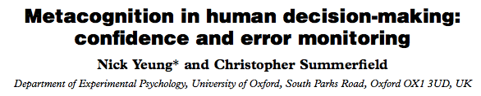
Classifier Stability (Ongoing)
(with Emmanuel Dupoux) Stability of the classifier’s posterior estimate for minor changes in the input is a cue for continuous error monitoring
Notes:
\mathbf{y}=F(\mathbf{x}) \text{ } x\in R^N, y\in R^M\\
\\
\mathbf{J} = \left(
\begin{array}{ccc}
\frac{\partial y_1}{\partial x_1} & \ldots & \frac{ \partial y_1 }{\partial x_N} \\
\vdots & \ddots & \vdots \\
\frac{\partial y_M}{\partial x_1} & \ldots & \frac{ \partial y_M }{\partial x_N} \\
\end{array} \right)\\

Slide 19
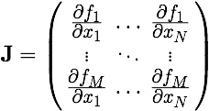

Input Jacobian
Instantaneous input Jacobian of the classifier represents the stability of the classifier at the current input
Analytical form available for computation and shares computation with posterior estimation
Not yet successful in showing correlation with the error
Notes:
\mathbf{y}=F(\mathbf{x}) \text{ } x\in R^N, y\in R^M\\
\\
\mathbf{J} = \left(
\begin{array}{ccc}
\frac{\partial y_1}{\partial x_1} & \ldots & \frac{ \partial y_1 }{\partial x_N} \\
\vdots & \ddots & \vdots \\
\frac{\partial y_M}{\partial x_1} & \ldots & \frac{ \partial y_M }{\partial x_N} \\
\end{array} \right)\\

Slide 20
Reflections on the problem
The current approach evaluates the classifier output on behavior its not trained to emulate however the classifier can be trained to emulate this behavior e.g. neural networks can be trained to produce posterior trajectories which are consistent with neighboring frames
How to measure performance in this case ? Rely on long range statistics which are difficult to model (?)

